Slide 1
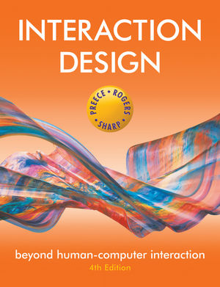
Chapter 5
EMOTIONAL
INTERACTION

Slide 2

Overview
Emotions and the user experience
Expressive and annoying interface
how the ‘appearance’ of an interface can affect users
Models of emotion
Ortony et al (2005)
Automatic emotion recognition and emotional technologies
Persuasive technologies and behavioral change
how technologies can be designed to change people’s attitudes and behavior
Anthropomorphism
The pros and cons
Notes:
2

Slide 3
Emotions and the user experience
HCI has traditionally been about designing efficient and effective systems
Now more about how to design interactive systems that make people respond in certain ways
e.g. to be happy, to be trusting, to learn, to be motivated
Emotional interaction is concerned with how we feel and react when interacting with technologies
Notes:
3

Slide 4
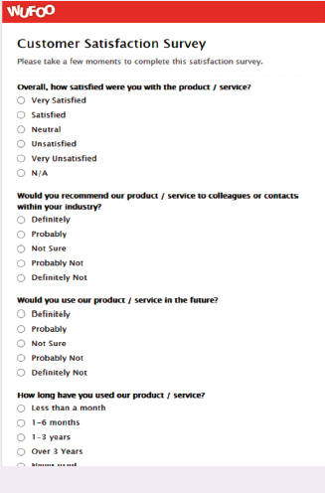
Is this form fun to fill in?
“My goal was to design Wufoo to feel like something Fisher-Price would make.”
- Kevin Hale, Wufoo director
Notes:
Wufoo is a company specialising in building online forms and have transformed what are usually boring and tedious tasks into being more fun. How do the forms below compare with others you have had to fill in? One reason is the way minimalism, balance and aesthetics have been used in the design of the forms. As commented by one of Wufoo’s creators, Kevin Hale: “The inspiration for our color palette did come from our competitors. It was really depressing to see so much software designed to remind people they’re making databases in a windowless office and so we immediately knew we wanted to go in the opposite direction. My goal was to design Wufoo to feel like something Fisher-Price would make. We were determined to make sure Wufoo was fun.”
4

Slide 5
Emotional interaction
What makes us happy, sad, annoyed, anxious, frustrated, motivated, delirious and so on
translating this into different aspects of the user experience
Why people become emotionally attached to certain products (e.g. virtual pets)
Can social robots help reduce loneliness and improve wellbeing?
How to change human behavior through the use of emotive feedback
Notes:
Emotional interaction is about considering what makes us happy, sad, annoyed, anxious, frustrated, motivated, delirious and so on and translating this knowledge into different aspects of the user experience, from when we first want something to when we no longer interact with it or need to replace it. However, it is not straightforward to achieve as people’s moods and feelings are constantly changing. There are also many reasons that might cause someone to be happy or sad, such as the sun shining or someone else winning a game.
5

Slide 6
Activity
Try to remember the emotions you went through when buying a big ticket item online (e.g. a fridge, a vacation, a computer)
How many different emotions did you go through?
Notes:
Consider the different emotions you experience for a common everyday activity – shopping online for a product, such as a new phone, a washing machine or a vacation. Firstly, there is the realisation of needing or wanting it, and then the desire and anticipation of purchasing it. This is followed by the joy or frustration of finding out more about what products are available and deciding which to choose from potentially hundreds or even thousands (by visiting numerous websites, such as comparison sites, reviews, recommendations, blogs). This entails matching what is available with what you like or need and if you can afford it. The thrill of deciding on a purchase may be quickly followed by the shock of how much it costs and the disappointment that you can’t afford it. The process of having to decide again may be accompanied by annoyance as you cant find one that is as good as your first choice. You think about other options, such as seeking advice from an expert in a shopping mall, but you have an aversion to sales assistants and don’t trust their advice, because you think they have their own interests (making money), rather than yours, at heart. So you carry on looking, getting more tired and frustrated. When you do make a decision you experience a sense of relief. You click merrily though the various options (such as color, size, warranty) and then the dreaded online payment form pops up. You type in all your details and press the final payment button. A window then appears saying that your credit card number is incorrect. So you type it in again very slowly. And you notice you need to type the 3 number security code in again. Finally, when all is done you let out a big sigh. But as you walk away from your computer doubts start to form in your mind – maybe you should have bought the other one...
This rollercoaster set of emotions is what many of us experience when shopping online, especially for expensive products, where there are a myriad of options to choose from and where we want to be sure that we make the right choice.
6

Slide 7
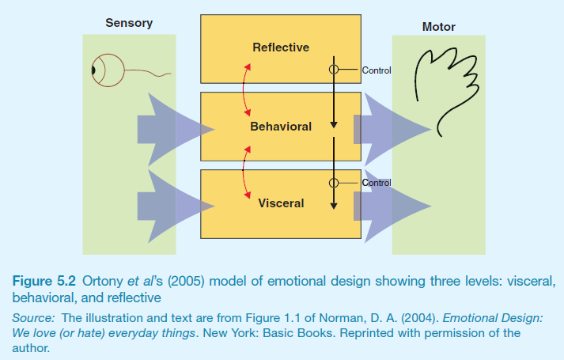
Emotional design model
Norman, Ortony and Revelle (2004) model of emotion
Notes:
7

Slide 8
Claims from model
Our emotional state changes how we think
when frightened or angry we focus narrowly and body responds by tensing muscles and sweating
more likely to be less tolerant
when happy we are less focused and the body relaxes
more likely to overlook minor problems and be more creative
Notes:
8

Slide 9
Activity
Do you feel more creative when you are in a happy mood? Do you get less work done when you are feeling stressed?

Slide 10

Expressive interfaces
Provide reassuring feedback that can be both informative and fun
But can also be intrusive, causing people to get annoyed and even angry
Color, icons, sounds, graphical elements and animations are used to make the ‘look and feel’ of an interface appealing
conveys an emotional state
In turn this can affect the usability of an interface
people are prepared to put up with certain aspects of an interface (e.g. slow download rate) if the end result is appealing and aesthetic
Notes:
10
A good place to start understanding how emotions affect behavior and how behavior affects emotions is to examine how people express themselves and read each other’s expressions. These include understanding the relationship between facial expressions, body language, gestures and tone of voice. For example, when people are happy they typically smile, laugh and open their bodies up. When they are angry they shout, gesticulate and screw up their face. A person’s expressions can trigger emotional responses in others. So when someone smiles it can cause others to feel good and smile back.

Slide 11
Friendly interfaces
Microsoft pioneered friendly interfaces for technophobes - ‘At home with Bob’ software
3D metaphors based on familiar places (e.g. living rooms)
Agents in the guise of pets (e.g. bunny, dog) were included to talk to the user
Make users feel more at ease and comfortable
Notes:
11

Slide 12
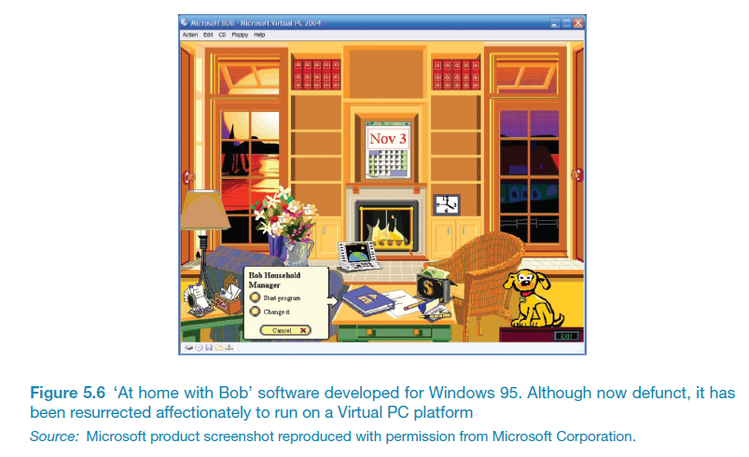
Bob
Notes:
12

Slide 13
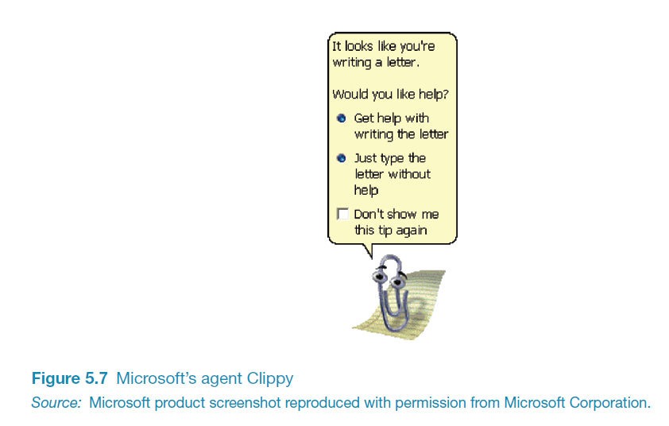
Clippy
Why was Clippy disliked by so many?
Was it annoying, distracting, patronising or other?
What sort of user liked Clippy?
Notes:
13

Slide 14
Frustrating interfaces
Many causes:
When an application doesn’t work properly or crashes
When a system doesn’t do what the user wants it to do
When a user’s expectations are not met
When a system does not provide sufficient information to enable the user to know what to do
When error messages pop up that are vague, obtuse or condemning
When the appearance of an interface is garish, noisy, gimmicky or patronizing
When a system requires users to carry out too many steps to perform a task, only to discover a mistake was made earlier and they need to start all over again
Notes:
14

Slide 15
Gimmicks
Amusing to the designer but not the user, e.g.
Clicking on a link to a website only to discover that it is still ‘under construction’
Notes:
15

Slide 16
Error messages
“The application Word Wonder has unexpectedly quit due to a type 2 error.”
Why not instead:
“the application has expectedly quit due to poor coding in the operating system”
Shneiderman’s guidelines for error messages include:
avoid using terms like FATAL, INVALID, BAD
Audio warnings
Avoid UPPERCASE and long code numbers
Messages should be precise rather than vague
Provide context-sensitive help
Notes:
16

Slide 17
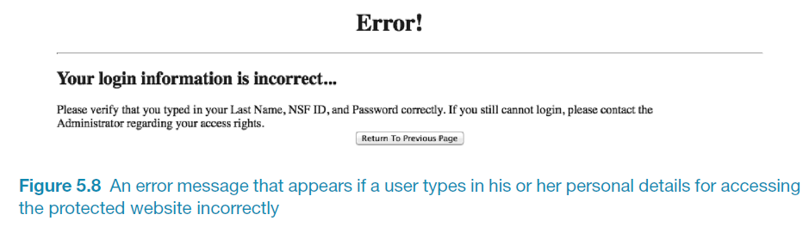
Website error messages
Notes:
17
Can you change to Figure 5.8

Slide 18
More helpful error message
“The requested page /helpme is not available on the web server.
If you followed a link or bookmark to get to this page, please let us know, so that we can fix the problem. Please include the URL of the referring page as well as the URL of the missing page.
Otherwise check that you have typed the address of the web page correctly.
The Web site you seek Cannot be located, but Countless more exist.”
Notes:
18

Slide 19
Should computers say they’re sorry?
Reeves and Naas (1996) argue that computers should be made to apologize
Should emulate human etiquette
Would users be as forgiving of computers saying sorry as people are of each other when saying sorry?
How sincere would they think the computer was being? For example, after a system crash:
“I’m really sorry I crashed. I’ll try not to do it again”
How else should computers communicate with users?
Notes:
19

Slide 20
Detecting emotions and emotional technology
Sensing technologies used to measure GSR, facial expressions, gestures, body movement
Aim is to predict user’s emotions and aspects of their behavior –
E.g. what is someone most likely to buy online when feeling sad, bored or happy

Slide 21
Facial Coding
Measures a user’s emotions as they interact with a computer or tablet
.
Analyses images captured by a webcam of their face
Uses this to gauge how engaged the user is when looking at movies, online shopping sites and ads
6 core expressions - sadness, happiness, disgust, fear, surprise and anger

Slide 22
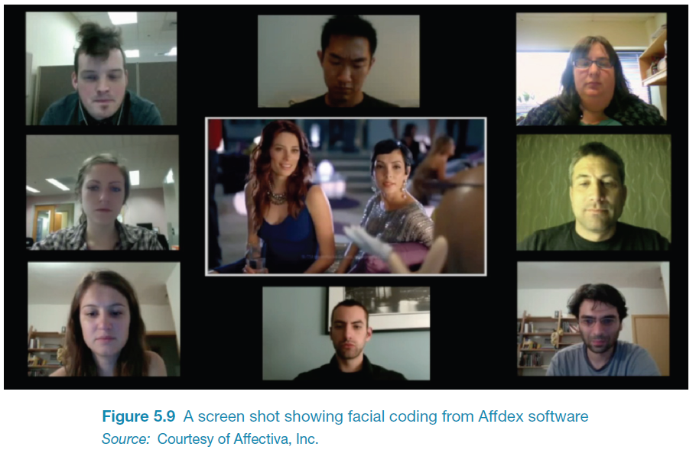

Slide 23
How to use the emotional data?
If user screws up their face when an ad pops up -> feel disgust
If start smiling -> they are feeling happy
Website can adapt its ad, movie storyline or content to match user’s emotional state
Eye-tracking, finger pulse, speech and words/phrases also analysed when tweeting or posting to Facebook

Slide 24
Indirect emotion detection
Beginning to be used more to infer or predict someone’s behavior
For example, determining a person’s suitability for a job, or how they will vote at an election
Do you think it is creepy that technology can read your emotions from your facial expressions or from your tweets?

Slide 25
Persuasive technologies and behavioral change
Interacive computing systems deliberately designed to change people’s attitudes and behaviors (Fogg, 2003)
A diversity of techniques now used to change what they do or think
Pop-up ads, warning messages, reminders, prompts, personalized messages, recommendations, Amazon 1-click
Commonly referred to as nudging
Notes:
25

Slide 26
Nintendo’s Pocket Pikachu
Changing bad habits and improving well being
Designed to motivate children to be more physically active on a regular basis
owner of the digital pet that ‘lives’ in the device is required to walk, run, or jump
If owner does not exercise the virtual pet becomes angry and refuses to play anymore
Notes:
26
This use of positive rewarding and sulking can be a powerful means of persuasion, given that children often become emotionally attached to their virtual pets, especially when they start to care for them.

Slide 27
How effective?
Is the use of novel forms of interactive technologies (e.g., the combination of sensors and dynamically updated information) that monitor, nag, or send personalized messages intermittently to a person more effective at changing a person’s behavior than non-interactive methods, such as the placement of warning signs, labels, or ads in prominent positions?
Notes:
27

Slide 28
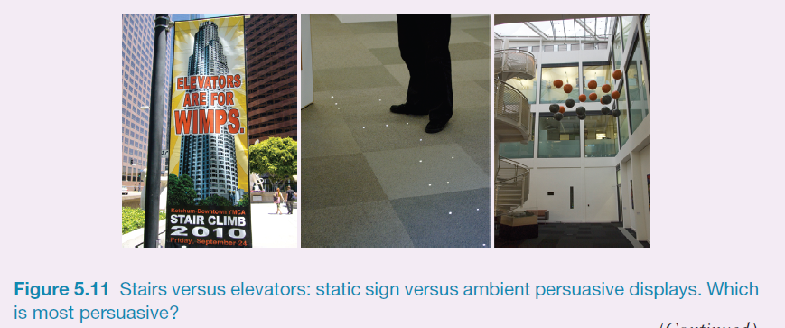
Which is most effective?
Notes:
The photo on the left in Figure 5.12 is of a banner placed in downtown LA, in an attempt to encourage the general public to take the stairs instead of the elevator, asking people to climb stairs on a certain day. The two photos on the right are of ambient displays (see also chapter 2) designed to do the same thing but using more subtle and interactive methods: (i) lights that twinkled when people approach them, intended to lure them to take the stairs and (ii) Clouds of different colored spheres that move up and down depending on how many people have taken the stairs or the elevator for a given period of time (grey represents elevator). The higher the orange cloud is relative to the grey one the more people taking the stairs than the elevator (Rogers et al, 2010). Which representation do you think is the most effective?
Comment
The banner on the left uses a striking slogan that metaphorically points a finger at you. Some people might find this amusing or a challenge. Others, however, are likely to find it offensive and even insulting and ignore it. The extent to which it will change behavior is debatable. In contrast, the ambient displays shown in the other images are meant to be much more subtle and aesthetic. They are assumed to work by raising people’s awareness of a behavior that they normally overlook or try not to think about and to nudge them at the point of decision-making (Thaler and Sunstein, 2008). An in the wild study was conducted when they were embedded in a building showed a significant increase in stair taking. Interestingly, the majority of people, when asked, were not aware of changing their behavior in response to noticing them. This suggests that ambient displays can influence at an unconscious level, and they can be used to encourage people to adhere to certain kinds of desired behaviors, where there is a choice, such as washing hands or not, eating healthy or unhealthy snacks, taking one route or another through a building, switching off the lights or leaving them on.
28

Slide 29
Tracking devices
Mobile apps designed to help people monitor and change their behaviour (e.g. fitness, sleeping, weight)
Can compare with online leader boards and charts, to show how they have done in relation to their peers and friends
Also apps that encourage reflection that in turn increase well-being and happiness

Slide 30
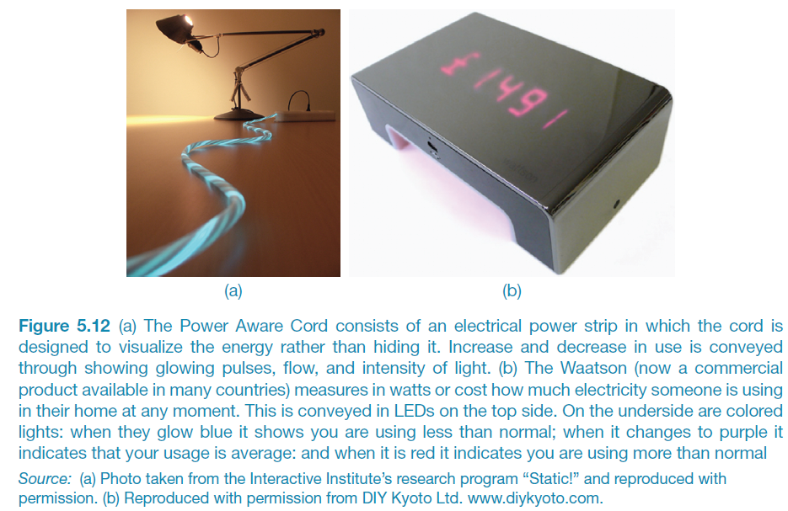
Energy reduction
Notes:
The global concern about climate change has led a number of HCI researchers to design and evaluate various energy sensing devices that display real-time feedback. A goal is to find ways of helping people reduce their energy consumption (and is part of a larger research agenda called sustainable HCI, Mankoff et al, 2008; DiSalvo et al, 2010). A focus is on persuading people to change their everyday habits with respect to environmental concerns, such as reducing their own carbon footprint, their community’s (e.g. school, workplace) or an even larger organization’s (e.g. street, town, country). Two well-known products are the Power Aware Cord and the Waatson. The Power-Aware Cord consists of an electrical power strip in which the cord is designed to visualize the energy rather than hiding it. Increase and decrease in use is conveyed through showing glowing pulses, flow, and intensity of light. The Waatson (now a commercial product available in many countries) measures in watts or cost how much electricity someone is using in their home at any moment. This is conveyed in LEDS on the top-side. On the underside are coloured lights; when they glow blue it shows you are using less than normal; when it changes to purple it indicates that your usage is average, and when it is red it indicates you are using more than usual.
30

Slide 31
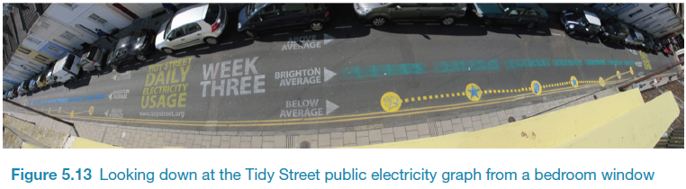
The Tidy Street project
large-scale visualization of the street’s electricity usage
stenciled display on the road surface using chalk
provided realtime feedback that all could see change each day
reduced electricity consumption by 15%

Slide 32
Phishing and trust
Web used to deceive people into parting with personal details
e.g. Paypal, eBay and won the lottery letters
Allows Internet fraudsters to access their bank accounts and draw money from them
Many vulnerable people fall for it
The art of deception is centuries old but internet allows ever more ingenious ways to trick people
Notes:
32

Slide 33
Anthropomorphism
Attributing human-like qualities to inanimate objects (e.g. cars, computers)
Well known phenomenon in advertising
Dancing butter, drinks, breakfast cereals
Much exploited in human-computer interaction
Make user experience more enjoyable, more motivating, make people feel at ease, reduce anxiety
Notes:
33

Slide 34
Which do you prefer?
1. As a welcome message
“Hello Chris! Nice to see you again. Welcome back. Now what were we doing last time? Oh yes, exercise 5. Let’s start again.”
“User 24, commence exercise 5.”
Notes:
34

Slide 35
Which do you prefer?
2. Feedback when get something wrong
“Now Chris, that’s not right. You can do better than that. Try again.”
“Incorrect. Try again.”
Is there a difference as to what you prefer depending on type of message? Why?
Notes:
35

Slide 36
Evidence to support anthropomorphism
Reeves and Naas (1996) found that computers that flatter and praise users in education software programs -> positive impact on them
“Your question makes an important and useful distinction. Great job!”
Students were more willing to continue with exercises with this kind of feedback
Notes:
36

Slide 37
Criticism of anthropomorphism
Deceptive, make people feel anxious, inferior or stupid
People tend not to like screen characters that wave their fingers at the user and say:
Now Chris, that’s not right. You can do better than that.Try again.”
Many prefer the more impersonal:
“Incorrect. Try again.”
Studies have shown that personalized feedback is considered to be less honest and makes users feel less responsible for their actions (e.g. Quintanar, 1982)
Notes:
37

Slide 38
Virtual characters
Appearing on our screens in the form of:
Sales agents, characters in videogames, learning companions, wizards, pets, newsreaders
Provides a persona that is welcoming, has personality and makes user feel involved with them
Notes:
38

Slide 39
Disadvantages
Can lead people into false sense of belief, enticing them to confide personal secrets with chatterbots
Annoying and frustrating
e.g. Clippy
May not be trustworthy
virtual shop assistants?
Notes:
39

Slide 40
Virtual agents
What do the virtual agents do?
Do they elicit an emotional response in you?
Do you trust them?
What is the style of interaction?
What facial expression do they have?
Are they believable, pushy, helpful?
Would it be different if they were male? If so, how?
Notes:
40

Slide 41
What makes a virtual agent believable?
Believability refers to the extent to which users come to believe an agent’s intentions and personality
Appearance is very important
Are simple cartoon-like characters or more realistic characters, resembling the human form more believable?
Behaviour is very important
How an agent moves, gestures and refers to objects on the screen
Exaggeration of facial expressions and gestures to show underlying emotions (c.f. animation industry)
Notes:
41

Slide 42
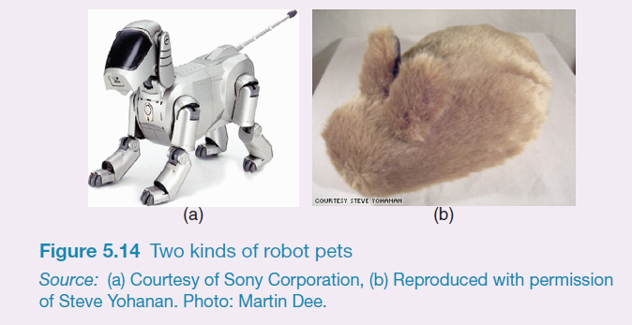
Robot-like or cuddly?
Which do you prefer and why?
Notes:
Most people like stroking pets and cuddly toys and so will as likely want to stroke pet robots. However, because they look and feel like the real thing some people may find them a bit creepy. A motivation for making robot pets cuddly is to enhance the emotional experience people have through using their sense of touch. For example, the Haptic Creature is a robotic device that mimics a pet that might sit in your lap, such as a rabbit or a cat (Yohanan et al, 2008). It is made up of a body, two ear-like appendages, a breathing mechanism, a purring mechanism, and a warming element. These enable it to detect the way it is stroked and to respond accordingly. When it is placed in a human’s lap and that person strokes its fur, it might consider this as a pleasing interaction and will update its emotional state to reflect happiness. This then triggers quick rhythmic breathing that causes its ribcage to press against the human’s hand. It also stiffens its ears and makes a gentle purring-like vibration. Note how the rabbit has no eyes, nose or mouth. These were deliberately left off to see how people respond to it primary through touch.
42

Slide 43
Implications
Should we create products that adapt according to people’s different emotional states?
When people are feeling angry should an interface be more attentive and informative than when they are happy?
Is Norman right?
designers “can get away with more” for products intended to be used during leisure time than those designed for serious tasks
Notes:
43

Slide 44
Summary
Emotional aspects of interaction design concerned with how to facilitate certain states (e.g. pleasure) or avoid reactions (e.g. frustration)
Well-designed interfaces can elicit good feelings in people
Aesthetically pleasing interfaces can be a pleasure to use
Expressive interfaces can provide reassuring feedback to users
Badly designed interfaces make people frustrated, annoyed, or angry
Emotional technologies can be designed to persuade people to change their behaviors or attitudes
Anthropomorphism is the attribution of human qualities to objects
Virtual agents and robot pets have been developed to make people feel motivated, reassured, and in a good mood
Notes:
44

