Slide 1
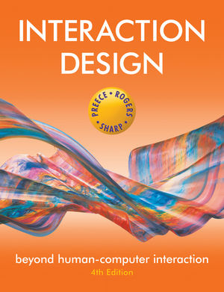
Chapter 9
THE PROCESS OF INTERACTION DESIGN

Slide 2
Overview
What is involved in Interaction Design?
Importance of involving users
Degrees of user involvement
What is a user-centered approach?
Four basic activities
Some practical issues
Who are the users?
What are ‘needs’?
Where do alternatives come from?
How to choose among alternatives?
How to integrate interaction design activities in other lifecycle models?

Slide 3
What is involved in Interaction Design?
It is a process:
a goal-directed problem solving activity informed by intended use, target domain, materials, cost, and feasibility
a creative activity
a decision-making activity to balance trade-offs
Generating alternatives and choosing between them is key
Four approaches: user-centered design, activity-centered design, systems design, and genius design

Slide 4
Importance of involving users
Expectation management
Realistic expectations
No surprises, no disappointments
Timely training
Communication, but no hype
Ownership
Make the users active stakeholders
More likely to forgive or accept problems
Can make a big difference to acceptance and success of product

Slide 5
Degrees of user involvement
Member of the design team
Full time: constant input, but lose touch with users
Part time: patchy input, and very stressful
Short term: inconsistent across project life
Long term: consistent, but lose touch with users
Newsletters and other dissemination devices
Reach wider selection of users
Need communication both ways
User involvement after product is released
Combination of these approaches

Slide 6
What is a user-centered approach?
User-centered approach is based on:
Early focus on users and tasks: directly studying cognitive, behavioral, anthropomorphic & attitudinal characteristics
Empirical measurement: users’ reactions and performance to scenarios, manuals, simulations & prototypes are observed, recorded and analysed
Iterative design: when problems are found in user testing, fix them and carry out more tests

Slide 7
Four basic activities in Interaction Design
Establishing requirements
Designing alternatives
Prototyping
Evaluating

Slide 8
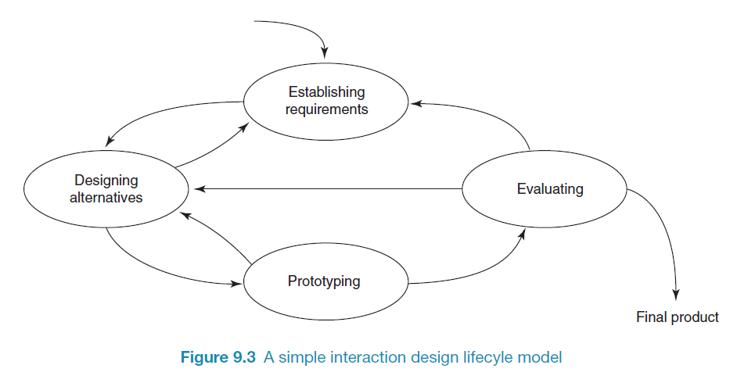
A simple interaction design lifecycle model
Exemplifies a user-centered design approach

Slide 9
Some practical issues
Who are the users?
What do we mean by ‘needs’?
How to generate alternatives
How to choose among alternatives
How to integrate interaction design activities with other lifecycle models?

Slide 10
Who are the users/stakeholders?
Not as obvious as you think:
those who interact directly with the product
those who manage direct users
those who receive output from the product
those who make the purchasing decision
those who use competitor’s products
Three categories of user (Eason, 1987):
primary: frequent hands-on
secondary: occasional or via someone else
tertiary: affected by its introduction, or will influence its purchase

Slide 11
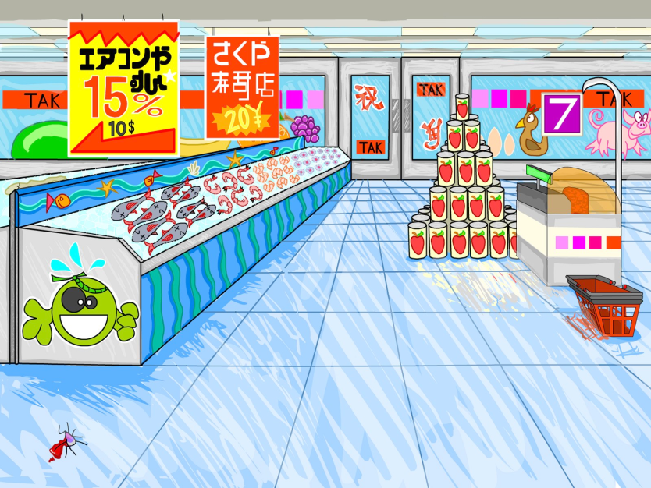
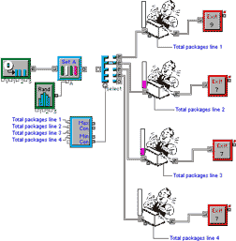

Who are the stakeholders?
Check-out operators
• Suppliers
• Local shop owners
Customers
Managers and owners

Slide 12
What do we mean by ‘needs’?
Users rarely know what is possible
Users can’t tell you what they ‘need’ to help them achieve their goals
Instead, look at existing tasks:
their context
what information do they require?
who collaborates to achieve the task?
why is the task achieved the way it is?
Envisioned tasks:
can be rooted in existing behaviour
can be described as future scenarios

Slide 13
How to generate alternatives
Humans stick to what they know works
But considering alternatives is important to ‘break out of the box’
Designers are trained to consider alternatives, software people generally are not
How do you generate alternatives?
‘Flair and creativity’: research and synthesis
Seek inspiration: look at similar products or look at very different products

Slide 14
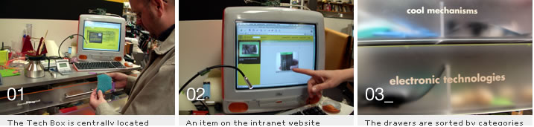
IDEO TechBox
Library, database and website all-in-one
Contains physical gizmos for inspiration

Slide 15
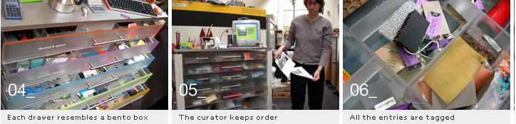
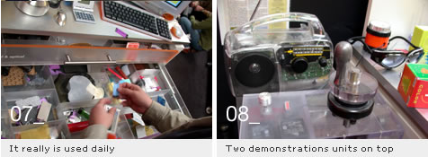
The TechBox

Slide 16
How to choose among alternatives
Evaluation with users or with peers, e.g. prototypes
Technical feasibility: some not possible
Quality thresholds: Usability goals lead to usability criteria set early on and check regularly
safety: how safe?
utility: which functions are superfluous?
effectiveness: appropriate support? task coverage, information available
efficiency: performance measurements
learnability: is the time taken to learn a function acceptable to the users?
memorability: can infrequent users remember how to achieve their goal?

Slide 17
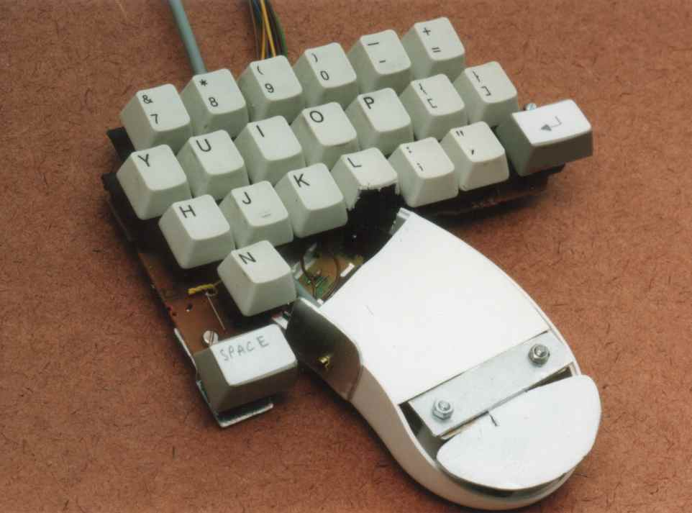
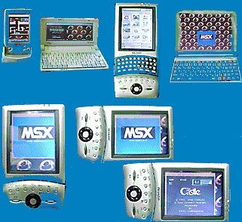
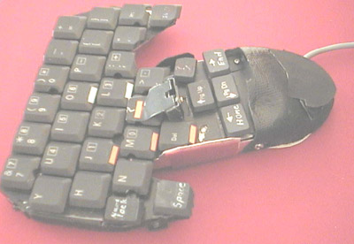
Testing prototypes to choose among alternatives

Slide 18
How to integrate interaction design in other models
Integrating interaction design activities in lifecycle models from other disciplines needs careful planning
Several software engineering lifecycle models have been considered
Integrating with agile software development is promising
it stresses the importance of iteration
it champions early and regular feedback
it handles emergent requirements
it aims to strike a balance between flexibility and structure

Slide 19
Summary
Four basic activities in the design process
Establishing requirements
Designing alternatives
Prototyping
Evaluating
User-centered design rests on three principles
Early focus on users and tasks
Empirical measurement using quantifiable & measurable usability criteria
Iterative design

