Slide 1
COMPUTATIONAL THINKING AND CODING SYMPOSIUM
Department of Computer Science
28 February 2019

Slide 2
OUTLINE
History of Computer Science in Regina
Current student enrolment and faculty complement
Program or be programmed!
Opportunities and responsibilities
Outreach

Slide 3
HISTORY
Department approved by Senate on November 1, 1968
In 1970, Larry Symes (BA’63) became Department Head and Director of Computer Centre
Until the Fall of 1971, Computer Science classes were offered in Administration and Mathematics
First Computer Science degree awarded in 1972
In 1973, the Computer Centre took delivery of a Xerox Sigma 9, the first time-shared computer on campus
Grace Hopper gave invited lecture in 1974
Longest continuously-accredited CS program in Canada

Slide 4
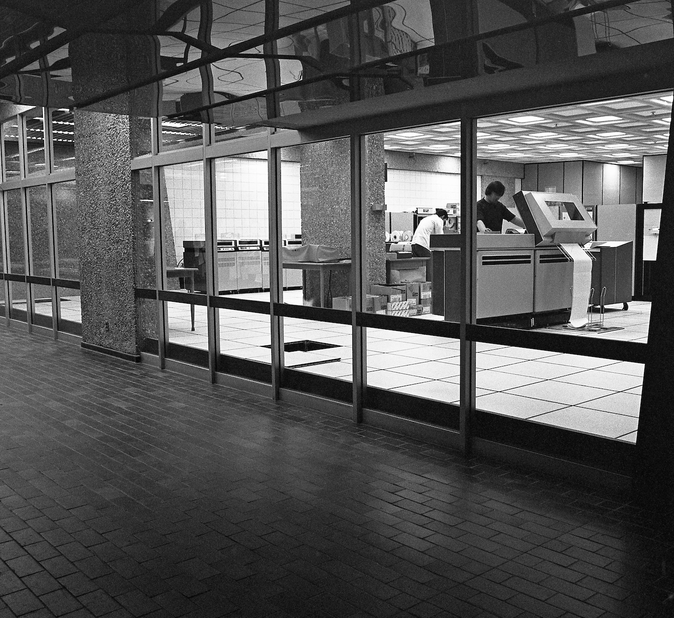
HISTORY

Slide 5
CURRENTLY
Enrolment in Fall semester:
687 undergraduates
163 graduate students: 21 PhD and 142 MSc (30 Thesis-based, 9 Project-based, 99 Course-based and 4 Co-op)
Faculty:
X
Y
Z

Slide 6
PROGRAM OR BE PROGRAMMED
To learn to program a computer:
Not the choice to drive a car, but not know how to fix it
The choice is to be a passenger, but not know how to drive the car anywhere

Slide 7
Notes:
Have a student read this quote aloud and ask: What did he mean? Discuss the quote. (For reference, Isaac Asimov is a famous science fiction writer and the author of hundreds of works, including I, Robot.)

Slide 9
Asimov’s Laws (1942)
0: A robot may not injure humanity, or, through inaction, allow humanity to come to harm. (1985)
1: A robot may not injure a human being, or, through inaction, allow a human being to come to harm.
2: A robot must obey the orders given it by human beings except where such orders would conflict with the First Law.
3: A robot must protect its own existence as long as such protection does not conflict with the First or Second Law.

Slide 10
Raskin’s Laws
1: Software may not damage a human’s work, or, through inaction, allow a human’s work to come to harm.
2: Software shall not require a human to do more work than necessary

Slide 11
Licklider’s Symbiosis (1960)
“In short, it seems worthwhile to avoid argument with (other) enthusiasts for artificial intelligence by conceding dominance in the distant future of cerebration to machines alone. There will nevertheless be a fairly long interim during which the main intellectual advances will be made by men and computers working together in intimate association. A multidisciplinary study group, examining future research and development problems of the [United States] Air Force, estimated that it would be 1980 before developments in artiﬁcial intelligence make it possible for machines alone to do much thinking or problem solving of military signiﬁcance.

Slide 12
Licklider’s Symbiosis
That would leave, say, ﬁve years to develop man-computer symbiosis and ﬁfteen years to use it. The ﬁfteen may be ten or ﬁve hundred, but those years should be intellectually the most creative and exciting in the history of mankind”

Slide 13

Licklider’s Symbiosis

Slide 14
Brainstorming Activity
What does “computer science” (CS) mean to you? What images does the term elicit?
What does “information technology” (IT) mean to you? What imagery does the term elicit?
Notes:
TIPS: When working with a small audience or with a long period of time, use this time for THINK, PAIR, SHARE and have the audience spend a few minutes thinking about the questions, talking about ideas with a neighbor, and sharing responses with the entire group. When working with a large audience or a limited time slot, it may be more manageable to have them think about each question for 30 seconds and then call on students to share ideas with the group. SAMPLE STATEMENT (following THINK, PAIR, SHARE):This is a field undergoing rapid change… fields are merging and creating new divisions. These new areas come about every day as professionals realize that their field has particular information and technological needs
Examples:
Geographic Information Systems
Bioinformatics
Nursing informatics

Slide 15
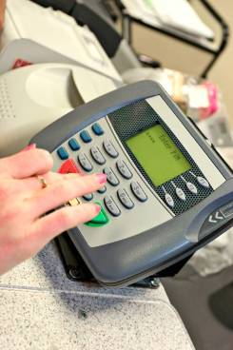
What is information technology?
Information technology (IT) is using computers and computer science to…
Communicate
Solve problems
Design and imagine
Share, store, retrieve or manipulate information
Where do you see information technologies in use every day?
Notes:
Ask the students to provide examples of information technologies they see around them every day. Use the four bullet categories to facilitate students’ thinking past gaming devices and common hardware to unique devices and applications. Explore personal devices (such as iPods and cell phones) and familiar settings (like a grocery store, bank, classroom, or office).

Slide 16
Why study computing?
More job openings in CS/IT-related fields than qualified graduates to fill them
CS/IT is a lucrative career path
CS/IT training can increase employment and salary opportunities within one’s field of interest
Notes:
1.) CS/IT is one of the fastest growing career fields in the United States, yet the number of students choosing to major in CS/IT has been steadily decreasing for the past few years.
2.) CS/IT is one of the highest paying career fields in terms of starting salary and median salary. CS/IT workers start out making more than most lawyers, nurses, police officers, and other popular professions.
3.) CS/IT is important in almost every career field; major in CS/IT and another field like nursing, law enforcement, or biology to have an edge above other job applicants and the ability to negotiate a higher salary.

Slide 17
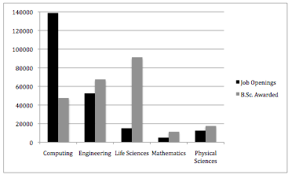
Why study computing?
Notes:
1.) CS/IT is one of the fastest growing career fields in the United States, yet the number of students choosing to major in CS/IT has been steadily decreasing for the past few years.
2.) CS/IT is one of the highest paying career fields in terms of starting salary and median salary. CS/IT workers start out making more than most lawyers, nurses, police officers, and other popular professions.
3.) CS/IT is important in almost every career field; major in CS/IT and another field like nursing, law enforcement, or biology to have an edge above other job applicants and the ability to negotiate a higher salary.

Slide 18

Computer science — not computer literacy —underlies most innovation today, from biotechnology to cinematography to energy and climate change.
Notes:
From CSEdWeek website…

Slide 19
Sooo…. Why should you consider a career in computing?
Notes:
Ask students the above question.

Slide 20

IT’s collaborative!
Meeting of a project team at Google
Notes:
Cool people working TOGETHER in a cool setting. Work life is changing in IT. Notice the team is working collaboratively in a professional but casual setting. The typical work space at Google is open and full of large couches, chairs, and scattered with rubber balls to create a fun work and social environment. Google makes sure employees are always within 500 feet of food, and they support healthy lifestyles with recreation and sports equipment, and even a pool. Other perks: Google provides employees three gourmet meals per day, offers free laundry service, an in-house hair salon and massage parlor, and employees are allowed to bring their dogs to work. TIPS: Make sure everyone knows what Google is. Call on someone to explain to the group what Google is/does. ASK STUDENTS TO DISCUSS: WHY might Google offer these employee benefits? What does Google get out of having so many perks?

Slide 21
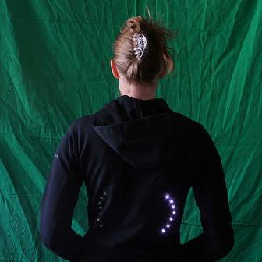
IT’s creative!
CS/IT is NOT just code
Code is technical, but it’s also creative!
Introducing Leah Buechley
Before College: Interested in art and design, liked math.
In College: Studied fine arts, then computer science.
Now: Creates clothes that light up.
Notes:
Leah is an example of someone who didn’t start out in computing or IT. She blended computing with her other interests, including art and design. This is Leah wearing her programmable shirt. It has LEDs (light emitting diodes) sewn into it that run on a watch battery. Conductive thread connects the LEDS to a programmable chip inside the shirt. On the slide you will see a picture of Leah wearing a shirt made for bicyclists. There is a right and left turn signal so bicycle riders can let others know which way they are planning on turning. The turn signal lights up when the rider presses a button on either the left or right sleeve of the shirt.
Check out Leah's lab at MIT, where she is a professor:
http://hlt.media.mit.edu/

Slide 22
IT’s a Growth Sector
U.S. Department of Labor’s Bureau of Labor Statistics reported in 2009 that computing-related occupations are projected to be the fastest growing segment of the professional workforce between 2008 and 2018:
Computer and Mathematical Sciences
Community and Social Services
Healthcare Practitioners and Technical Occupations
Source: Bureau of Labor Statistics, Monthly Labor Review, November 2009.
Notes:
In 2006, Money magazine rated “software engineer” the best job in America, based on low stress, flexibility, and use of creativity.
For more information see NCWIT-produced By the Numbers, www.ncwit.org/bythenumbers.

Slide 23
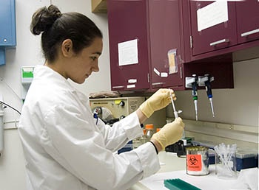
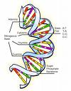
CS/IT Jobs Benefit Society
The Human Genome Project and the field of bioinformatics have revolutionized what is possible in forensics, health care, science, criminal justice and other fields through the creation of the DNA database.
Pictured right: DNA Database Laboratory and No-suspect Nuclear Case Work Unit in Connecticut
Photo: Connecticut Department of Public Safety, Forensics Division
Notes:
The DNA database, designed by computer scientists, has changed the way law enforcement analyzes crime scenes and the way chemists and biologists study diseases. POSSIBLE DISCUSSION PROMPT: Think of other fields where technology has changed the way we work. Discuss the jobs behind those technologies.
ADDITIONAL INFORMATION FOR PRESENTER:
Human Genome Project: http://www.ornl.gov/sci/techresources/Human_Genome/home.shtml
Most bioinformatics is concerned with information about cellular and biomolecular structures and systems (Source: http://www.bioplanet.com/bioinformatics_faq.html#definitions).
With the completion of the Human Genome Project the field of genome informatics, a subfield of bioinformatics dealing specifically with software development, management, and analysis of genomes and the DNA database, is exploding and leading to increasing employment opportunities in health care, criminal justice, social science, and the natural sciences.

Slide 24
Student Interests + CS/IT =
Innovative Careers!
Find out what you love to do and do that. It’s that simple.
~ Dr. A. L. Garcia
Notes:
In an article titled “All Science is Computer Science,” George Johnson (2001) writes about computer science in the twenty-first century: “As research on so many fronts is becoming increasingly dependent on computation, all science, it seems, is becoming computer science.” New fields in computer science and information technology are constantly emerging as technology becomes more integral for a wider range of professions. If a career that involves student interests and IT doesn’t currently exist, it will.

Slide 25
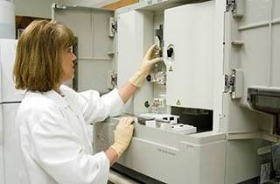
Healthcare + CS/IT = Something for everyone
Health informatics or (Bio)medical informatics:
Medical informatics
Bioinformatics
Nursing informatics
Genome informatics
Pictured above: DNA Database Laboratory and No-suspect Nuclear Case Work Unit in Connecticut
Photo: Connecticut Department of Public Safety, Forensics Division
Notes:
Informatics includes the science of information, the practice of information processing, and the engineering of information systems. Informatics studies the structure, behavior, and interactions of natural and artificial systems that store, process and communicate information. Since computers, individuals and organizations all process information, informatics has computational, cognitive and social aspects, including study of the social impact of information technologies. Used as a compound, in conjunction with the name of a discipline it denotes the specialization of informatics to the management and processing of data, information and knowledge in the named discipline (Source: http://en.wikipedia.org/wiki/Informatics).
Health informatics, Health care informatics or medical informatics is the intersection of information science, computer science, and health care. It deals with the resources, devices, and methods required to optimize the acquisition, storage, retrieval, and use of information in health and biomedicine. Health informatics tools include not only computers but also clinical guidelines, formal medical terminologies, and information and communication systems. It is applied to the areas of nursing, clinical care, dentistry, pharmacy, public health and (bio)medical research. Source: http://en.wikipedia.org/wiki/Health_informatics

Slide 26
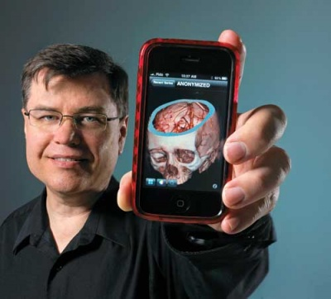
Healthcare + CS/IT = Something for everyone
U of R Distinguished
Alumnus (now at
Mayo Clinic)
Notes:
Informatics includes the science of information, the practice of information processing, and the engineering of information systems. Informatics studies the structure, behavior, and interactions of natural and artificial systems that store, process and communicate information. Since computers, individuals and organizations all process information, informatics has computational, cognitive and social aspects, including study of the social impact of information technologies. Used as a compound, in conjunction with the name of a discipline it denotes the specialization of informatics to the management and processing of data, information and knowledge in the named discipline (Source: http://en.wikipedia.org/wiki/Informatics).
Health informatics, Health care informatics or medical informatics is the intersection of information science, computer science, and health care. It deals with the resources, devices, and methods required to optimize the acquisition, storage, retrieval, and use of information in health and biomedicine. Health informatics tools include not only computers but also clinical guidelines, formal medical terminologies, and information and communication systems. It is applied to the areas of nursing, clinical care, dentistry, pharmacy, public health and (bio)medical research. Source: http://en.wikipedia.org/wiki/Health_informatics

Slide 27

Science + CS/IT = Something for everyone
Bioinformatics
Computational biology
Genome informatics
Cheminformatics
Pictured above: Human chromosomes on a black background,
from the National Human Genome Research Institute
Notes:
Informatics includes the science of information, the practice of information processing, and the engineering of information systems. Informatics studies the structure, behavior, and interactions of natural and artificial systems that store, process and communicate information. Since computers, individuals and organizations all process information, informatics has computational, cognitive and social aspects, including study of the social impact of information technologies. Used as a compound, in conjunction with the name of a discipline it denotes the specialization of informatics to the management and processing of data, information and knowledge in the named discipline (Source: http://en.wikipedia.org/wiki/Informatics).
Bioinformatics is the application of computer science to the field of molecular biology. The term bioinformatics was coined by Paulien Hogeweg in 1979 for the study of informatic processes in biotic systems. Its primary use since at least the late 1980s has been in genomics and genetics, particularly in those areas of genomics involving large-scale DNA sequencing. Source: http://en.wikipedia.org/wiki/Bioinformatics
Computational biology is an interdisciplinary field that applies the techniques of computer science, applied mathematics and statistics to address biological problems. Source: http://en.wikipedia.org/wiki/Computational_biology
The Genome Informatics program supports research in computational biology that will enable the development of tools for sequence analysis, gene mapping, complex trait mapping and genetic variation. These tools include mathematical and statistical methods for the identification of functional elements in complex genomes; the identification of patterns in large datasets (for example, microarray data); and the mapping of complex traits and genetic variations (for example, single nucleotide polymorphisms, or SNPs). Source: http://www.genome.gov/10001735
Cheminformatics (also known as chemoinformatics and chemical informatics) is the use of computer and informational techniques, applied to a range of problems in the field of chemistry. These in silico techniques are used in pharmaceutical companies in the process of drug discovery. Source: http://en.wikipedia.org/wiki/Cheminformatics

Slide 28
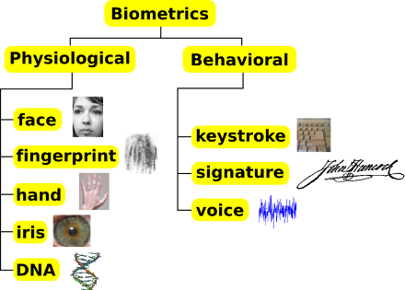
Criminal Justice + CS/IT=
Criminal justice informatics
Biometrics
Forensic informatics/ digital forensic science
Information Security
Bioinformatics
Pictured above: Classification of some biometric traits
Photo: Connecticut Department of Public Safety, Forensics Division
Notes:
ADDITIONAL INFORMATION FOR PRESENTERS:
Criminal Justice Informatics- Criminal justice agencies are increasingly relying on computer technology for many tasks including administration, allocation of resources, criminal investigation, and research. This change has created a growing demand for criminal justice students with computer/information technology (IT) skills (Source: http://www.uml.edu/grad/Programs_of_Study/Criminal_Justice_Informatics.html).
Biometrics (ancient Greek: bios ="life", metron ="measure") is the study of methods for uniquely recognizing humans based upon one or more intrinsic physical or behavioral traits. The modern rapid advancements in networking, communication and mobility increased the need of reliable ways to verify the identity of any person. Biometric characteristics can be divided in two main classes, as represented in the figure above: 1) physiological are related to the shape of the body. The oldest traits, that have been used for more than 100 years, are fingerprints. Other examples are face recognition, hand geometry and iris recognition; 2) behavioral are related to the behavior of a person. The first characteristic to be used, still widely used today, is the signature. More modern approaches are the study of keystroke dynamics and of voice (Source: http://en.wikipedia.org/wiki/Biometrics).
Forensic Informatics aims to provide students with an understanding of the potential of information systems within the forensic investigation process. These systems are not just employed by investigators in a ‘reactive’ manner (for example, in the use of DNA databases) but increasingly more proactively. In the latter case examples include inferential databases for child homicide and data mining of crime patterns (Source: http://www.canterbury.ac.uk/courses/prospectus/undergraduate/c.asp?courseUrl=forensic-investigation).
Information security is the process of protecting data from unauthorized access, use, disclosure, destruction, modification, or disruption. The terms information security, computer security and information assurance are frequently used interchangeably. These fields are interrelated and share the common goals of protecting the confidentiality, integrity and availability of information; however, there are some subtle differences between them (Source: http://en.wikipedia.org/wiki/Information_security).

Slide 29
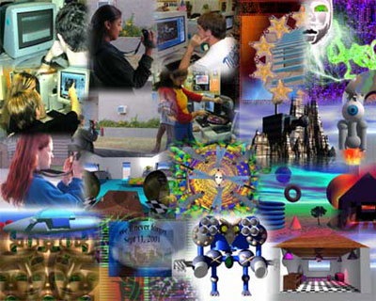
Humanities/Social Science + CS/IT=
Motion graphic design
Animation (2D & 3D)
Computer graphics
Computational linguistics
Speech recognition software
Human computer interaction
Pictured above: Digital art collage created by students at the Texas School for the Deaf in Austin, TX
Photo: Texas School for the Deaf
Notes:
Motion Design is a subset of graphic design in that it uses graphic design principles in a film or video context (or other temporally evolving visual medium) through the use of animation or filmic techniques. Examples include the typography and graphics you see as the titles for a film, or opening sequences for television or the spinning, web-based animations, three-dimensional logo for a television channel. (Source: http://en.wikipedia.org/wiki/Motion_graphic_design)
Animation is the rapid display of a sequence of images of 2-D or 3-D artwork or model positions in order to create an illusion of movement. It is an optical illusion of motion due to the phenomenon of persistence of vision, and can be created and demonstrated in a number of ways. (Source: http://en.wikipedia.org/wiki/Animation)
Computer graphics are graphics created using computers and, more generally, the representation and manipulation of image data by a computer. (Source: http://en.wikipedia.org/wiki/Computer_graphics) Computational linguistics is an interdisciplinary field dealing with the statistical and/or rule-based modeling of natural language from a computational perspective. This modeling is not limited to any particular field of linguistics. Source: http://en.wikipedia.org/wiki/Computational_linguistics
Speech Recognition Software Modern speech recognition software enables a single computer user to speak text and/or commands to the computer, largely, but not entirely, bypassing the use of the keyboard and mouse interface.
Human–computer interaction (HCI) is the study of interaction between people (users) and computers. It is often regarded as the intersection of computer science, behavioral sciences, design and several other fields of study. Interaction between users and computers occurs at the user interface (or simply interface), which includes both software and hardware; for example, characters or objects displayed by software on a personal computer's monitor, input received from users via hardware peripherals such as keyboards and mice, and other user interactions with large-scale computerized systems such as aircraft and power plants. Source: http://en.wikipedia.org/wiki/Human%E2%80%93computer_interaction

Slide 30
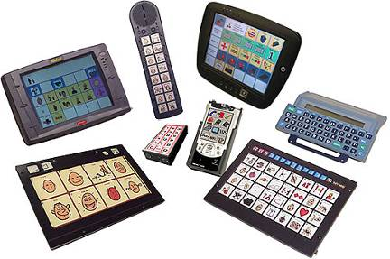
Education + CS/IT=
Educational technology
Instructional design
Assistive technology
Electronic learning/ e-learning/online learning
Distance education
Educational animation
Pictured above: Assistive speech generating devices for language learners and disabled learners
Photo: Spectronicsinoz
Notes:
ADDITIONAL INFORMATION FOR PRESENTERS:
Educational technology is the use of technology in education to improve learning and teaching. Educational technology is also known as instructional technology or learning technology (Source: http://en.wikipedia.org/wiki/Category:Educational_technology). Instructional design is the practice of arranging media to help learners and teachers transfer knowledge most effectively. The process consists broadly of determining the current state of learner understanding, defining the end goal of instruction, and creating some media-based "intervention" to assist in the transition (Source: http://en.wikipedia.org/wiki/Instructional_design). Assistive Technology (AT) is a generic term that includes assistive, adaptive, and rehabilitative devices and the process used in selecting, locating, and using them. AT promotes greater independence for people with disabilities by enabling them to perform tasks that they were formerly unable to accomplish, or had great difficulty accomplishing, by providing enhancements to or changed methods of interacting with the technology needed to accomplish such tasks. According to disability advocates, technology is often created without regard to people with disabilities, creating unnecessary barriers to hundreds of millions of people (Source: http://en.wikipedia.org/wiki/Assistive_technology). Electronic learning or E-learning is a general term used to refer to computer-enhanced learning. It is used interchangeably in so many contexts that it is critical to be clear what one means when one speaks of 'eLearning'. In many respects, it is commonly associated with the field of advanced learning technology (ALT), which deals with both the technologies and associated methodologies in learning using networked and/or multimedia technologies (Source: http://en.wikipedia.org/wiki/E-learning). Distance education, or distance learning, is a field of education that focuses on the pedagogy/andragogy, technology, and instructional systems design that are effectively incorporated in delivering education to students who are not physically "on site" to receive their education. Instead, teachers and students may communicate asynchronously (at times of their own choosing) by exchanging printed or electronic media, or through technology that allows them to communicate in real time (synchronously) (Source: http://en.wikipedia.org/wiki/Distance_education). Educational animations are animations produced for the specific purpose of fostering learning (Source: http://en.wikipedia.org/wiki/Educational_animation).

Slide 31
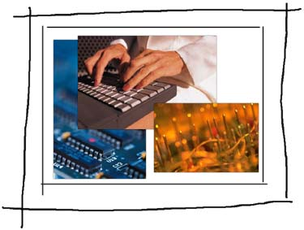
Business + CS/IT=
Management information systems (MIS)
Computer information systems (CIS)
Database administrator
Network administrator
IT Portfolio Management
Notes:
ADDITIONAL INFORMATION FOR PRESENTERS:
A management information system (MIS) is a system or process that provides information needed to manage organizations effectively. Management information systems are regarded to be a subset of the overall internal controls procedures in a business, which cover the application of people, documents, technologies, and procedures by management accountants to solve business problems such as costing a product, service or a business-wide strategy. Management information systems are distinct from regular information systems in that they are used to analyze other information systems applied in operational activities in the organization. (Source: http://en.wikipedia.org/wiki/Management_information_system)
Computer and Information Systems Managers In the modern workplace, it is imperative that Information Technology (IT) works both effectively and reliably. Computer and information systems managers play a vital role in the implementation and administration of technology within their organizations. They plan, coordinate, and direct research on the computer-related activities of firms. In consultation with other managers, they help determine the goals of an organization and then implement technology to meet those goals. They oversee all technical aspect of an organization, such as software development, network security, and Internet operations. Source: http://www.bls.gov/oco/ocos258.htm
Database administrator (DBA) maintains a database system, and is responsible for the integrity of the data and the efficiency and performance of the system (Source: http://en.wikipedia.org/wiki/System_administrator).
Network administrator maintains network infrastructure such as switches and routers, and diagnoses problems with these or with the behavior of network-attached computers (Source: http://en.wikipedia.org/wiki/System_administrator).
IT portfolio management is the application of systematic management to large classes of items managed by enterprise Information technology (IT) capabilities. Examples of IT portfolios would be planned initiatives, projects, and ongoing IT services (e.g. application support). The promise of IT portfolio management is the quantification of previously mysterious IT efforts, enabling measurement and objective evaluation of investment scenarios (Source: http://en.wikipedia.org/wiki/IT_Portfolio_Management).
Business intelligence (BI) is a business management term, which refers to applications and technologies that are used to gather, provide access to, and analyze data and information about company operations. Business intelligence systems can help companies have a more comprehensive knowledge of the factors affecting their business, such as metrics on sales, production, internal operations, and they can help companies to make better business decisions. Business Intelligence should not be confused with competitive intelligence, which is a separate management concept (Source: http://en.wikipedia.org/wiki/Business_intelligence).

Slide 32
Here’s some advice…
Think about your interests.
Learn how your interests + CS/IT = more job opportunities and more money
Sports!
Recreation!
Art! Music!
Health!
Biology!
Graphic Design!
Audio Engineering!
Sports / Recreation Informatics!
Health Informatics! Bioinformatics!
Notes:
Encourage students to explore academic programs and career opportunities using the internet and career counselors. Remember: technological innovations create new jobs.

Slide 33
Learn more!
camps, clubs & competitions
online programs & classes
virtual Web experiences
programmable devices
Notes:
Encourage students to seek out experiences that will introduce them to computing. Describe local opportunities and pass out any materials you've brought that advertise these.

