Slide 1

Chapter 8
Data Analysis, Interpretation and Presentation

Slide 2
Aims
Discuss the difference between qualitative and quantitative data and analysis.
Enable you to analyze data gathered from:
Questionnaires.
Interviews.
Observation studies.
Make you aware of software packages that are available to help your analysis.
Identify common pitfalls in data analysis, interpretation, and presentation.
Enable you to interpret and present your findings in appropriate ways.

Slide 3
Quantitative and qualitative
Quantitative data – expressed as numbers
Qualitative data – difficult to measure sensibly as numbers, e.g. count number of words to measure dissatisfaction
Quantitative analysis – numerical methods to ascertain size, magnitude, amount
Qualitative analysis – expresses the nature of elements and is represented as themes, patterns, stories
Be careful how you manipulate data and numbers!

Slide 4
Simple quantitative analysis
Averages
Mean: add up values and divide by number of data points
Median: middle value of data when ranked
Mode: figure that appears most often in the data
Percentages
Be careful not to mislead with numbers!
Graphical representations give overview of data
4

Slide 5
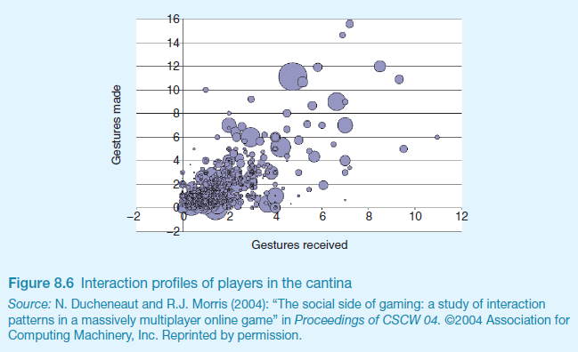
Visualizing log data
Interaction profiles of players in online game

Slide 6
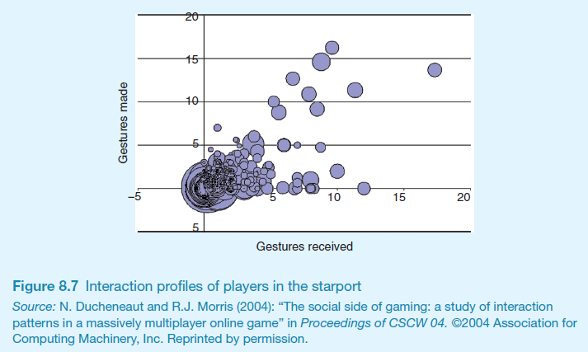
Visualizing log data
Log of web page activity

Slide 7
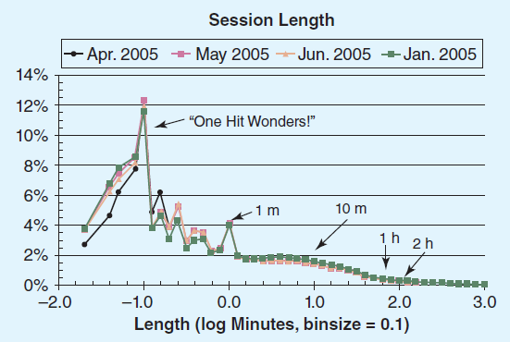
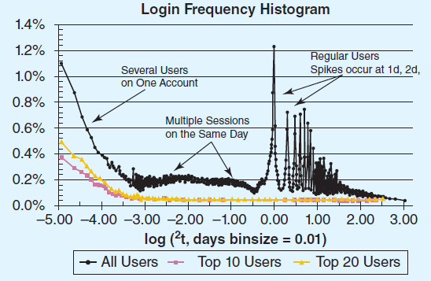
Web analytics

Slide 8
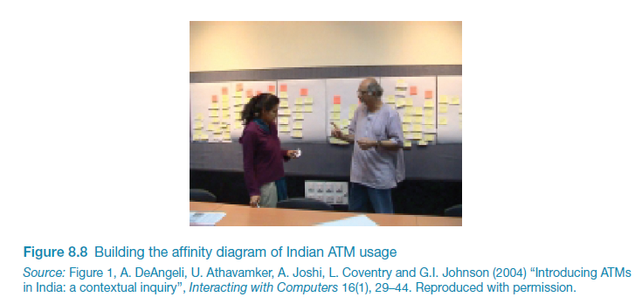
Simple qualitative analysis
Recurring patterns or themes
Emergent from data, dependent on observation framework if used
Categorizing data
Categorization scheme may be emergent or pre-specified
Looking for critical incidents
Helps to focus in on key events

Slide 9
Tools to support data analysis
Spreadsheet – simple to use, basic graphs
Statistical packages, e.g. SPSS
Qualitative data analysis tools
Categorization and theme-based analysis
Quantitative analysis of text-based data
Nvivo and Atlas.ti support qualitative data analysis
CAQDAS Networking Project, based at the University of Surrey (http://caqdas.soc.surrey.ac.uk/)

Slide 10
Theoretical frameworks for qualitative analysis
Basing data analysis around theoretical frameworks provides further insight
Three such frameworks are:
Grounded Theory
Distributed Cognition
Activity Theory

Slide 11
Grounded Theory
Aims to derive theory from systematic analysis of data
Based on categorization approach (called here ‘coding’)
Three levels of ‘coding’
Open: identify categories
Axial: flesh out and link to subcategories
Selective: form theoretical scheme
Researchers are encouraged to draw on own theoretical backgrounds to inform analysis

Slide 12
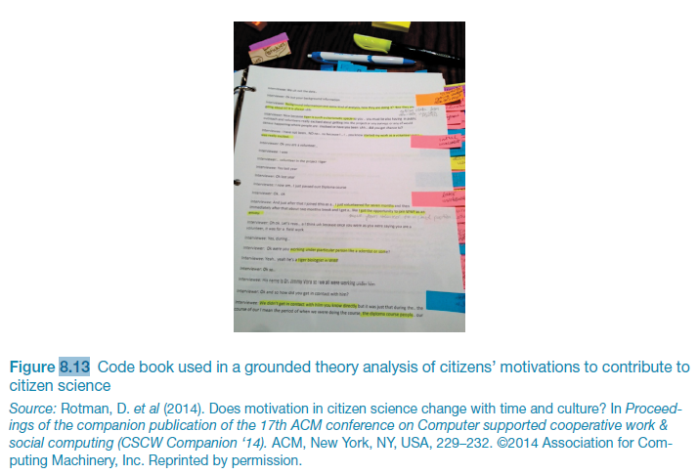
Code book used in grounded theory analysis

Slide 13
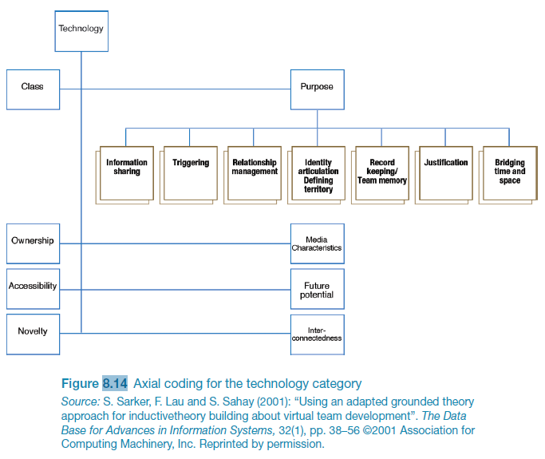
Excerpt showing axial coding

Slide 14
Distributed Cognition
The people, environment & artefacts are regarded as one cognitive system
Used for analyzing collaborative work
Focuses on information propagation & transformation

Slide 15
Activity Theory
Explains human behaviour in terms of our practical activity in the world
Provides a framework that focuses analysis around the concept of an ‘activity’ and helps to identify tensions between the different elements of the system
Two key models: one outlines what constitutes an ‘activity’; one models the mediating role of artifacts

Slide 16
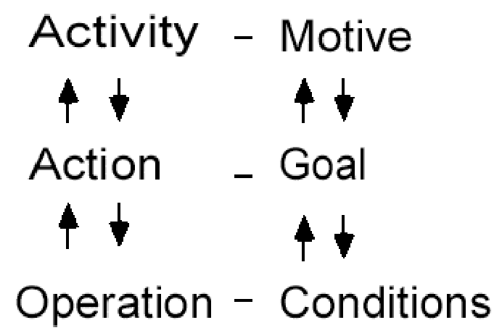
Individual model
16

Slide 17
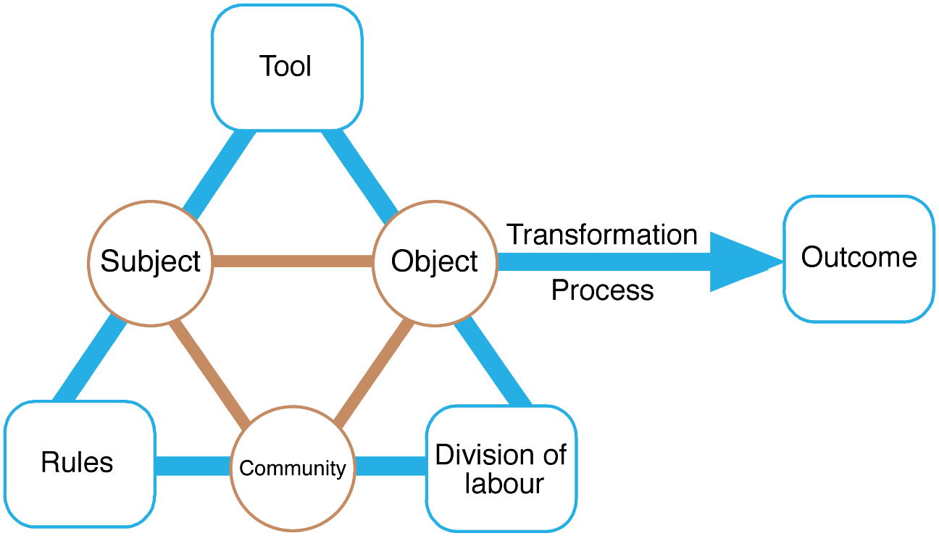
Engeström’s (1999) activity system model
17
Notes:
P312
Figure 8.17 Engeström’s (1999) activity system model. The tool element is sometimes referred to
as the mediating artifact
Source: Reproduced from Engeström, Y. (1999) Perspectives on Activity Theory, CUP.

Slide 18
Presenting the findings
Only make claims that your data can support
The best way to present your findings depends on the audience, the purpose, and the data gathering and analysis undertaken
Graphical representations (as discussed above) may be appropriate for presentation
Other techniques are:
Rigorous notations, e.g. UML
Using stories, e.g. to create scenarios
Summarizing the findings

Slide 19
Summary
The data analysis that can be done depends on the data gathering that was done
Qualitative and quantitative data may be gathered from any of the three main data gathering approaches
Percentages and averages are commonly used in Interaction Design
Mean, median and mode are different kinds of ‘average’ and can have very different answers for the same set of data
Grounded Theory, Distributed Cognition and Activity Theory are theoretical frameworks to support data analysis
Presentation of the findings should not overstate the evidence
19

