Slide 1
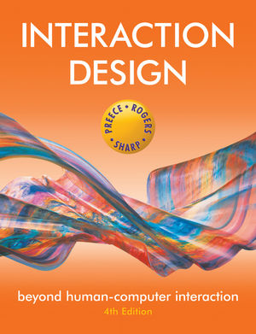
Chapter 12
INTERACTION DESIGN IN PRACTICE

Slide 2
Overview
AgileUX
Design Patterns
Open Source Resources
Tools for Interaction Design

Slide 3
Agile development
Short (one to three week) timeboxes of iterative development (sprint, iteration, cycle)
Early and repeated customer/user feedback
Re-prioritisation of work based on customer/user so that emergent requirements can be handled
Many approaches, e.g. eXtreme Programming (XP), Scrum, DSDM

Slide 4
AgileUX
Integrates techniques from interaction design and Agile software development
AgileUX requires a change of mindset
In Agile, as implementation proceeds:
requirements are elaborated
requirements are re-prioritised
All techniques in UX are still relevant but when and how much needs re-thinking
focus on product, not design, as deliverable
cross-functional teams
Three practical areas: user research, aligning work practices, documentation

Slide 5
User research
Aims to characterise users through data collection and analysis
Agile’s timeboxing approach does not support long periods of user research
User evaluations and some detailed work can be fitted within a timebox
Some user research can be performed in iteration 0 (zero), before implementation starts
Ongoing programme of user research

Slide 6
Aligning work practices
Designing a complete product upfront causes problems because of re-prioritisation
Some upfront work is needed (technical and UX)
Use a parallel tracks approach:
create product vision before development starts
do design work one iteration ahead of development
some teams work two iterations ahead

Slide 7
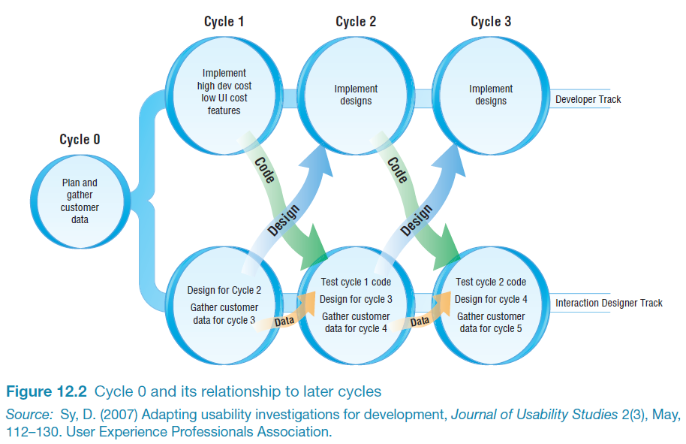
Parallel tracks approach to AgileUX

Slide 8
Aligning work practices
Advantages of parallel tracks approach:
no design time wasted on features not implemented
usability testing and contextual inquiry could be done on the same customer visit, saving time
timely feedback on the designs was received from developers and customers
Agile flexibility supports schedule changes if a problem is found
Parallel tracks is commonly used

Slide 9
Documentation
Most common communication approach for UX designers
Agile discourages this kind of communication, in favour of discussion
Only use documentation where needed. Ask:
Who will read it?
Who will use it?
What is the minimum needed?
Is there duplication anywhere?
How polished does it need to be?

Slide 10
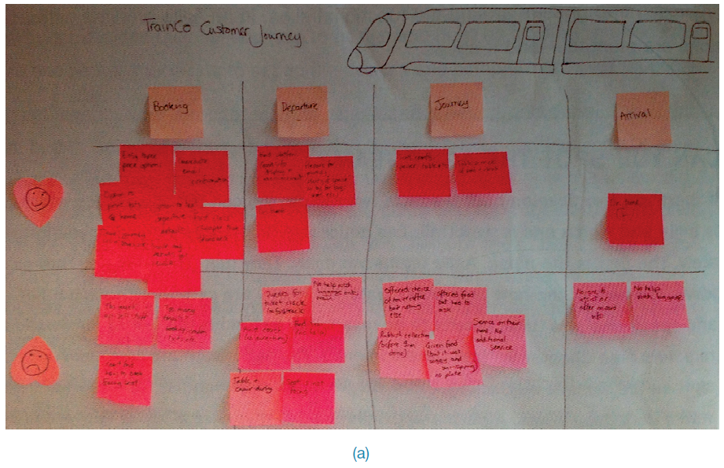
Documentation: how polished?

Slide 11
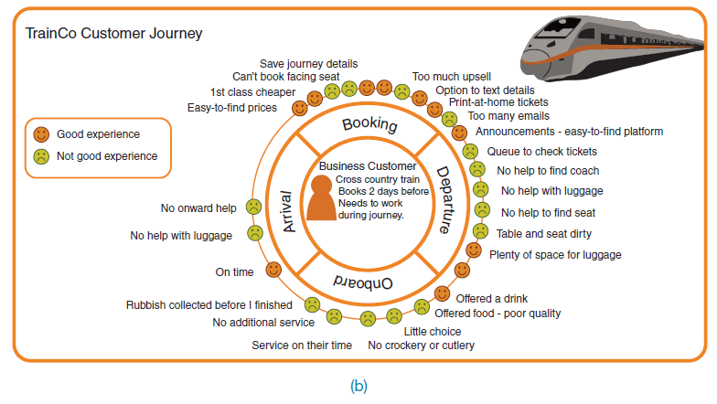
Documentation: how polished?

Slide 12
Design Patterns
Capture design experience:
a solution to a problem in a context
can be instantiated in many ways: generative
Patterns may be individual, in languages, in catalogues, galleries or libraries
Patterns often are associated with software components, e.g. Github or platform websites
Carousel pattern as example:

Slide 13
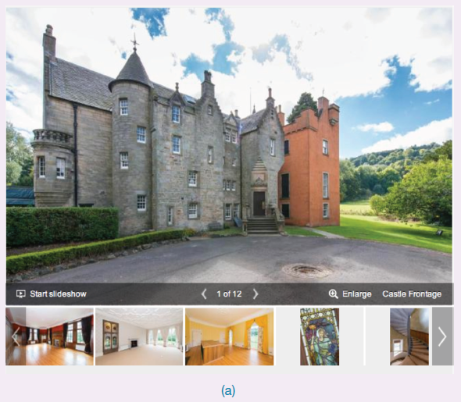
Design Patterns
Insert Figure 12.5 (a)

Slide 14
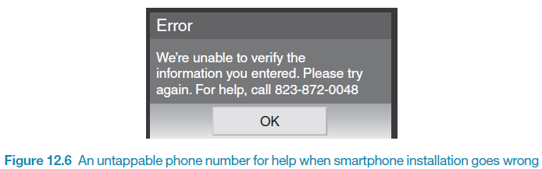
Design Patterns
Capture design experience, but that doesn’t necessarily mean good design:
anti-patterns: don’t do it this way!
dark patterns: deliberate tricks

Slide 15
Open Source Resources
Components, frameworks, systems available free of charge
Community-driven
Available for interaction design:
design pattern libraries
Bootstrap framework

Slide 16
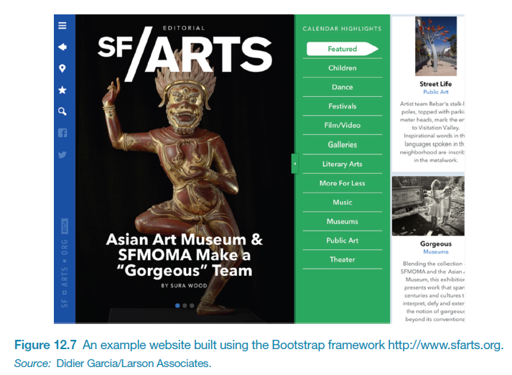
Open Source Resources

Slide 17
Tools for Interaction Design
Tools support all aspects of the design process:
creativity, sketching, simulation, brainstorming, library search, mindmapping, video capture
Tools integrate together to speed up prototyping
Interactive wireframes or mockups can be produced using, e.g.
Balsamiq©
Axure©
Higher fidelity prototype can be produced by linking interactive wireframe to design pattern library with software components

Slide 18
Summary
AgileUX refers to approaches that integrate UX design and agile development
it requires a change in mindset by designers and developers
requirements are repeatedly re-prioritised, which aims to avoid wasted effort
UX design activities need rethinking: when, how much, and how to take forward
Design patterns present a solution to a problem in a context
Open source resources, e.g. on Github, make development of standard applications easier and quicker
A range of automated tools to support interaction design in practice is available

