Slide 1
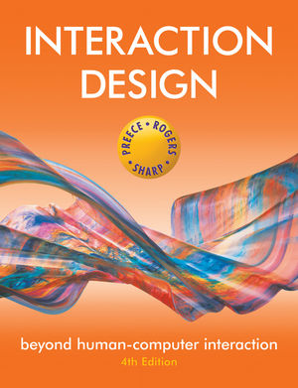
Chapter 11
DESIGN, PROTOTYPING and CONSTRUCTION

Slide 2
Overview
Prototyping
Conceptual design
Concrete design
Using scenarios
Generating prototypes
Construction

Slide 3
Prototyping
What is a prototype?
Why prototype?
Different kinds of prototyping
- Low fidelity
- High fidelity
Compromises in prototyping
- Vertical
- Horizontal
Final product needs to be engineered

Slide 4
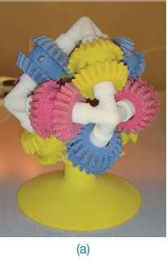
What is a prototype?
In other design fields a prototype is a small-scale model:
a miniature car
a miniature building or town
the examples here come from a 3D printer

Slide 5
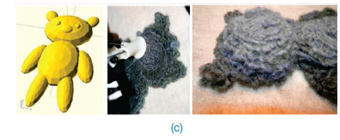

Slide 6
What is a prototype?
In interaction design it can be (among other things):
a series of screen sketches
a storyboard, i.e. a cartoon-like series of scenes
a Powerpoint slide show
a video simulating the use of a system
a lump of wood (e.g. PalmPilot)
a cardboard mock-up
a piece of software with limited functionality written in the target language or in another language

Slide 7
Why prototype?
Evaluation and feedback are central to interaction design
Stakeholders can see, hold, interact with a prototype more easily than a document or a drawing
Team members can communicate effectively
You can test out ideas for yourself
It encourages reflection: very important aspect of design
Prototypes answer questions, and support designers in choosing between alternatives

Slide 8
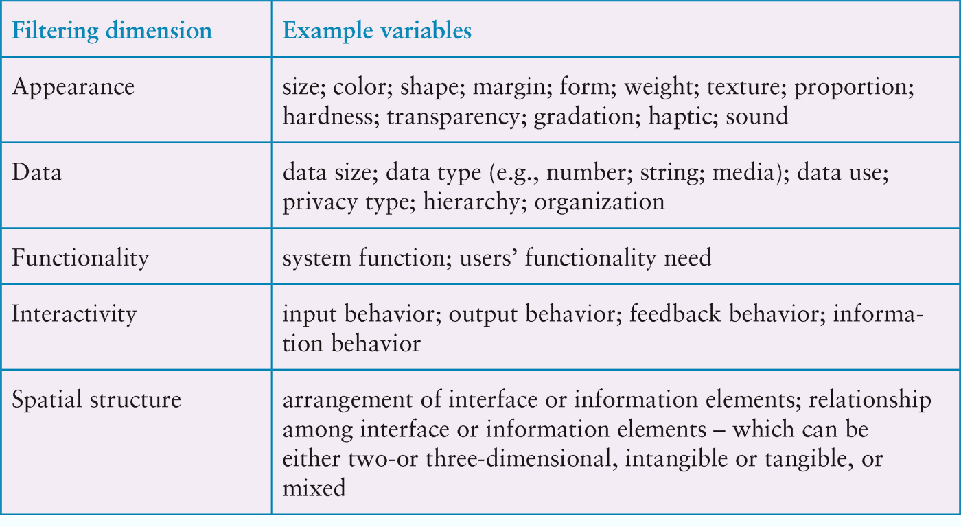
Filtering dimensions of prototyping

Slide 9
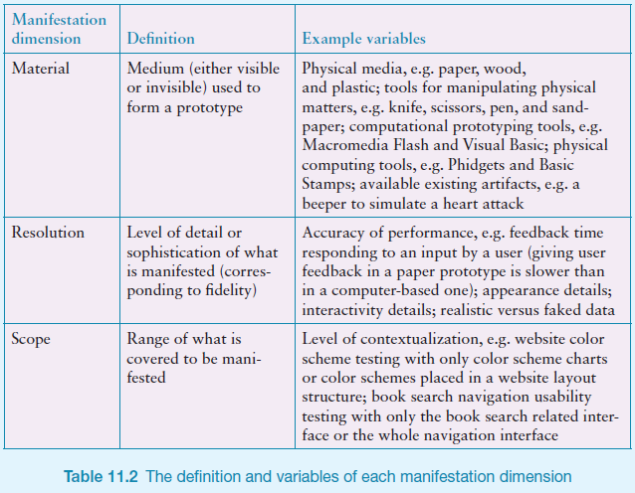
Manifestation dimensions of prototyping

Slide 10
What to prototype?
Technical issues
Work flow, task design
Screen layouts and information display
Difficult, controversial, critical areas

Slide 11
Low-fidelity Prototyping
Uses a medium which is unlike the final medium, e.g. paper, cardboard
Is quick, cheap and easily changed
Examples:
sketches of screens, task sequences, etc
‘post-it’ notes
storyboards
‘Wizard-of-Oz’

Slide 12
Storyboards
Often used with scenarios, bringing more detail, and a chance to role play
It is a series of sketches showing how a user might progress through a task using the device
Used early in design

Slide 13
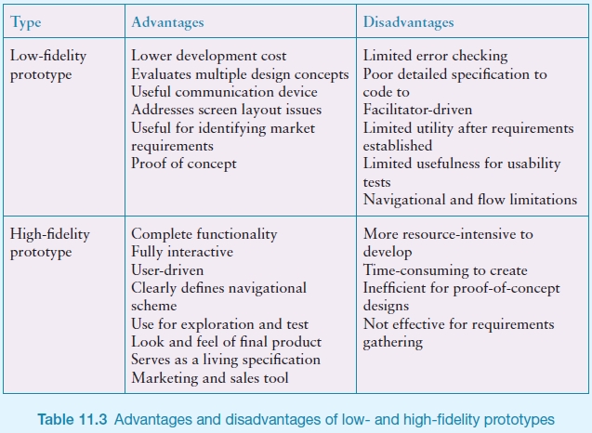
Example storyboard

Slide 14
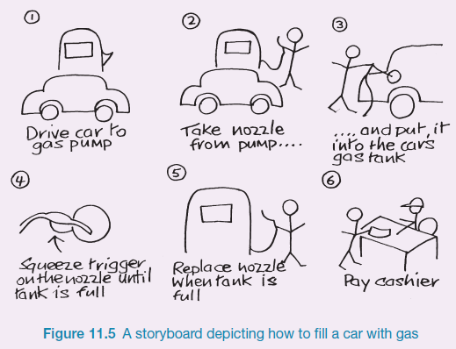
Sketching
Sketching is important to low-fidelity prototyping
Don’t be inhibited about drawing ability. Practice simple symbols
14

Slide 15
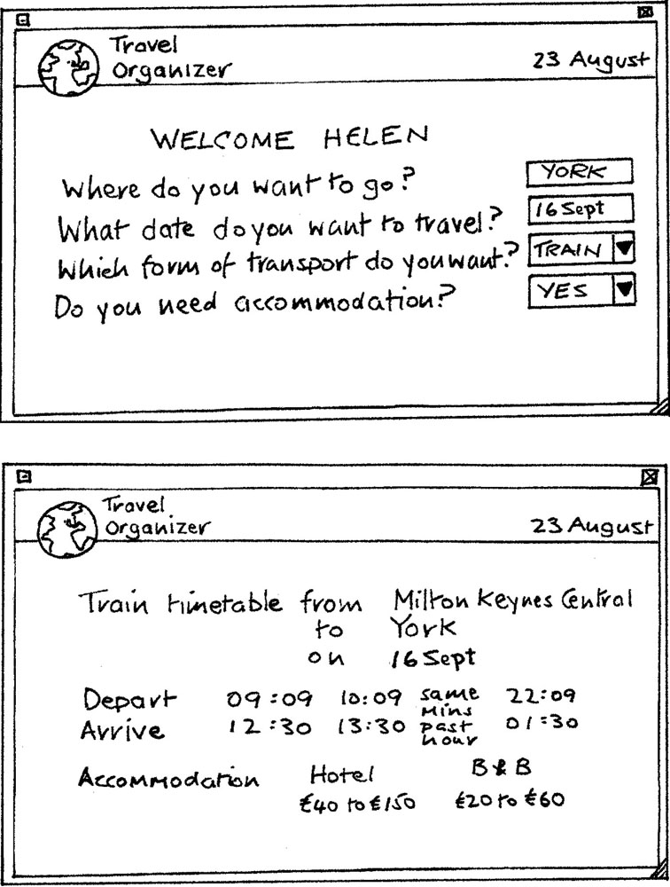
Card-based prototypes
Index cards (3 X 5 inches)
Each card represents one screen or part of screen
Often used in website development
15

Slide 16
‘Wizard-of-Oz’ prototyping
The user thinks they are interacting with a computer, but a developer is responding to output rather than the system.
Usually done early in design to understand users’ expectations
What is ‘wrong’ with this approach?
User
>Blurb blurb
>Do this
>Why?

Slide 17
High-fidelity prototyping
Uses materials that you would expect to be in the final product
Prototype looks more like the final system than a low-fidelity version
High-fidelity prototypes can be developed by integrating existing hardware and software components
Danger that users think they have a complete system…….see compromises

Slide 18
Compromises in prototyping
All prototypes involve compromises
For software-based prototyping maybe there is a slow response? sketchy icons? limited functionality?
Two common types of compromise
horizontal: provide a wide range of functions, but with little detail
vertical: provide a lot of detail for only a few functions
Compromises in prototypes mustn't be ignored. Product needs engineering

Slide 19
Conceptual design
Transform user requirements/needs into a conceptual model
A conceptual model is an outline of what people can do with a product and what concepts are needed to understand and interact with it
Mood board may be used to capture feel
Consider alternatives: prototyping helps

Slide 20
Is there a suitable metaphor?
Interface metaphors combine familiar knowledge with new knowledge in a way that will help the user understand the product.
Three steps: understand functionality, identify potential problem areas, generate metaphors
Evaluate metaphors:
How much structure does it provide?
How much is relevant to the problem?
Is it easy to represent?
Will the audience understand it?
How extensible is it?

Slide 21
Considering interaction and interface types
Which interaction type?
How the user invokes actions
Instructing, conversing, manipulating or exploring
Do different interface types provide insight?
shareable, tangible, augmented reality, etc.

Slide 22
Expanding the initial conceptual model
What functions will the product perform?
- What will the product do and what will the human do (task allocation)?
How are the functions related to each other?
- Sequential or parallel?
- Categorisations, e.g. all actions related to privacy on a smartphone
What information is needed?
- What data is required to perform the task?
- How is this data to be transformed by the system?

Slide 23
Concrete design
Many aspects to concrete design
Color, icons, buttons, interaction devices etc.
User characteristics and context
Accessibility, cross-cultural design
Cultural website guidelines
successful products “are … bundles of social solutions. Inventors succeed in a particular culture because they understand the values, institutional arrangements, and economic notions of that culture.”

Slide 24
Using scenarios
Express proposed or imagined situations
Used throughout design in various ways
as a basis for overall design
scripts for user evaluation of prototypes
concrete examples of tasks
as a means of co-operation across professional boundaries
Plus and minus scenarios to explore extreme cases

Slide 25
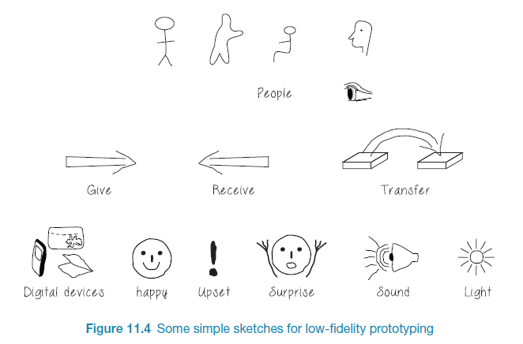
Generate storyboard from scenario
25

Slide 26
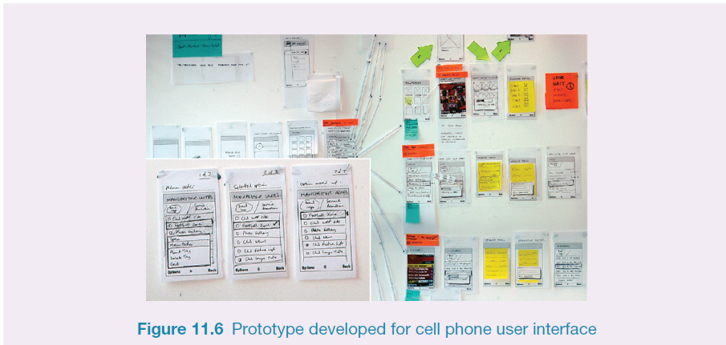
Generate card-based prototype from use case
26

Slide 27
Explore the user’s experience
Use personas, card-based prototypes or stickies to model the user experience
Visual representation called:
design map
customer/user journey map
experience map
Two common representations
wheel
timeline
27

Slide 28
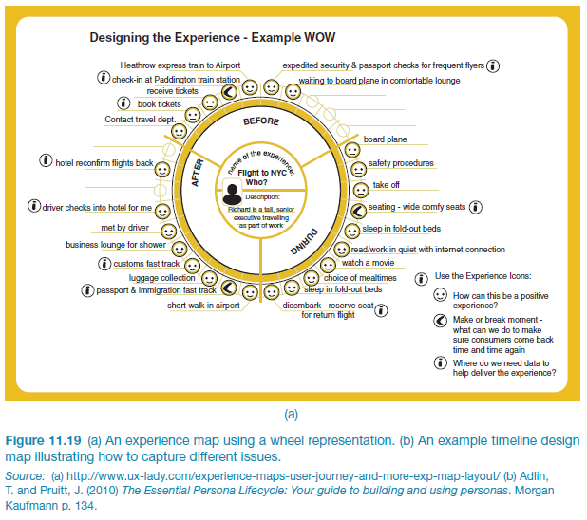
An experience map drawn as a wheel
28

Slide 29
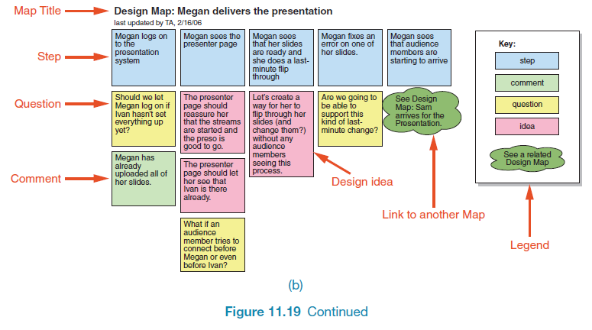
An experience map drawn as a timeline
29

Slide 30
Construction: physical computing
Build and code prototypes using electronics
Toolkits available include
Arduino
LilyPad (for fabrics)
Senseboard
MaKey MaKey
Designed for use by wide range of people
30

Slide 31
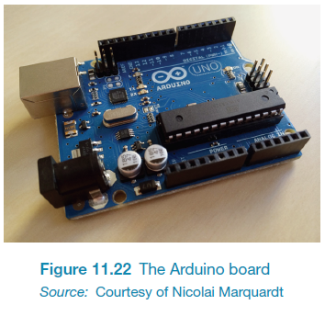
Physical computing kits
31

Slide 32
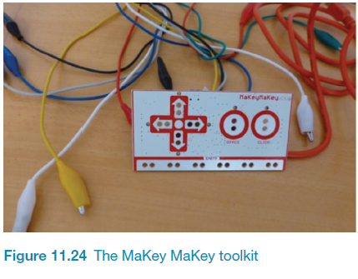
Physical computing kits
32

Slide 33
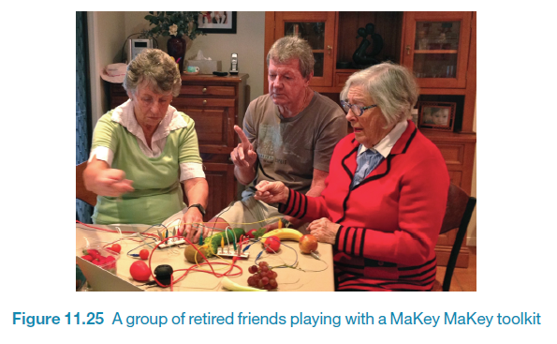
Physical computing kits
33

Slide 34
Construction: SDKs
Software Development Kits
programming tools and components to develop for a specific platform, e.g. iOS
Includes: IDE, documentation, drivers, sample code, application programming interfaces (APIs)
Makes development much easier
Microsoft’s Kinect SDK has been used in research
34

Slide 35
Summary
Different kinds of prototyping are used for different purposes and at different stages
Prototypes answer questions
The final product must be engineered appropriately
Two aspects of design: conceptual and concrete
To generate conceptual design, consider interface metaphors, interaction types and interface types
Storyboards can be generated from scenarios
Card-based prototypes can be generated from use cases
Physical computing kits and SDKs facilitate transition from design to construction

