Slide 1

Chapter 7
GATHERING DATA

Slide 2
Aims
Discuss how to plan and run a successful data gathering program.
Enable you to plan and run an interview.
Enable you to design a simple questionnaire.
Enable you to plan and carry out an observation.

Slide 3
Five key issues
Setting goals
Decide how to analyze data once collected
Identifying participants
Decide who to gather data from
Relationship with participants
Clear and professional
Informed consent when appropriate
Triangulation
Look at data from more than one perspective
Collect more than one type of data, eg qualitative from experiments and qualitative from interviews
Pilot studies
Small trial of main study

Slide 4
Data recording
Notes, audio, video, photographs can be used individually or in combination:
Notes plus photographs
Audio plus photographs
Video
Different challenges and advantages with each combination
4

Slide 5
Interviews
Unstructured - are not directed by a script. Rich but not replicable.
Structured - are tightly scripted, often like a questionnaire. Replicable but may lack richness.
Semi-structured - guided by a script but interesting issues can be explored in more depth. Can provide a good balance between richness and replicability.
Focus groups – a group interview

Slide 6
Interview questions
Two types:
‘closed questions’ have a predetermined answer format, e.g.. ‘yes’ or ‘no’
‘open questions’ do not have a predetermined format
Closed questions are easier to analyze
Avoid:
Long questions
Compound sentences - split them into two
Jargon and language that the interviewee may not understand
Leading questions that make assumptions e.g.. why do you like …?
Unconscious biases e.g.. gender stereotypes

Slide 7
Running the interview
Introduction – introduce yourself, explain the goals of the interview, reassure about the ethical issues, ask to record, present the informed consent form.
Warm-up – make first questions easy and non-threatening.
Main body – present questions in a logical order
A cool-off period – include a few easy questions to defuse tension at the end
Closure – thank interviewee, signal the end, eg. switch recorder off.

Slide 8
Enriching the interview process
Props - devices for prompting interviewee, e.g. use a prototype, scenario

Slide 9
Questionnaires
Questions can be closed or open
Closed questions are easier to analyze, and may be distributed and analyzed by computer
Can be administered to large populations
Disseminated by paper, email and the web
Sampling can be a problem when the size of a population is unknown as is common online evaluation

Slide 10
Questionnaire design
The impact of a question can be influenced by question order.
You may need different versions of the questionnaire for different populations.
Provide clear instructions on how to complete the questionnaire.
Strike a balance between using white space and keeping the questionnaire compact.
Avoid very long questionnaires
Decide on whether phrases will all be positive, all negative or mixed.

Slide 11
Question and response format
‘Yes’ and ‘No’ checkboxes
Checkboxes that offer many options
Rating scales
Likert scales
semantic scales
3, 5, 7 or more points
Open-ended responses
11

Slide 12
Encouraging a good response
Make sure purpose of study is clear
Promise anonymity
Ensure questionnaire is well designed
Offer a short version for those who do not have time to complete a long questionnaire
If mailed, include a stamped addressed envelope
Follow-up with emails, phone calls, letters
Provide an incentive
40% response rate is good, 20% is often acceptable

Slide 13
Advantages of online questionnaires
Relatively easy and quick to distribute
Responses are usually received quickly
No copying and postage costs
Data can be collected in database for analysis
Time required for data analysis is reduced
Errors can be corrected easily
13

Slide 14
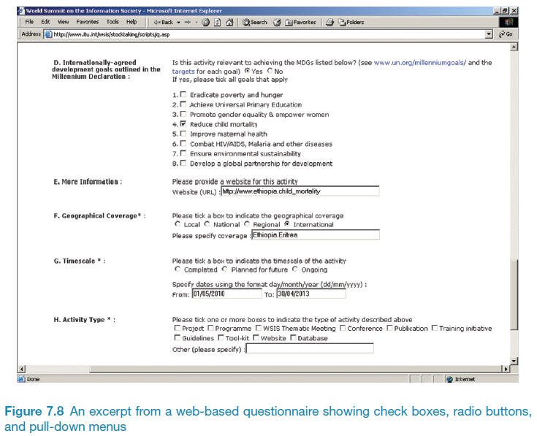
Example of an online questionnaire
14

Slide 15
Problems with online questionnaires
Sampling is problematic if population size is unknown
Preventing individuals from responding more than once can be a problem
Individuals have also been known to change questions in email questionnaires

Slide 16
Observation
Direct observation in the field
Structuring frameworks
Degree of participation (insider or outsider)
Ethnography
Direct observation in controlled environments
Indirect observation: tracking users’ activities
Diaries
Interaction logging
Video and photographs collected remotely by drones or other equipment
16
Notes:
Figure 7.9 Mars Exploration Rover p257
Please add source: Source: Reproduced by permission of NASA Jet Propulsion Laboratory (NASA-JPL).

Slide 17
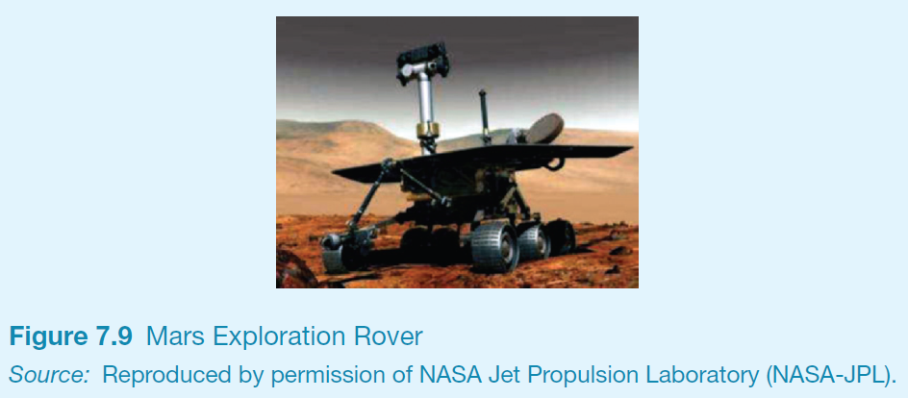
Observation
17

Slide 18
Structuring frameworks to guide observation
Three easy-to-remember parts:
The person: Who?
The place: Where?
The thing: What?
A more detailed framework (Robson, 2014):
Space: What is the physical space like and how is it laid out?
Actors: What are the names and relevant details of the people involved?
Activities: What are the actors doing and why?
Objects: What physical objects are present, such as furniture
Acts: What are specifi c individual actions?
Events: Is what you observe part of a special event?
Time: What is the sequence of events?
Goals: What are the actors trying to accomplish?
Feelings: What is the mood of the group and of individuals?

Slide 19
Planning and conducting observation in the field
Decide on how involved you will be: passive observer to active participant
How to gain acceptance
How to handle sensitive topics, eg. culture, private spaces, etc.
How to collect the data:
What data to collect
What equipment to use
When to stop observing

Slide 20
Ethnography (1)
Ethnography is a philosophy with a set of techniques that include participant observation and interviews
Debate about differences between participant observation and ethnography
Ethnographers immerse themselves in the culture that they study
A researcher’s degree of participation can vary along a scale from ‘outside’ to ‘inside’
Analyzing video and data logs can be time-consuming
Collections of comments, incidents, and artifacts are made

Slide 21
Ethnography (2)
Co-operation of people being observed is required
Informants are useful
Data analysis is continuous
Interpretivist technique
Questions get refined as understanding grows
Reports usually contain examples
21

Slide 22
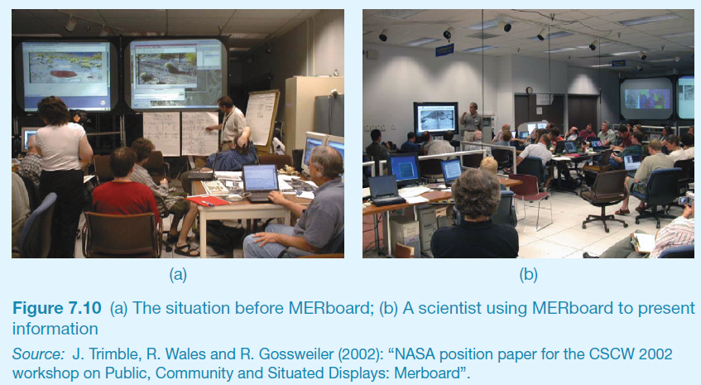
Ethnography (2)
22

Slide 23
Online Ethnography
Virtual, Online, Netnography
Online and offline activity
Interaction online differs from face-to-face
Virtual worlds have a persistence that physical worlds do not have
Ethical considerations and presentation of results are different
23

Slide 24
Observations and materials that might be collected (Crabtree, 2007)
Activity or job descriptions.
Rules and procedures that govern particular activities.
Descriptions of activities observed.
Recordings of the talk taking place between parties.
Informal interviews with participants explaining the detail of observed activities.
Diagrams of the physical layout, including the position of artifacts.
Other information collected when observing activities:
Photographs of artifacts (documents, diagrams, forms, computers, etc.)
Videos of artifacts.
Descriptions of artifacts.
Workflow diagrams showing the sequential order of tasks.
Process maps showing connections between activities.
24

Slide 25
Observation in a controlled environment
Direct observation
Think aloud techniques
Indirect observation – tracking users’ activities
Diaries
Interaction logs
Web analytics
Video, audio, photos, notes are used to capture data in both types of observations
25

Slide 26
Web analytics
A system of tools and techniques for optimizing web usage by:
Measuring,
Collecting,
Analyzing, and
Reporting web data
Typically focus on the number of web visitors and page views.
26

Slide 27
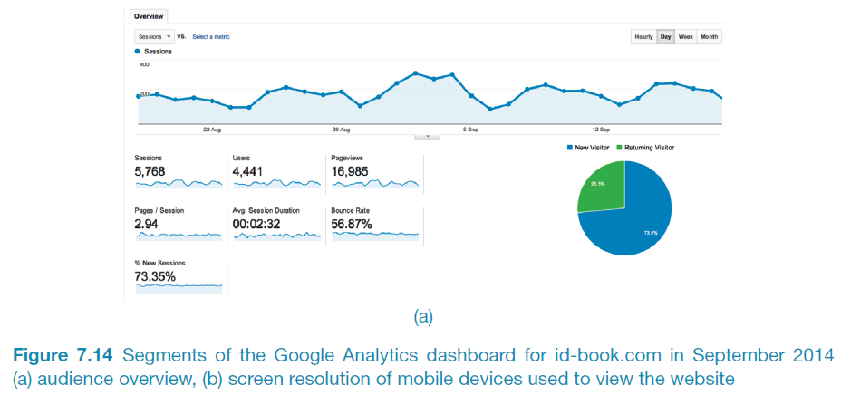
A section of Google analytics dashboard for id-book.com
27

Slide 28
Choosing and combining techniques
Depends on the:
Focus of the study
Participants involved
Nature of the technique(s)
Resources available
Time available
28

Slide 29
Summary
Data gathering sessions should have clear goals.
An informed consent may be needed.
Five key issues of data gathering are: goals, choosing participants, triangulation, participant relationship, pilot.
Data may be recorded using handwritten notes, audio or video recording, a camera, or any combination of these.
Interviews may be structured, semi-structured or unstructured
Focus groups are group interviews
Questionnaires may be on paper, online or telephone
Observation may be direct or indirect, in the field or in controlled settings.
Techniques can be combined depending on the study focus, participants, nature of technique, available resources and time.
29

