Slide 1

Chapter 10
ESTABLISHING REQUIREMENTS

Slide 2
Overview
The importance of requirements
Different types of requirements
Data gathering for requirements
Data analysis and presentation
Task description: Scenarios Use Cases Essential use cases
Task analysis: HTA

Slide 3
What, how and why?
What needs to be achieved?
Understand as much as possible about users, task, context
Produce a stable set of requirements
How can this be done?
Data gathering activities
Data analysis activities
Expression as ‘requirements’
All of this is iterative

Slide 4
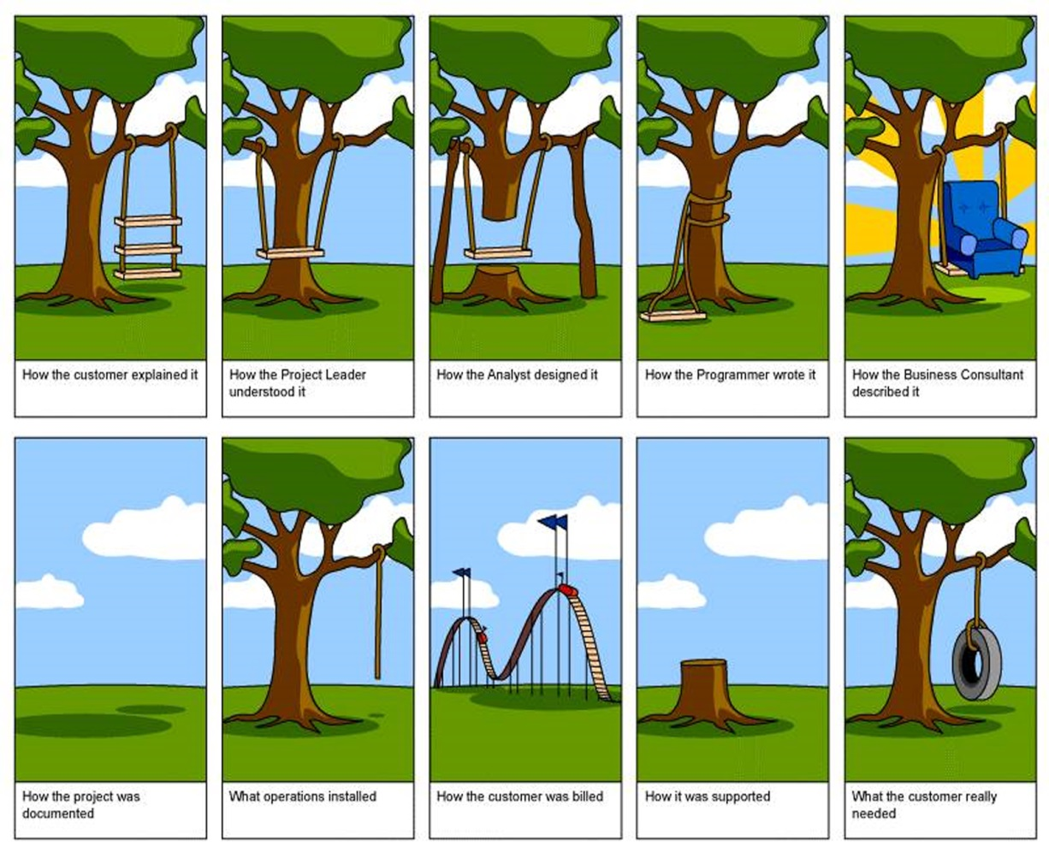
What, how and why?
Why bother?
Requirements definition is the stage where failure occurs most commonly
Getting requirements right is crucial
4

Slide 5
Establishing requirements
What do users want? What do users ‘need’?
Requirements need clarification, refinement, completion, re-scoping
Input: Requirements document (maybe)
Output: stable requirements
Why ‘establish’?
Requirements arise from understanding users’ needs
Requirements can be justified & related to data

Slide 6
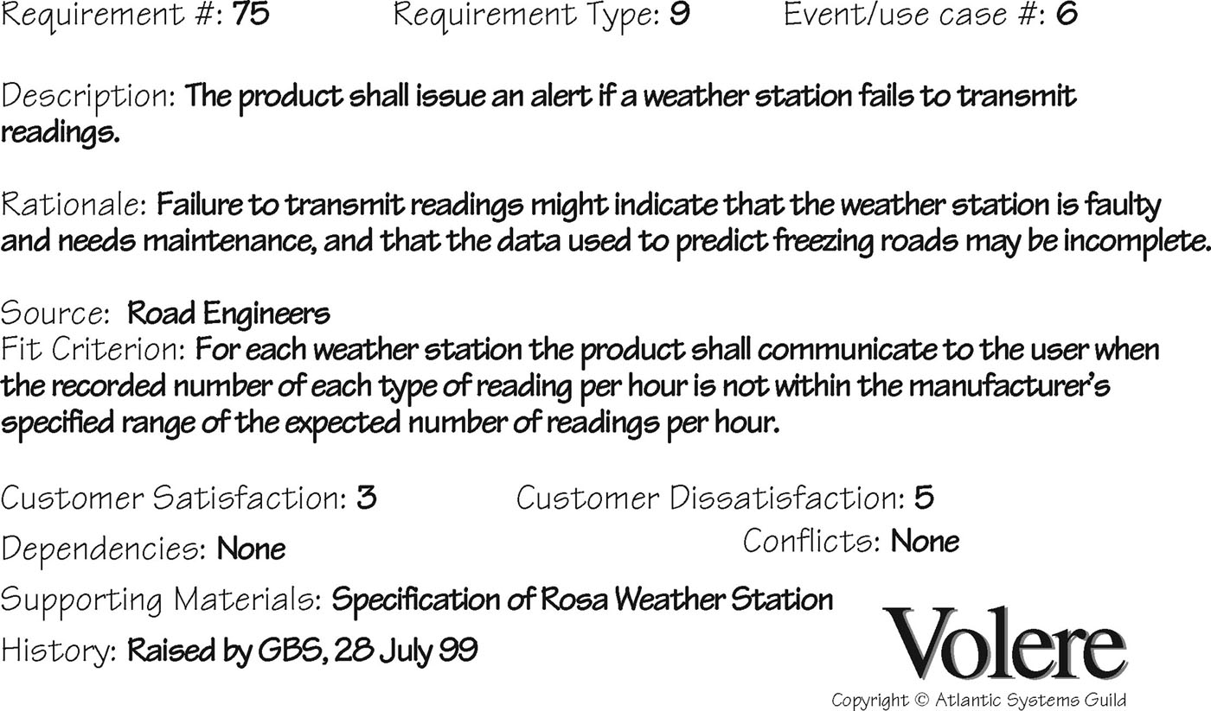
Volere shell

Slide 7
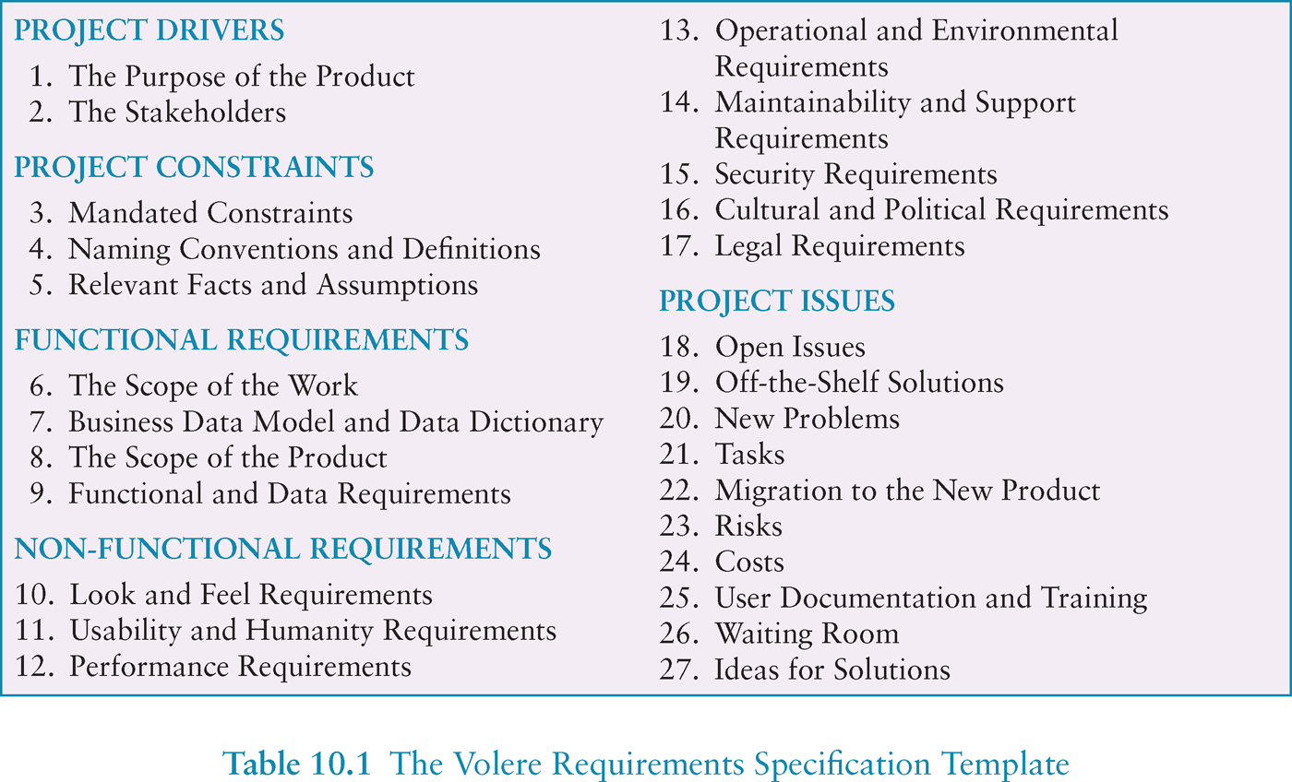
Volere requirements template

Slide 8
Different kinds of requirements
Functional:
What the system should do
(Non-functional: security, response time...)
Data:
What kinds of data need to be stored?
How will they be stored (e.g. database)?

Slide 9
Different kinds of requirements
Environment or context of use:
physical: dusty? noisy? vibration? light? heat? humidity? …. (e.g. ATM)
social: sharing of files, of displays, in paper, across great distances, synchronous, privacy for clients
organisational: hierarchy, IT department’s attitude and remit, user support, communications structure and infrastructure, availability of training

Slide 10
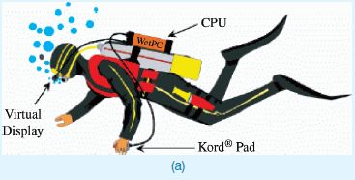
Underwater computing

Slide 11
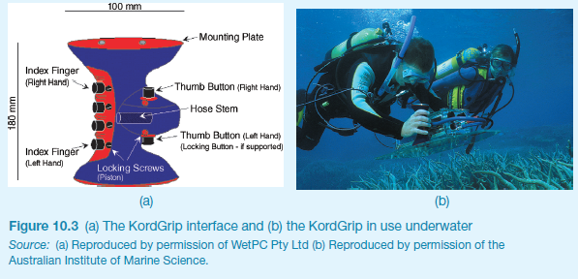
Underwater computing

Slide 12
Different kinds of requirements
Users: Who are they?
Characteristics: nationality, educational background, attitude to computers
System use: novice, expert, casual, frequent
Novice: prompted, constrained, clear
Expert: flexibility, access/power
Frequent: short cuts
Casual/infrequent: clear menu paths

Slide 13


What are the users’ capabilities?
Humans vary in many dimensions:
size of hands may affect the size and positioning of input buttons
motor abilities may affect the suitability of certain input and output devices
height if designing a physical kiosk
strength - a child’s toy requires little strength to operate, but greater strength to change batteries
disabilities (e.g. sight, hearing, dexterity)

Slide 14
Personas
Capture a set of user characteristics (user profile)
Not real people, but synthesised from real users
Should not be idealised
Bring them to life with a name, characteristics, goals, personal background
Develop a small set of personas with one primary

Slide 15
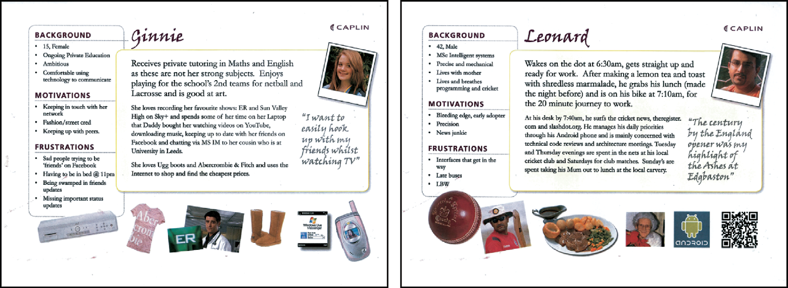
Example Persona

Slide 16
Data gathering for requirements
Interviews:
Props, e.g. sample scenarios of use, prototypes, can be used in interviews
Good for exploring issues
Development team members can connect with stakeholders
Focus groups:
Group interviews
Good at gaining a consensus view and/or highlighting areas of conflict
But can be dominated by individuals

Slide 17
Data gathering for requirements
Questionnaires:
Often used in conjunction with other techniques
Can give quantitative or qualitative data
Good for answering specific questions from a large, dispersed group of people
Researching similar products:
Good for prompting requirements

Slide 18
Data gathering for requirements
Direct observation:
Gain insights into stakeholders’ tasks
Good for understanding the nature and context of the tasks
But, it requires time and commitment from a member of the design team, and it can result in a huge amount of data
Indirect observation:
Not often used in requirements activity
Good for logging current tasks

Slide 19
Data gathering for requirements
Studying documentation:
Procedures and rules are often written down in manuals
Good source of data about the steps involved in an activity, and any regulations governing a task
Not to be used in isolation
Good for understanding legislation, and getting background information
No stakeholder time, which is a limiting factor on the other techniques

Slide 20
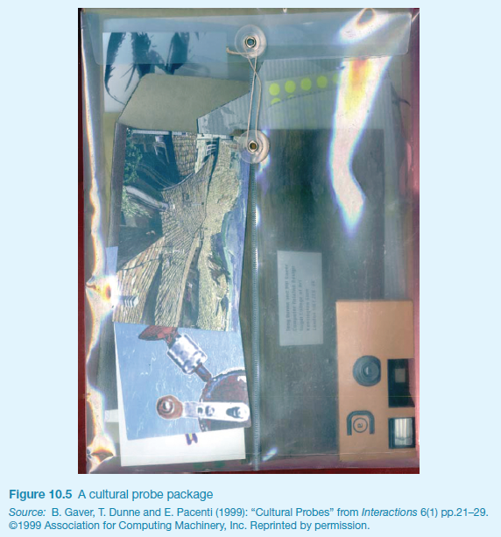
Some examples
Cultural probes

Slide 21
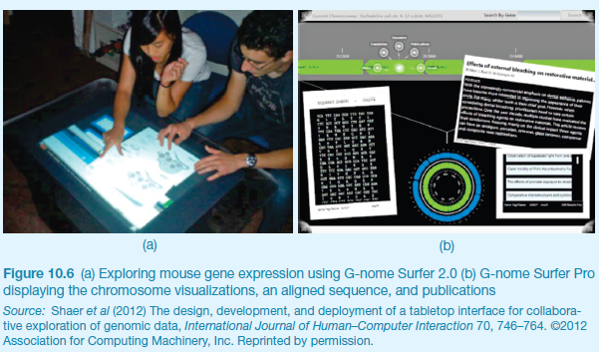
Some examples
Ethnographic study, interviews, usability tests, and user participation

Slide 22
Contextual Inquiry
An approach to ethnographic study where user is expert, designer is apprentice
A form of interview, but
at users’ workplace (workstation)
2 to 3 hours long
Four main principles:
Context: see workplace & what happens
Partnership: user and developer collaborate
Interpretation: observations interpreted by user and developer together
Focus: project focus to understand what to look for

Slide 23
Considerations for data gathering (1)
Identifying and involving stakeholders: users, managers, developers, customer reps?, union reps?, shareholders?
Involving stakeholders: workshops, interviews, workplace studies, co-opt stakeholders onto the development team
‘Real’ users, not managers
Political problems within the organisation
Dominance of certain stakeholders
Economic and business environment changes
Balancing functional and usability demands

Slide 24
Considerations for data gathering (2)
Requirements management: version control, ownership
Communication between parties:
within development team
with customer/user
between users… different parts of an organisation use different terminology
Domain knowledge distributed and implicit:
difficult to dig up and understand
knowledge articulation: how do you walk?
Availability of key people

Slide 25
Data gathering guidelines
Focus on identifying the stakeholders’ needs
Involve all the stakeholder groups
Involve more than one representative from each stakeholder group
Use a combination of data gathering techniques
Support the process with props such as prototypes and task descriptions

Slide 26
Data interpretation and analysis
Start soon after data gathering session
Initial interpretation before deeper analysis
Different approaches emphasize different elements e.g. class diagrams for object-oriented systems, entity-relationship diagrams for data intensive systems

Slide 27
Task descriptions
Scenarios
an informal narrative story, simple, ‘natural’, personal, not generalisable
Use cases
assume interaction with a system
assume detailed understanding of the interaction
Essential use cases
abstract away from the details
does not have the same assumptions as use cases

Slide 28
Scenario for travel organizer
“The Thomson family enjoy outdoor activities and want to try their hand at sailing this year. There are four family members: Sky (10 years old), Eamonn (15 years old), Claire (35), and Will (40). One evening after dinner they decide to start exploring the possibilities. They all gather around the travel organizer and enter their initial set of requirements – a sailing trip for four novices in the Mediterranean. The console is designed so that all members of the family can interact easily and comfortably with it. The system’s initial suggestion is a flotilla, where several crews (with various levels of experience) sail together on separate boats. Sky and Eamonn aren’t very happy at the idea of going on vacation with a group of other people, even though the Thomsons would have their own boat. The travel organizer shows them descriptions of flotillas from other children their ages and they are all very positive, so eventually, everyone agrees to explore flotilla opportunities. Will confirms this recommendation and asks for detailed options. As it’s getting late, he asks for the details to be saved so everyone can consider them tomorrow. The travel organizer emails them a summary of the different options available.”

Slide 29
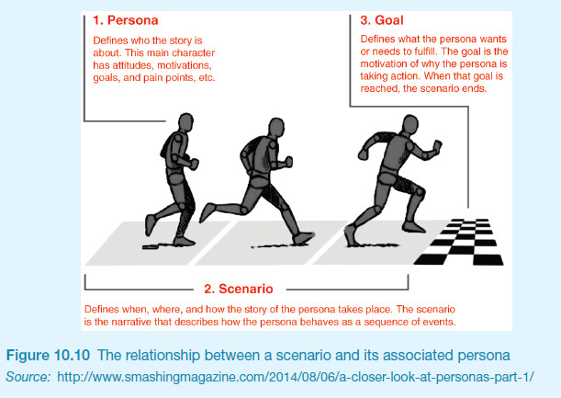
Scenarios and Personas

Slide 30
Use case for travel organizer
1. The system displays options for investigating visa and vaccination requirements.
2. The user chooses the option to find out about visa requirements.
3. The system prompts user for the name of the destination country.
4. The user enters the country’s name.
5. The system checks that the country is valid.
6. The system prompts the user for her nationality.
7. The user enters her nationality.
8. The system checks the visa requirements of the entered country for a passport holder of her nationality.
9. The system displays the visa requirements.
10. The system displays the option to print out the visa requirements.
11. The user chooses to print the requirements.

Slide 31
Alternative courses for travel organizer
Some alternative courses:
6. If the country name is invalid:
6.1 The system displays an error message.
6.2 The system returns to step 3.
8. If the nationality is invalid:
8.1 The system displays an error message.
8.2 The system returns to step 6.
9. If no information about visa requirements is found:
9.1 The system displays a suitable message.
9.2 The system returns to step 1.

Slide 32
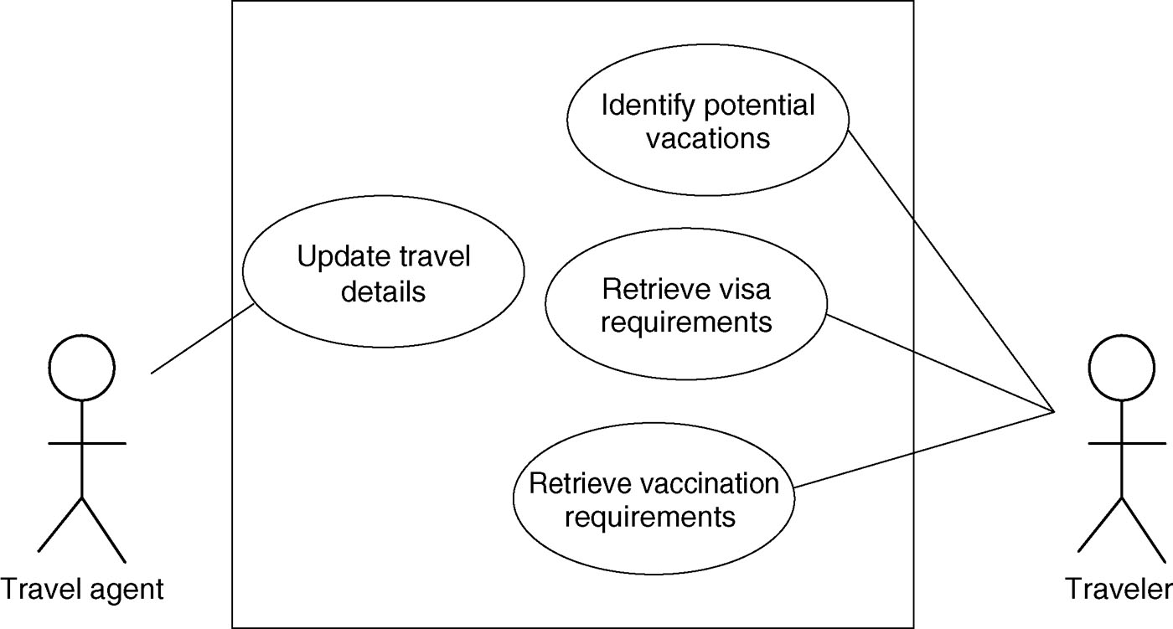
Example use case diagram for travel organizer

Slide 33
Example essential use case for travel organizer
retrieve Visa
USER INTENTION SYSTEM RESPONSIBILITY
find visa requirements request destination and nationality supply required information obtain appropriate visa info obtain copy of visa info offer info in different formats choose suitable format provide info in chosen format

Slide 34
Task analysis
Task descriptions are often used to envision new systems or devices
Task analysis is used mainly to investigate an existing situation
It is important not to focus on superficial activities
What are people trying to achieve?
Why are they trying to achieve it?
How are they going about it?
Many techniques, the most popular is Hierarchical Task Analysis (HTA)

Slide 35
Hierarchical Task Analysis
Involves breaking a task down into subtasks, then sub-sub-tasks and so on. These are grouped as plans which specify how the tasks might be performed in practice
HTA focuses on physical and observable actions, and includes looking at actions not related to software or an interaction device
Start with a user goal which is examined and the main tasks for achieving it are identified
Tasks are sub-divided into sub-tasks

Slide 36
Example Hierarchical Task Analysis
0. In order to buy a DVD
1. locate DVD
2. add DVD to shopping basket
3. enter payment details
4. complete address
5. confirm order
plan 0: If regular user do 1-2-5. If new user do 1-2-3-4-5.

Slide 37
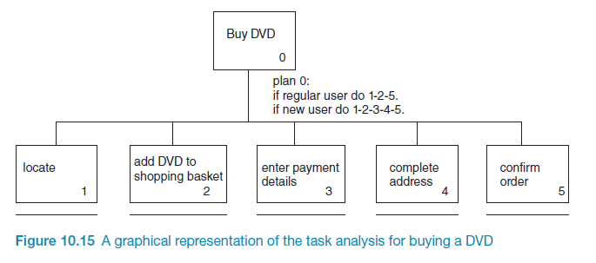
Example Hierarchical Task Analysis (graphical)

Slide 38
Summary
Getting requirements right is crucial
There are different kinds of requirement, each is significant for interaction design
The most commonly-used techniques for data gathering are: questionnaires, interviews, focus groups, direct observation, studying documentation and researching similar products
Scenarios, use cases and essential use cases can be used to articulate existing and envisioned work practices.
Task analysis techniques such as HTA help to investigate existing systems and practices

