Slide 1
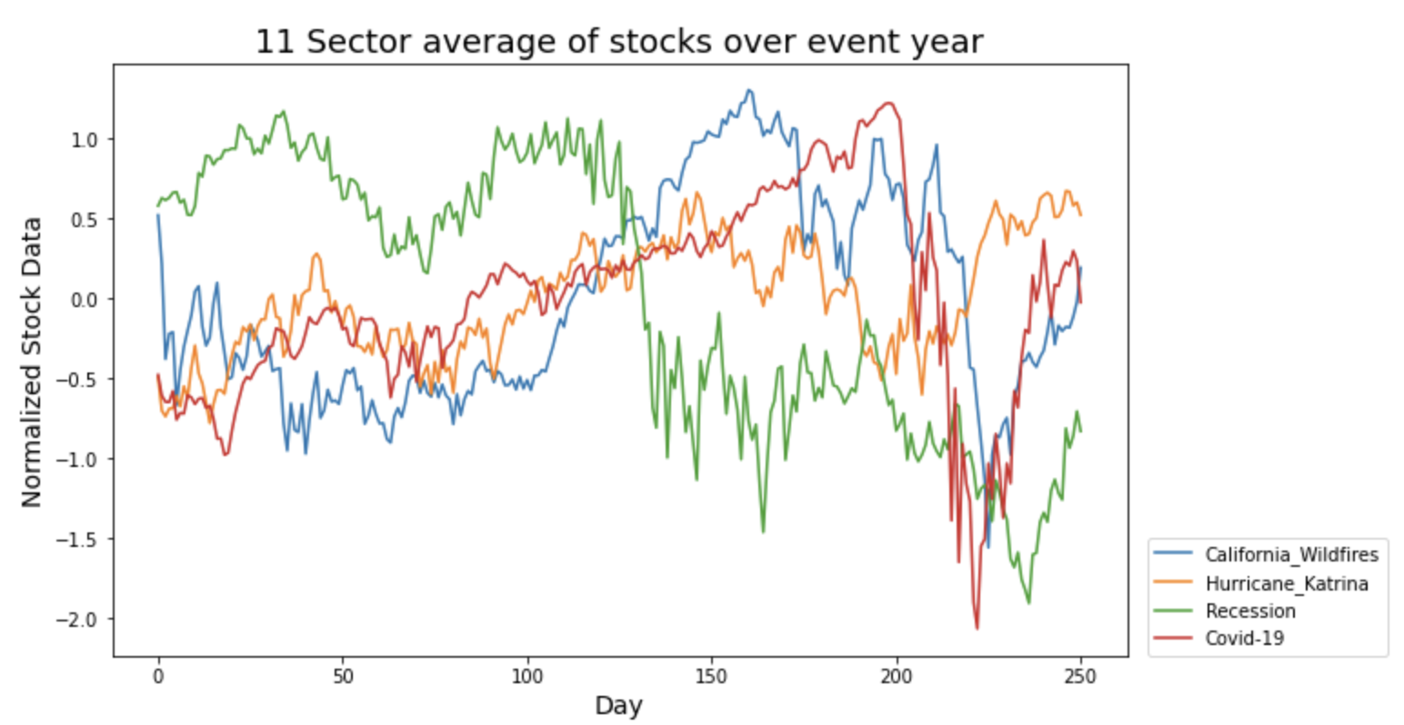
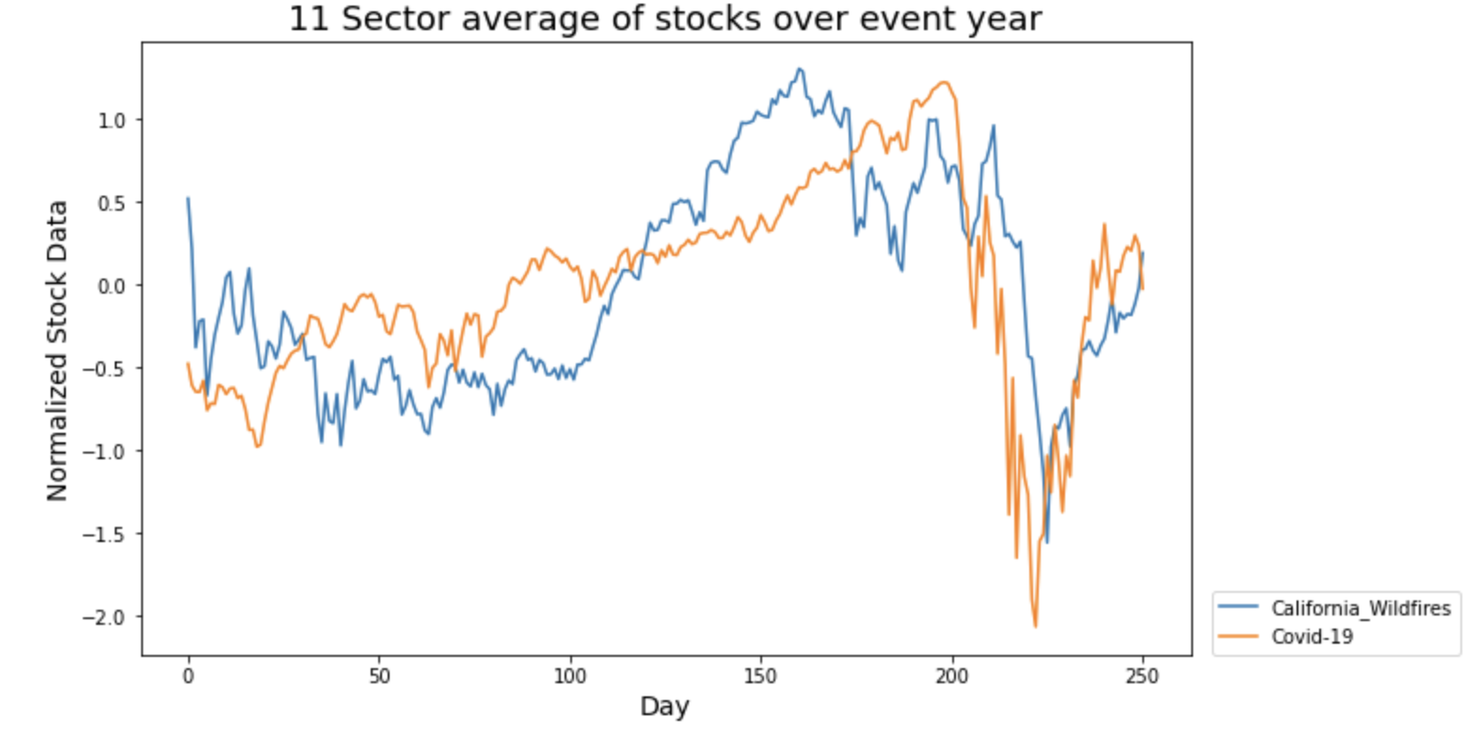
Modeling stock market economy before, during and after Covid-19
Main Question
Can we model and forecast the current economy with historical recession and natural disaster data?
Main Obstacle
Data Collection and Data Wrangling
Most interesting result to date…
How closely the California wildfire stock data correlates (r=0.661) to the Covid-19 stock data, but it is not during the time period of the wildfire season.
See graphs below

