Slide 1


HOME CREDIT SCORECARD
MODEL
Virtual Internship Program Rakamin Academy
By : Dhika Haryuna Aziiz

Slide 2
Table of contents
01
02
Problem
Research
Data
Pre-Procesing
03
04
Data Visualization and Business Insight
Machine Learning Implementation
05
Business Recommendation

Slide 3
Data Pre-Procesing
application_train.csv
Analysis for feature selection with correlation and data visualization
Clean up, transformation, sclaing, encoding, imputing nulls,
KNN, Random Forest, Logistic Reggresion, LGBMclassifier, Summarize resulst
application_test.csv
Predict with KNN, Random Forest, Logistic Reggresion, LGBMclassifier.
Result

Slide 4
Problem
research
How well the borrower has performed in repayment on previous loans
Which occupancy group has no problem in repayment
The company's loss if it mistakenly determines potential borrowers who are difficult to pay

Slide 5
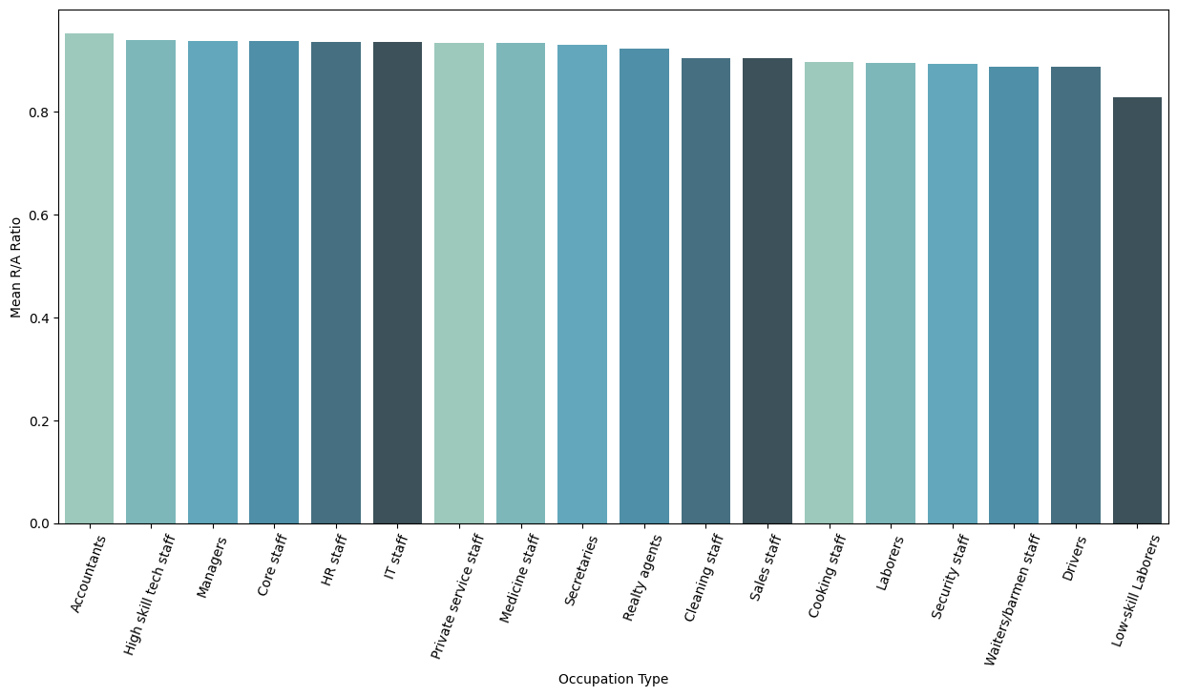
Data Visualization and Business Insight
We can see that lending money to accountants is the most secure with an R/A ratio of 0.9516 and lending money to low-skilled employees is the least secure with an R/A ratio of 0.8284 based on the ratio of repayments to applicants in each job class.

Slide 6
Machine Learning Implementation
Supervised machine learning techniques such as KNN, Random Forests, Logistic Regression, LightGBM, and MLPClassifier are used to identify candidates who won't have payment issues. The result of combining all of these techniques is user ids that are secure in payment with a target symbol of 0, and user concepts that will experience issues with payment with a target symbol of 1.
KNN |  |  |  | Random Forest
Accuracy | Recall | Precision | ROC AUC | Accuracy | Recall | Precision | ROC AUC
0.8364 | 0.9886 | 0.7581 | 0.9423 | 0.8931 | 0.9157 | 0.8764 | 0.9604
MPL
Accuracy | Recall | Precision | ROC AUC
0.7028 | 0.7368 | 0.6904 | 0.7727
Logistic Regression |  |  |  | LightGBM
Accuracy | Recall | Precision | ROC AUC | Accuracy | Recall | Precision | ROC AUC
0.6728 | 0.6685 | 0.6749 | 0.7348 | 0.7067 | 0.7099 | 0.706 | 0.7821

Slide 7
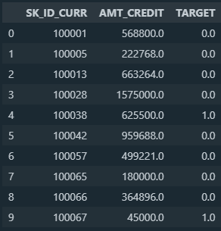
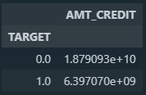
The following is the outcome of the machine learning, with TARGET having a value of 0 for a candidate who is projected to have no problems with payment and a value of 1 for a candidate who is predicted to have troubles with payment.

Slide 8
Business Recommendation
Accountants, highly skilled tech personnel, and managers are occupation categories without remuneration issues.
By accounting for applicants who are predicted to have difficulty in payment with a total of 14050 and are predicted to have difficulty in payment with a total loan credit amount of 6,397,070,000, the company's loss if it incorrectly determines prospective borrowers who are difficult to pay is calculated through the use of machine learning.
The home credit company can reduce the loss of 6,397,070,000 caused by lending to borrowers who are at danger of default by using machine learning to establish a score.

Slide 9
You can see the entire
project documentation here!
https://github.com/dhikaha/HOME-CREDIT-SCORECARD-MODEL.git

Slide 10
Thank you

