Slide 1
Numpy Arrays
Module 02
Data Science Developer

Slide 2

Using Numpy

Slide 3
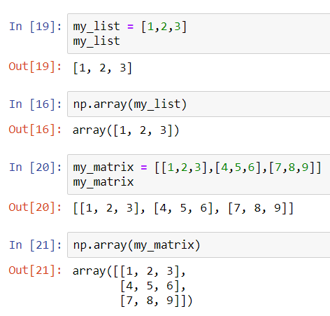
Creating Numpy Arrays From a Python List

Slide 4
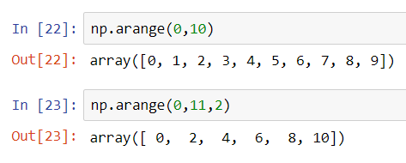
Built-in Methods arange

Slide 5
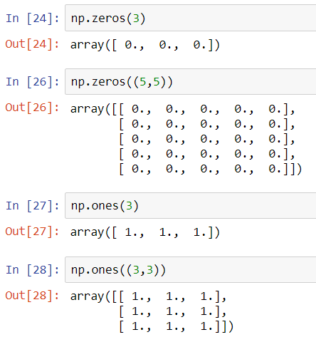
Built-in Methods zeros and ones

Slide 6
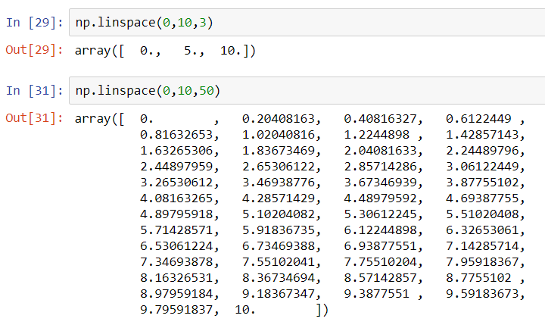
Built-in Methods linspace

Slide 7
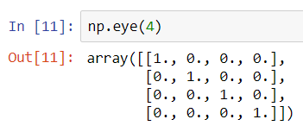
Built-in Methods eye

Slide 8
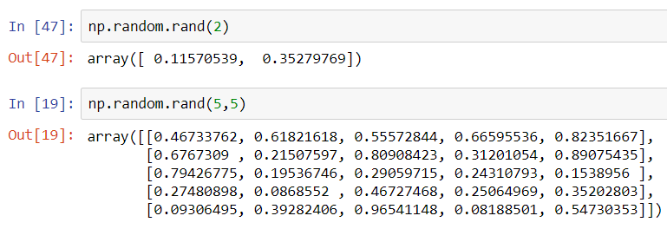
Built-in Methods random.rand

Slide 9
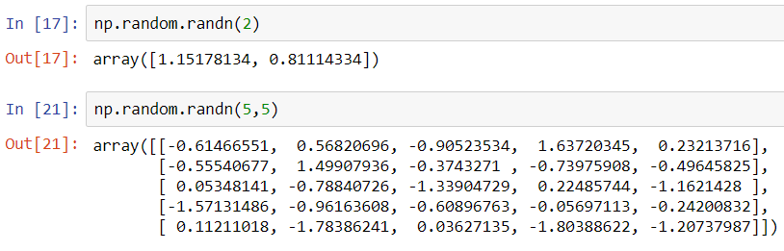
Built-in Methods random.randn

Slide 10
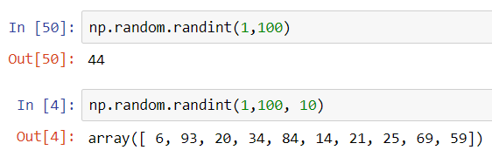
Built-in Methods random.randint

Slide 11
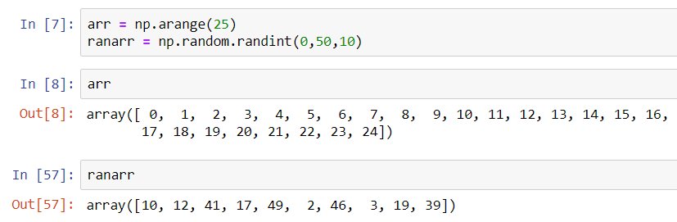
Array Attributes and Methods

Slide 12
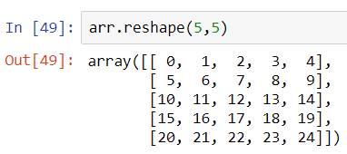
Array Attributes and Methods reshape

Slide 13
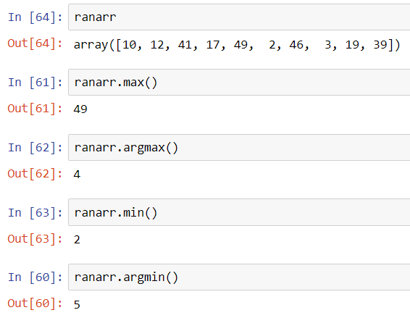
Array Attributes and Methods max, min, argmax, argmin

Slide 14
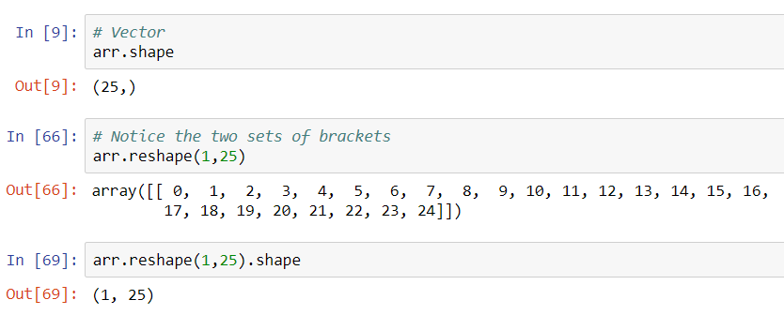
Array Attributes and Methods shape

Slide 15
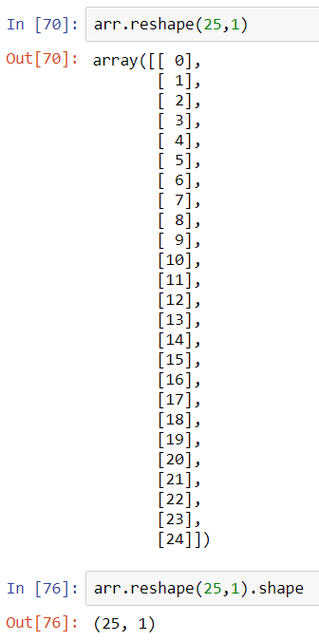
Array Attributes and Methods shape

Slide 16
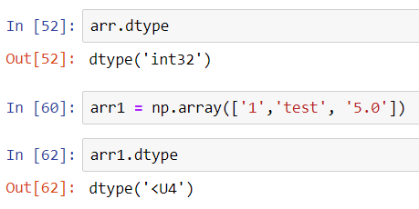
Array Attributes and Methods dtype

