Slide 1
Series
Module 02
Data Science Developer

Slide 2
Definition
A Series is very similar to a NumPy array (in fact it is built on top of the NumPy array object).
What differentiates the NumPy array from a Series, is that a Series can have axis labels, meaning it can be indexed by a label, instead of just a number location.
It also doesn't need to hold numeric data, it can hold any arbitrary Python Object.

Slide 3

Using Numpy and Pandas

Slide 4
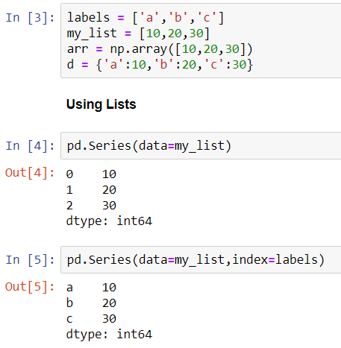
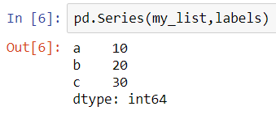
Creating a Series From a Python List

Slide 5
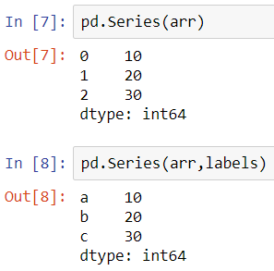
Creating a Series From a Numpy Array

Slide 6
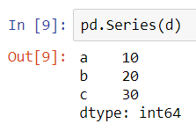
Creating a Series From a Dictionary

Slide 7
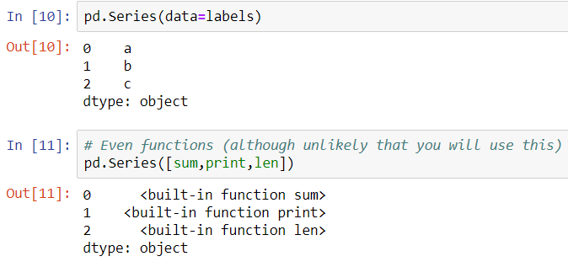
Data in a Series
A pandas Series can hold a variety of object types:

Slide 8
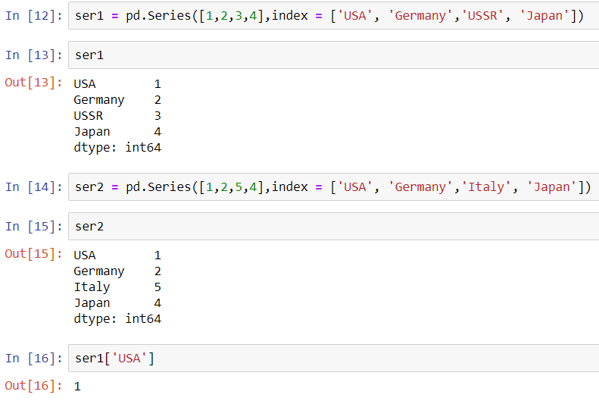
Using an Index

Slide 9
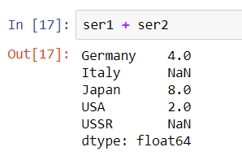
Using an Index
Operations are then also done based off of index:

