Slide 1
Numpy Indexing and Selection
Module 02
Data Science Developer

Slide 2
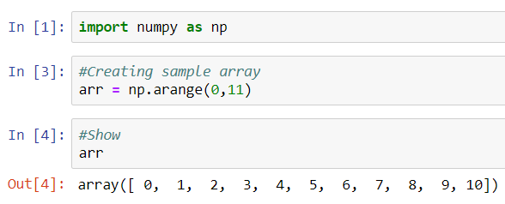
Using Numpy

Slide 3
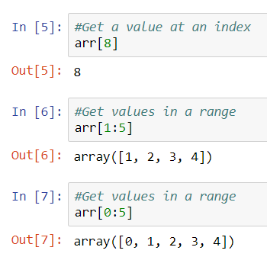
Bracket Indexing and Selection

Slide 4
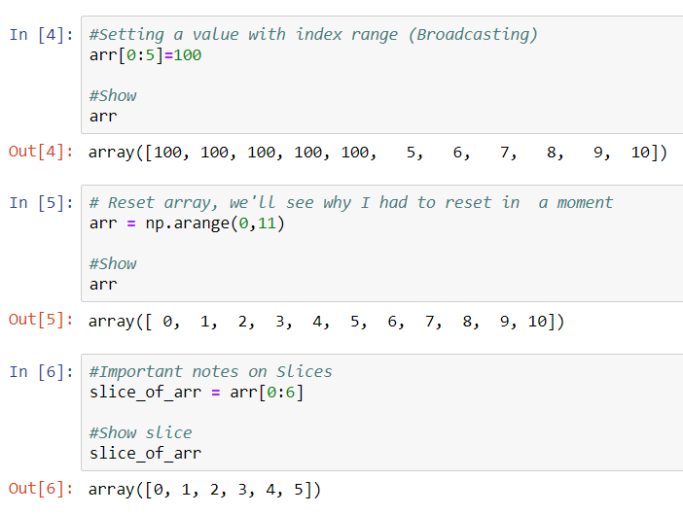
Broadcasting

Slide 5
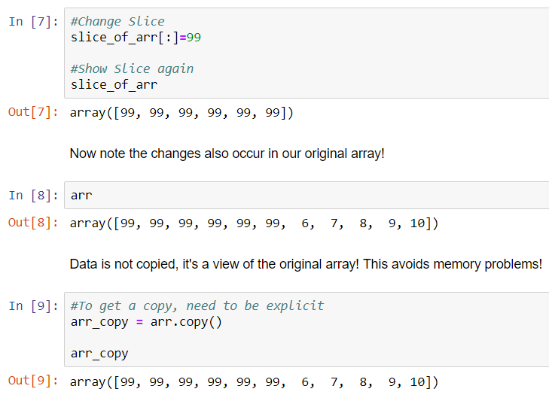
Broadcasting

Slide 6
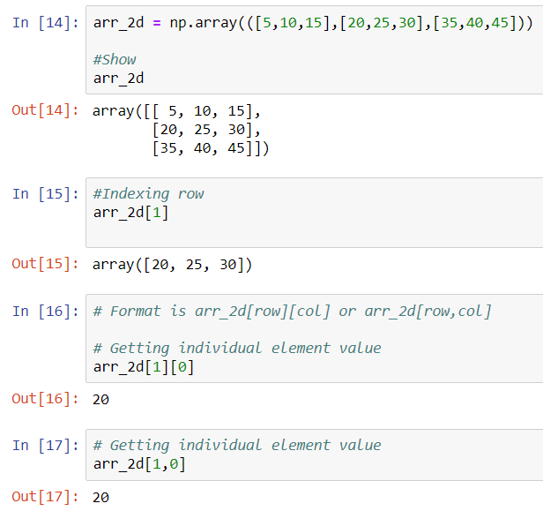
Indexing a 2D array

Slide 7
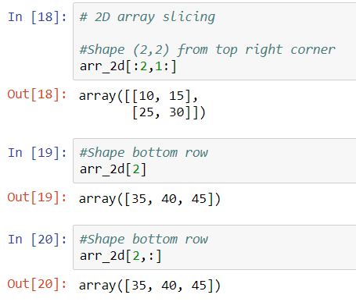
Indexing a 2D array

Slide 8
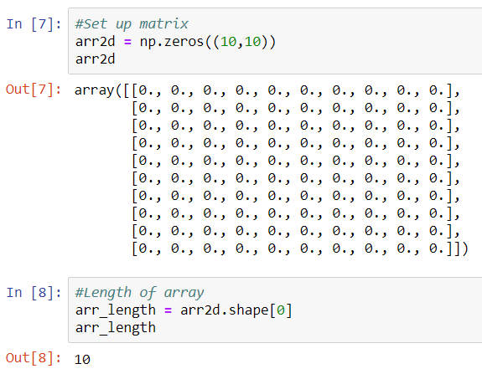
Fancy Indexing

Slide 9
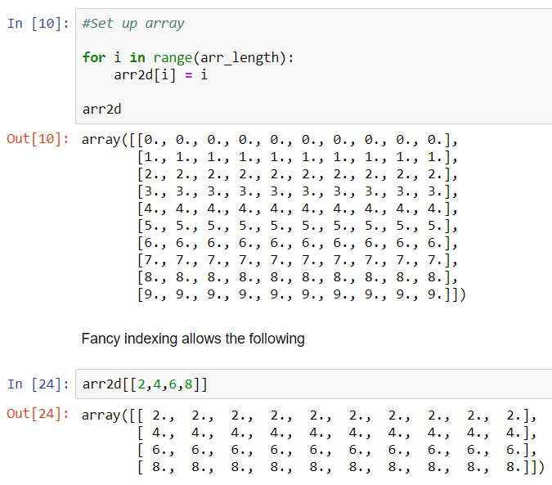
Fancy Indexing

Slide 10
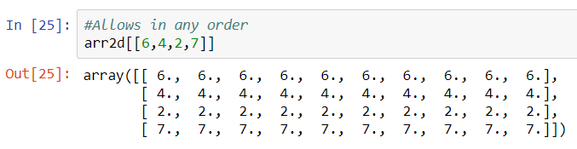
Fancy Indexing

Slide 11
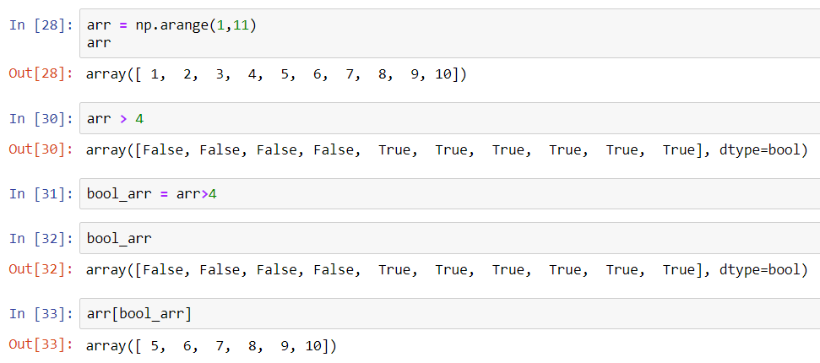
Selection

Slide 12
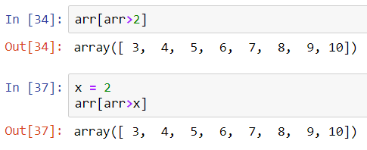
Selection

