Slide 1
DataFrames
Module 02
Data Science Developer

Slide 2
Definition
DataFrames are the workhorse of pandas and are directly inspired by the R programming language.
We can think of a DataFrame as a bunch of Series objects put together to share the same index.
Let's use pandas to explore this topic!

Slide 3

Using Numpy and Pandas

Slide 4
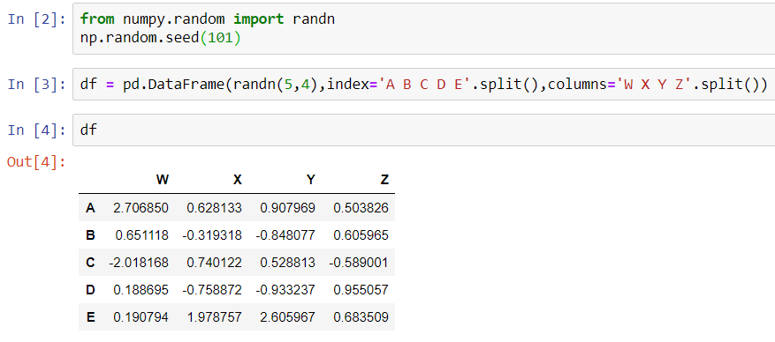
Creating a DataFrame

Slide 5
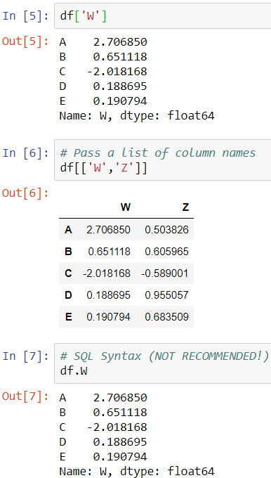
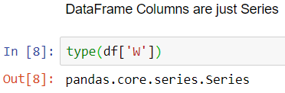
Selection and Indexing

Slide 6
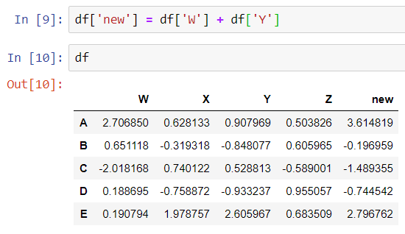
Creating a New Column

Slide 7
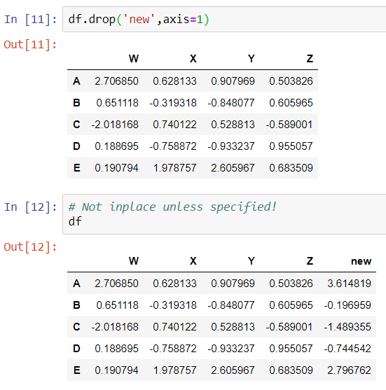
Removing Columns without inplace

Slide 8
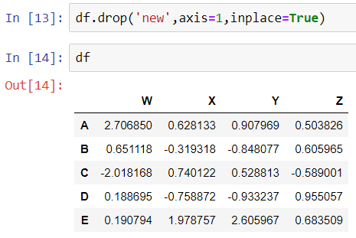
Removing Columns with inplace

Slide 9
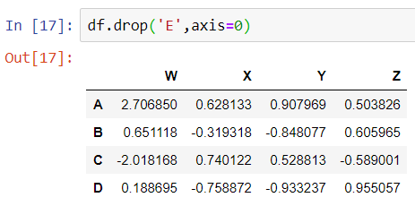
Removing Rows
Same with drop columns, the difference is the axis:

Slide 10
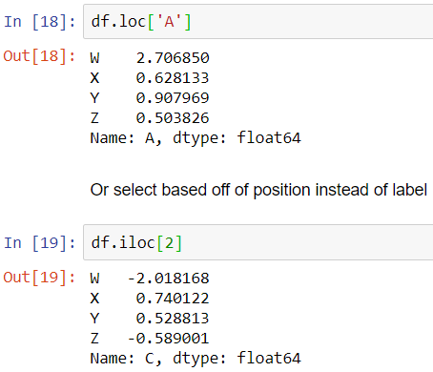
Selecting Rows

Slide 11
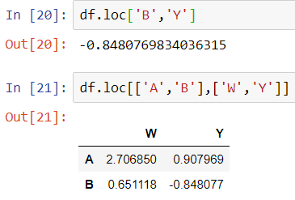
Selecting Subset of Rows and Columns

Slide 12
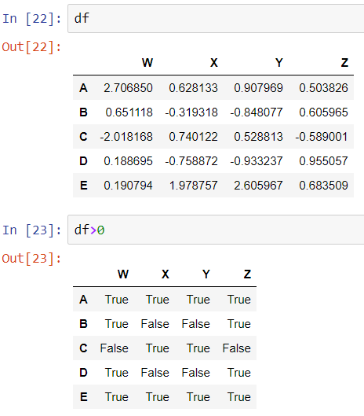
Conditional Selection

Slide 13
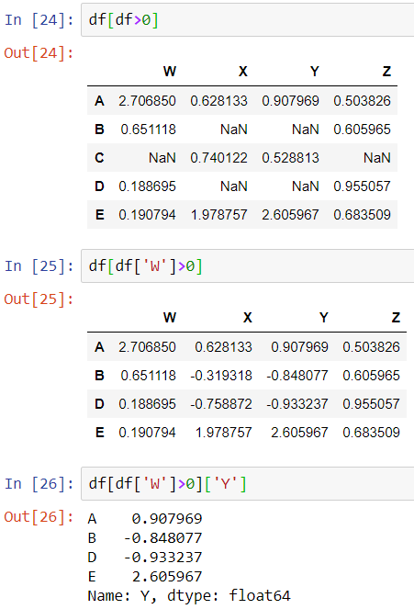
Conditional Selection

Slide 14
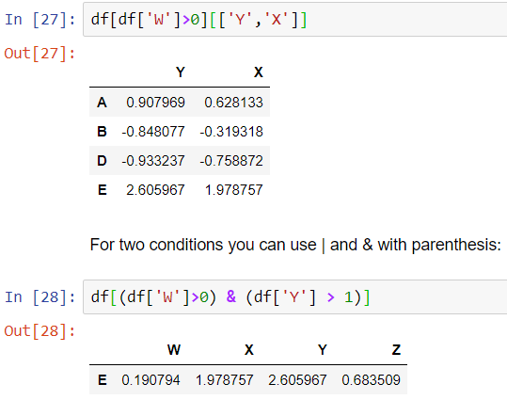
Conditional Selection

Slide 15
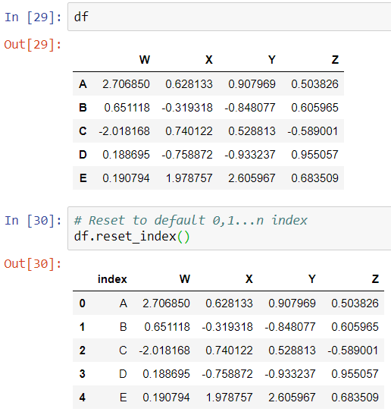
More Index Details

Slide 16
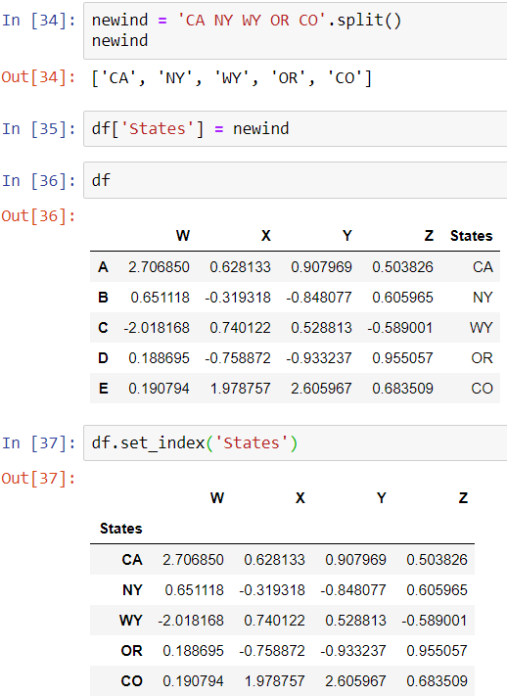
More Index Details

Slide 17
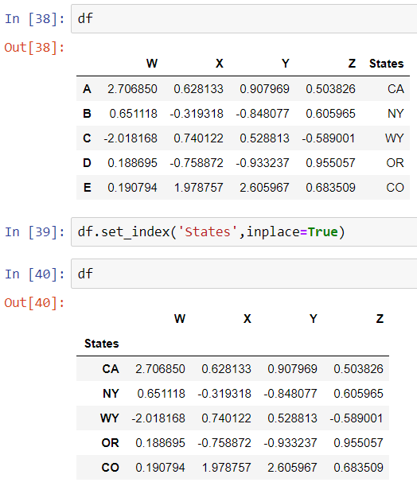
More Index Details

Slide 18
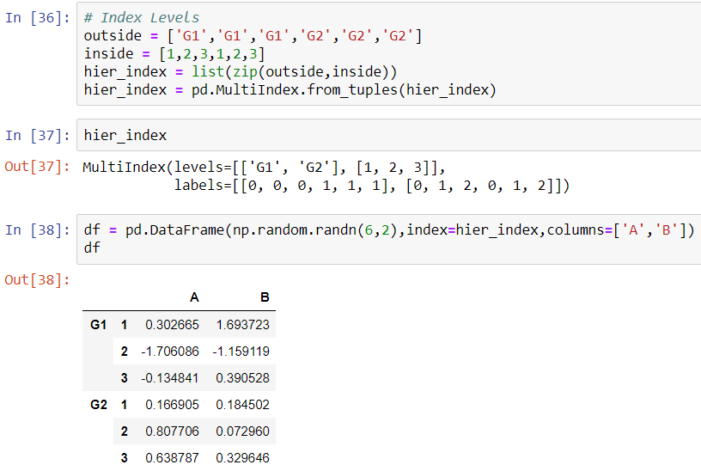
Multi-Index and Index Hierarchy

Slide 19
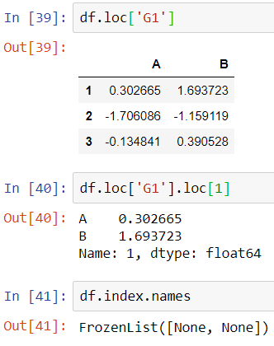
Multi-Index and Index Hierarchy
Now let's show how to index this! For index hierarchy we use df.loc[], if this was on the columns axis, you would just use normal bracket notation df[]. Calling one level of the index returns the sub-dataframe:

Slide 20
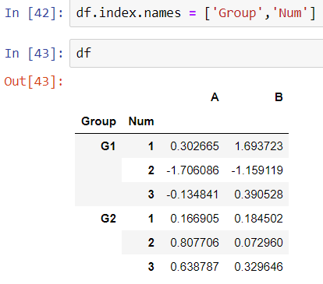
Multi-Index and Index Hierarchy

Slide 21
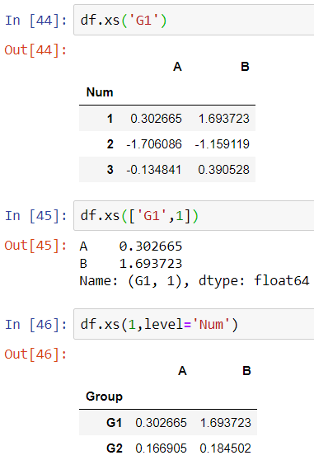
Multi-Index and Index Hierarchy

