Slide 1
Numpy Operations
Module 02
Data Science Developer

Slide 2
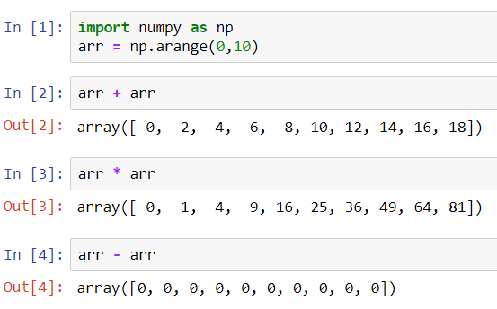
Arithmetic

Slide 3
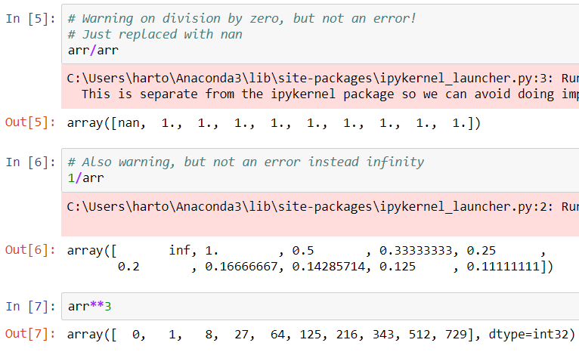
Arithmetic

Slide 4
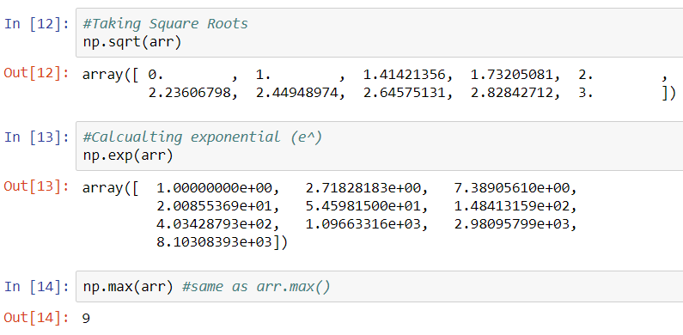
Universal Array Functions

Slide 5
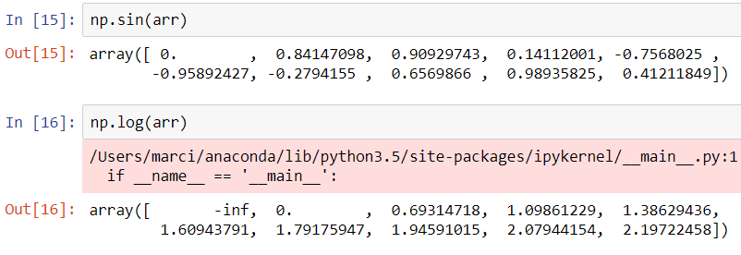
Universal Array Functions

