Slide 1
Merging, Joining, and Concatenating
Module 02
Data Science Developer

Slide 2
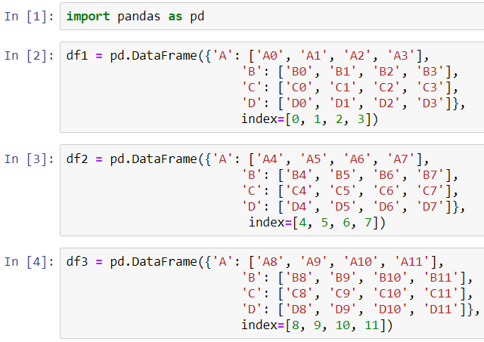
Create DataFrames

Slide 3
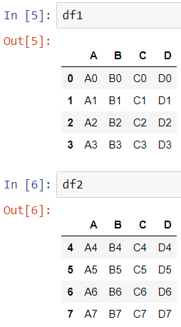
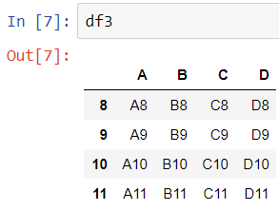
The DataFrames

Slide 4
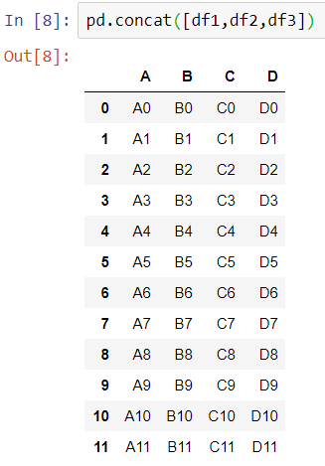
Concatenation
Concatenation basically glues together DataFrames. Keep in mind that dimensions should match along the axis you are concatenating on. You can use pd.concat and pass in a list of DataFrames to concatenate together:

Slide 5
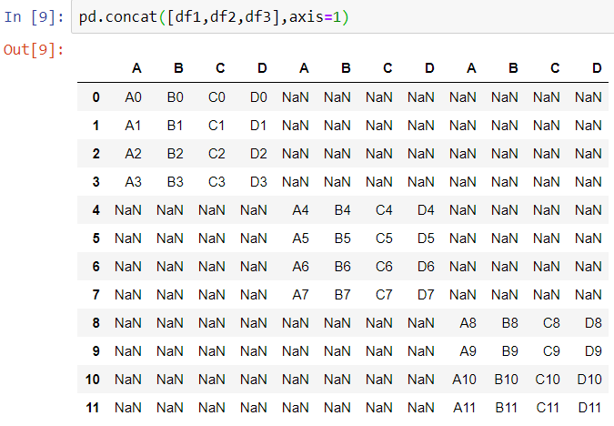
Concatenation

Slide 6
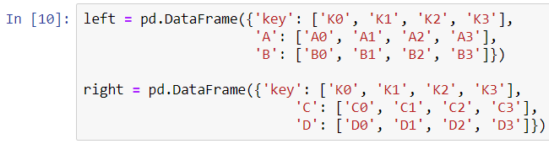
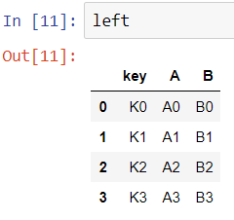
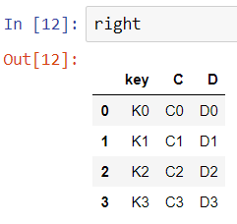
Create DataFrames

Slide 7
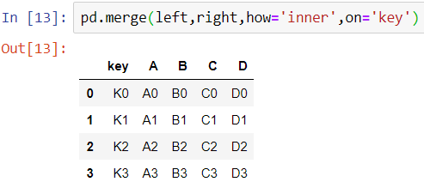
Merging
The merge function allows you to merge DataFrames together using a similar logic as merging SQL Tables together. For example:

Slide 8
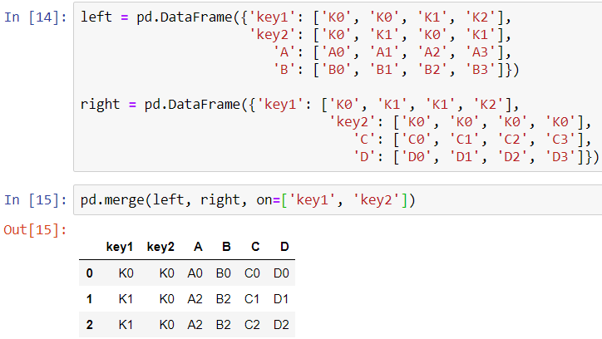
Merging

Slide 9
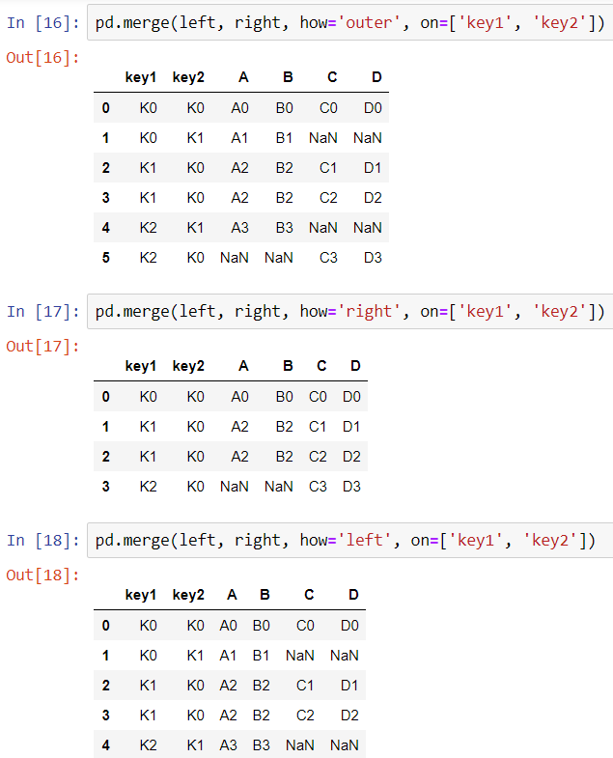
Merging

Slide 10
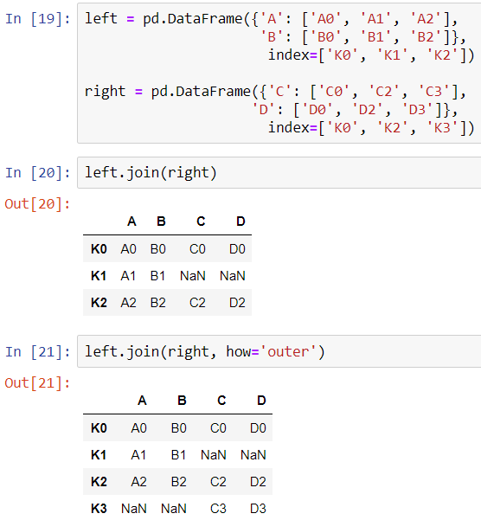
Joining
Joining is a convenient method for combining the columns of two potentially differently-indexed DataFrames into a single result DataFrame.

