Slide 1
Operations
Module 02
Data Science Developer

Slide 2
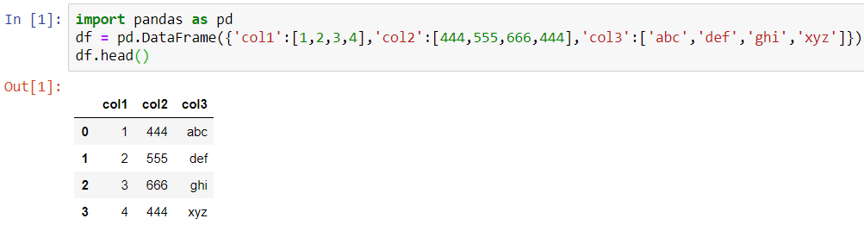
Create DataFrame

Slide 3
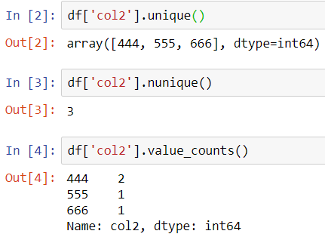
Info on Unique Values

Slide 4
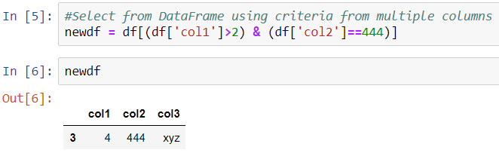
Selecting Data

Slide 5
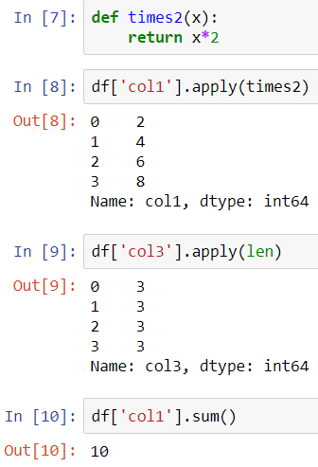
Applying Functions

Slide 6
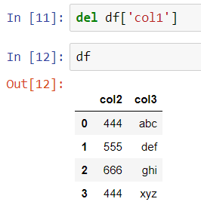
Permanently Removing a Column

Slide 7
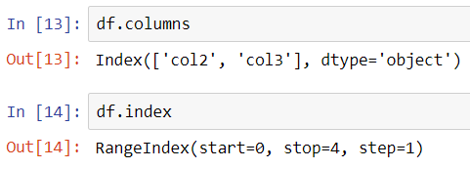
Get Column and Index Names

Slide 8
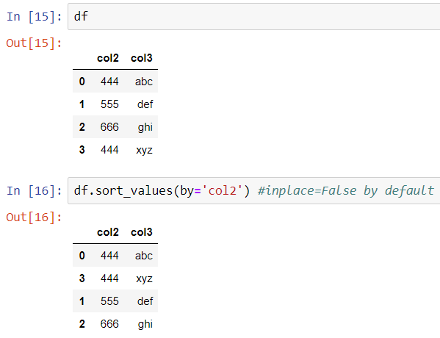
Sorting and Ordering a DataFrame

Slide 9
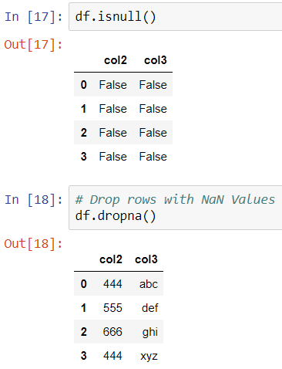
Check for Null Values

Slide 10
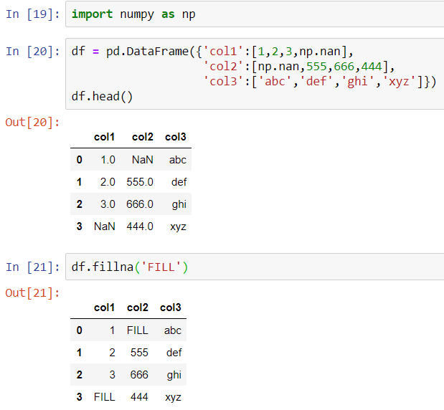
Filling in NaN with Something Else

Slide 11
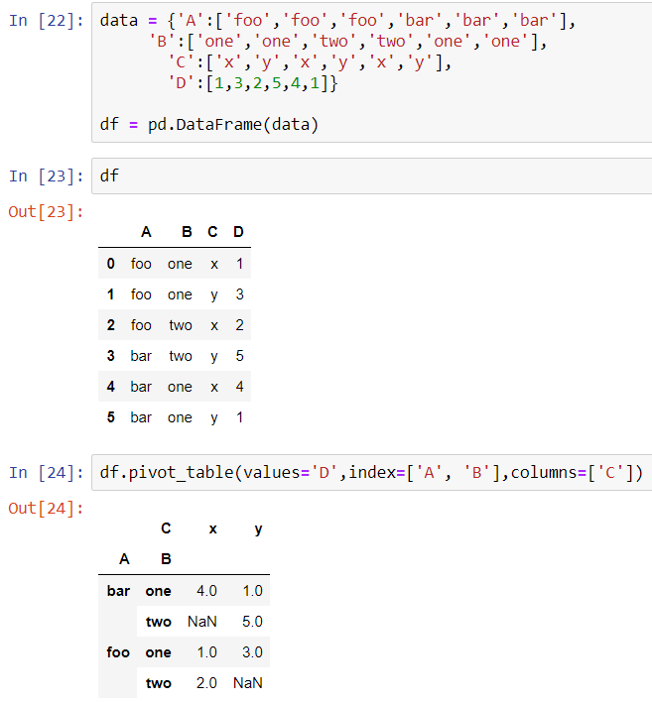
Pivot Table

