Slide 1
Data Input and Output
Module 02
Data Science Developer

Slide 2

Using Pandas

Slide 3
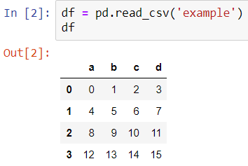
CSV Input

Slide 4
CSV Output

Slide 5
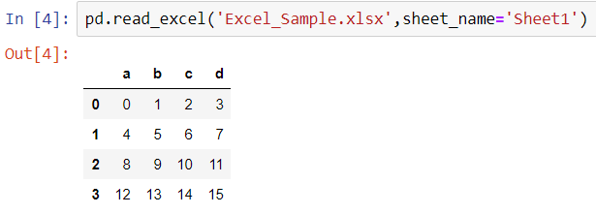
Excel Input

Slide 6
Excel Output

Slide 7
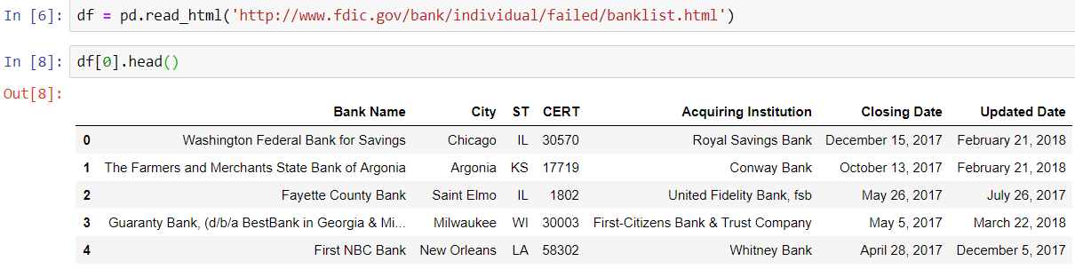
HTML Input

Slide 8
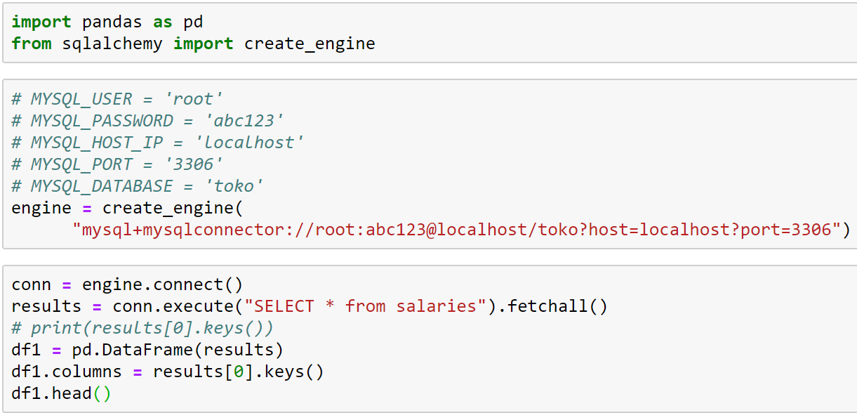
MySQL (Open Connection & Get Data)

Slide 9
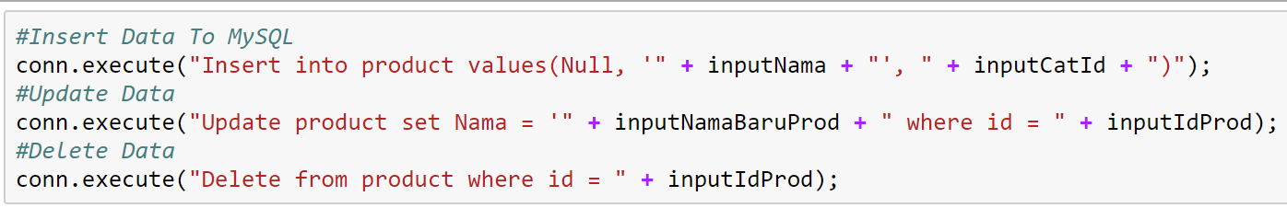
MySQL (CRUD Examples)
Example executing query (Insert,Update, and Delete) from python :

