Slide 1
DevOps Approach for IEDR Data Pipeline Managing Code Across Dev, QA, Prod & Main
Presenter: Dheeraj Kaushal

Slide 2
Agenda
Project Overview
Repository Structure
Branch Strategy
SDLC Process
CI/CD Pipeline
What we did
Next Steps

Slide 3
Project Overview
IEDR Data Pipeline is a medallion architecture built on Databricks
  Bronze Layer — Raw CSV ingestion from landing zone
  Silver Layer — Cleansed and transformed data
  Gold Layer — Aggregated, business-ready tables
  Platform — Databricks (Serverless), Unity Catalog, GitHub

Slide 4
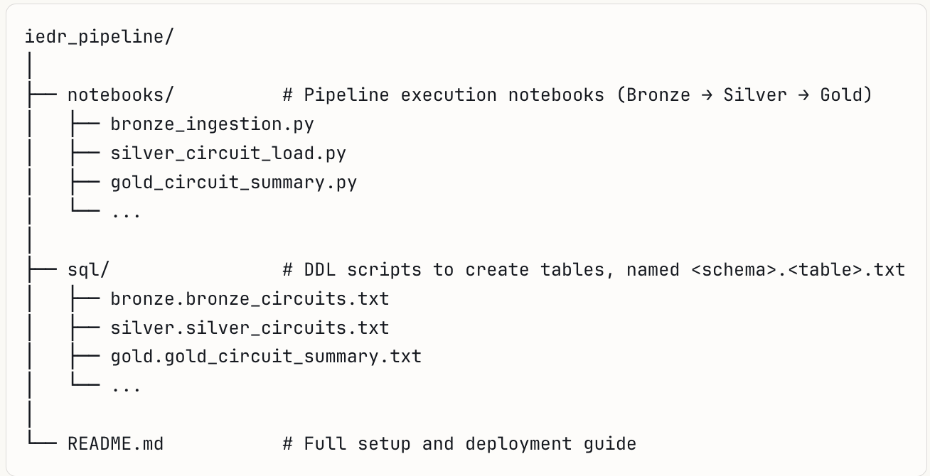
Repository Structure

Slide 5
Branch Strategy
Branch | Purpose | Who works on it
DEV | Active development | Developer
QA | Testing & validation | QA / Developer
PROD | Stable running code | Controlled releases
Main | Verified, long-term baseline | After prod sign-off
Flow:
dev → qa → prod → main

Slide 6
Why This Branch Model?
  dev - Safe sandbox, no impact to live data
  qa - Mirrors prod environment, catches issues early
  prod - Code runs here for months before being considered stable
  main — Only receives code that has proven itself in prod over time
Gives the team full control and visibility at every stage. Prevents untested code from reaching production data

Slide 7
SDLC Process
Step 1 — Develop
  Developer works locally or in Databricks on dev branch
  Writes/updates notebooks and SQL scripts
  Commits and pushes to remote dev
Step 2 — Test (QA)
  Code automatically promoted to qa via CI/CD on push to dev or we can keep approver to keep an eye on code
  QA validates data outputs, transformations, and table counts
  Any issues → fix on dev, re-push, auto-promotes again

Slide 8
SDLC Process cont’d
Step 3 — Production
  On QA sign-off, push to qa triggers auto-deploy to prod
  Code runs in prod for 2-3 months
  Monitor data quality, pipeline runs, and volumes
Step 4 — Main
  After stable prod run, merge from prod → main
  main is the golden copy — always clean, always proven

Slide 9
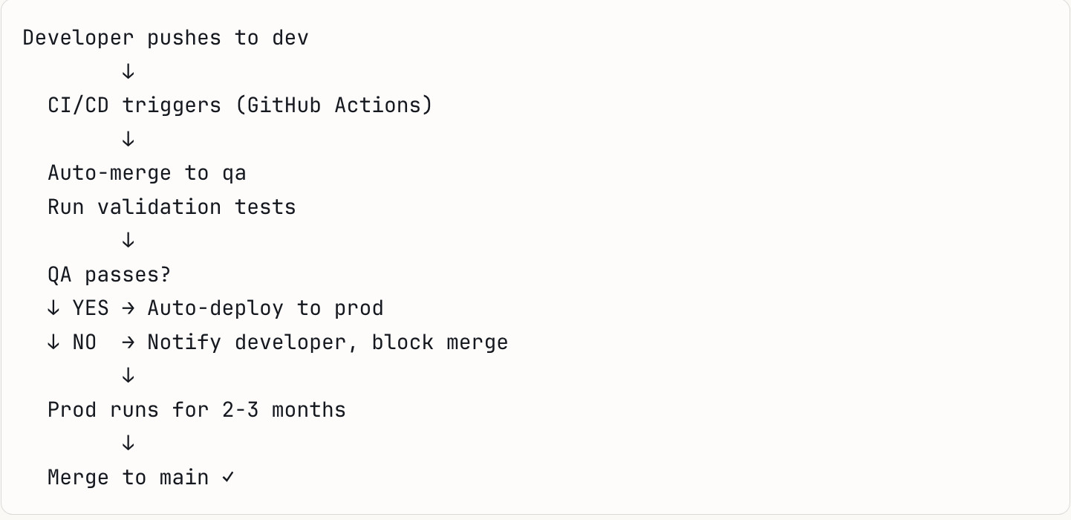
CI/CD Pipeline
Current state: Merges to qa and prod done manually Target state: Automated via GitHub Actions on push

Slide 10
What We Did
  Checked out dev branch locally
  Built all notebooks (Bronze, Silver, Gold layers)
  Organised SQL DDL scripts per table
  Updated README with full setup guide
  Committed and pushed to remote dev
  Manually merged dev → qa
  Manually merged qa → main
In a full CI/CD setup, merge steps could be automated the moment code is pushed.

Slide 11
Databricks Integration
  Code lives in GitHub, executed in Databricks
  Notebooks imported under: Workspace → Users → your-email → IEDR_Project
  Source CSV files dropped to: /Volumes/workspace/default/iedr_csv/landing
  Tables created in Unity Catalog under workspace catalog

Slide 12
What CI/CD Would Look Like in Full
GitHub Actions Workflow (example)
  On push to dev → run linting + auto-merge to qa
  On push to qa → run integration tests → auto-deploy to prod
  On merge to main → tag release version

Slide 13
Next Steps
  Set up GitHub Actions for automated CI/CD (dev → qa → prod)
  Implement Unity Catalog permissions to control access to tables by role and environment — analysts read Gold only, engineers write to Bronze/Silver, admins control all layers
  Add data quality checks in Silver layer notebooks
  Schedule notebooks using Databricks Jobs & Pipelines
  Monitor pipeline runs via Databricks Run History
  After 2-3 months of stable prod → merge to main

