Slide 1
Spring Batch
By- Puneet Vashisht

Slide 2
Listeners

Slide 3
Intercepting Job Execution
During the course of the execution of a Job, it may be useful to be notified of various events in its lifecycle so that custom code may be executed.
The Simple Job allows for this by calling a JobListener at the appropriate time
public interface JobExecutionListener {
void beforeJob(JobExecution jobExecution);
void afterJob(JobExecution jobExecution);
}
Implementation
@BeforeJob
@AfterJob
<job id="footballJob">
// steps
<listeners>
<listener ref="sampleListener"/>
</listeners>
</job>

Slide 4
JobExecution Properties
Property | Description
status | Indicates the status of the execution
startTime | Representing the current system time when the execution was started
endTime | Representing the current system time when the execution finished
exitStatus | Indicating the result of the run
createTime | Representing the current system time when the JobExecution was first persisted
lastUpdated | Representing the last time a JobExecution was persisted
executionContext | The 'property bag' containing any user data that needs to be persisted between executions
failureExceptions | The list of exceptions encountered during the execution of a Job

Slide 5
Intercepting Step Execution
Just as with the Job, there are many events during the execution of a Step where a user may need to perform some functionality.
Any class that implements one of the extensions of StepListener (but not that interface itself since it is empty) can be applied to a step via the listeners element.
public interface StepExecutionListener extends StepListener {
void beforeStep(StepExecution stepExecution); ExitStatus afterStep(StepExecution stepExecution);
}
Implementation
<step id="step1">
<tasklet>
<chunk reader="reader" writer="writer" commit-interval="10"/>
<listeners>
<listener ref=“myStepListener"/>
</listeners>
</tasklet>
</step>
@BeforeStep
@AfterStep

Slide 6
StepExecution Properties
Property | Description
status | Indicates the status of the execution
startTime | Representing the current system time when the execution was started
endTime | Representing the current system time when the execution finished
exitStatus | Indicating the result of the run
executionContext | The 'property bag' containing any user data that needs to be persisted between executions
readCount | The number of items that have been successfully read
writeCount | The number of items that have been successfully written
commitCount | The number transactions that have been committed for this execution
rollbackCount | The number of times the business transaction controlled by the Step has been rolled back

Slide 7
ChunkListener
A chunk is defined as the items processed within the scope of a transaction.
Committing a transaction, at each commit interval, commits a 'chunk'.
A ChunkListener can be useful to perform logic before a chunk begins processing or after a chunk has completed successfully:
public interface ChunkListener extends StepListener {
void beforeChunk();
void afterChunk();
}
@BeforeChunk
@AfterChunk
Notes:
A ChunkListener can be applied when there is no chunk declaration: it is the TaskletStep that is responsible for calling the ChunkListener so it applies to a non-item-oriented tasklet as well (called before and after the tasklet).

Slide 8
ItemReadListener
When discussing skip logic above, it was mentioned that it may be beneficial to log the skipped records, so that they can be deal with later.
In the case of read errors, this can be done with an ItemReaderListener
public interface ItemReadListener<T> extends StepListener {
void beforeRead();
void afterRead(T item);
void onReadError(Exception ex);
}
@BeforeRead
@AfterRead
@OnReadError

Slide 9
ItemProcessListener
Just as with the ItemReadListener, the processing of an item can be 'listened' too
Object returned by ItemReader
Object to be passed to ItemWriter
public interface ItemProcessListener<T, S> extends StepListener {
void beforeProcess(T item);
void afterProcess(T item, S result);
void onProcessError(T item, Exception e);
}
@BeforeProcess
@AfterProcess
@OnProcessError

Slide 10
ItemWriteListener
The writing of an item can be 'listened' to with the ItemWriteListener
public interface ItemWriteListener<S> extends StepListener {
void beforeWrite(List<? extends S> items);
void afterWrite(List<? extends S> items);
void onWriteError(Exception exception, List<? extends S> items);
}
@BeforeWrite
@AfterWrite
@OnWriteError

Slide 11
SkipListener
ItemReadListener, ItemProcessListener, and ItemWriteListner all provide mechanisms for being notified of errors, but none will inform you that a record has actually been skipped.
For this reason, there is a separate interface for tracking skipped items:
public interface SkipListener<T,S> extends StepListener {
void onSkipInRead(Throwable t);
void onSkipInProcess(T item, Throwable t);
void onSkipInWrite(S item, Throwable t);
}
@OnSkipInRead
@OnSkipInWrite
@OnSkipInProcess

Slide 12
Configuring and Running a Job

Slide 13
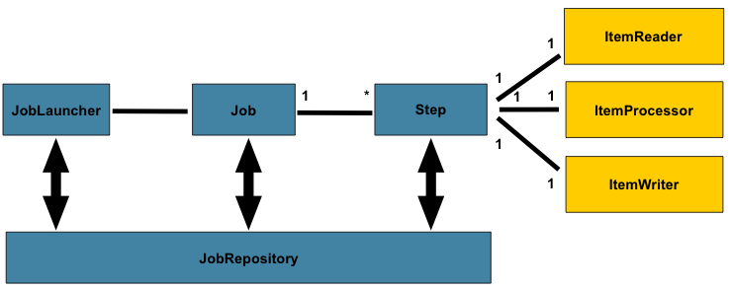
Overall architecture design

Slide 14
Configuring a Job
Job has only three required dependencies
A name
JobRepository
A list of Steps
<job id="footballJob">
<step id="playerload" parent="s1" next="gameLoad"/>
<step id="gameLoad" parent="s2" next="playerSummarization"/>
<step id="playerSummarization" parent="s3"/>
</job>
The XML namespace defaults to referencing a repository with an id of 'jobRepository'

Slide 15
Configuring a Job
<job id="footballJob“ job-repository="specialRepository" >
<step id="playerload" parent="s1" next="gameLoad"/>
<step id="gameLoad" parent="s2" next="playerSummarization"/>
<step id="playerSummarization" parent="s3"/>
</job>
The XML namespace job-repository explicitly overridden

Slide 16
Job Restartability
It is entirely up to the developer to ensure that a new JobInstance is created in this scenario.
If a Job should never be restarted, but should always be run as part of a new JobInstance, then the restartable property may be set to 'false':
<job id="footballJob" restartable="false" >
<step id="playerload" parent="s1" next="gameLoad"/>
<step id="gameLoad" parent="s2" next="playerSummarization"/>
<step id="playerSummarization" parent="s3"/>
</job>

Slide 17
Intercepting Job Execution
During the course of the execution of a Job, it may be useful to be notified of various events in its lifecycle so that custom code may be executed.
The Simple Job allows for this by calling a JobListener at the appropriate time
public interface JobExecutionListener {
void beforeJob(JobExecution jobExecution);
void afterJob(JobExecution jobExecution);
}
Implementation
@BeforeJob
@AfterJob
<job id="footballJob">
// steps
<listeners>
<listener ref="sampleListener"/>
</listeners>
</job>

Slide 18
Inheriting from a Parent Job
If a group of Jobs share similar, but not identical, configurations, then it may be helpful to define a "parent" Job
<job id="baseJob" abstract="true">
<listeners>
<listener ref="listenerOne"/>
<listeners>
</job>
<job id="job1" parent="baseJob">
<step id="step1" parent="standaloneStep"/>
<listeners merge="true">
<listener ref="listenerTwo"/>
<listeners>
</job>

Slide 19
JobParametersValidator
A job declared in the XML namespace or using any subclass of AbstractJob can optionally declare a validator for the job parameters at runtime. This is useful when for instance you need to assert that a job is started with all its mandatory parameters.
There is a DefaultJobParametersValidator that can be used to constrain combinations of simple mandatory and optional parameters
<job id="job1" parent="baseJob3">
<step id="step1" parent="standaloneStep"/>
<validator ref="paremetersValidator"/>
</job>

Slide 20
Step

Slide 21
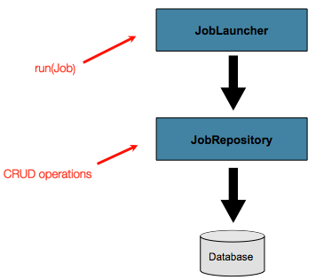
Advanced Meta-Data Usage
So far, both the JobLauncher and JobRepository interfaces have been discussed. Together, they represent simple launching of a job, and basic CRUD operations of batch domain objects

Slide 22
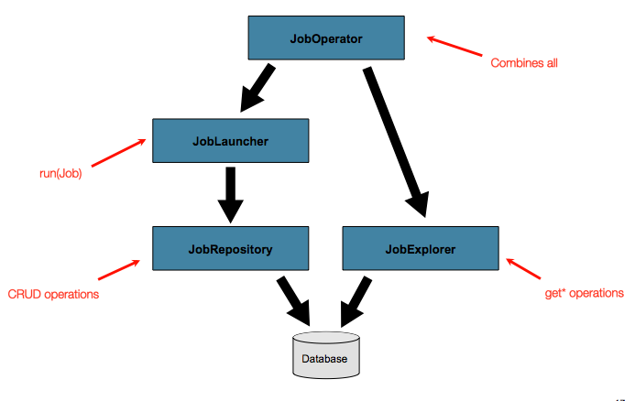
Advanced Meta-Data Usage
A JobLauncher uses the JobRepository to create new JobExecution objects and run them. Job and Step implementations later use the same JobRepositoryfor basic updates of the same executions during the running of a Job. The basic operations suffice for simple scenarios, but in a large batch environment with hundreds of batch jobs and complex scheduling requirements, more advanced access of the meta data is required:

Slide 23
Transaction Attributes
Transaction attributes can be used to control the isolation, propagation, and timeout settings
<step id="step1">
<tasklet>
<chunk reader="itemReader" writer="itemWriter" commit-interval="2"/>
<transaction-attributes isolation="DEFAULT"
propagation="REQUIRED"
timeout="30"/>
</tasklet>
</step>

Slide 24
Flow
Sequential
Conditional
Split

Slide 25
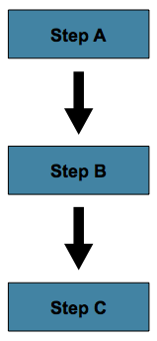
Sequential Flow
The simplest flow scenario is a job where all of the steps execute sequentially:
Achieved by using the 'next' attribute of the step element
<job id="job">
<step id="stepA" parent="s1" next="stepB" />
<step id="stepB" parent="s2" next="stepC"/>
<step id="stepC" parent="s3" />
</job>
'step A' will execute first because it is the first Step listed. If 'step A' completes normally, then 'step B' will execute, and so on

Slide 26
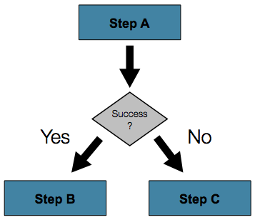
Conditional Flow
Consider there are only two possibilities:
The Step is successful and the next Step should be executed.
The Step failed and thus the Job should fail.
<job id="job">
<step id="stepA" parent="s1">
<next on="*" to="stepB" />
<next on="FAILED" to="stepC" />
</step>
<step id="stepB" parent="s2" next="stepC" />
<step id="stepC" parent="s3" />
</job>
"*" will zero or more characters
"?" will match exactly one character
For example, "c*t" will match "cat" and "count", while "c?t" will match "cat" but not "count"

Slide 27
Programmatic Flow Decisions
If In some situations, more information than the ExitStatus is required to decide which step to execute next use JobExecutionDecider
<job id="job">
<step id="step1" parent="s1" next="decision" />
<decision id="decision" decider="decider">
<next on="FAILED" to="step2" />
<next on="COMPLETED" to="step3" />
</decision>
<step id="step2" parent="s2" next="step3"/>
<step id="step3" parent="s3" />
</job>
<beans:bean id="decider" class="com.MyDecider"/>
public class MyDecider implements JobExecutionDecider {
public FlowExecutionStatus decide(JobExecution jobExecution,
StepExecution stepExecution) {
if (someCondition) {
return "FAILED";
}
else {
return "COMPLETED";
}
}
}

Slide 28
Split Flow
Every scenario described so far has involved a Job that executes its Steps one at a time in a linear fashion. In addition to this typical style, the Spring Batch namespace also allows for a job to be configured with parallel flows using the 'split' element
<split id="split1" next="step4">
<flow>
<step id="step1" parent="s1" next="step2"/>
<step id="step2" parent="s2"/>
</flow>
<flow>
<step id="step3" parent="s3"/>
</flow>
</split>
<step id="step4" parent="s4"/>

Slide 29
Late Binding of Job and Step Attributes
Both the XML and Flat File examples above use the Spring Resource abstraction to obtain a file. This works because Resource has a getFile method, which returns a java.io.File. Both XML and Flat File resources can be configured using standard Spring constructs:
<bean id="flatFileItemReader"
class="org.springframework.batch.item.file.FlatFileItemReader">
<property name="resource"
value=“classpath:outputs/205CustomerReportStep.TEMP.txt" />
</bean>
The above Resource will load the file from the classpath
file: can be used for file system location
Default is classpath:

Slide 30
Late Binding of Job and Step Attributes
Often in a batch setting it is preferable to parameterize the file name in the JobParameters of the job.
Any bean that uses late-binding must be declared with scope="step"
<bean id="flatFileItemReader" scope="step"
class="org.springframework.batch.item.file.FlatFileItemReader">
<property name="resource" value="#{jobParameters['input.file.name']}" />
</bean>
<bean id="flatFileItemReader" scope="step"
class="org.springframework.batch.item.file.FlatFileItemReader">
<property name="resource" value="#{jobExecutionContext['input.file.name']}" />
</bean>
<bean id="flatFileItemReader" scope="step"
class="org.springframework.batch.item.file.FlatFileItemReader">
<property name="resource" value="#{stepExecutionContext['input.file.name']}" />
</bean>

Slide 31
Multi-threaded Step
The simplest way to start parallel processing is to add a TaskExecutor to your Step configuration
As an attribute of the tasklet
<step id="loading">
<tasklet task-executor="taskExecutor">
...
</tasklet>
</step>
The simplest multi-threaded TaskExecutor is a SimpleAsyncTaskExecutor

Slide 32
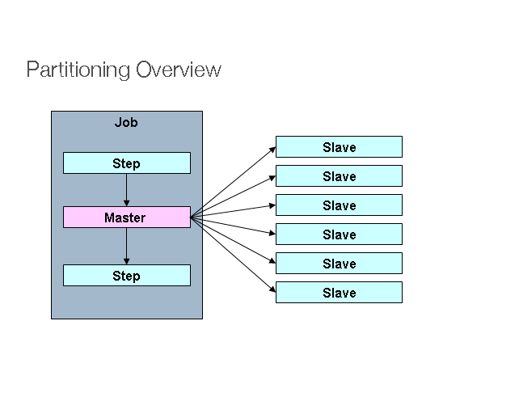
Partitioning
Spring Batch also provides an SPI for partitioning a Step execution and executing it remotely. In this case the remote participants are simply Step instances that could just as easily have been configured and used for local processing.

