Slide 1

ANNAMALAI
UNIVERSITY
FACULTY OF SCIENCE
DEPARTMENT OF COMPUTER & INFORMATION SCIENCE
Weather Forecasting Application Using API
INSTRUCTED BY:
PRESENTED BY:
S.BARANI M.Sc.Information Technology(Third Year)
Reg no:23131026510722010
Dr.K.VADIVAZHAGAN
ASSISTANT PROFESSOR/PROGRAMMER

Slide 2
AIM OF THE PROJECT
To Develop a Weather Forecasting Web Application
The main aim is to create a simple and user-friendly application that provides real-time weather information for different locations.
To Use API for Real-Time Weather Data
The project uses Open-Meteo public API to fetch live weather data such as temperature and wind speed.

Slide 3
OBJECTIVES
To design and develop a web-based weather forecasting system
To integrate an external public weather API (Open-Meteo)
To fetch real-time weather data using HTTP requests
To process and interpret JSON response data
To implement asynchronous programming using JavaScript
To display weather information dynamically on the web page
To improve user experience using weather-based images

Slide 4
PROJECT MODULES
Input field for city name
Search button
Displays weather details
Module 1: User Interface (UI)
Connects to Open-Meteo API
Sends HTTP request
Receives JSON data
Module 2: API Integration Module

Slide 5
PROJECT MODULES
Converts JSON data into JavaScript object
Extracts temperature, wind speed
Handles errors
Module 3: Data Processing Module
Displays weather data dynamically
Shows weather-based images
Improves UI interaction
Module 4: Weather Visualization Module

Slide 6
DATA FLOW DIAGRAM
USER
Enter City Name
FRONTEND (JavaScript)
API Request (Open-Meteo)
Weather Data (JSON)
Process Data
Display on UI

Slide 7
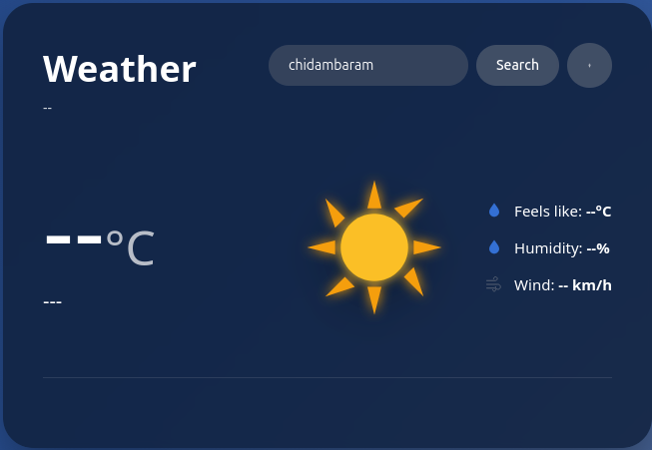
Final Output Screenshots

Slide 8
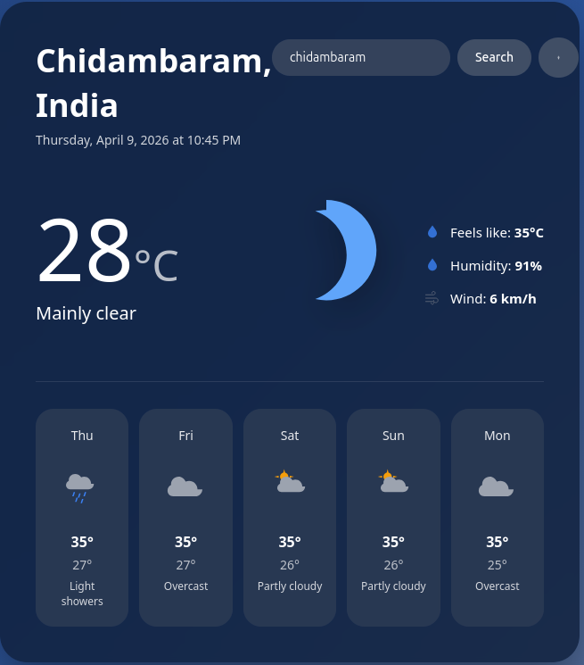
Final Output Screenshots

Slide 9
CONCLUSION
This project demonstrates a simple and effective weather forecasting system using API integration. It successfully retrieves real-time weather data and displays it dynamically on the web interface. The project highlights the use of JavaScript, asynchronous programming, and JSON data handling, making it useful for learning modern web development concepts.

Slide 10
THANK YOU !

