Slide 1
NAME: DHILIP SANJU V
COLLEGE : RAJALAKSHMI
ENGINEERING COLLEGE
HOME
AUTOMATION
A home that notices what is happening and responds with less manual effort.
Convenience · accessibility · energy awareness
Notes:
Introduce home automation as a system that responds to everyday conditions. The focus is not gadgets for their own sake, but useful actions that happen with less manual effort.

Slide 2
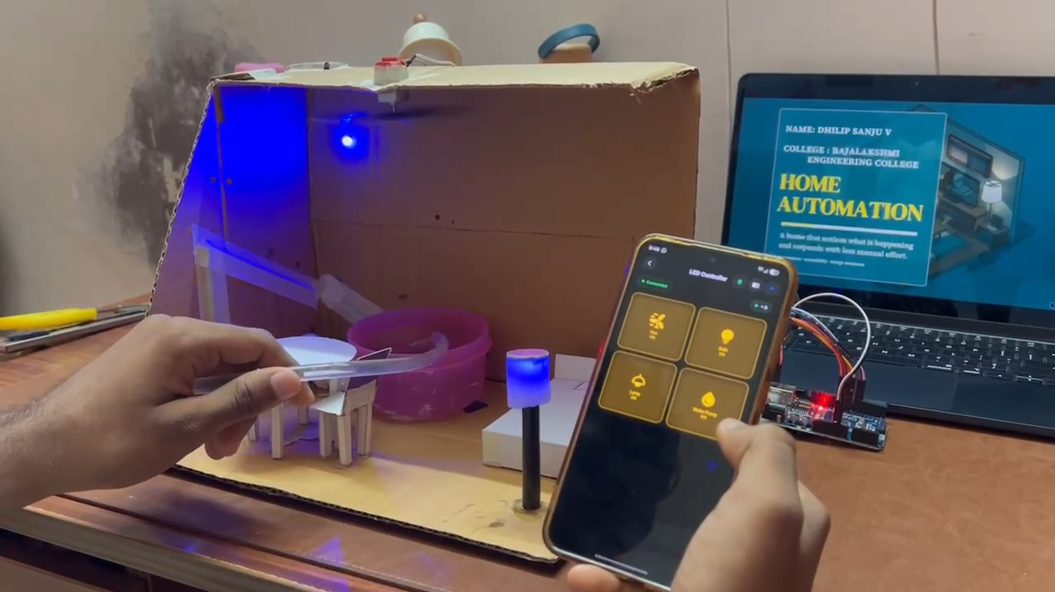
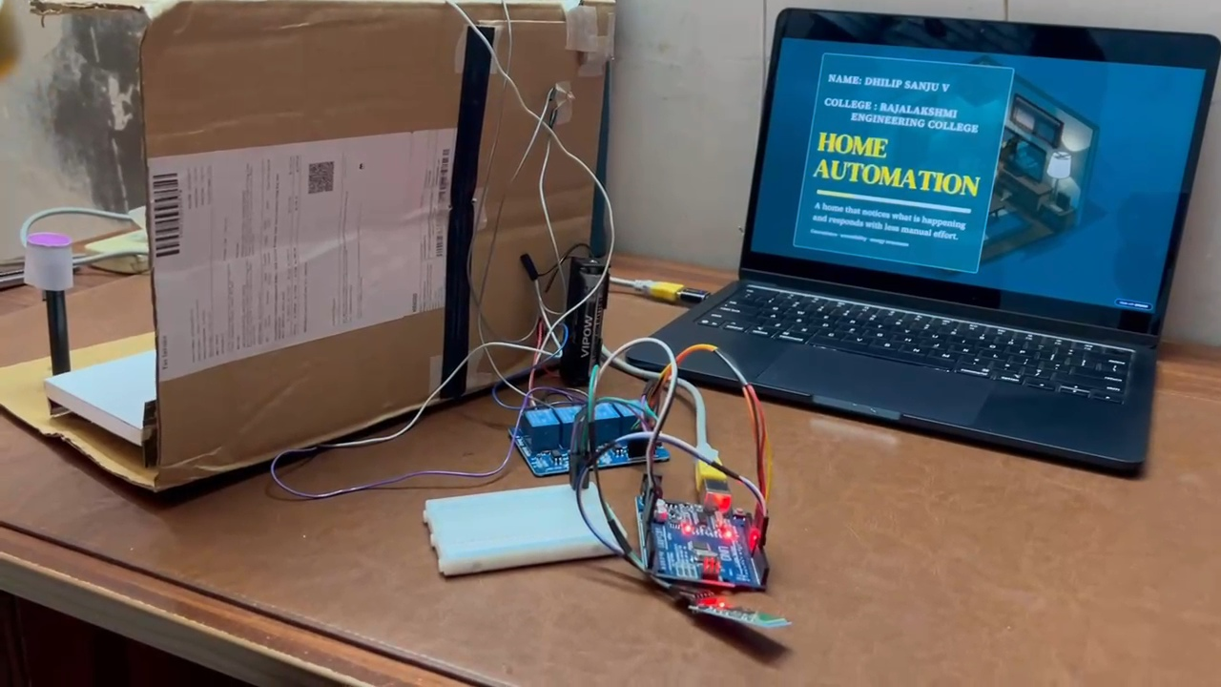
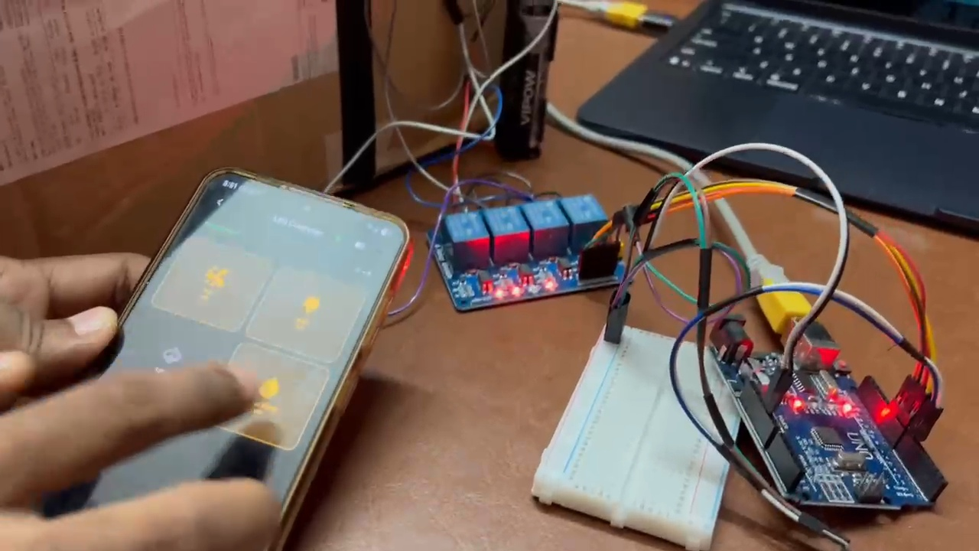
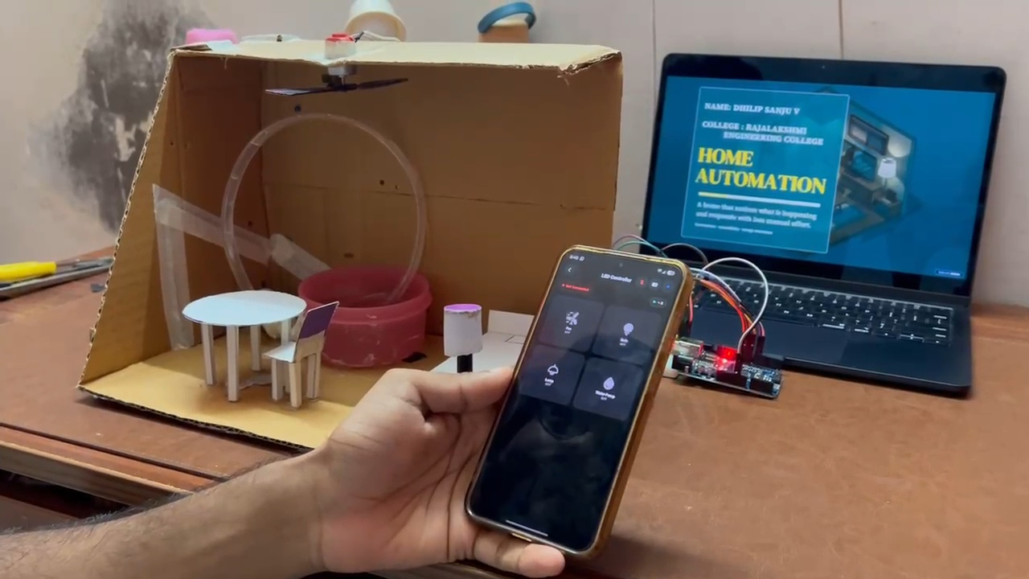
HOME AUTOMATION
Notes:
Keep the definition plain. A smart home connects devices, sensors, and software so routine actions can happen automatically. The repeating pattern is sense, decide, and act.

Slide 3


THE CORE IDEA
PROJECT-RELATED DESCRIPTION
Home automation connects devices, sensors, and software so routine actions happen with less manual effort.
Sense
Decide
Act
Receive ON/OFF commands from the smartphone through the HC-05 Bluetooth module.
Arduino Uno receives and processes the Bluetooth commands to determine which appliance to control.
The relay module switches the. Connected lights and fans ON and OFF based on the received commands.
The pattern is simple: send a command, process the instruction and control the appliances.
Notes:
Keep the definition plain. A smart home connects devices, sensors, and software so routine actions can happen automatically. The repeating pattern is sense, decide, and act.

Slide 4
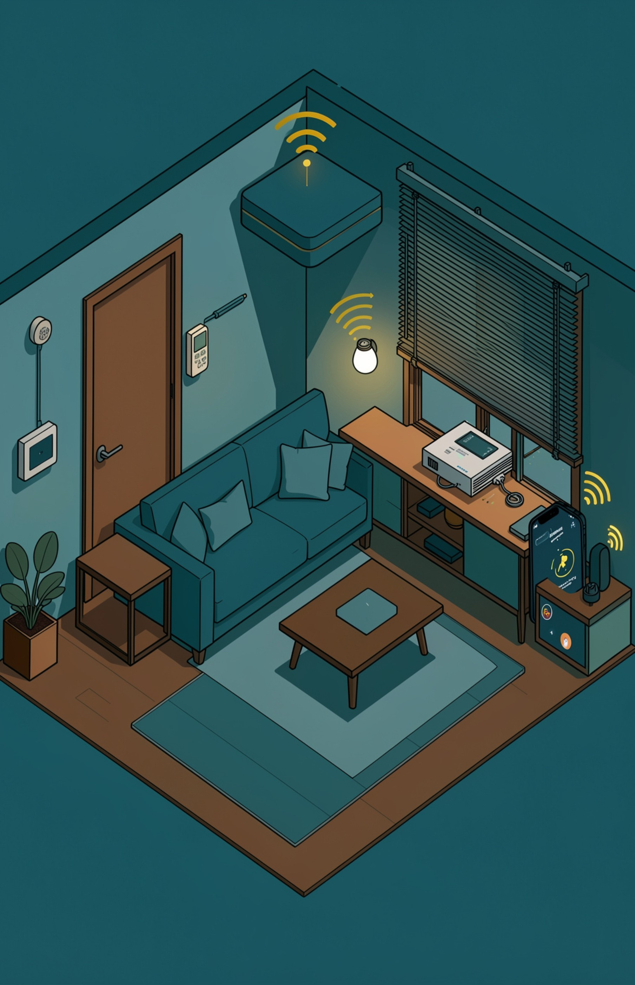
Required Materials and Components
Arduino Uno
HC-05 Bluetooth Module
4 Channel Relay Module
DC Motor
LED
Resisters
Water Pump Motor
Silicone Tube
Jumper Wires
Connecting Wire
3.7V Lithium Battery
Cardboard And Glue
Notes:
These four parts work together. Sensors provide information, the controller makes a decision, actuators change the environment, and the interface gives people visibility and control.

Slide 5
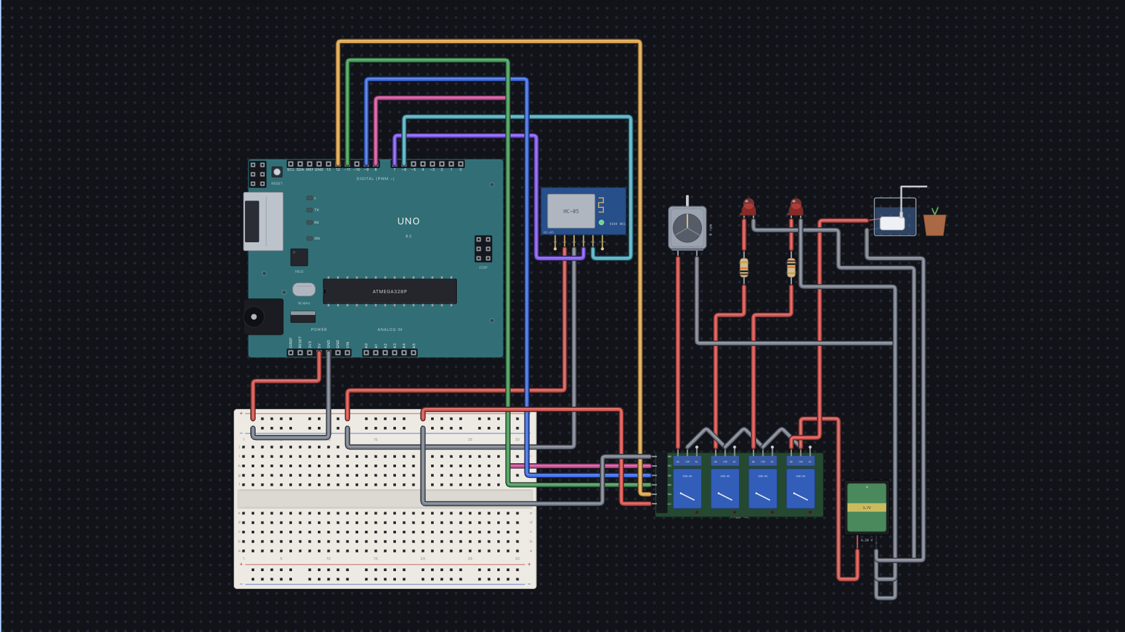
CIRCUIT DIAGRAM
Notes:
Walk left to right through one concrete example. The sensor notices motion, the controller checks the rule, the light responds, and the system either reports the result or waits for another event.

Slide 6
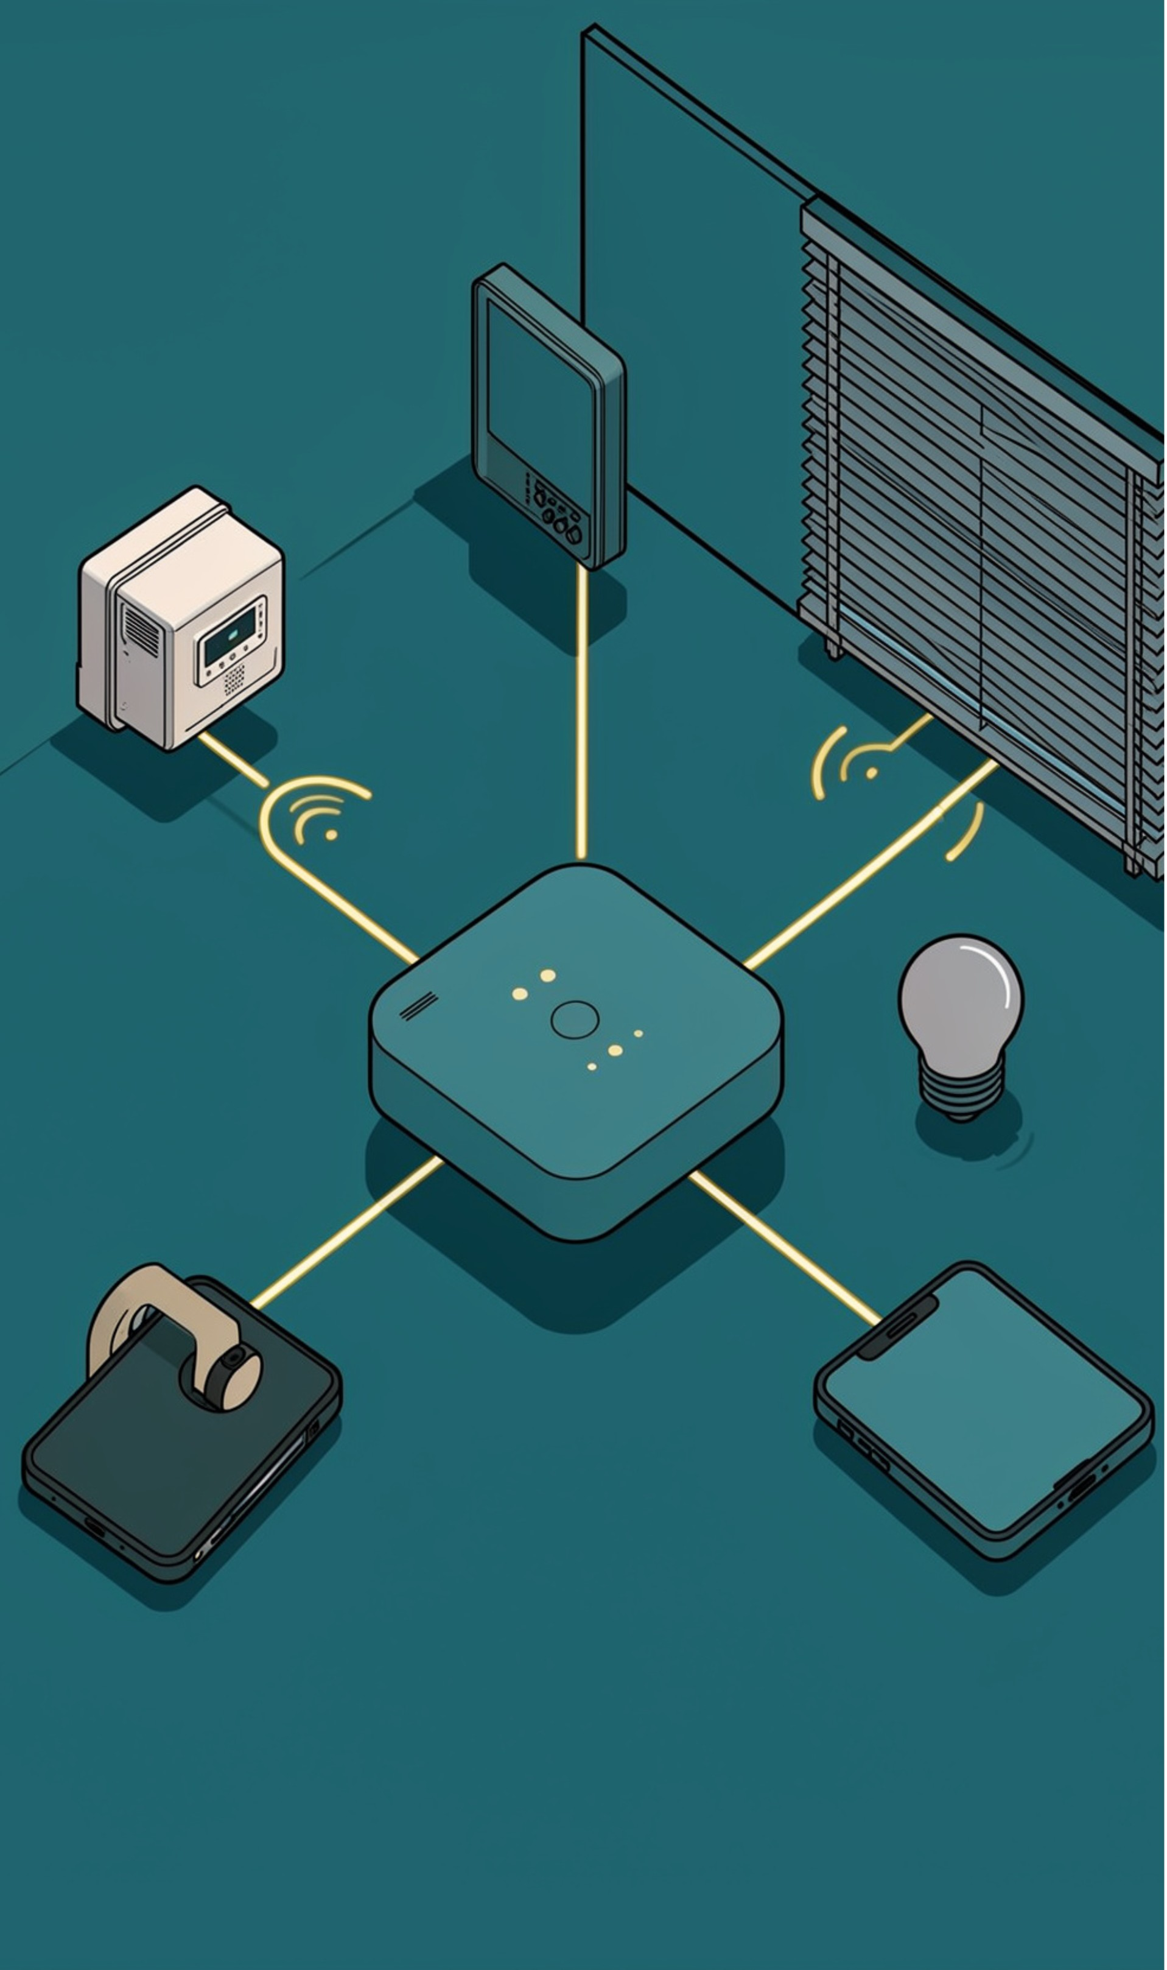
OPERATING LOGIC
CIRCUIT AND CONNECTION EXPLANATION
The home automation system consists of three main circuits:
  1.Bluetooth Circuit: Receives commands from a smartphone using the HC-05 module.
  2.Relay Circuit: Controls appliances using a 4-channel relay module.
  3.Appliance Circuit: Controls the fan, bulb, lamp, and water pump.
The Arduino Uno processes Bluetooth commands and sends signals to the relay module.
The relays switch the respective appliances ON or OFF based on the received commands.
This system enables convenient wireless control of household appliances.
Notes:
Walk left to right through one concrete example. The sensor notices motion, the controller checks the rule, the light responds, and the system either reports the result or waits for another event.

Slide 7
CONNECTIVITY
CIRCUIT CONNECTIONS
HC-05: VCC and GND connect to 5V and GND. TXD connects to D6 and RXD to D7 (with voltage-level protection).
Relay Module: VCC and GND connect to 5V and GND. IN1–IN4 connect to Arduino pins 8–11.
Appliances: Fan, bulb, lamp, and water pump are connected through the relay switching terminals.
The smartphone sends Bluetooth commands to the Arduino.
The Arduino controls the corresponding relays to switch appliances ON or OFF.
Notes:
Devices can connect in different ways, but they still need a shared language and a place where decisions happen. Matter supports interoperability, while a controller or hub links the devices and runs the automations.

Slide 8
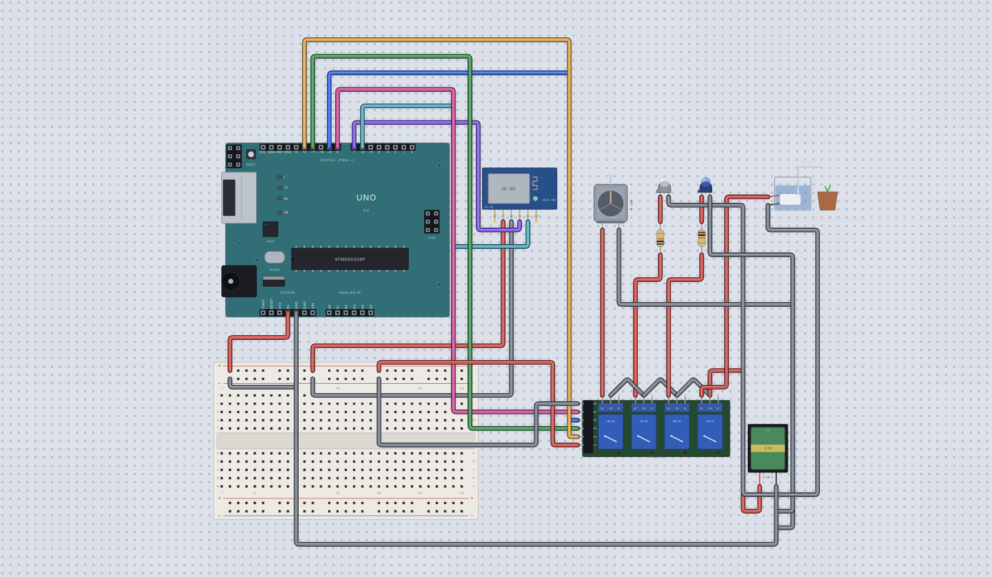
CONNECTIVITY
ONLINE SIMULATION
The circuit was designed and stimulated using MOKXI CIRCUITS to test Home Automation using Arduino Uno.
The HC-05 BLUETOOTH MODULE reads values from smartphones and transmit the data to Arduino.
The Arduino processes the data and turns on/off the RELAY MODULE according to the entered value. Example the Arduino turns on the channel 1 of relay for input “A” and turns off for input “B”.
The devices connected to the relay works when the respective command is received from the user’s smartphone. The used electronic devices are – DC motor, LED, bulb and DC water pump motor.
Notes:
A routine bundles several device actions around a recognizable moment. The value is the coordinated experience: one trigger or command can prepare the home for morning, departure, or sleep.

Slide 9
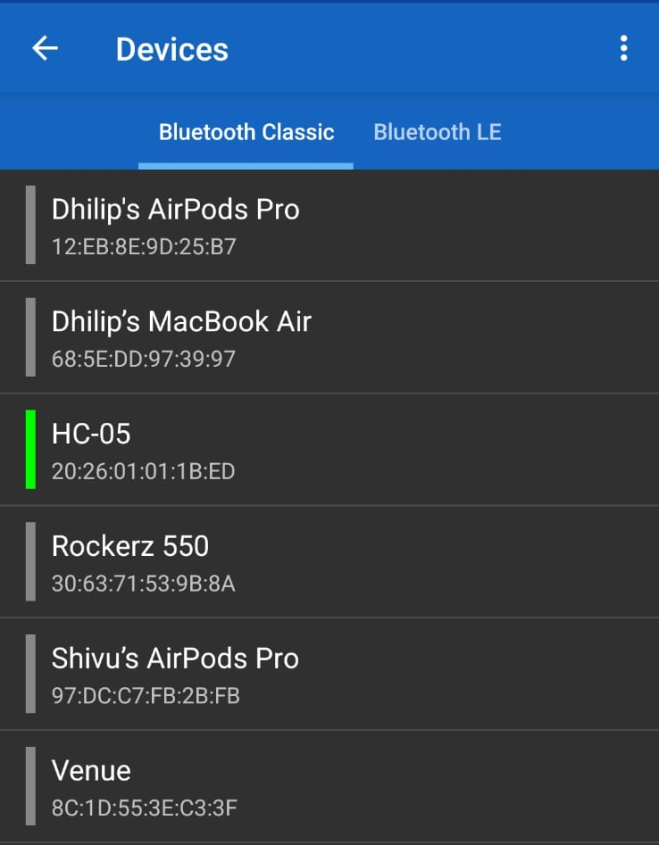
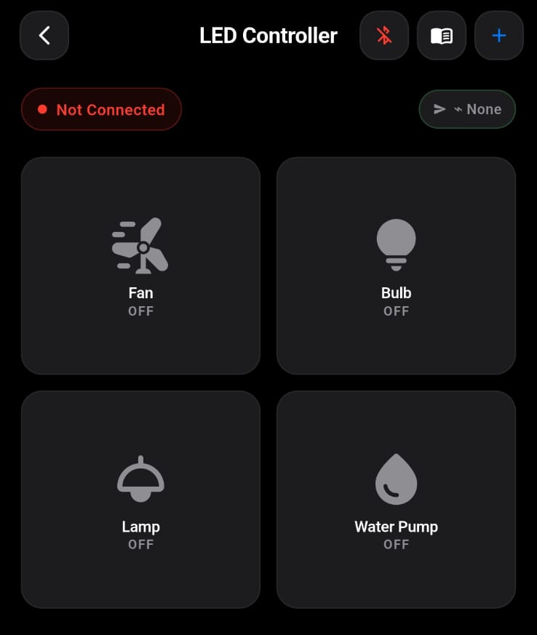
SMARTPHONE CONTROL
SERIAL BLUETOOTH TERMINAL
The commands for the operation are given from the smartphone using SERIAL BLUETOOTH TERMINAL. It is an application that connects with the HC-05 vis Bluetooth and transmits data from smartphone to HC-05 Bluetooth module.
In advance, we can use BLUEBOT SERIAL BLUETOOTH TERMINAL to customize buttons so that the respective command can be sent by clicking the respective button.
Example : If “A” is the command to turn on the fan, and “B” turns it off, we can customize a button named ‘FAN’, so that if it is pressed once ”A” is sent as input and when pressed again, “B” is sent as input.
Notes:
A routine bundles several device actions around a recognizable moment. The value is the coordinated experience: one trigger or command can prepare the home for morning, departure, or sleep.

Slide 10
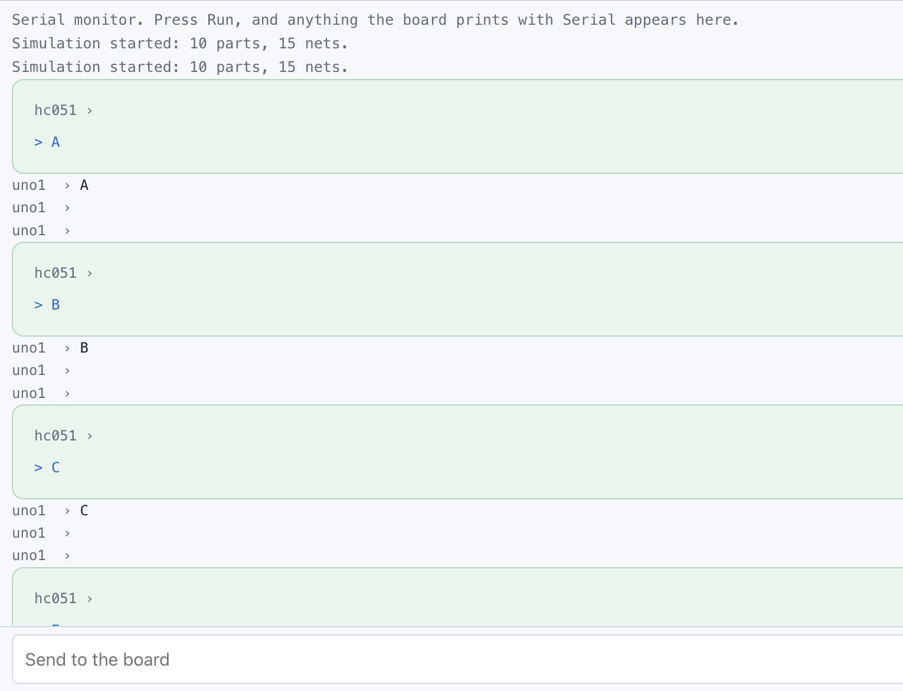
WORKING
SERIAL MONITER
Serial Monitor prompts the user to enter an input data. If the entered data is “A”, the motor turns on and turns off when “B” is entered.
Similarly for each device, there is a keyword to turn ON and OFF the device.
An online stimulation video in Mokxi is given below👇
https://drive.google.com/file/d/1EjvWr4nWjh-v-xusOBjp-p_EBxgSMNDa/view?usp=drivesdk
Notes:
A routine bundles several device actions around a recognizable moment. The value is the coordinated experience: one trigger or command can prepare the home for morning, departure, or sleep.

Slide 11
ARDUINO IDE
ARDUINO SOFTWARE
Arduino IDE was used to write and upload the program to the Arduino Uno. The system helps
maintain soil moisture and reduces water wastage.
The full ready code for Automatic Soil Moisture Detection System is given below👇
https://docs.google.com/document/d/1NyyOLEGnkX8f12dRmS0fogEwVW5cWRGa/edit?usp=drivesdk&ouid=105999624478677265909&rtpof=true&sd=true

Slide 12
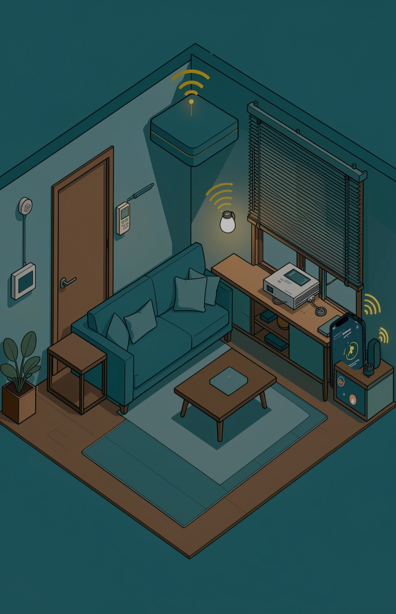
WORKING
VIDEO / SIMULATION
The working demo or simulation video is given in the link below 👇
https://drive.google.com/file/d/1oCUDi8ejaBVaQOYSrUdMgP8doiXJRvdg/view?usp=drivesdk
Notes:
Close with a manageable path. Choose one useful problem, check compatibility, secure the accounts and devices, then test the automation with a fallback for important functions. A connected home is built one clear improvement at a time.

Slide 13
THANK YOU

