Slide 1

HEALTHCARE ANALYTICS
Liver DiseaseAnalysis Dashboard
Patient Insights & Biomarker Evaluation — Built with Python · Pandas · NumPy · Matplotlib

Slide 2

EXECUTIVE SUMMARY
Key Findings at a Glance
Analysis of liver patient data reveals strong biomarker signals for early disease detection. The dataset exhibits significant class imbalance, with approximately 70% of patients diagnosed with liver disease. Lab values show high variance, and key biomarkers provide actionable diagnostic features.
~70% Disease Prevalence
High Biomarker Variance
Early Detection Possible
Majority of patients in the dataset carry a liver disease diagnosis — strong class imbalance requiring careful modeling strategy.
Bilirubin, SGPT, SGOT, and Alkaline Phosphatase all display wide distributions with extreme outliers in diseased cohorts.
Lab value patterns clearly differentiate disease vs. non-disease groups — enabling ML-driven early detection pipelines.
Key Message: Data indicates a strong correlation between core biomarkers and liver disease diagnosis. Targeted feature engineering can power reliable predictive models.

Slide 3

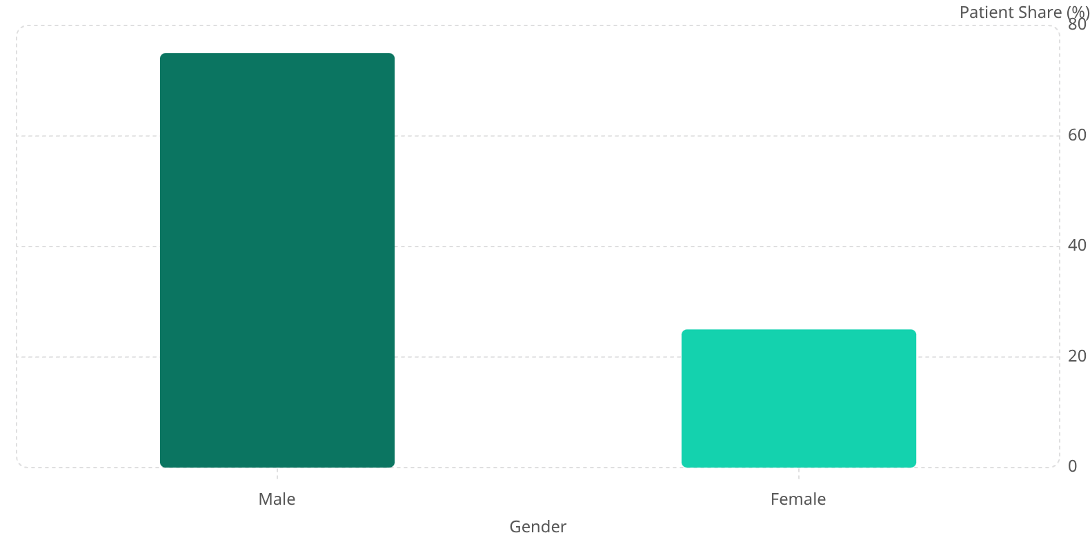


Disease & Gender Distribution
Patient composition reveals two critical demographic patterns: a heavily skewed disease ratio and a pronounced male-dominant cohort — both requiring analytical attention before modeling.
Disease Distribution
Gender Distribution
71
75
29
25
Dataset imbalance detected — apply SMOTE or class-weighting before training classifiers.
Higher liver disease prevalence in males — target male population for early screening programs.

Slide 4
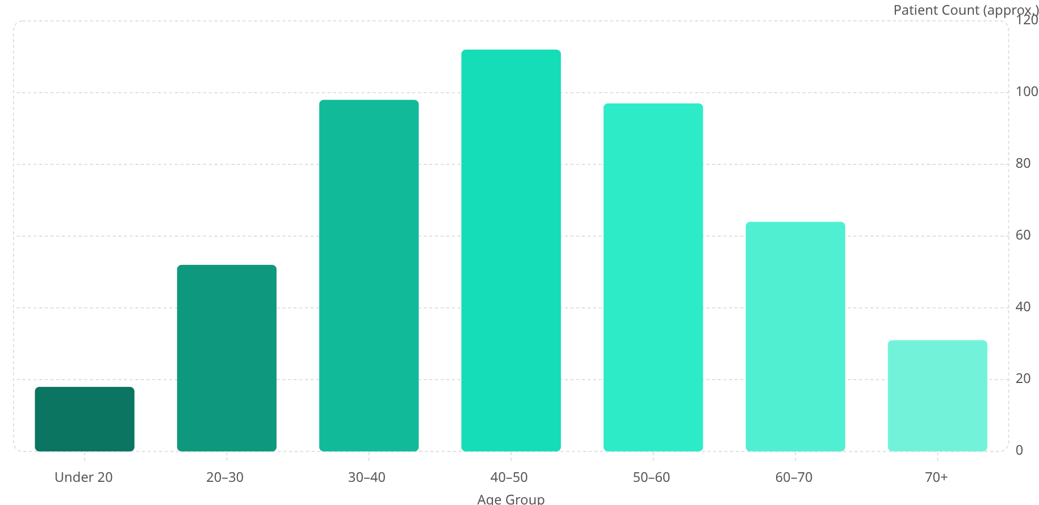

Age Profile & Disease Relationship
Age analysis uncovers a concentration of at-risk patients in the 30–60 year bracket. While diseased patients skew slightly older, age alone is insufficient — it must be combined with biomarker data for predictive accuracy.
Age Distribution Across All Patients
Age vs Disease Group
Disease Group
Non-Disease Group
Median age slightly higher (~47 yrs). Wider age spread, confirming age as a contributing — but not sole — factor.
Median age lower (~38 yrs). Tighter distribution around younger cohorts.
Recommendation: Combine age with biomarkers (Bilirubin, SGPT) for superior predictive models. Launch preventive campaigns targeting the 30+ population.

Slide 5
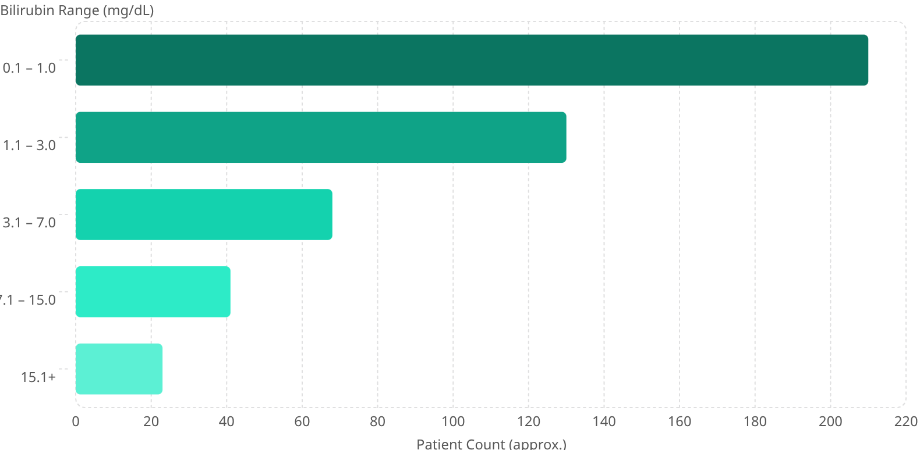
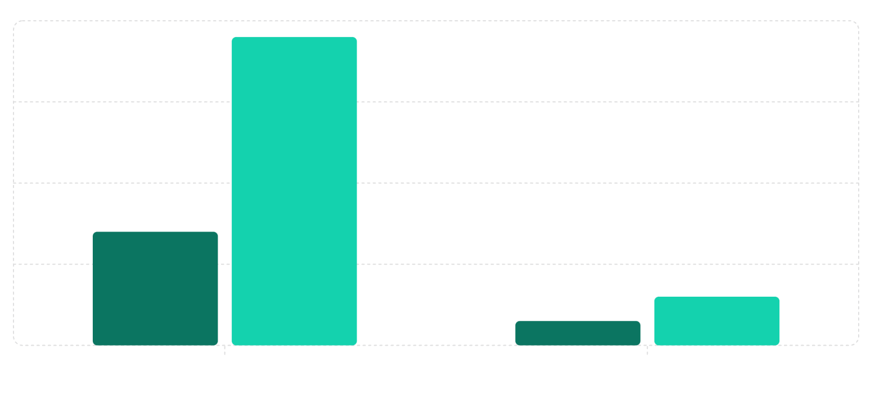

Bilirubin Analysis — Total & Direct
Bilirubin levels are among the most diagnostically powerful features in the dataset. Both total and direct bilirubin show stark separation between disease and non-disease cohorts.
Total Bilirubin Distribution
Direct Bilirubin: Disease vs. Non-Disease
Median Direct Bilirubin (mg/dL)
75th Percentile (mg/dL)
3.8
1.4
0.3
0.6
Highly right-skewed — most values cluster low, but disease patients pull the tail significantly rightward.
🚨 Critical Insight: Direct bilirubin is a strong discriminating indicator. Prioritize it as a primary feature in all screening models.

Slide 6
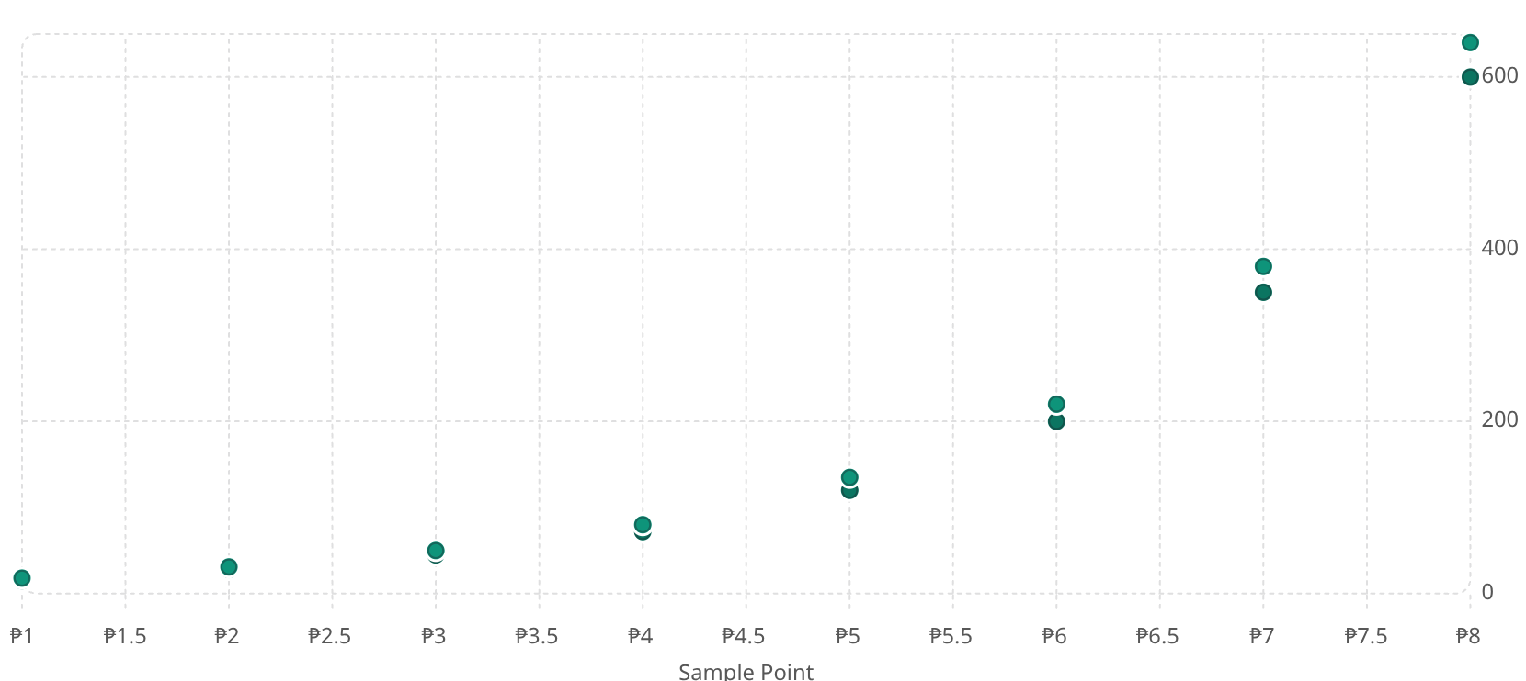

Enzyme Biomarkers — SGPT, SGOT & Alkaline Phosphatase
Liver enzymes tell a coordinated story: SGPT and SGOT rise in tandem under hepatic stress, while Alkaline Phosphatase displays extreme variability demanding careful preprocessing.
SGPT vs SGOT — Correlation Scatter
Alkaline Phosphatase (Alkphos)
SGPT (U/L)
SGOT (U/L)
Distribution Shape
Wide spread with extreme right-tail outliers. Values range from ~60 to 2000+ U/L across the patient cohort.
Clinical Insight
High variability reflects diverse disease stages. Outliers likely correspond to advanced biliary obstruction or bone disease.
Modeling Action
Log-transform Alkphos before modeling. Apply IQR-based outlier capping to prevent model distortion.
Strong positive correlation — enzyme levels rise together during liver damage. Use the SGPT/SGOT ratio as a combined diagnostic feature.

Slide 7

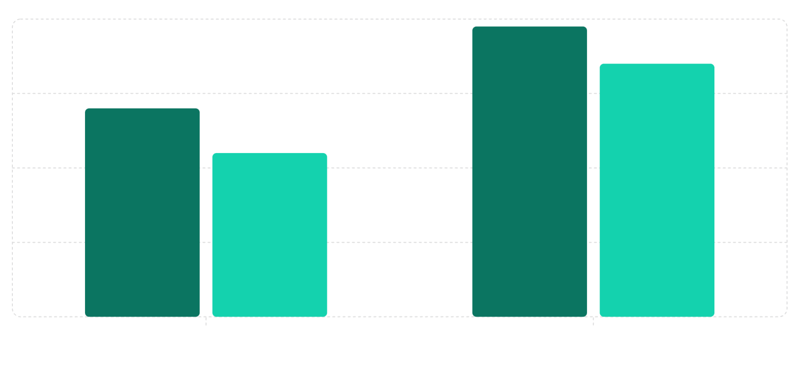



Albumin & Protein — Inverse Disease Indicators
Unlike enzyme biomarkers that rise with disease, Albumin levels fall as liver function deteriorates — making it a powerful inverse predictor in classification models.
Albumin: Disease vs. Non-Disease
Biomarker Direction Summary
Median Albumin (g/dL)
25th Percentile (g/dL)
Bilirubin (Total & Direct) ↑
3.9
Elevated in disease — use as a positive predictor. Direct bilirubin shows strongest separation.
3.4
2.8
2.2
SGPT / SGOT ↑
Rise together in hepatocellular damage — use combined ratio as a feature for added discriminatory power.
Alkaline Phosphatase ↑
High variance; useful after log-normalization and outlier treatment.
Lower albumin strongly signals poor liver synthetic function — use as an inverse feature (higher = healthier) in predictive models.
Albumin ↓
Depleted in disease — a reliable inverse indicator of liver synthetic capacity.

Slide 8
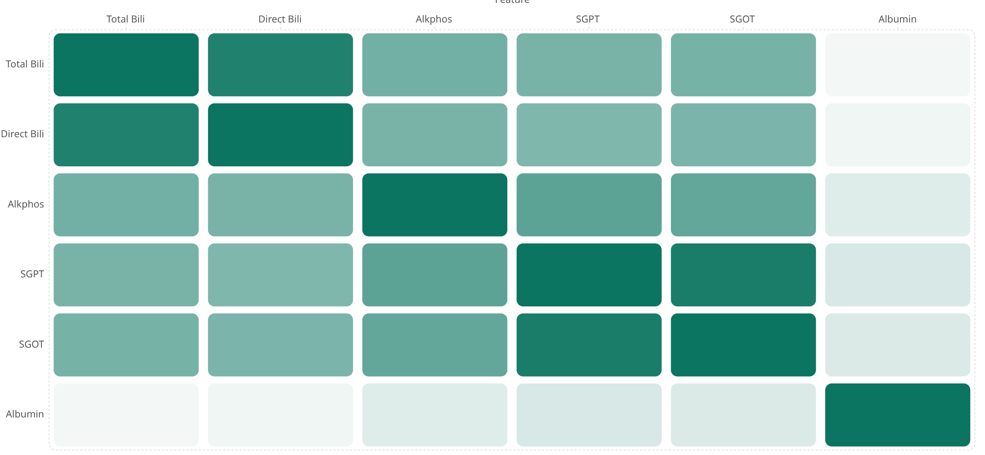


Correlation Matrix & Feature Relationships
The correlation heatmap exposes multicollinearity between enzyme markers — a critical consideration before building machine learning models. Feature selection or dimensionality reduction is strongly advised.
Multicollinearity Alert: SGPT ↔ SGOT correlation of ~0.92 and Total ↔ Direct Bilirubin of ~0.87 indicate redundant features. Remove or consolidate before modeling.
Recommendation: Apply PCA or Variance Inflation Factor (VIF) analysis. Retain Direct Bilirubin over Total, and use SGPT/SGOT ratio rather than both raw values.

Slide 9
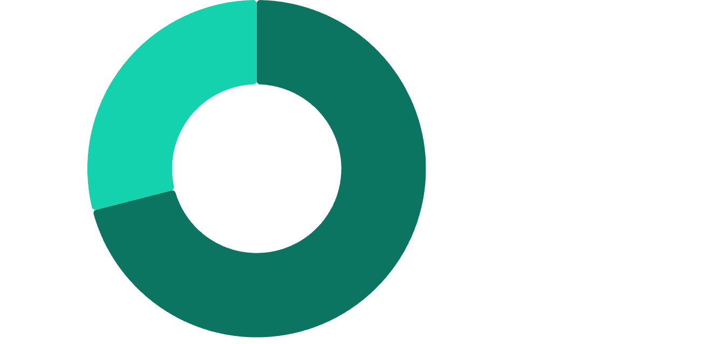
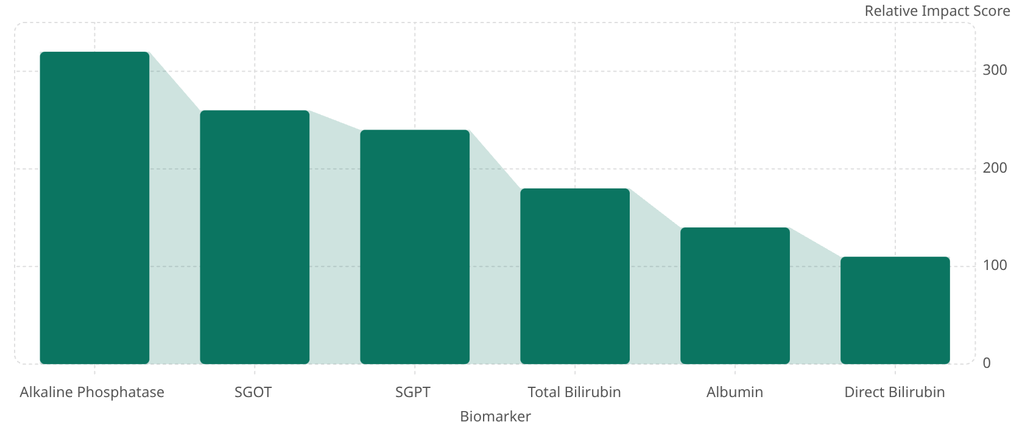

Disease Prevalence & Biomarker Impact Ranking
Two complementary views: the overall disease share confirming dataset imbalance, and a biomarker funnel ranking features by their contribution volume — guiding feature prioritization for ML models.
Disease Share — Patient Cohort
Biomarker Impact Funnel
34.38%
Total conversion rate
320
Liver Disease·71%
·71%
·
260
No Liver Disease·29%
240
·29%
·
180
140
110
71% disease prevalence — build classification models with stratified sampling and precision-recall metrics, not accuracy alone.
Different biomarkers have varying signal strength. Rank features using this funnel as a starting point for recursive feature elimination.

Slide 10




FINAL RECOMMENDATIONS
Action Plan & Next Steps
Translate biomarker insights into a production-ready early detection system for hospital deployment.
🧠 Build Predictive Model
⚖️ Handle Class Imbalance
🔧 Preprocess Biomarkers
Train Logistic Regression and Random Forest classifiers. Evaluate with AUC-ROC, F1-score, and precision-recall curves — not raw accuracy.
Apply SMOTE oversampling or class-weight adjustment. Use stratified k-fold cross-validation to ensure balanced evaluation.
Log-transform skewed features (Bilirubin, Alkphos). Cap outliers via IQR. Normalize all continuous variables before training.
Prioritize Key Biomarkers
Focus on Direct Bilirubin, SGPT/SGOT ratio, and Albumin as the top predictive features for initial model versions.
Feature Selection & Engineering
Remove multicollinear features (SGPT+SGOT raw pair). Apply VIF or PCA. Engineer the SGPT/SGOT ratio as a new composite feature.
Deploy Early Detection System
Integrate the final model into hospital lab workflows. Flag high-risk patients automatically based on incoming blood panel results.
Monitor & Retrain Continuously
Track model drift as patient demographics evolve. Schedule periodic retraining with updated hospital data to maintain accuracy.

