Slide 1
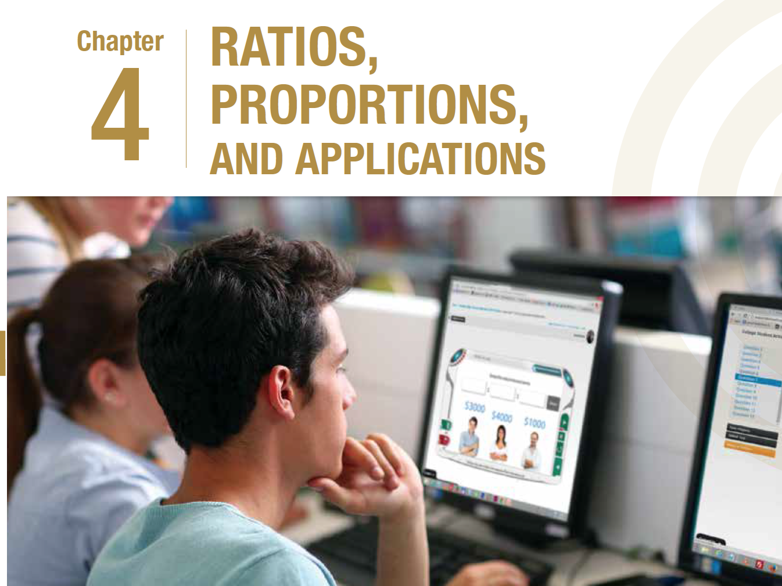

Slide 2
Topics
Section 4.2
Section 4.1: Ratios
Section 4.2: Proportions and Pro-rations
Section 4.3: Exchange Rates and their Applications
Section 4.4 Index Numbers and Applications
Section 4.1: Ratios
Section 4.2: Proportions and Pro-rations
Section 4.3: Exchange Rates and their Applications
Section 4.4: Index Numbers and Applications

Slide 3
Proportions
Section 4.2
When two sets of ratios are equal, we say that they are proportionate to each other. In the proportion equation, the ratios on the left side of the equation are equal to the ratios on the right side of the equation.
3
:
5
15
:
=
25
3
× 5
5
× 5
15
3
25
15
25
5
5
5
The proportion equation can also be represented as a fraction.

Slide 4

Proportions
Section 4.2
Unknown term
x
3
:
5
15
:
=
25
If one of the terms is an unknown quantity, we can find its value by rearranging the proportion equation and solving for the unknown term.
The proportion equation can also be represented as a fraction.

Slide 5
Proportions
Section 4.2
Unknown term
x
15
=
×
5
25
If one of the terms is an unknown quantity, we can find its value by rearranging the proportion equation and solving for the unknown term.
= 3
The proportion equation can also be represented as a fraction.

Slide 6


Solve for x in 6 : 11 = 10 : x.
Section 4.2
x = 5.45
x = 18.33
x = 0.05
x = 16.01
Notes:
Reasoning behind each multiple choice answer:
(6/11) x 10.
Correct answer: (11/6) x 10.
6/(10x11).
Random error.

Slide 7

Solve for x in 6 : 11 = 10 : x.
Section 4.2
6
:
11
10
:
x
=
6x
=
11×10
x
11×10
=
6
x
=
18.33

Slide 8
Proportions
Section 4.2
We just learned that:
A : B = C : D
A
C
=
B
D

Slide 9
Proportions with Three Terms
Section 4.2
A : B : C = D : E : F
B
A
A
E
D
D
=
=
=
F
E
C
F
B
C

Slide 10

Adam (A), Buck (B), and Charlie (C) start a computer software business together. A invests $120,000, B invests $180,000, and C invests $160,000. They agree to share the profits in the same ratio as their investments.
Section 4.2
(i) What is the ratio of their investments?
120,000 : 180,000: 160,000
Divide each term by the common factor of 10,000.
Divide each term by the common factor of 2.
÷10,000
12 : 18: 16
÷2
6 : 9: 8
The ratio of their investments is 6 : 9 : 8.

Slide 11
Adam (A), Buck (B), and Charlie (C) start a computer software business together. A invests $120,000, B invests $180,000, and C invests $160,000. They agree to share the profits in the same ratio as their investments.
Section 4.2
(ii) In the first year of running the business, A’s profit was $20,000. What were B’s and C’s profits?
Ratio of investment = Ratio of profit
6 : 9 : 8 = 20,000 : B : C
A’s profit
B’s profit
C’s profit

Slide 12
Adam (A), Buck (B), and Charlie (C) start a computer software business together. A invests $120,000, B invests $180,000, and C invests $160,000. They agree to share the profits in the same ratio as their investments.
Section 4.2
(ii) In the first year of running the business, A’s profit was $20,000. What were B’s and C’s profits?
=
6 : 9 : 8 20,000 : B : C
:
=
:
6
9
20,000
B
9
B
=
6
20,000
6
B
=
20,000
9
×
20,000
9
×
B
=
6
B’s profit
=
30,000

Slide 13
Adam (A), Buck (B), and Charlie (C) start a computer software business together. A invests $120,000, B invests $180,000, and C invests $160,000. They agree to share the profits in the same ratio as their investments.
Section 4.2
(ii) In the first year of running the business, A’s profit was $20,000. What were B’s and C’s profits?
6 : 9 : 8 20,000 : B : C
=
:
=
:
6
8
20,000
C
8
C
=
6
20,000
6
8
C
=
20,000
×
20,000
8
×
C
=
6
=
26,666.67
C’s profit

Slide 14

Paul (P), Quincy (Q), and Robert (R) start a marketing firm. P invests $200,000, Q invests $150,000, and R invests $250,000. They agree to share the profits in the same ratio as their investments. In the first year of running the business, P’s profit was $40,000. What were Q’s and R’s profits?
Section 4.2
Q: $50,000. R: $30,000.
Q: $30,000. R: $16,666.67.
Q: $30,000. R: $50,000.
Q: $30,000. R: $66,666.67.
Notes:
Reasoning behind each multiple choice answer:
Answer reversed.
(5/12x40000).
Correct answer.
(5/3x40000).

Slide 15
Paul (P), Quincy (Q), and Robert (R) start a marketing firm. P invests $200,000, Q invests $150,000, and R invests $250,000. They agree to share the profits in the same ratio as their investments. In the first year of running the business, P’s profit was $40,000. What were Q’s and R’s profits?
Section 4.2
(i) What is the ratio of their investments?
Divide each term by the common factor of 5.
Divide each term by the common factor of 10,000.
200,000 : 150,000: 250,000
÷10,000
20 : 15: 25
÷5
4 : 3: 5
The ratio of their investments is 4 : 3 : 5.

Slide 16
Paul (P), Quincy (Q), and Robert (R) start a marketing firm. P invests $200,000, Q invests $150,000, and R invests $250,000. They agree to share the profits in the same ratio as their investments. In the first year of running the business, P’s profit was $40,000. What were Q’s and R’s profits?
Section 4.2
(ii) In the first year of running the business, P’s profit was $40,000. What were Q’s and R’s profits?
Ratio of investment = Ratio of profit
4 : 3 : 5 = 40,000 : Q : R
P’s profit
Q’s profit
R’s profit

Slide 17
Paul (P), Quincy (Q), and Robert (R) start a marketing firm. P invests $200,000, Q invests $150,000, and R invests $250,000. They agree to share the profits in the same ratio as their investments. In the first year of running the business, P’s profit was $40,000. What were Q’s and R’s profits?
Section 4.2
(ii) In the first year of running the business, P’s profit was $40,000. What were Q’s and R’s profits?
=
4 : 3 : 5 40,000 : Q : R
:
=
:
4
3
40,000
Q
3
Q
=
4
40,000
4
Q
×
3
=
40,000
40,000
×
3
Q
=
4
=
30,000
Q’s profit

Slide 18
Paul (P), Quincy (Q), and Robert (R) start a marketing firm. P invests $200,000, Q invests $150,000, and R invests $250,000. They agree to share the profits in the same ratio as their investments. In the first year of running the business, P’s profit was $40,000. What were Q’s and R’s profits?
Section 4.2
(ii) In the first year of running the business, P’s profit was $40,000. What were Q’s and R’s profits?
4 : 3 : 5 40,000 : Q : R
=
:
=
:
4
5
40,000
R
5
R
=
4
40,000
4
5
R
×
=
40,000
40,000
5
×
R
=
4
=
50,000
R’s profit

Slide 19

Pro-ration
Section 4.2
Pro-ration is defined as sharing or allocating the quantities, usually amounts of money, on a proportionate basis.
Example
A 4 hour consultation session with Raymond cost a company $500. The company wants to hire him for another 2 hours.
:
$500
x
$250
?
500 : x = 4 : 2
Let the missing value be x.
2
x =
× 500
4
4 hrs
:
= 250
2hrs
Raymond’s pay pro-rated to 2 hours is $250.

Slide 20
Find the pro-rated insurance premium for 3 months if the annual premium is $6000.
Section 4.2
=
Premium : Time Premium : Time
:
x
:
3
=
6000
12
x
6000
=
3
12
6000
x
=
×
3
12
x
= $1500
The pro-rated premium for 3 months is $1500.

Slide 21
Angela paid $500 for a 1 year weekly gym membership. After going for 20 weeks, she decided to cancel her membership. What should be her refund? Assume 1 year = 52 weeks.
Section 4.2
$307.69
$192.31
$288.46
$15.625
Notes:
Reasoning behind each multiple choice answer:
Correct answer.
250,000/3,294,500 x 100.
3,294,500/250,000.
250,000/3,294,500 x 10,000.

Slide 22
Angela paid $500 for a 1 year weekly gym membership. After going for 20 weeks, she decided to cancel her membership. What should be her refund? Assume 1 year = 52 weeks.
Section 4.2
Angela should receive a refund for 52 − 20 = 32 weeks.
Premium : Time Premium : Time
:
=
x
32
:
52
=
500
x
500
=
32
52
500
=
x
×
32
52
x
= $307.69
Her refund should be $307.69.

