Slide 1
customer Analytics & RFM Analysis
Business Insights Dashboard

Slide 2
Project Overview
Analyze customer transactions and behavior
Perform RFM segmentation
Generate actionable business insights

Slide 3
Dataset Overview
23,050 transactions
Customer ID, Transaction Date, Transaction Amount
Derived Month column for time analysis

Slide 4
Data Cleaning
Checked for missing values
Validated Customer ID uniqueness
Ensured correct data types

Slide 5
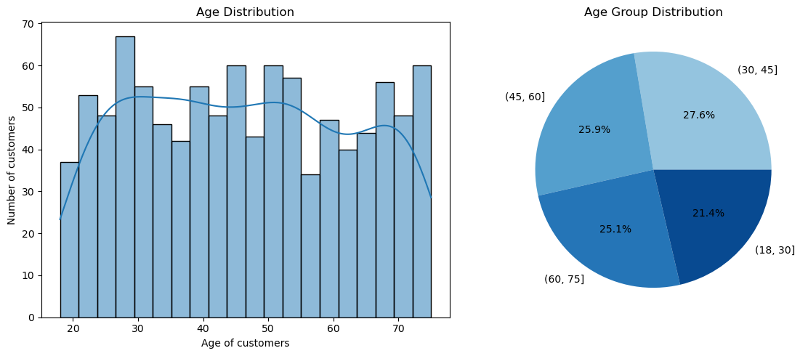
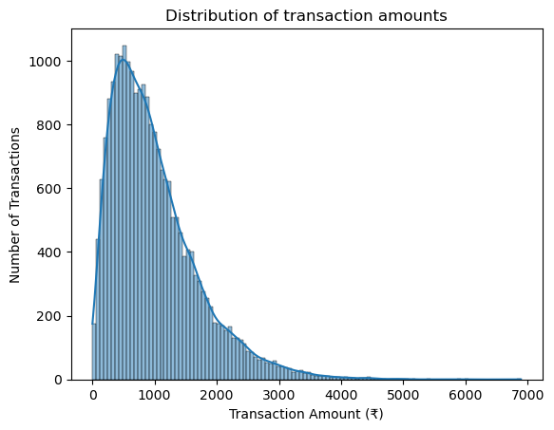
Univariate Analysis
Age and transaction distributions analyzed
Gender distribution is balanced
Customer demographics are diverse

Slide 6
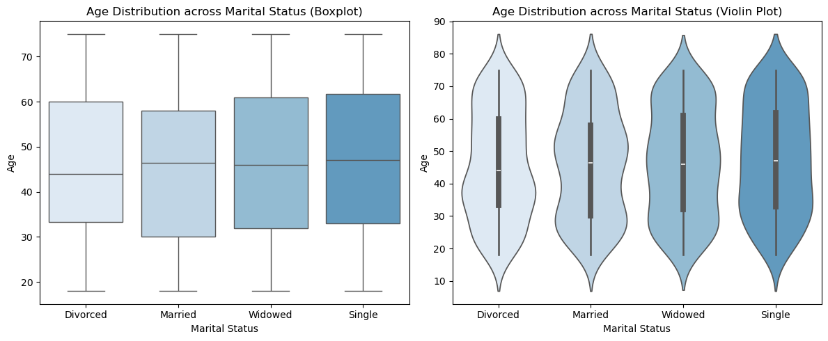
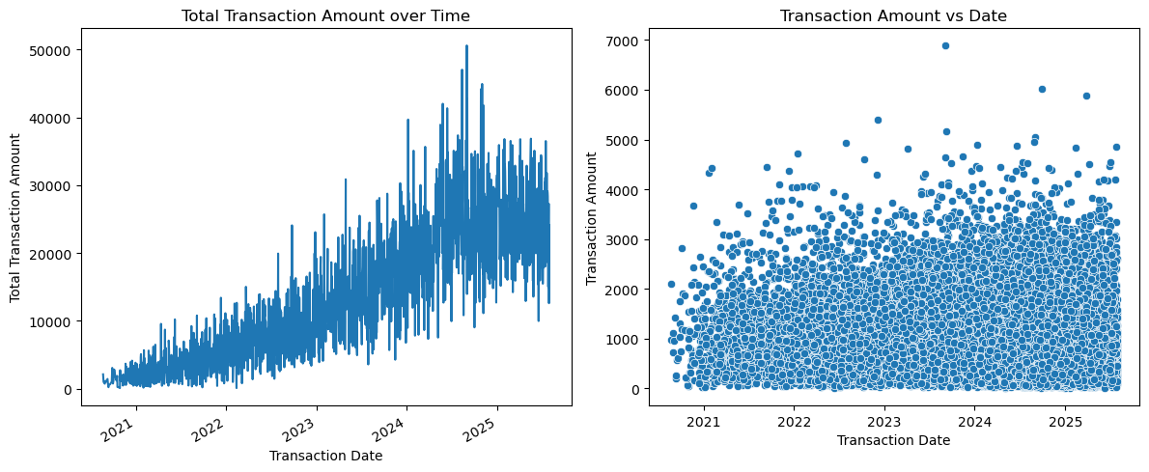
Bivariate Analysis
Transaction trends over time analyzed
Customer spending varies across timeline
Scatter plots show distribution patterns

Slide 7
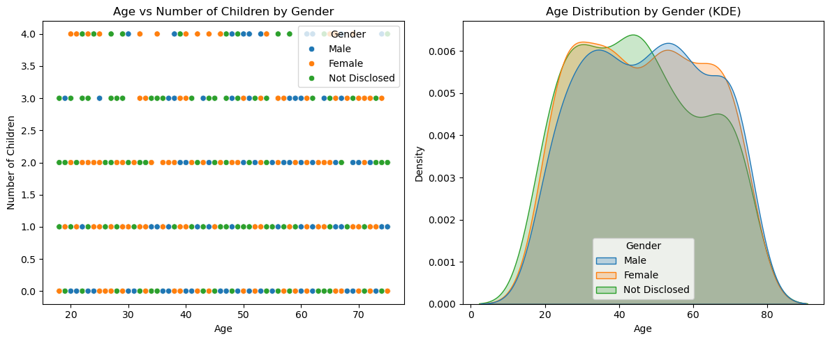
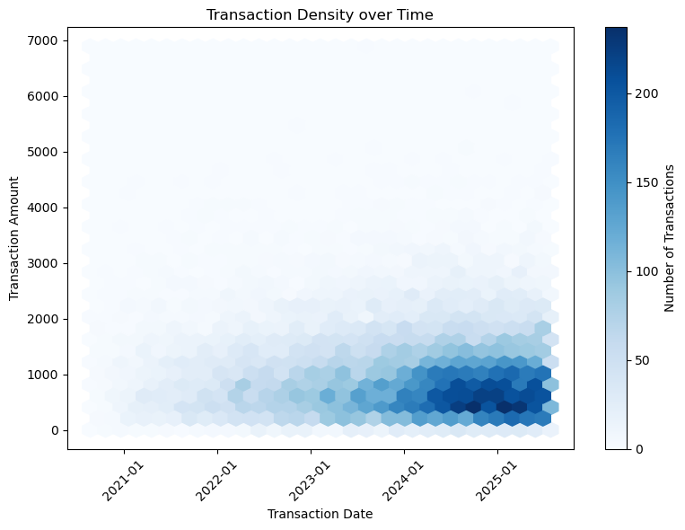
Multivariate Analysis
Combined time and transaction amount
Density plots highlight high activity zones
Customer behavior varies over time

Slide 8
RFM Analysis
Recency, Frequency, Monetary calculated
Customers grouped based on behavior
Helps identify high-value customers

Slide 9
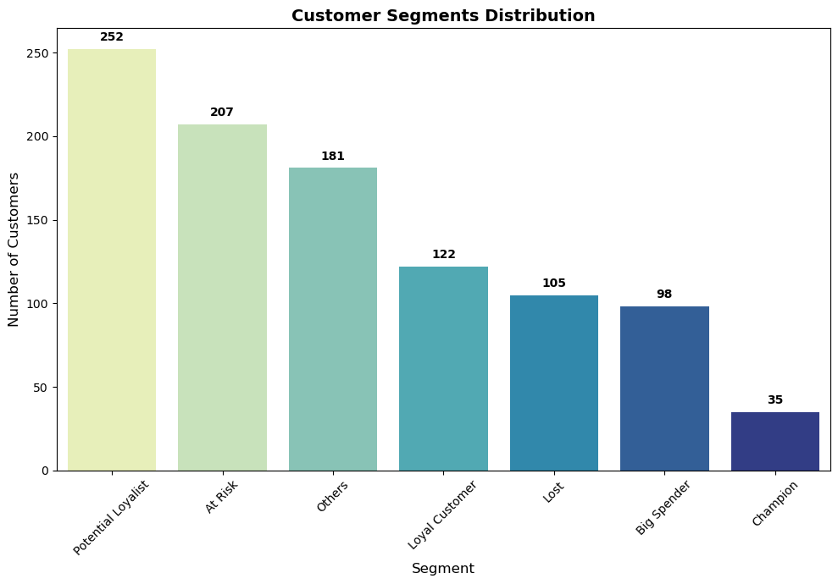
Customer Segments
Potential Loyalists are highest
At Risk and Lost customers present
Champions are few but valuable

Slide 10
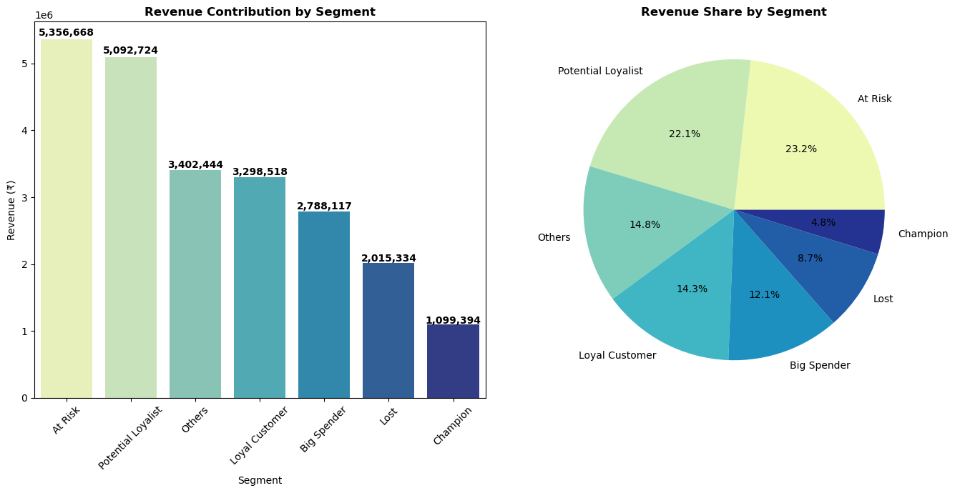
Revenue Contribution
Revenue spread across segments
High-value segments contribute more
Opportunity in mid-tier customers

Slide 11
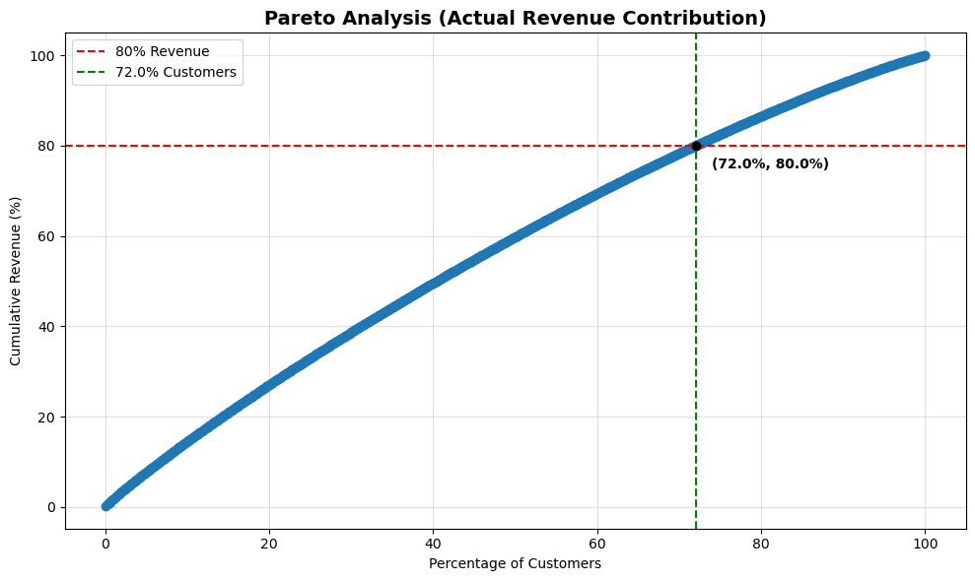
Pareto Analysis
72% customers generate 80% revenue
Revenue distribution is balanced
Not strictly 80/20 rule

Slide 12
Key Insights
Customer base is diverse
Growth potential in loyal segments
Balanced revenue structure

Slide 13
Business Recommendations
Retain high-value customers
Convert potential loyalists
Re-engage at-risk customers
Use targeted marketing strategies

Slide 14
Conclusion
Strong customer base with growth opportunities
Balanced revenue reduces dependency risk
Strategic segmentation can boost profitability

