Slide 1
SmartSignDeck
Digital Signage Management System
Developed By:
Dhimant N. Pandya
(BC065 / 23BCUOS076)
Developed At: Technostacks Infotech
Internal Guide: Prof. Minaz Shaikh

Slide 2
About The System
SmartSignDeck is a comprehensive, cloud-based Digital Signage Management SaaS platform.
It is designed to enable businesses, advertisers, and organizations to seamlessly control and update digital displays (TVs, Monitors, Billboards) located anywhere in the world from a single centralized dashboard.
Traditionally, updating a digital screen required a person to physically travel to the display monitor and plug in a USB drive. SmartSignDeck completely eliminates this manual effort by leveraging internet connectivity to push content to screens remotely.

Slide 3
About The System
Core Objectives:
1. Centralized Management: Control an unlimited number of screens across different physical locations simultaneously.
2. Real-Time Synchronization: Push media and layout updates to live screens instantly using WebSockets.
3. Intuitive Designing: Provide a drag-and-drop template editor (canvas) for users to build rich media layouts (Images, Videos, Clocks).
4. Multi-Tenant Architecture: Allow multiple companies to use the platform securely with strict data isolation.
5. Analytics & Auditing: Track exactly what content is playing and monitor screen online statuses.

Slide 4
Hardware & Software Details
Software Technologies (MERN Stack):
• Frontend: React.js, TypeScript, TailwindCSS, Fabric.js (Canvas)
• Backend: Node.js, Express.js, Socket.IO (WebSockets)
• Database: MongoDB Atlas (Mongoose ORM)
• Cloud Services: Firebase Auth (OAuth), Cloudinary (Media Storage)
Hardware Requirements:
• Cloud Server: 2 vCPUs, 2GB RAM minimum (Node.js backend hosting)
• Client (Admin UI): Standard Laptop/Desktop with a modern web browser
• Display Server (Player node): Smart TV, Raspberry Pi, or mini-PC with an active internet connection
• Network: Standard broadband connection for reliable media streaming.

Slide 5
Detailed Description
a) Existing System
Pain Points in Traditional Systems:
• Manual Effort: Content is stored on USB drives; employees must physically travel to displays to plug them in.
• No Centralization: Impossible to sync or update multiple billboards in different cities at the same time.
• Blind Operations: Management cannot remotely check if a screen is broken, offline, or turned off.
• Static Content: Very difficult to integrate dynamic elements like Live Clocks or real-time internet feeds alongside videos.

Slide 6
Detailed Description
b) Proposed System (SmartSignDeck)
Advantages & Solutions:
• Cloud-Based Pipeline: Admins securely upload layouts globally. Remote screens fetch updates via Wi-Fi/Ethernet.
• Instant WebSocket Triggers: The moment an admin clicks "Deploy", the display updates synchronously worldwide within milliseconds.
• Automated 24/7 Scheduling: Content rules shift layouts based strictly on current timeslots or days independently.
• Dynamic Designer: Embed Videos, Images, QR Codes, and Real-Time Clocks into a custom template canvas seamlessly.

Slide 7
Feasibility Study
1. Technical Feasibility:
• Highly scalable utilizing a modern MERN Stack and WebSocket architecture.
• Extremely low-latency real-time synchronization between server and client screens.
2. Economic Feasibility:
• Open-source framework eliminating hefty upfront licensing costs.
• Pay-As-You-Go cloud scaling keeps storage and computing inexpensive.
3. Operational Feasibility:
• Visual drag-and-drop mechanics ensure zero learning-curve for new admins.
• Automates previously tedious physical operations entirely.

Slide 8
System Diagrams
(UML, Data Flow, & ER)

Slide 9
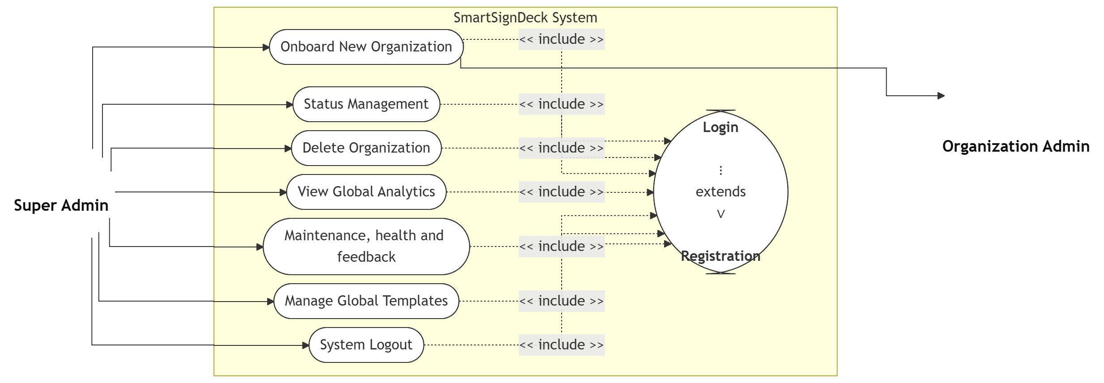
Use Case Diagram
a) Super Admin

Slide 10
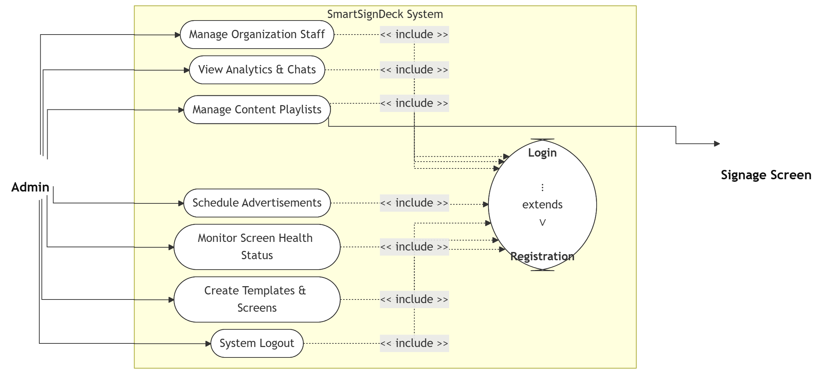
Use Case Diagram
b) Admin

Slide 11
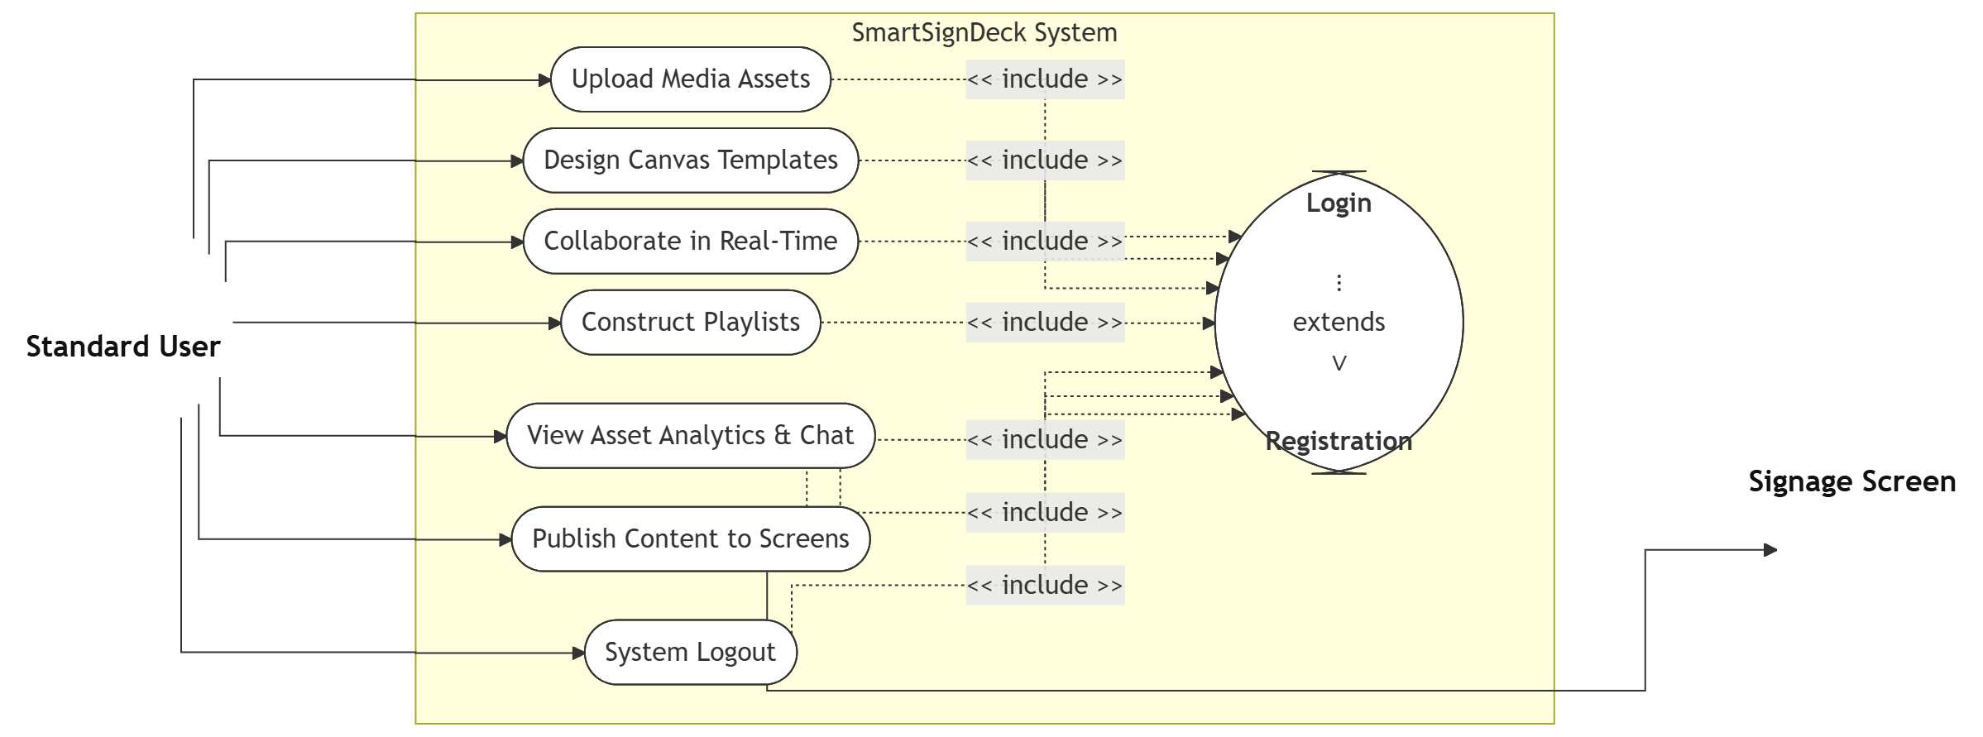
Use Case Diagram
c) User

Slide 12
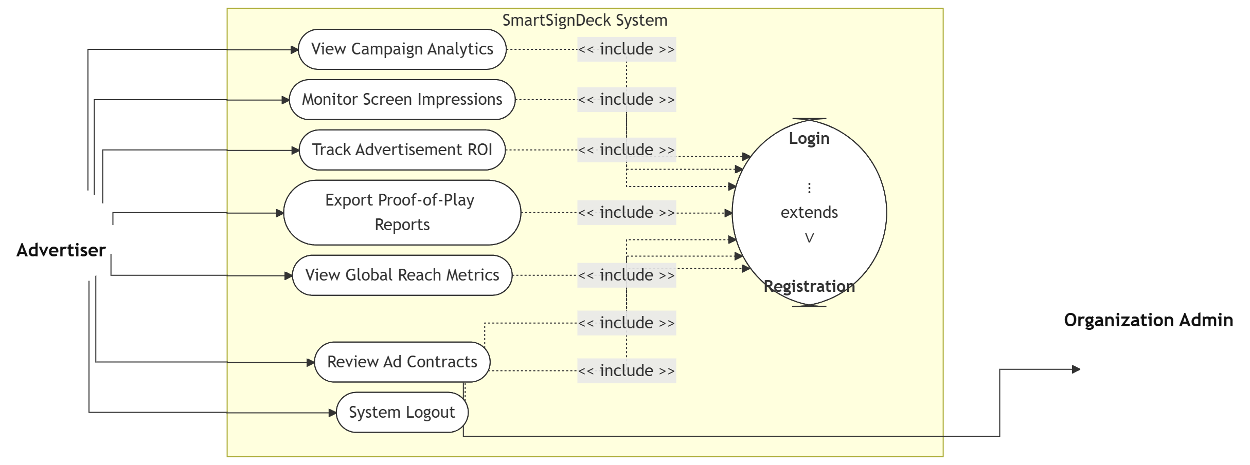
Use Case Diagram
d) Advertiser

Slide 13
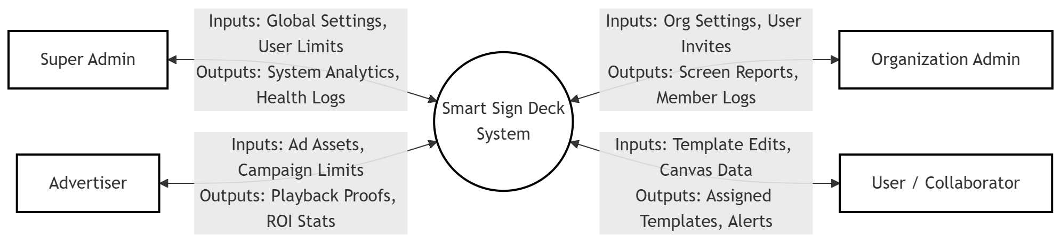
Data Flow Diagram
Context Level DFD (Level 0)

Slide 14
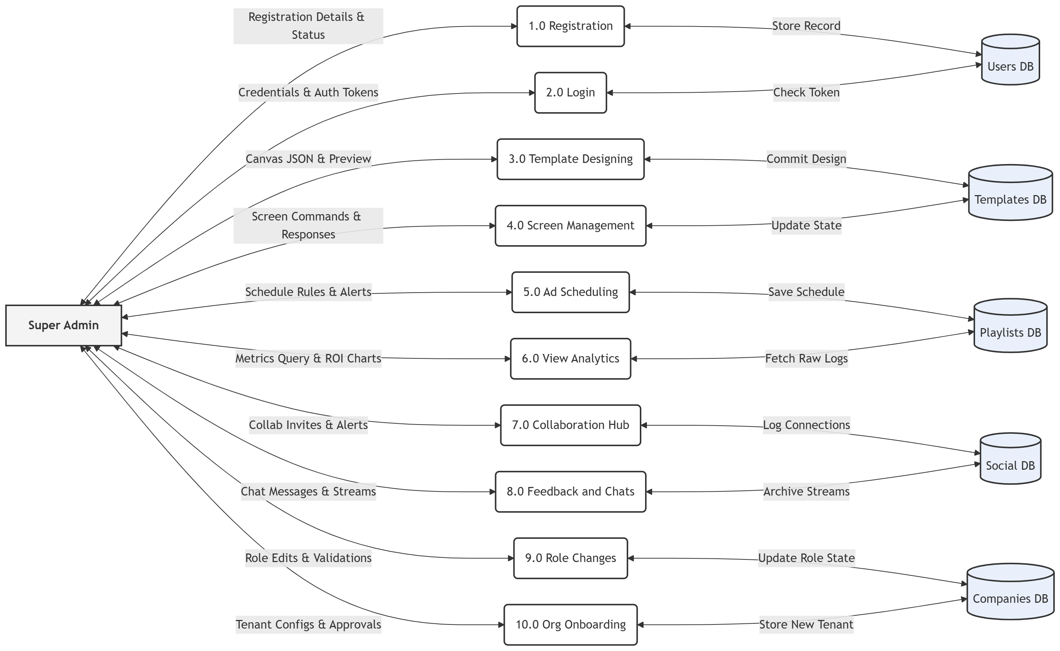
Data Flow Diagram
Level 1 DFD: Super Admin

Slide 15
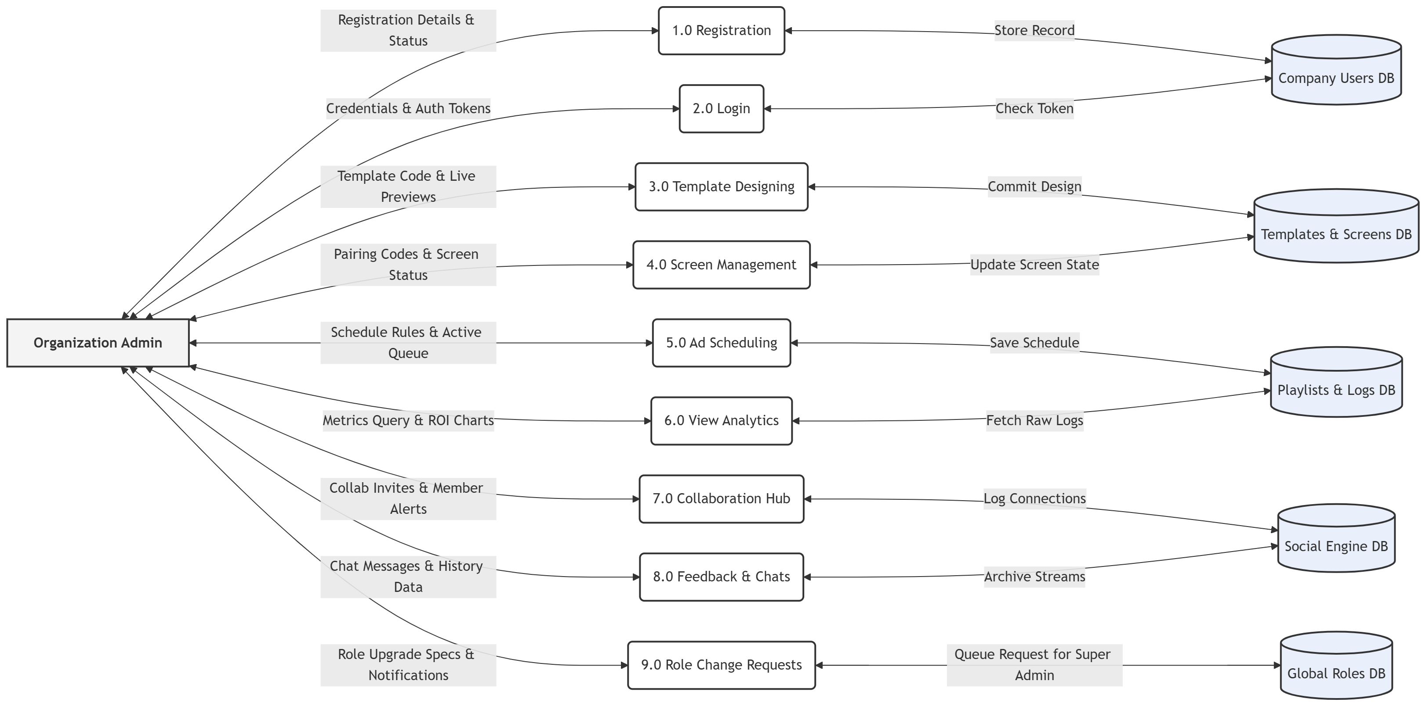
Data Flow Diagram
Level 1 DFD: Admin

Slide 16
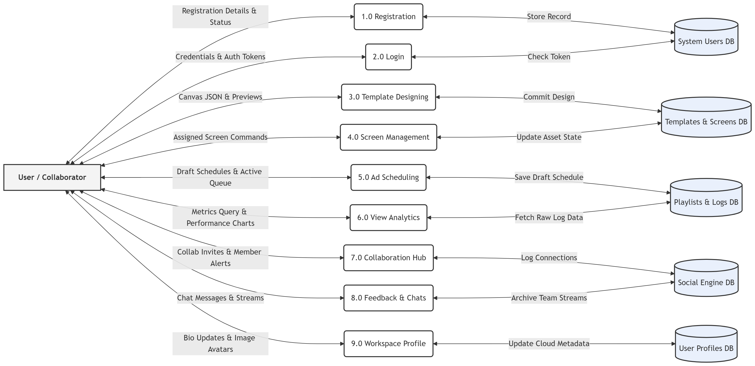
Data Flow Diagram
Level 1 DFD: User

Slide 17
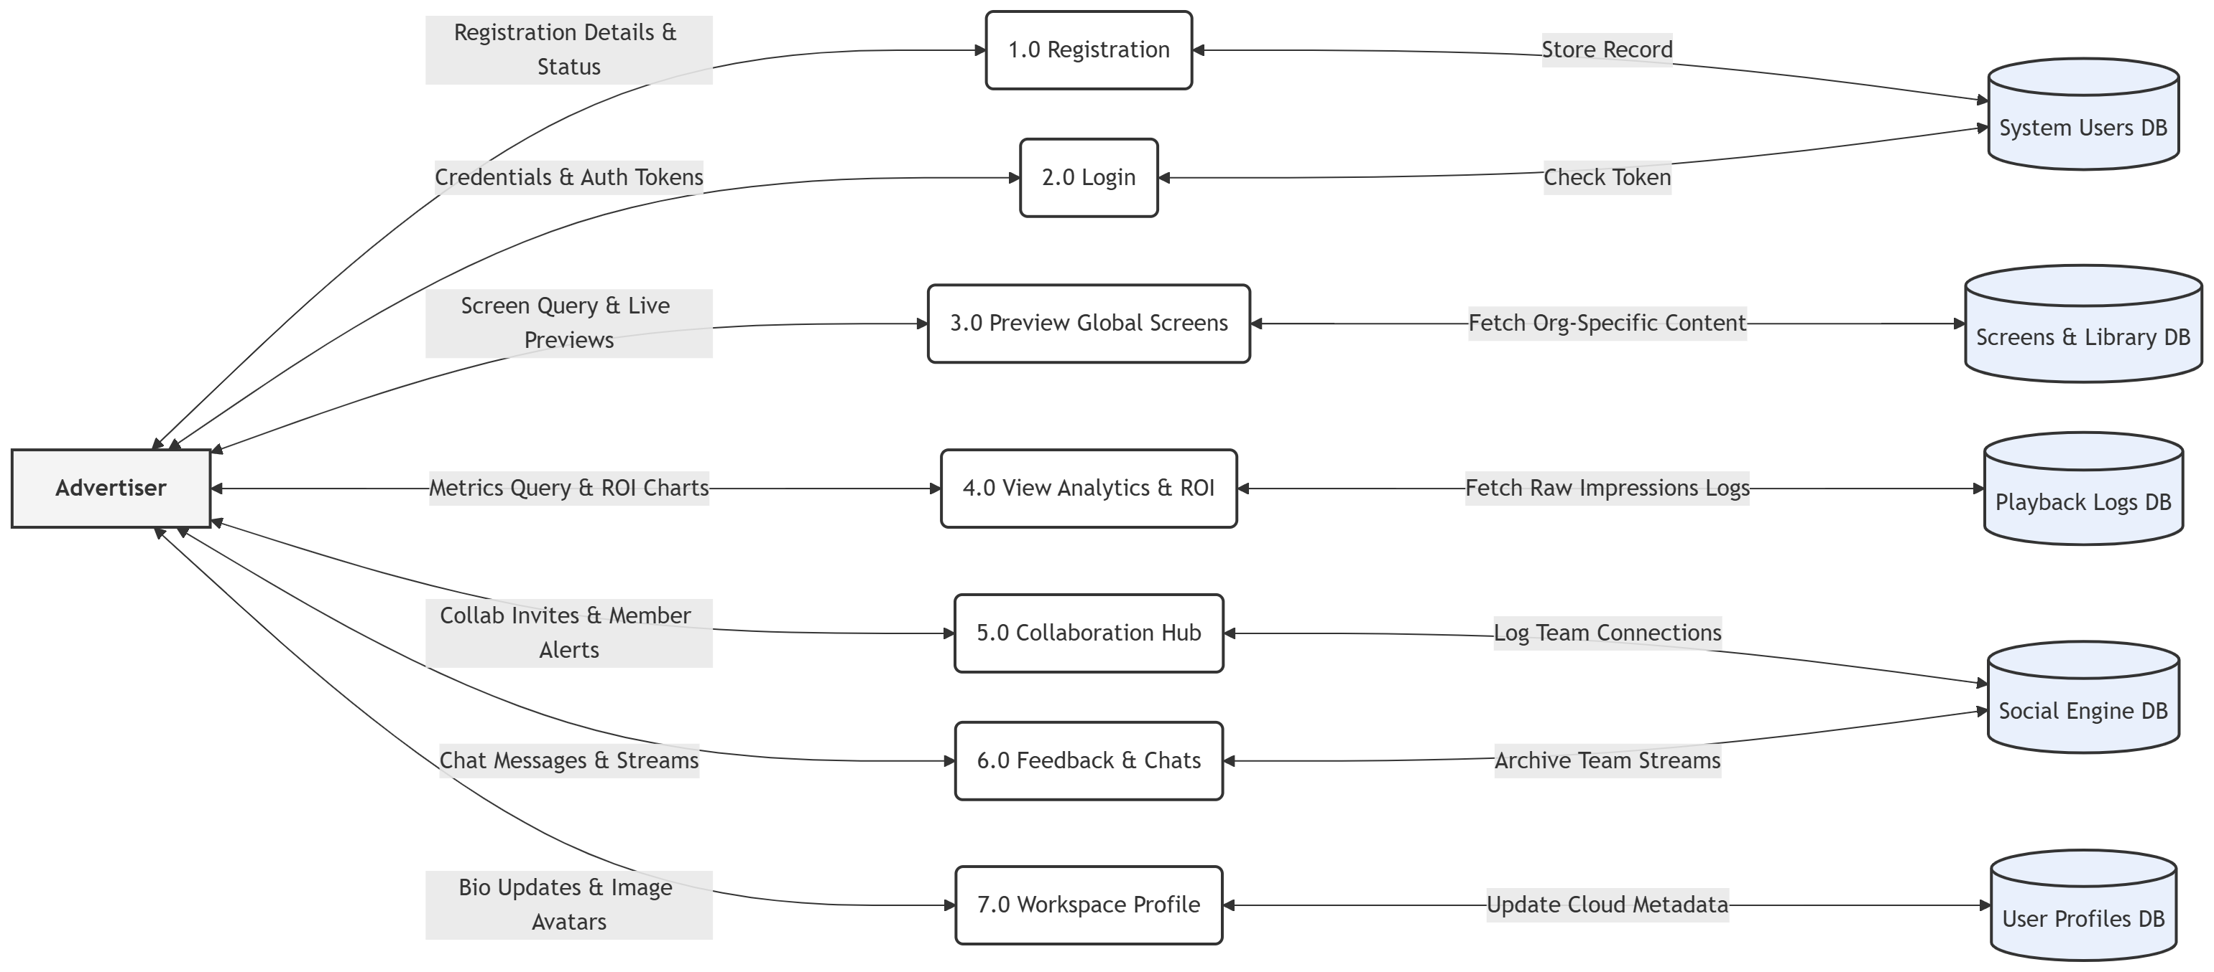
Data Flow Diagram
Level 1 DFD: Advertiser

Slide 18
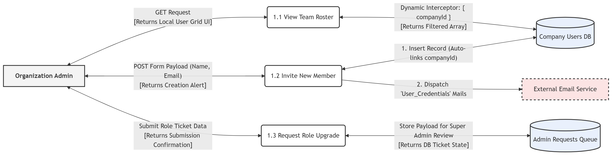
Data Flow Diagram
Level 2 DFD: Admin/Users

Slide 19
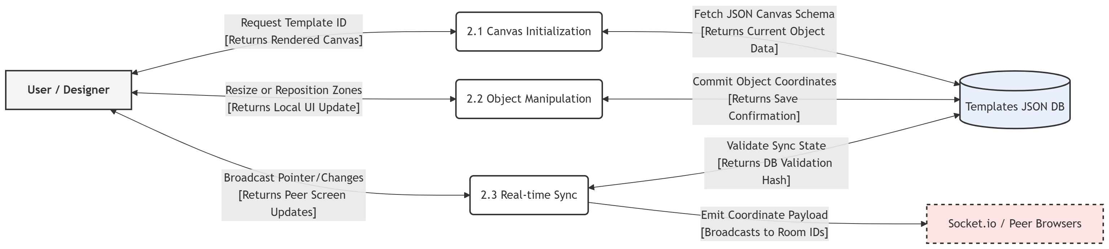
Data Flow Diagram
Level 2 DFD: User Canvas (Editor)

Slide 20
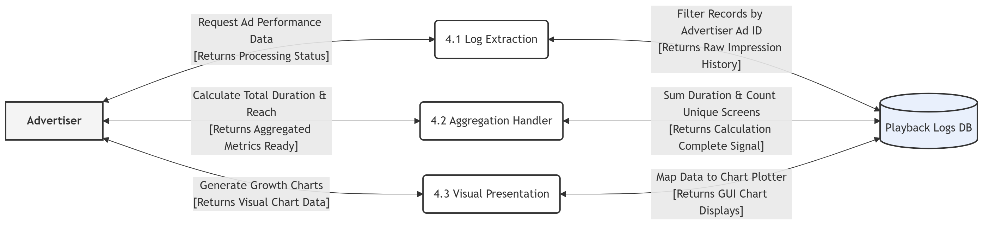
Data Flow Diagram
Level 2 DFD: Advertiser

Slide 21
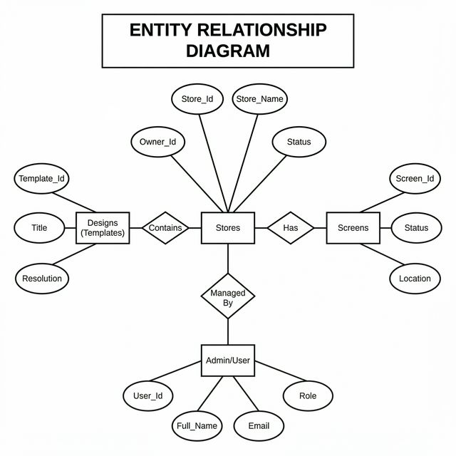
ER Diagram
Entity-Relationship Diagram

Slide 22
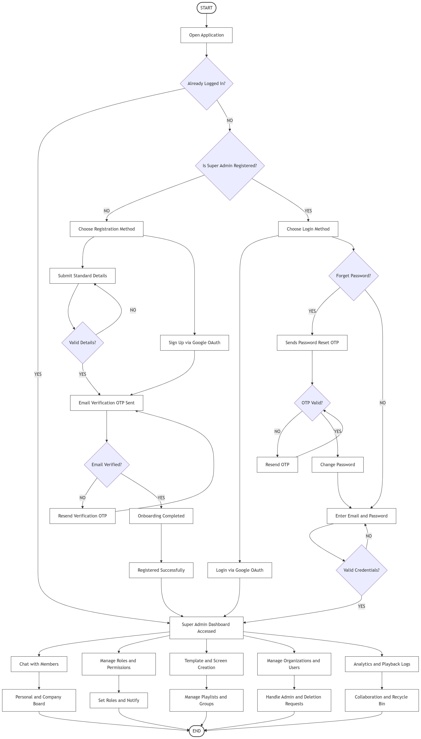
System Flow Processes
Flow Chart (Super Admin)

Slide 23
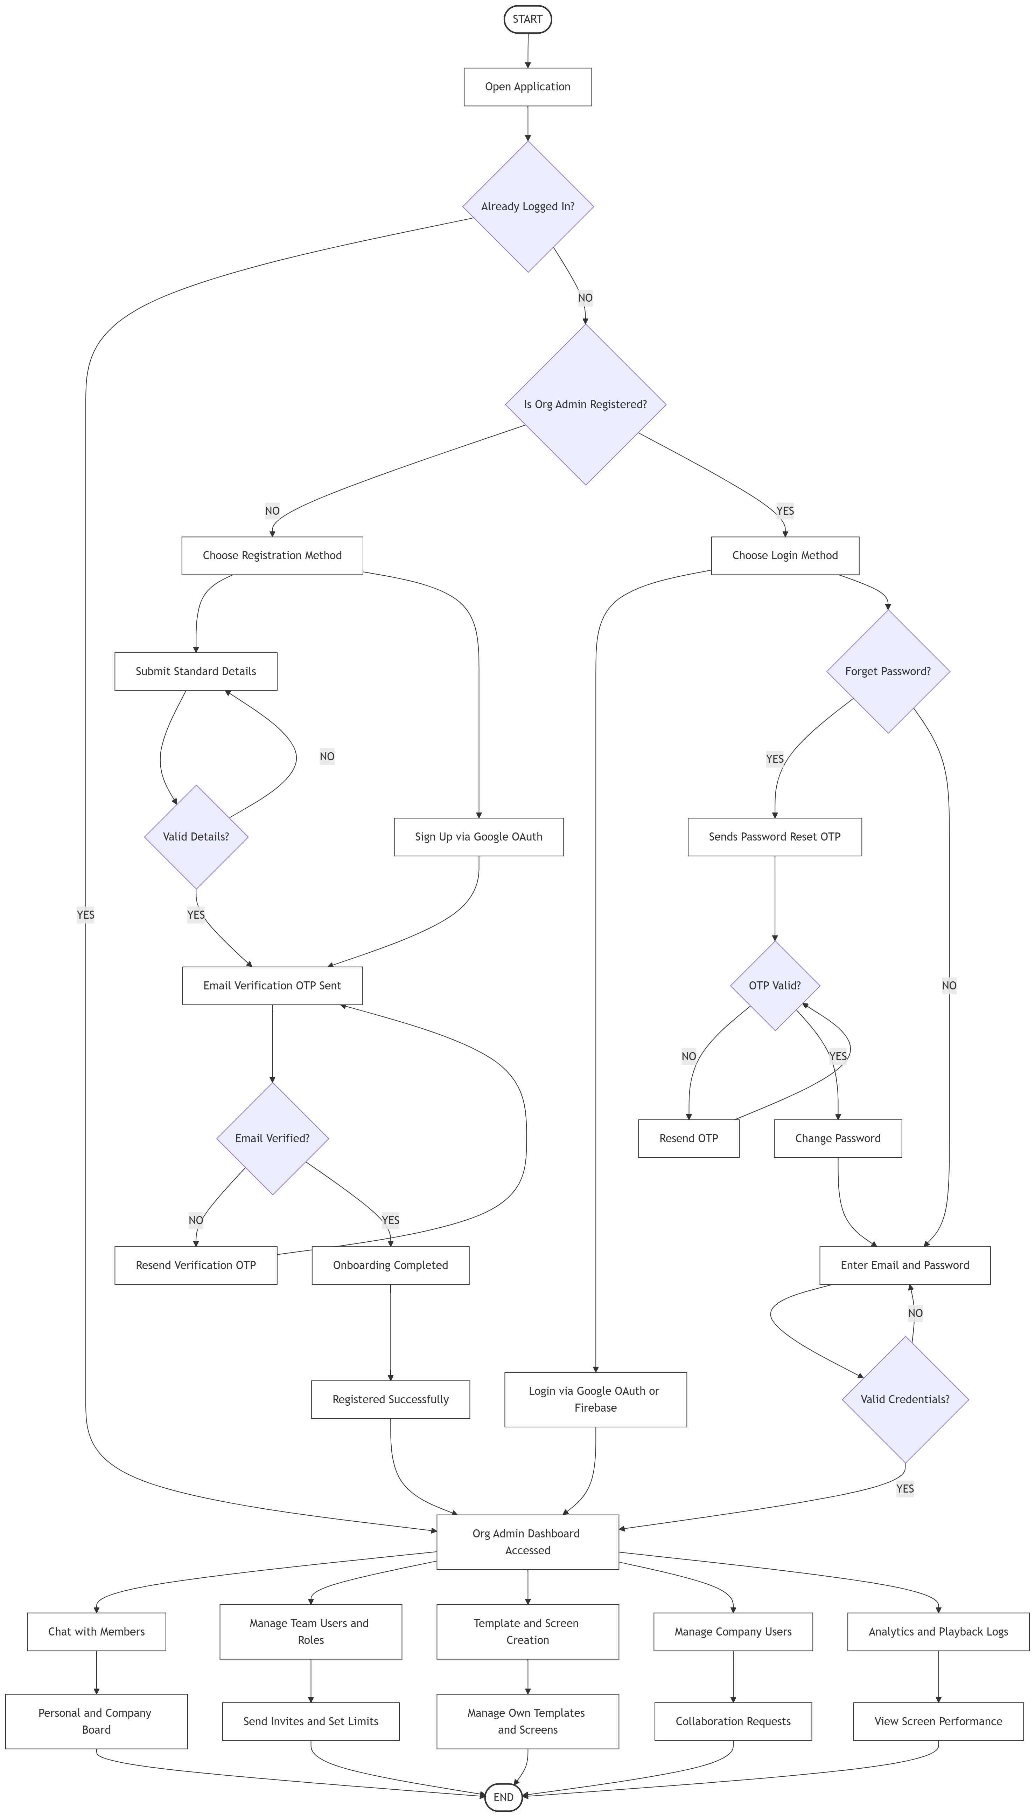
System Flow Processes
Flow Chart (Admin)

Slide 24
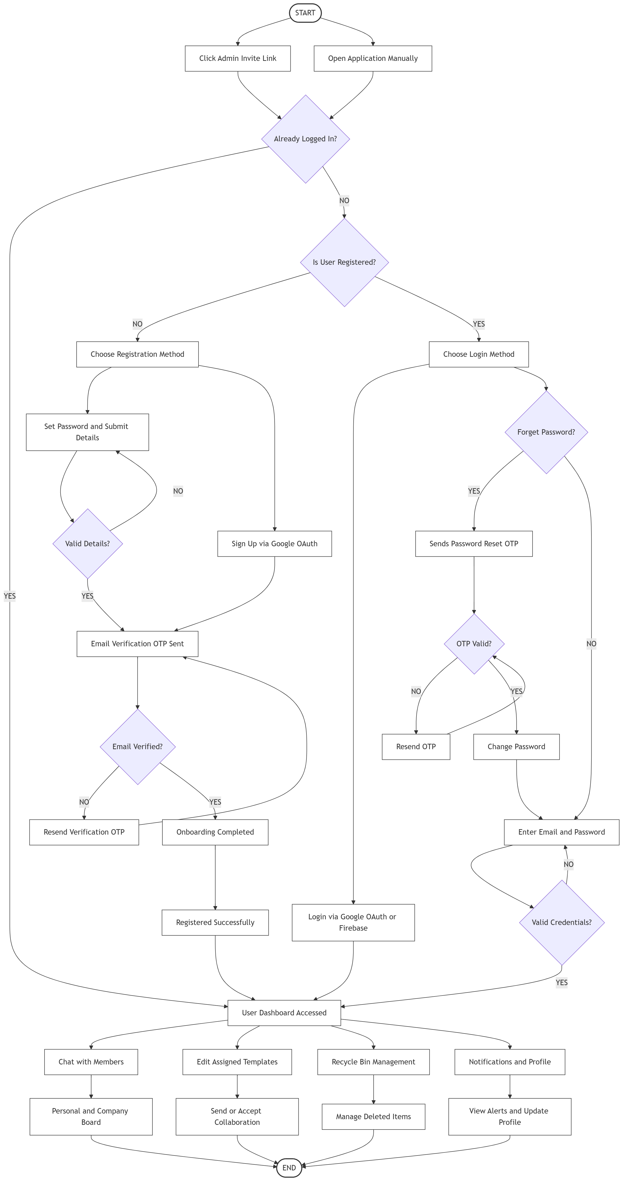
System Flow Processes
Flow Chart (User)

Slide 25
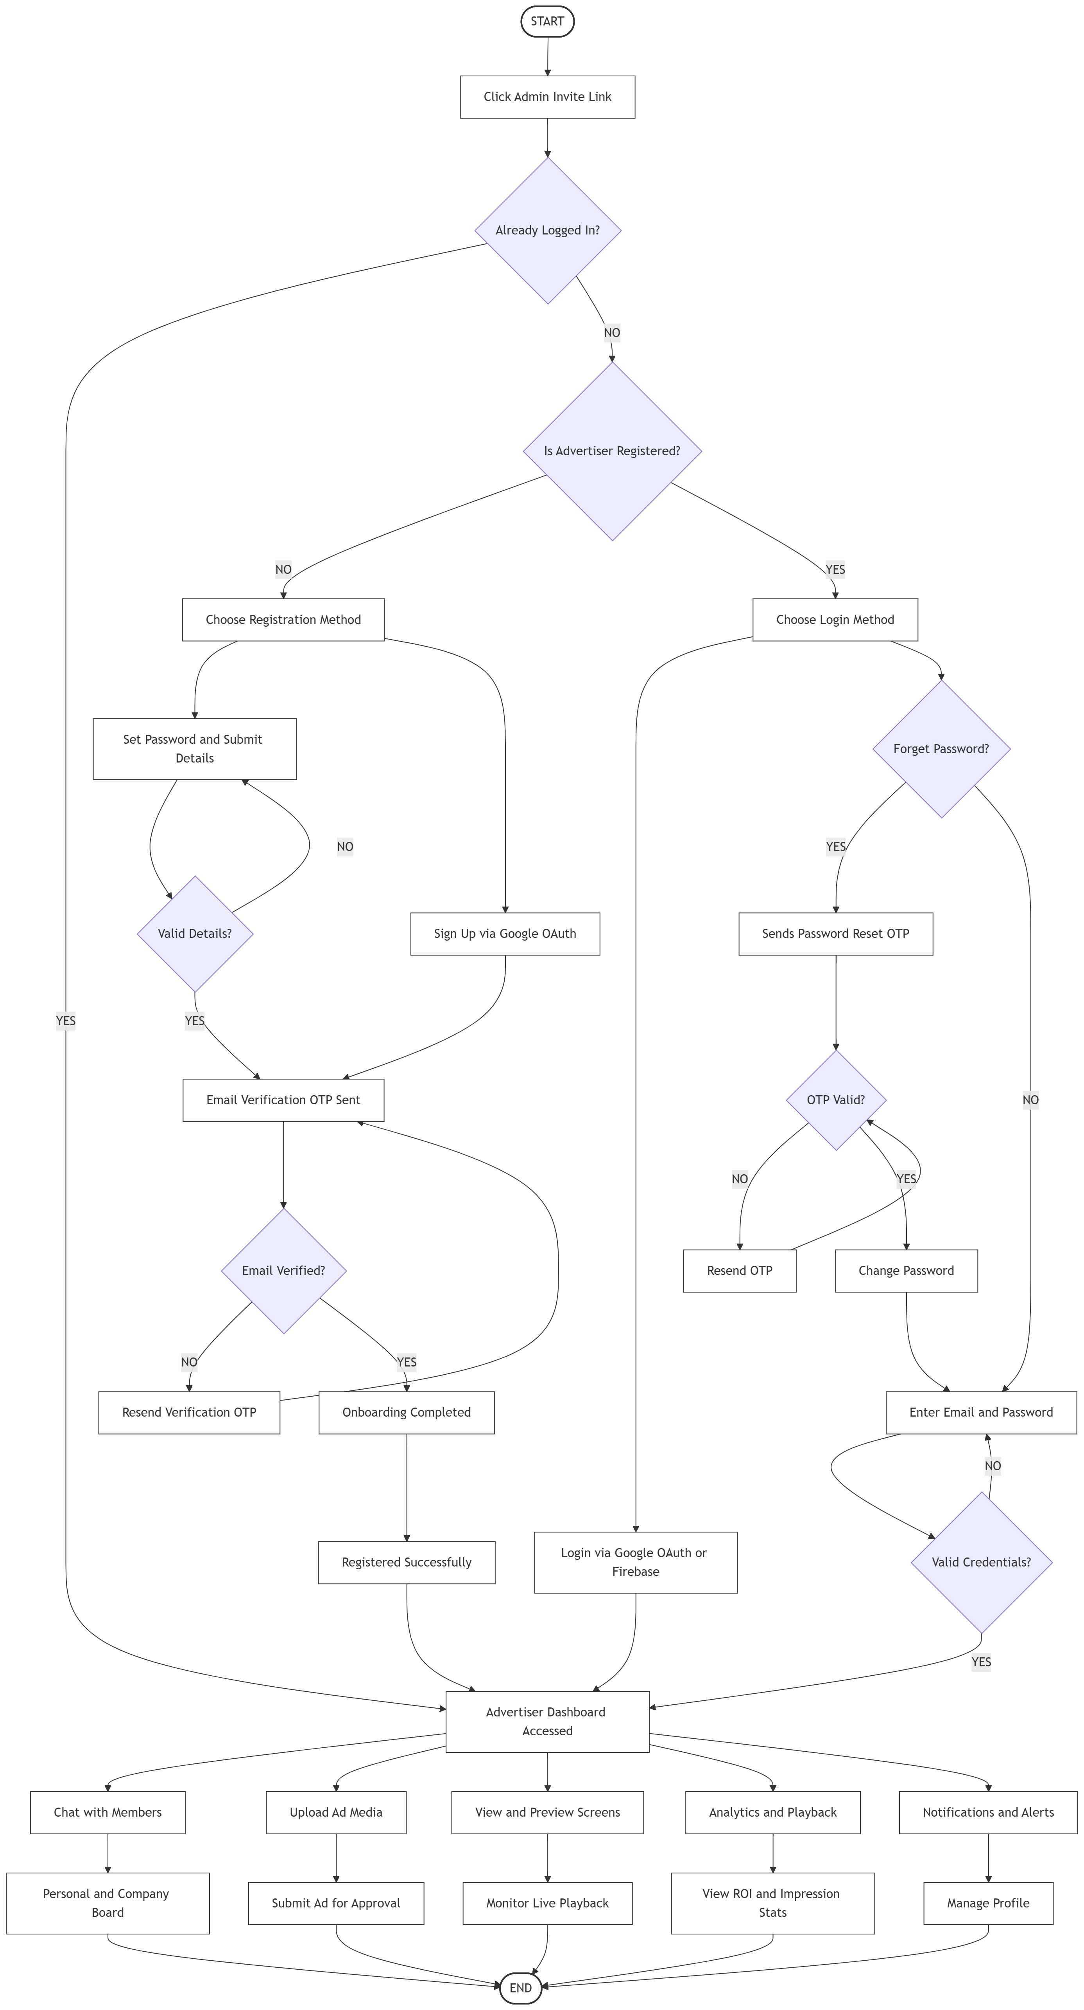
System Flow Processes
Flow Chart (Advertiser)

Slide 26
System Flow Processes
Activity Diagram
[ Please provide Activity Diagram Image to complete ]

Slide 27
System Flow Processes
Sequence Diagram
[ Please provide Sequence Diagram Image to complete ]

Slide 28
Data Dictionary (Collections)

Slide 29
Collection: users
Description: Store registered user profiles and authentication data.
No | Field Name | Data Type | Description
1 | _id | ObjectId | Primary key
2 | name | String | Full name of the user
3 | email | String | Unique email address
4 | password | String | Hashed password (bcrypt)
5 | role | String | System Access Level (admin, user)
6 | companyId | ObjectId | Foreign Key referencing Company

Slide 30
Collection: screens
Description: Holds all display locations and real-time socket statuses.
No | Field Name | Data Type | Description
1 | _id | ObjectId | Primary key
2 | name | String | Screen display area name
3 | macAddress | String | Unique network identifier
4 | status | String | Online or Offline playback status
5 | templateId | ObjectId | Foreign Key referencing Template

Slide 31
Collection: templates
Description: Saves the drag-and-drop grid canvas layouts.
No | Field Name | Data Type | Description
1 | _id | ObjectId | Primary key
2 | name | String | Title of the template
3 | resolution | String | Display output (e.g. 1920x1080)
4 | zones | Array | JSON array of screen layout zones
5 | visibility | String | Visibility permission

Slide 32
Collection: playlists
Description: Sequence of templates scheduled to run on screens.
No | Field Name | Data Type | Description
1 | _id | ObjectId | Primary key
2 | name | String | Playlist title
3 | templates | Array(Object) | Array mapping Template_IDs to Durations
4 | createdBy | ObjectId | Created By identifier

Slide 33
System Screen Layouts

Slide 34
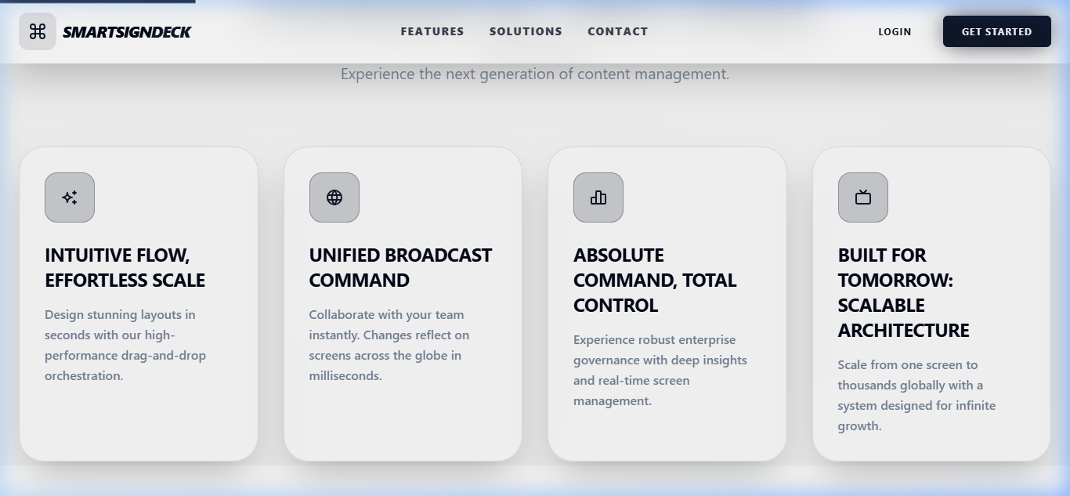
System Screen Layouts
Landing Page Features

Slide 35
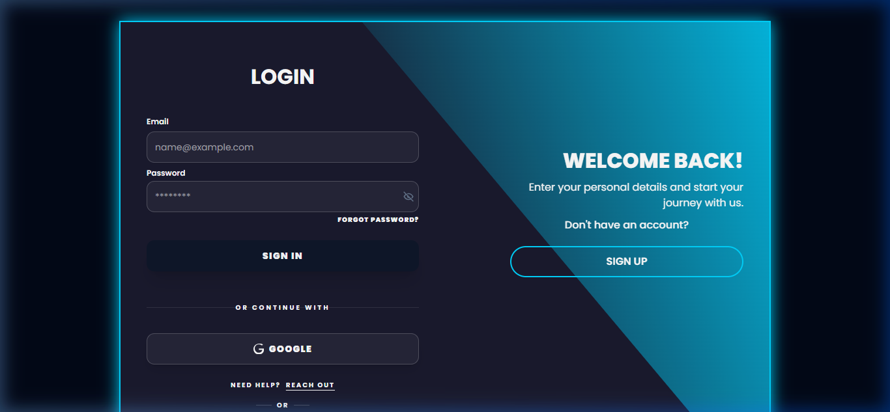
System Screen Layouts
Login Screen

Slide 36
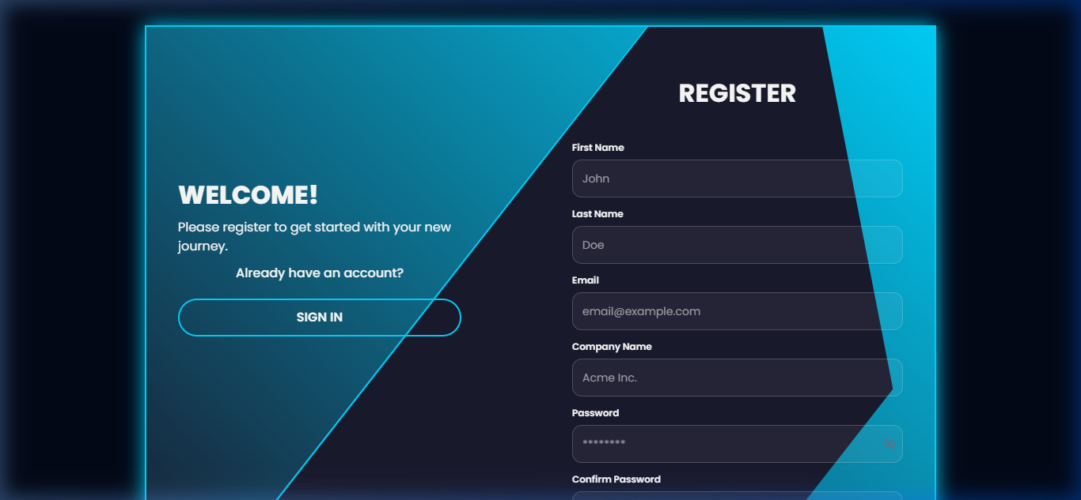
System Screen Layouts
Registration Form

Slide 37
System Screen Layouts
Main Dashboard
[ Paste Dashboard UI ]

Slide 38
System Screen Layouts
Template Builder
[ Paste Template Editor UI ]

Slide 39
Scope & Limitations
Scope:
• The system is capable of pushing dynamic visual changes to unlimited displays connected globally.
• Distinct access layers ensure users only control screens and media assigned to their workspace.
• Audit logging provides administrators with a complete history of all content changes over time.
Limitations:
• Strict dependency on reliable internet access. Screens cannot render completely new updates if the connection drops entirely.
• Timezone management is currently unified globally, lacking automatic local timezone logic for displays heavily relying on accurate local time.
• Pushing raw uncompressed 4K video assets may induce buffering latency on low-end WiFi networks.

Slide 40
Future Expansion
1. Implement Offline Player Architecture:
Develop electron-based or native mobile applications to heavily cache templates offline for 100% uninterrupted looping when internet drops.
2. AI-Powered Templating:
Integrate Generative AI tools (e.g. OpenAI) to automatically auto-design marketing graphics based entirely on prompt keywords.
3. Audience Analytics:
Embed camera modules at display zones to capture demographic engagement metrics and view-duration statistics anonymously.
4. Ad-Tech Payment Gateways:
Allow external third-party advertisers to bid and rent out your unused screen timeslots and pay digitally via Stripe.

Slide 41
Thank You
Any Questions?

