Slide 1
Dharmsinh Desai University
Faculty of Information Science (BCA)
SmartSignDeck
Cloud-Based Digital Signage SaaS Platform
INTERNAL GUIDE:
PRESENTED BY:
Prof. Minaz Shaikh
DHIMANT N. PANDYA
(BC065 / 23BCUOS076)
BCA Final Year Project | 2026

Slide 2
Contents
About The System
Existing System
Proposed System
Data Flow Diagram
Entity Relationship Diagram
Data Dictionaries
System Screen Layouts
System Generated Reports
Scope & Limitations
Future Expansion

Slide 3
About The System
• SmartSignDeck is a comprehensive, cloud-based Digital Signage Management SaaS platform.
It is designed to enable businesses, advertisers, and organizations to seamlessly control and update digital displays (TVs, Monitors, Billboards) located anywhere in the world from a single centralized dashboard.
Traditionally, updating a digital screen required a person to physically travel to the display monitor and plug in a USB drive. SmartSignDeck completely eliminates this manual effort by leveraging internet connectivity to push content to screens remotely.
.

Slide 4
Hardware & Software Details
Software Technologies (MERN Stack):
• Frontend: React.js, TypeScript, Fabric.js (Canvas)
• Backend: Node.js, Express.js, Socket.IO (WebSockets)
• Database: MongoDB Atlas (Mongoose ORM)
• Cloud Services: Firebase Auth, Cloudinary (Media)
Hardware Requirements:
• Cloud Server: 2 vCPUs, 2GB RAM minimum (Backend Hosting)
• Display Server (Player): Smart TV, Raspberry Pi, or mini-PC on Internet
• Network: Standard WiFi/Broadband for live WebSocket stream.

Slide 5
Detailed Description
a) Existing System
Main Points in Traditional Systems:
• Manual Effort: Content is stored on USB drives; employees must physically travel to displays to plug them in.
• No Centralization: Impossible to sync or update multiple billboards in different cities at the same time.
• Blind Operations: Management cannot remotely check if a screen is broken, offline, or turned off.
• Static Content: Very difficult to integrate dynamic elements like Live Clocks or real-time internet feeds alongside videos.

Slide 6
Detailed Description
b) Proposed System (SmartSignDeck)
Advantages & Solutions:
• Cloud-Based Pipeline: Admins securely upload layouts globally. Remote screens fetch updates via Wi-Fi/Ethernet.
• Instant WebSocket Triggers: The moment an admin clicks "Deploy", the display updates synchronously worldwide within milliseconds.
• Automated 24/7 Scheduling: Content rules shift layouts based strictly on current timeslots or days independently.
• Dynamic Designer: Embed Videos, Images, QR Codes, and Real-Time Clocks into a custom template canvas seamlessly.

Slide 7
Feasibility Study
1. Technical Feasibility:
• Highly scalable utilizing a modern MERN Stack and WebSocket architecture.
• Extremely low-latency real-time synchronization between server and client screens.
2. Economic Feasibility:
• Open-source framework eliminating hefty upfront licensing costs.
• Pay-As-You-Go cloud scaling keeps storage and computing inexpensive.
3. Operational Feasibility:
• Visual drag-and-drop mechanics ensure zero learning-curve for new admins.
• Automates previously tedious physical operations entirely.

Slide 8
System Diagrams
(Use Case, Data Flow, & ER)

Slide 9
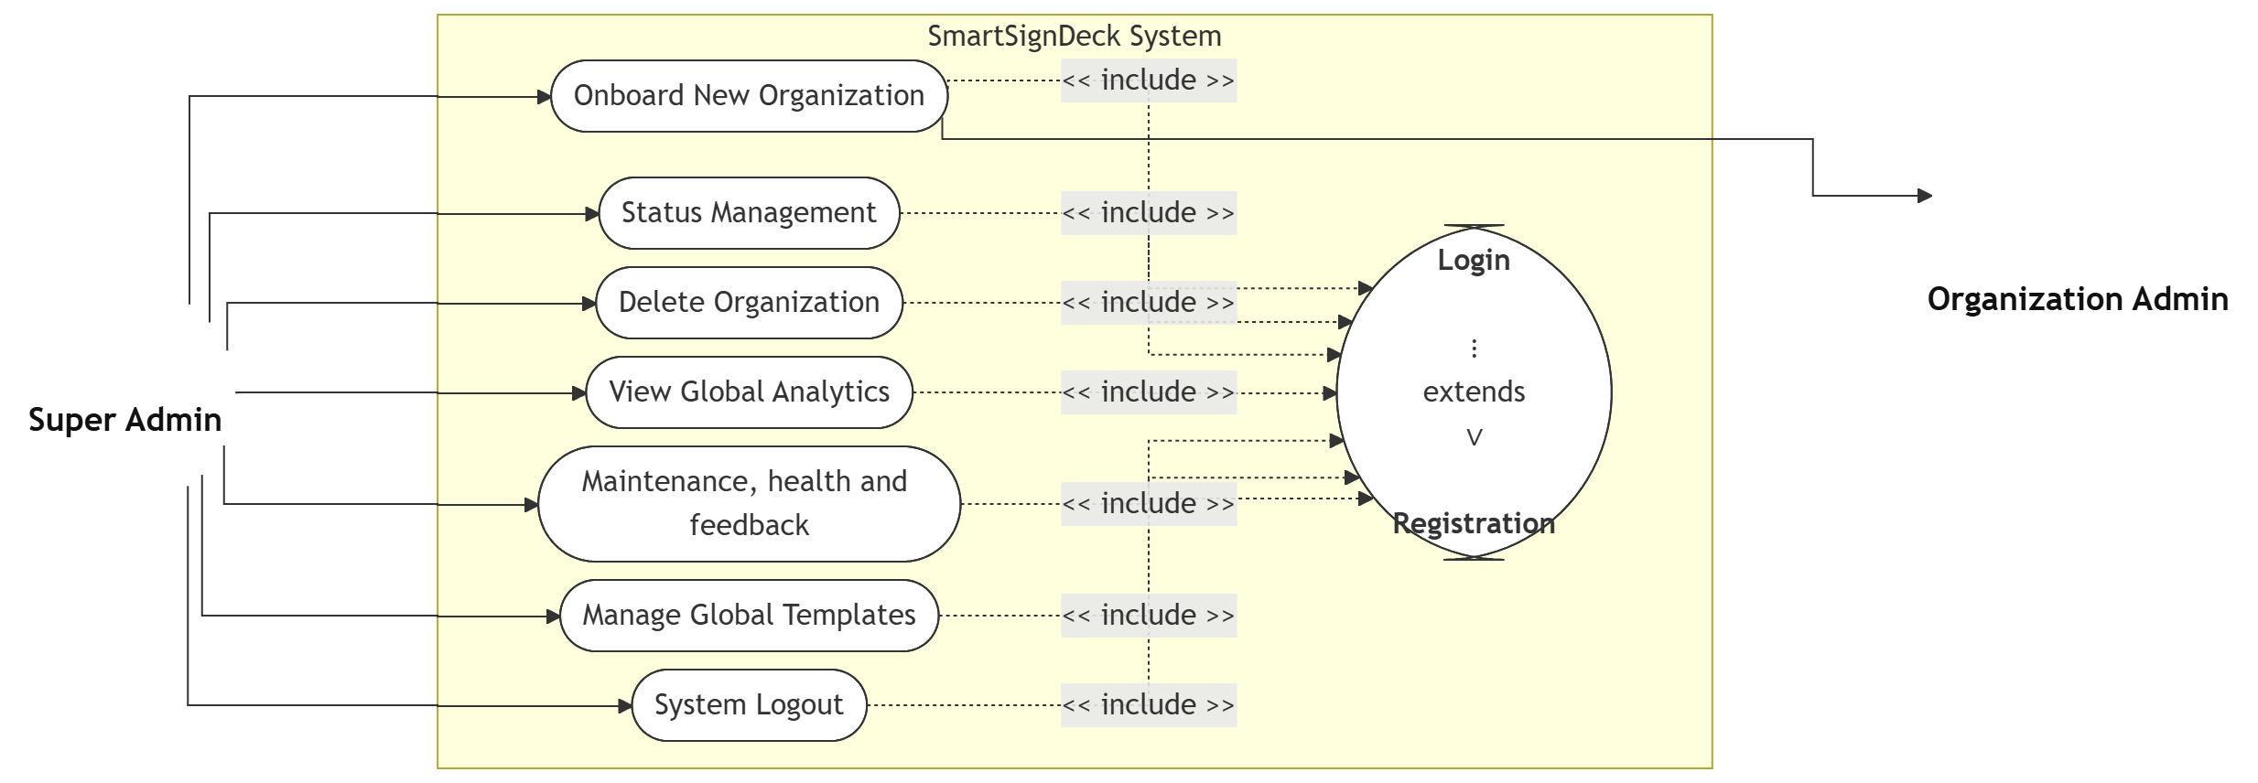
Use Case Diagram
Super Admin & Multi-User Access

Slide 10
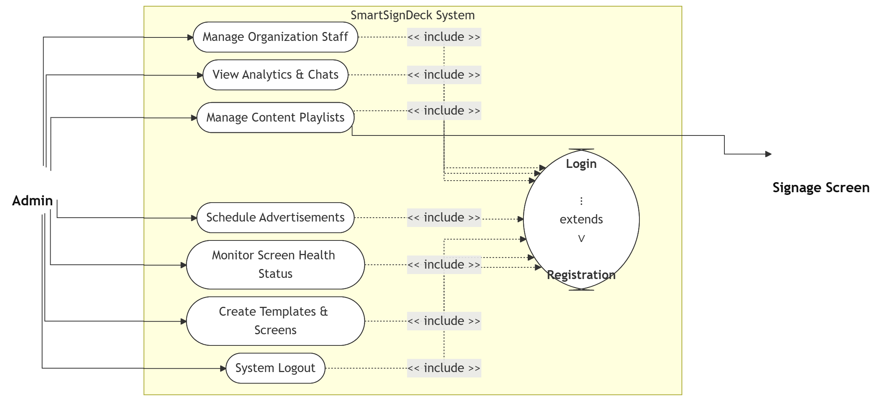
Use Case Diagram
b) Admin

Slide 11
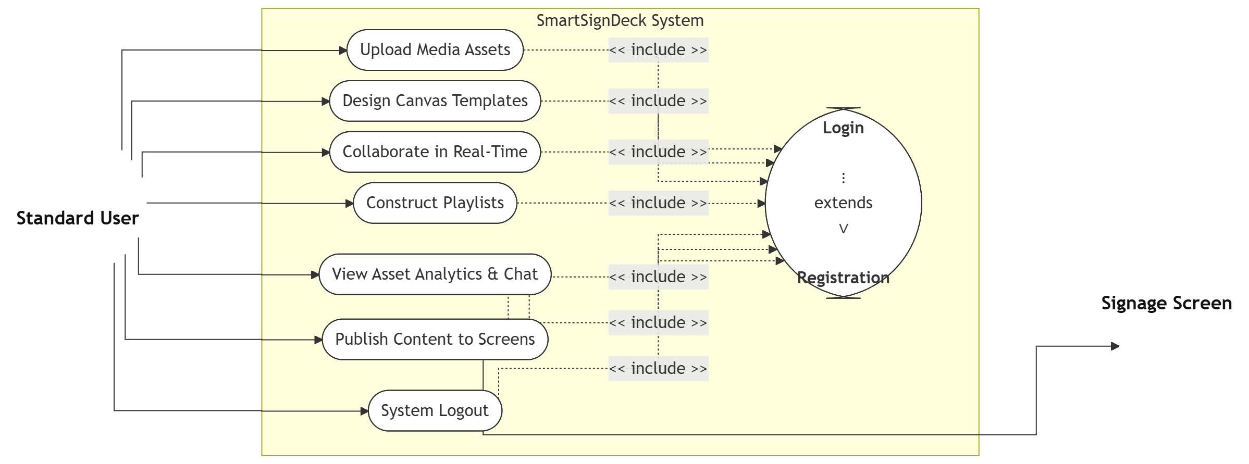
Use Case Diagram
c) User

Slide 12
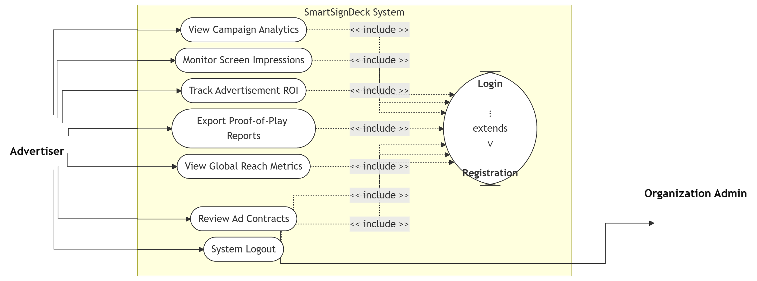
Use Case Diagram
d) Advertiser

Slide 13
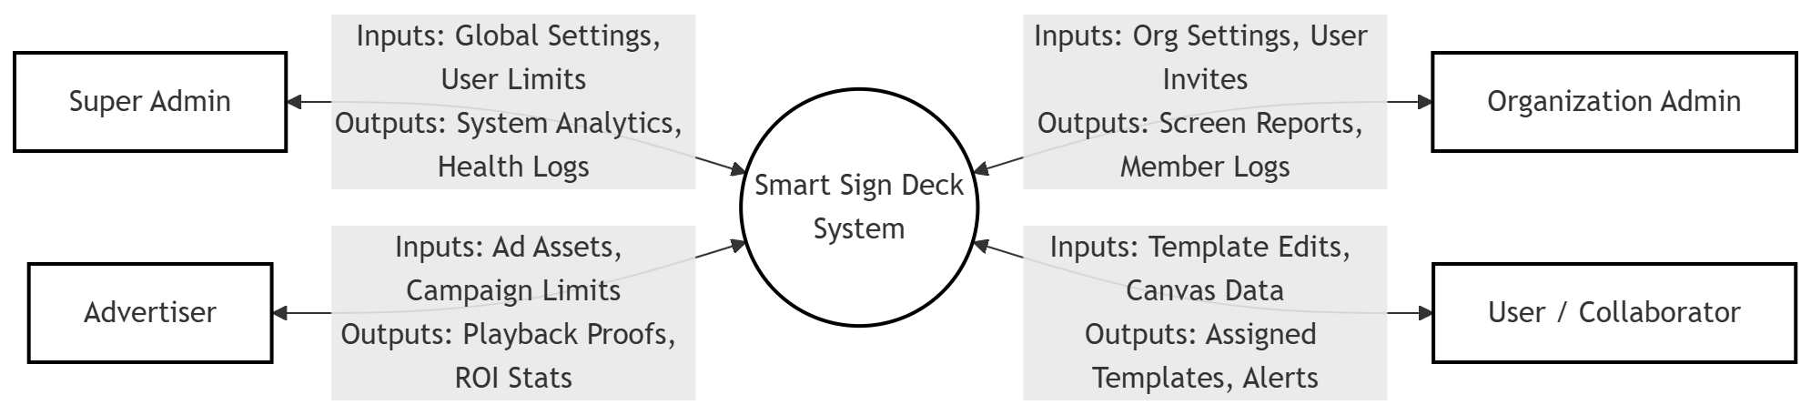
Data Flow Diagram
Context Level (Level 0)

Slide 14
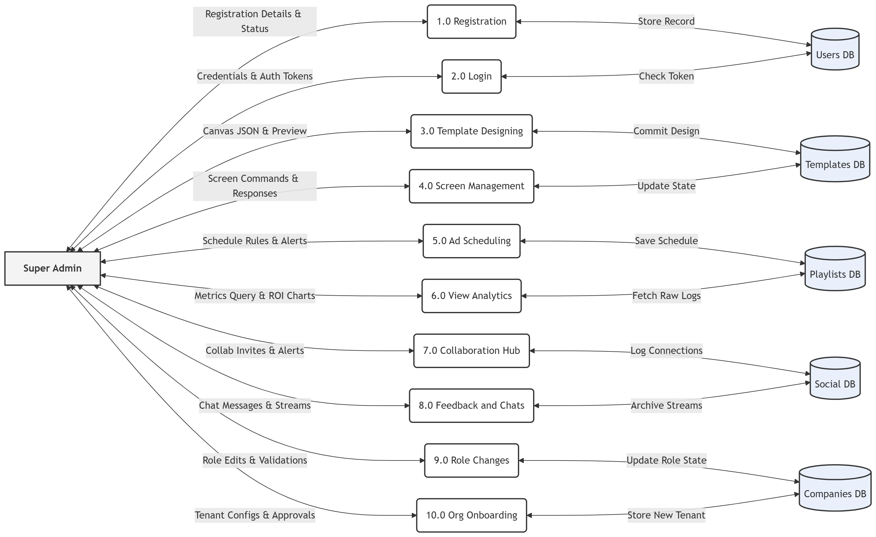
Data Flow Diagram
Level 1 DFD: Super Admin

Slide 15
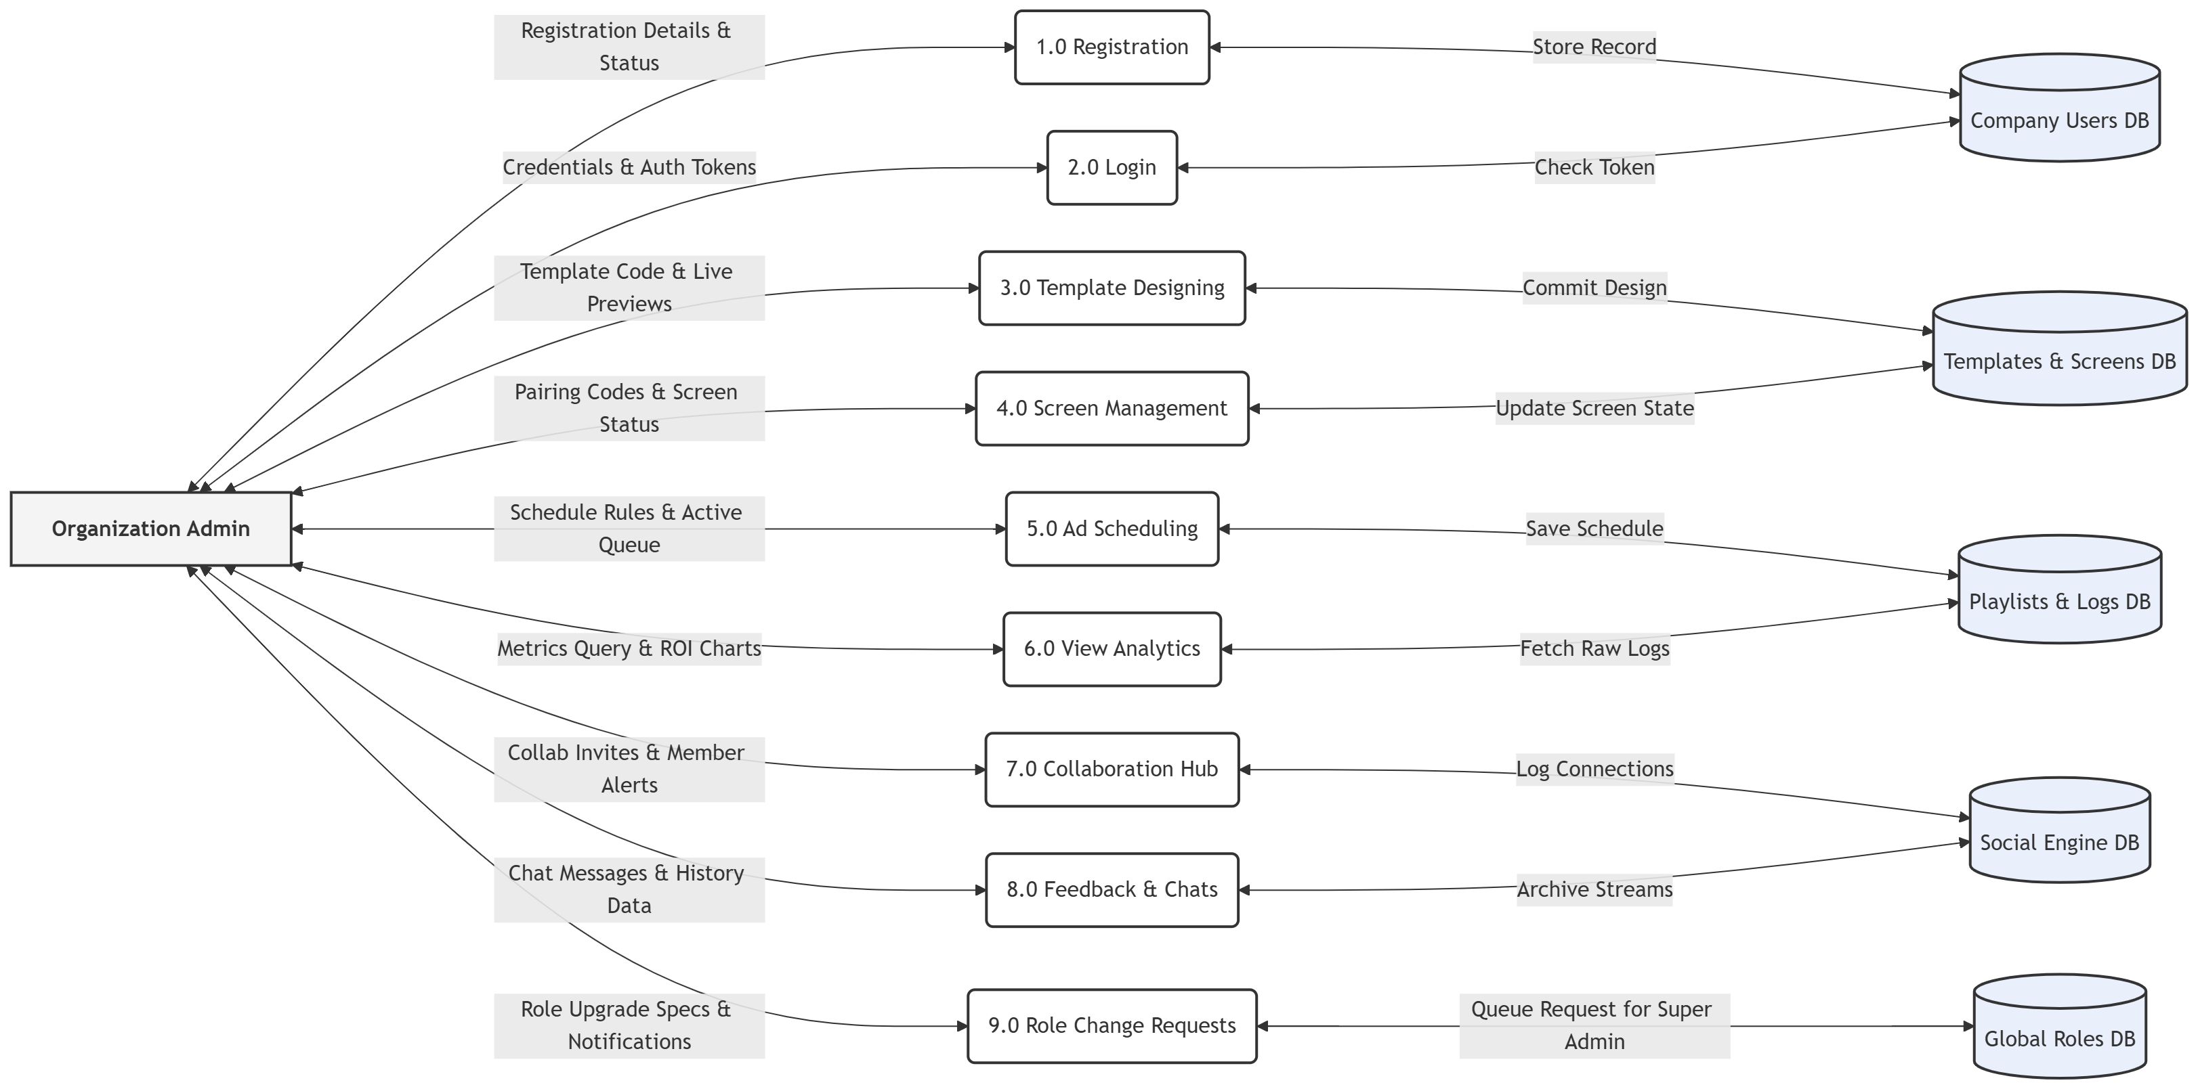
Data Flow Diagram
Level 1 DFD: Admin

Slide 16
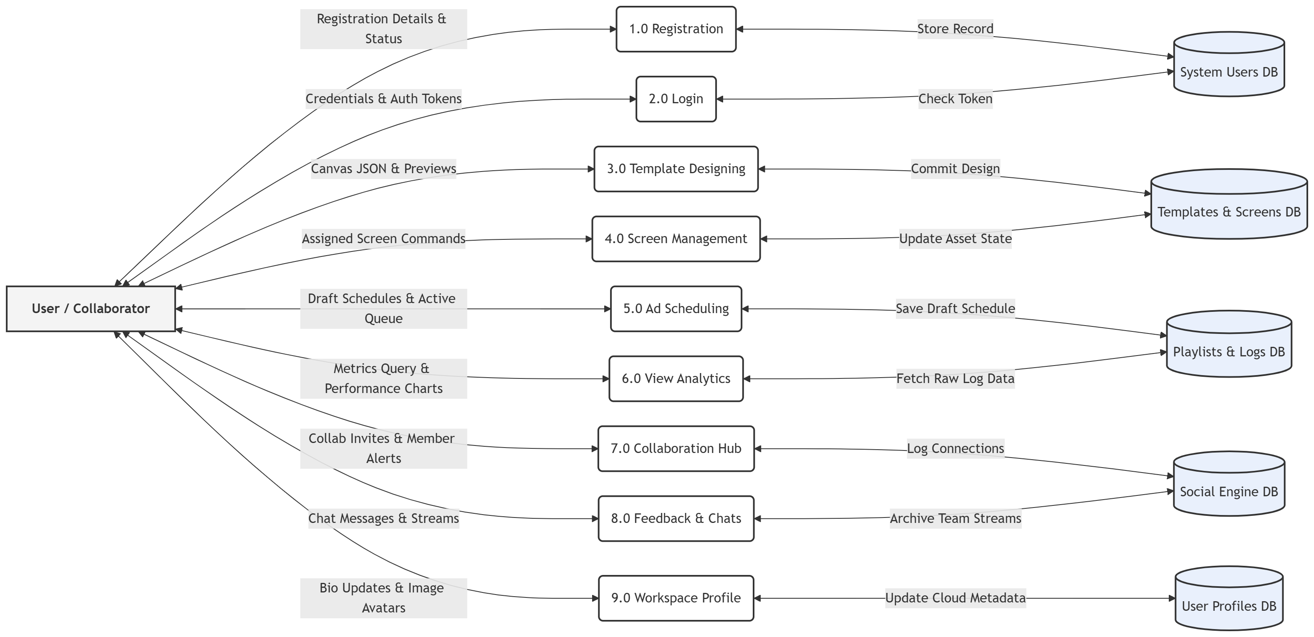
Data Flow Diagram
Level 1 DFD: User

Slide 17
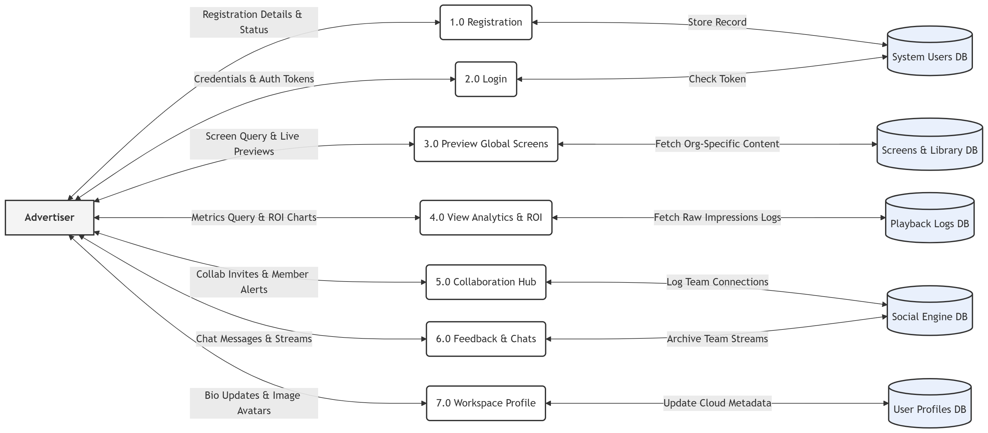
Data Flow Diagram
Level 1 DFD: Advertiser

Slide 18
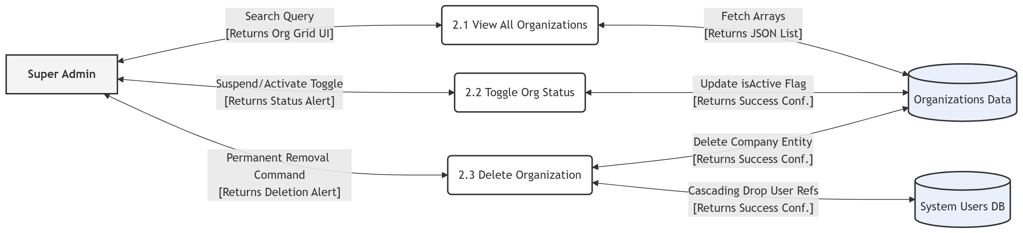
Data Flow Diagram
Level 2 DFD: Super Admin

Slide 19
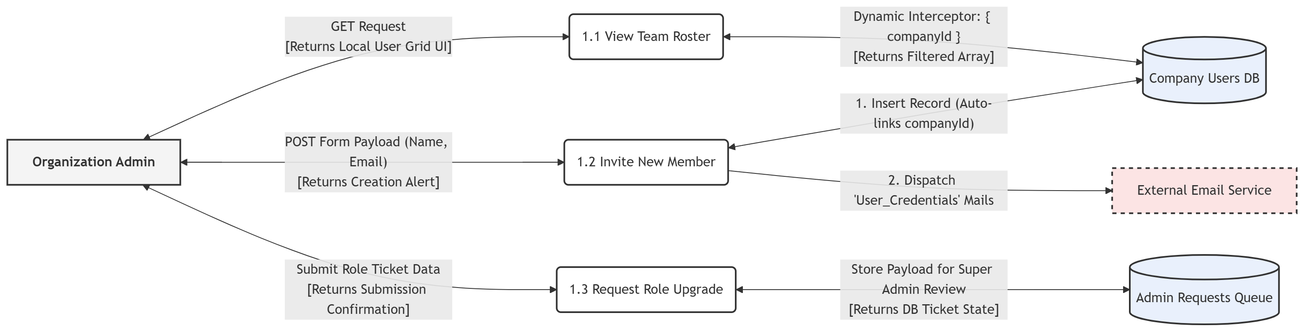
Data Flow Diagram
Level 2 DFD: Admin/Users

Slide 20
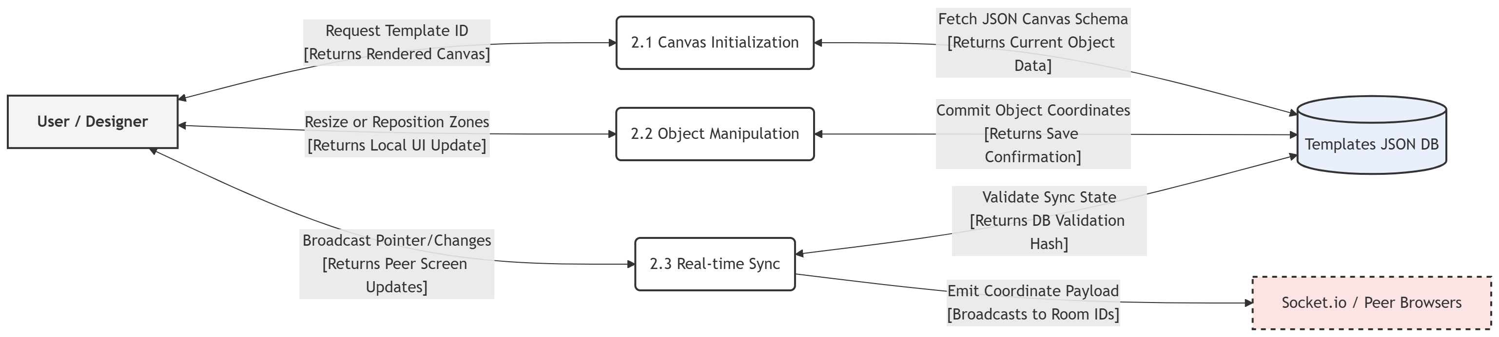
Data Flow Diagram
Level 2 DFD: User Canvas (Editor)

Slide 21
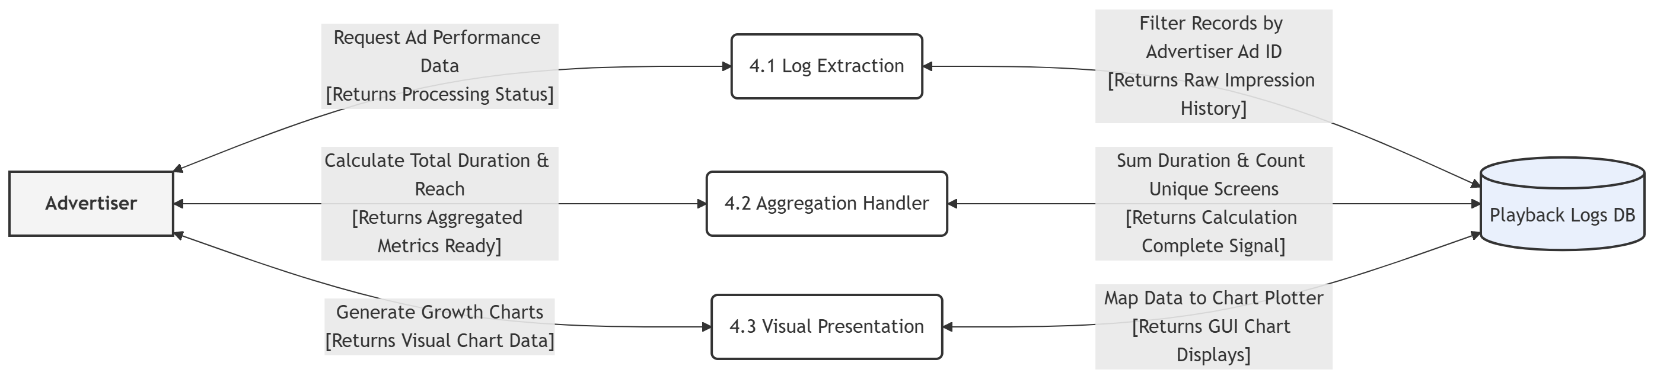
Data Flow Diagram
Level 2 DFD: Advertiser

Slide 22
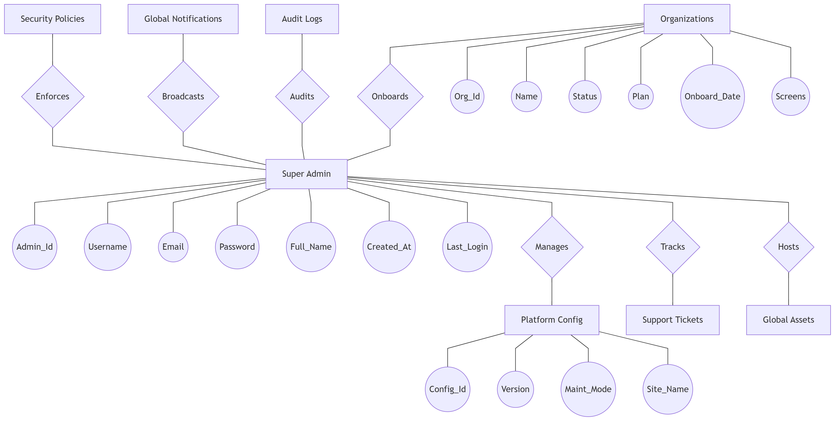
ER Diagram
Database Relationships (Super Admin View)

Slide 23
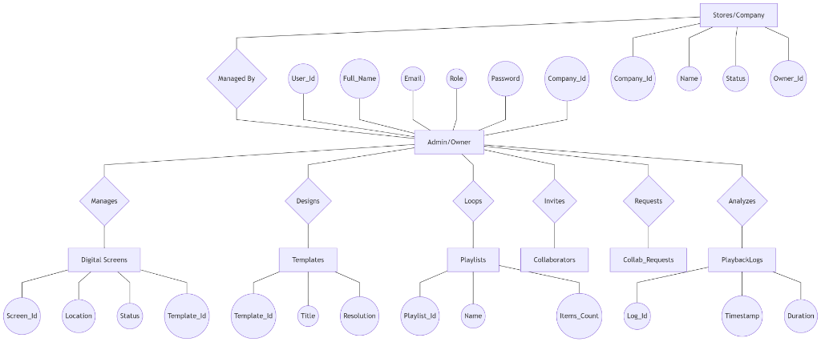
ER Diagram
Database Relationships (Admin/Owner View)

Slide 24
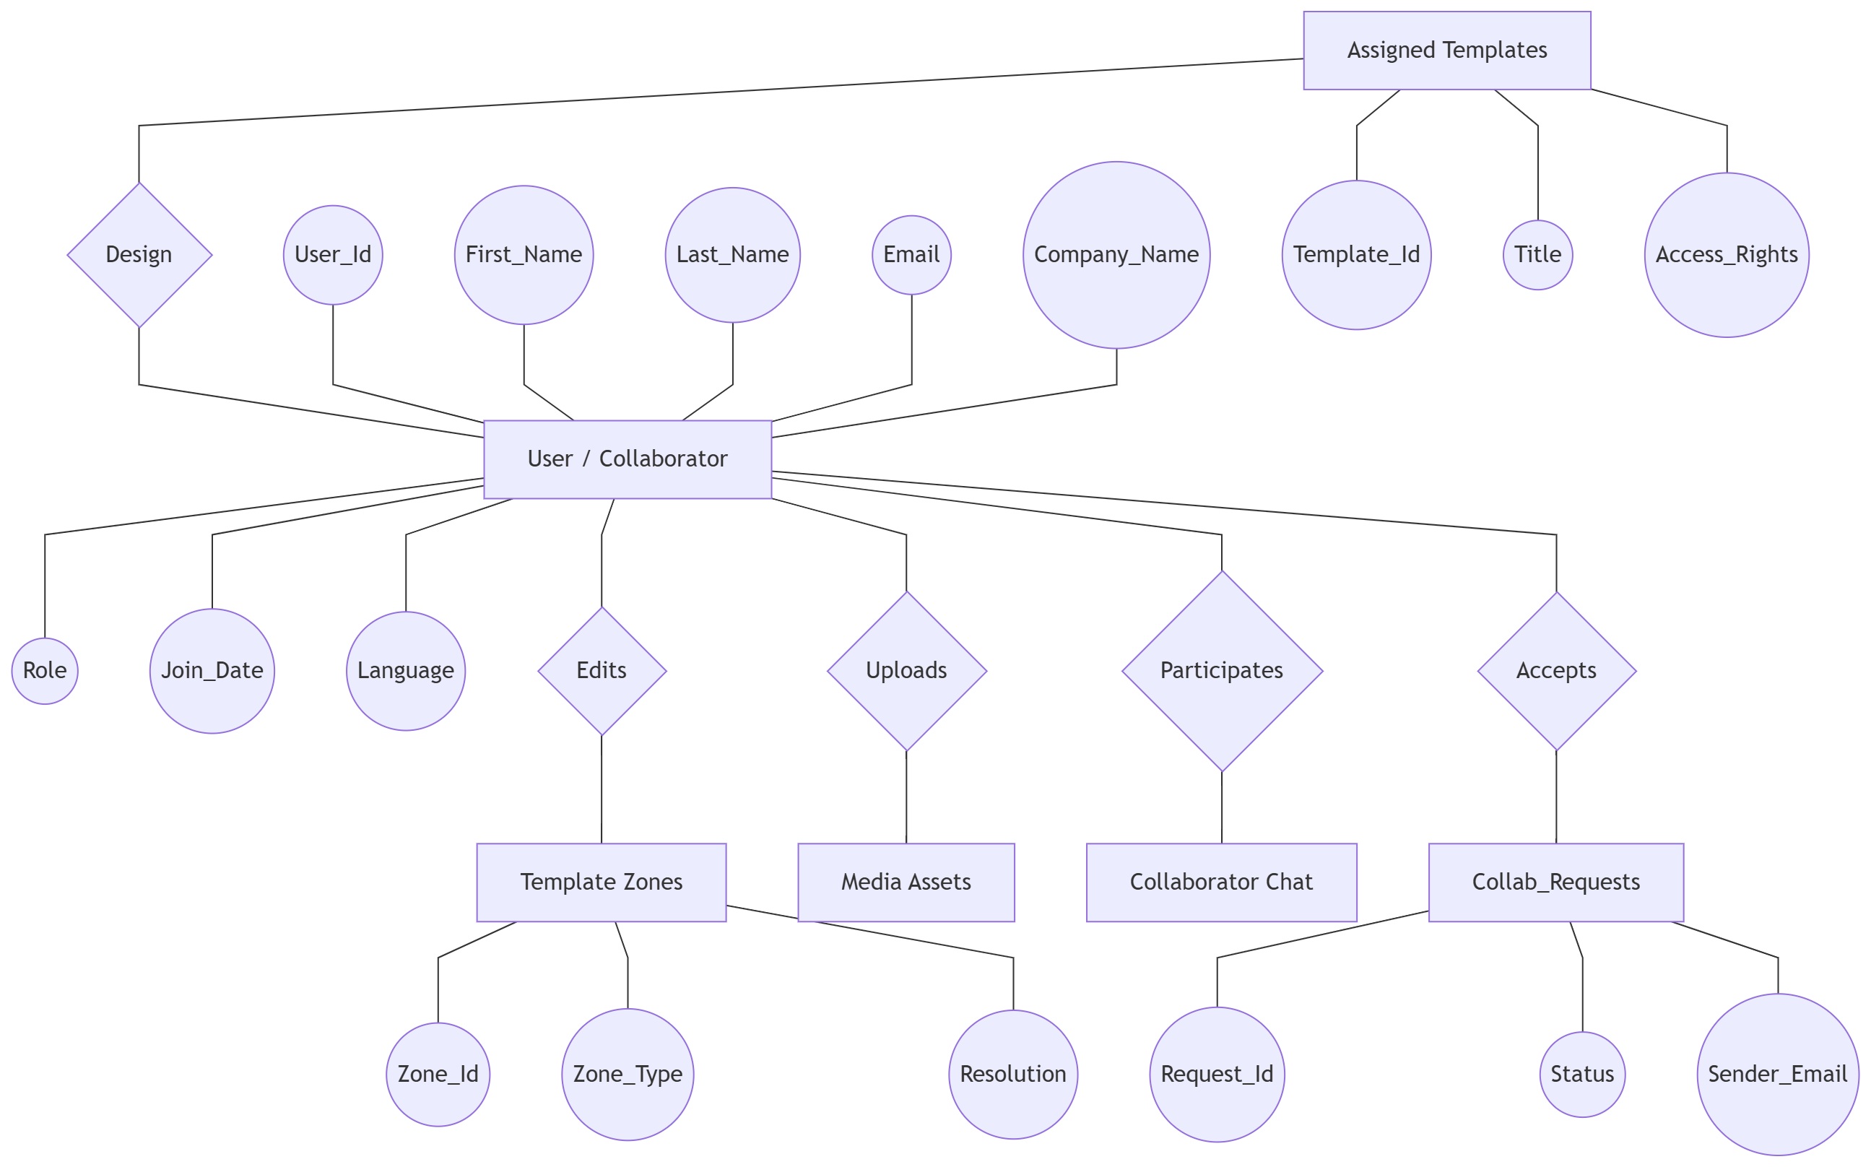
ER Diagram
Database Relationships (User View)

Slide 25
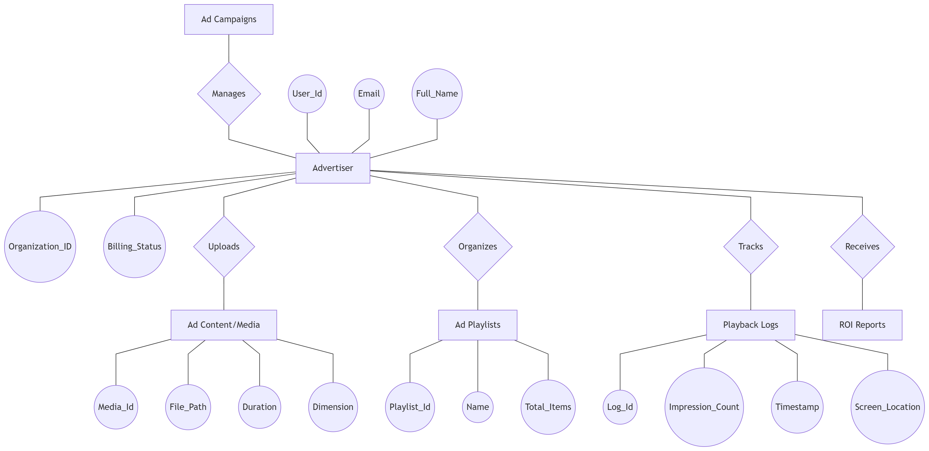
ER Diagram
Database Relationships (Advertiser View)

Slide 26
Data Dictionary

Slide 27
Collection: users
Description: Store user profiles and roles.
No | Field Name | Type | Description
1 | _id | ObjectId | Primary key
2 | name | String | Full name
3 | email | String | Unique email
4 | role | String | Access level

Slide 28
Collection: screens
Description: Track hardware status.
No | Field Name | Type | Description
1 | _id | ObjectId | Primary key
2 | name | String | Label
3 | macAddress | String | Unique ID
4 | status | String | Online/Offline

Slide 29
System Screen Layouts

Slide 30
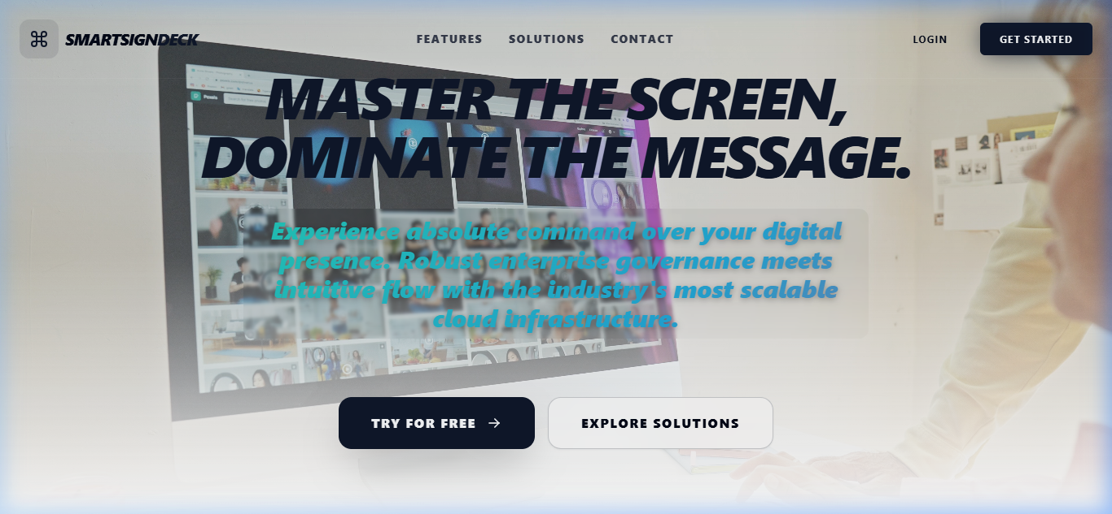
Landing Pages
System Screenshot Interface

Slide 31
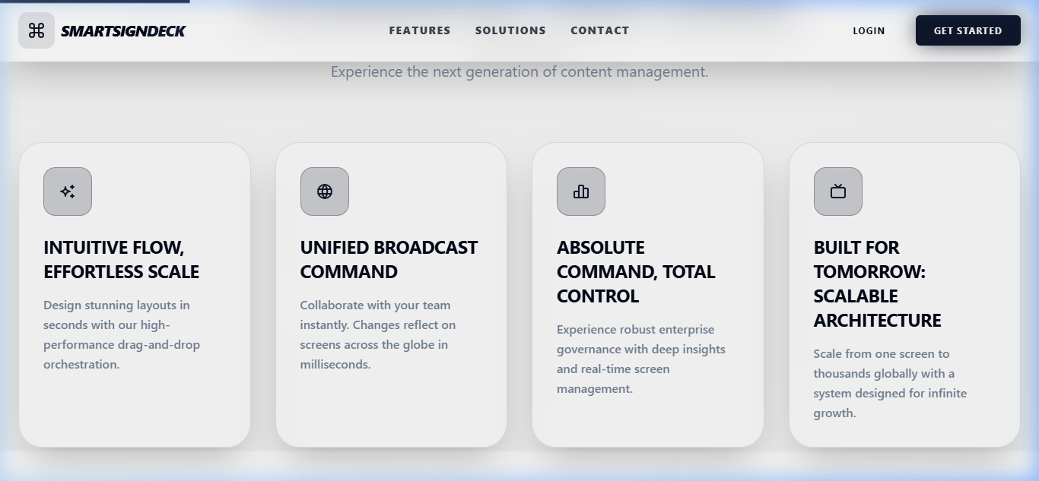
Landing Pages
System Screenshot Interface

Slide 32

Landing Pages
System Screenshot Interface

Slide 33
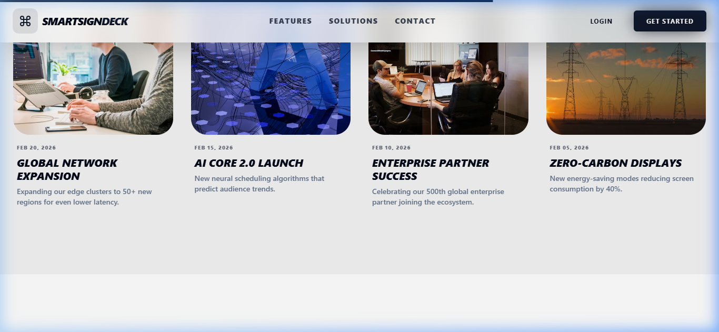
Landing Pages
System Screenshot Interface

Slide 34
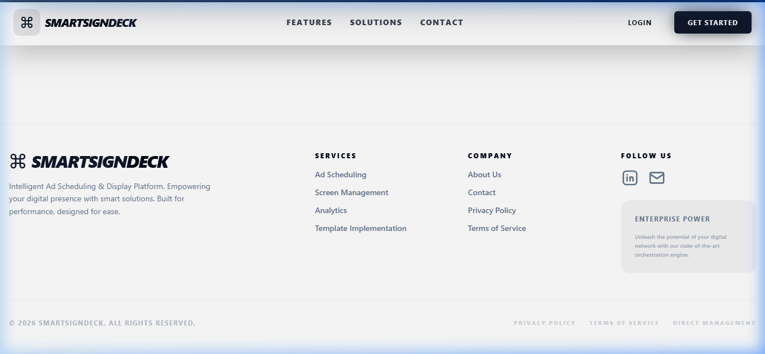
Landing Pages
System Screenshot Interface

Slide 35
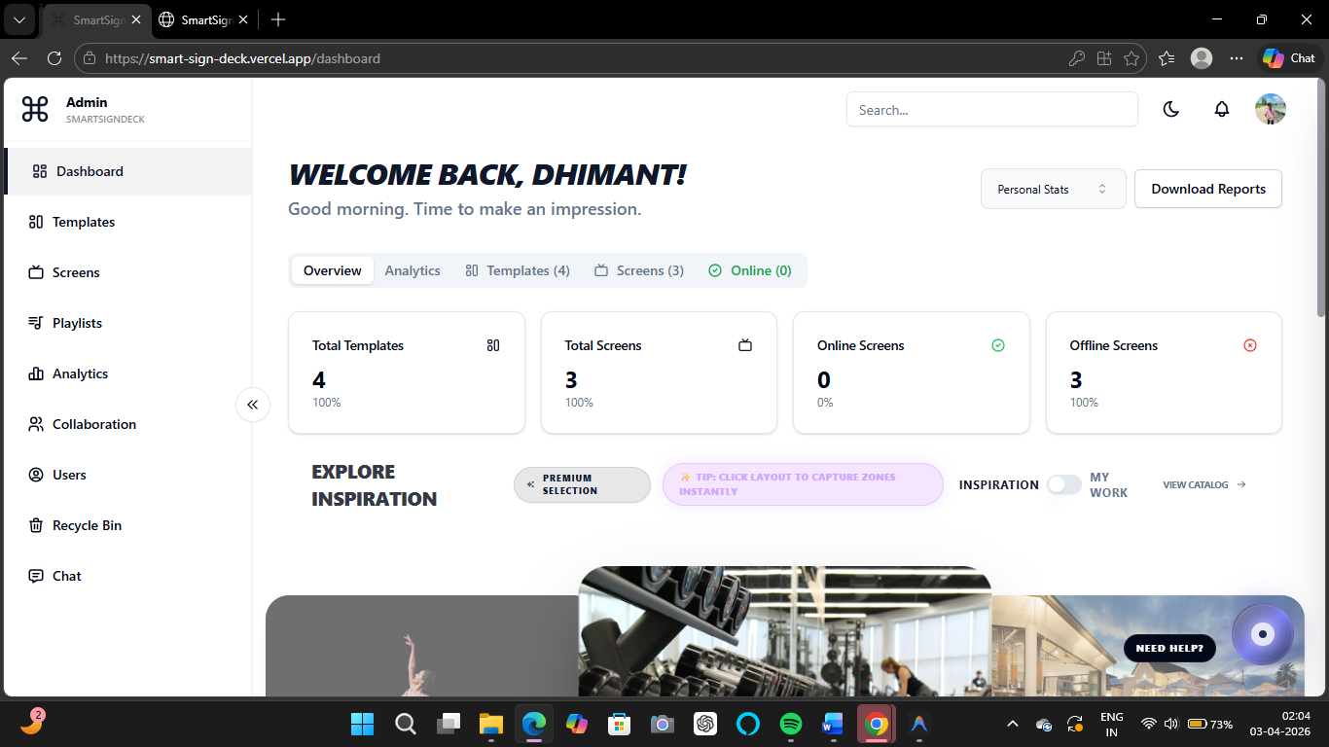
Login Screens
System Screenshot Interface

Slide 36
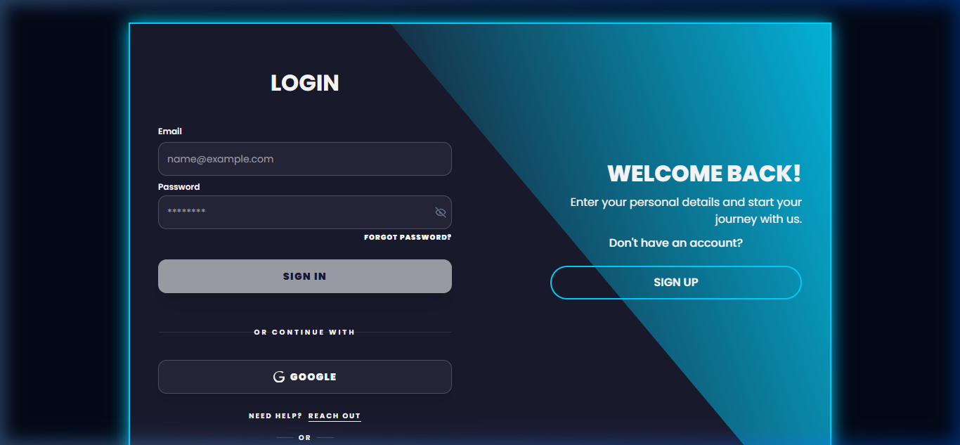
Login Screens
System Screenshot Interface

Slide 37
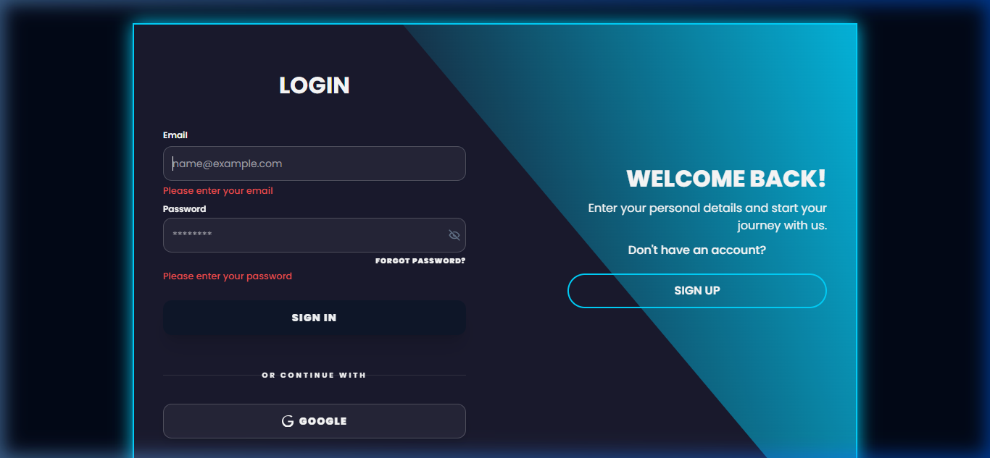
Login Screens
System Screenshot Interface

Slide 38
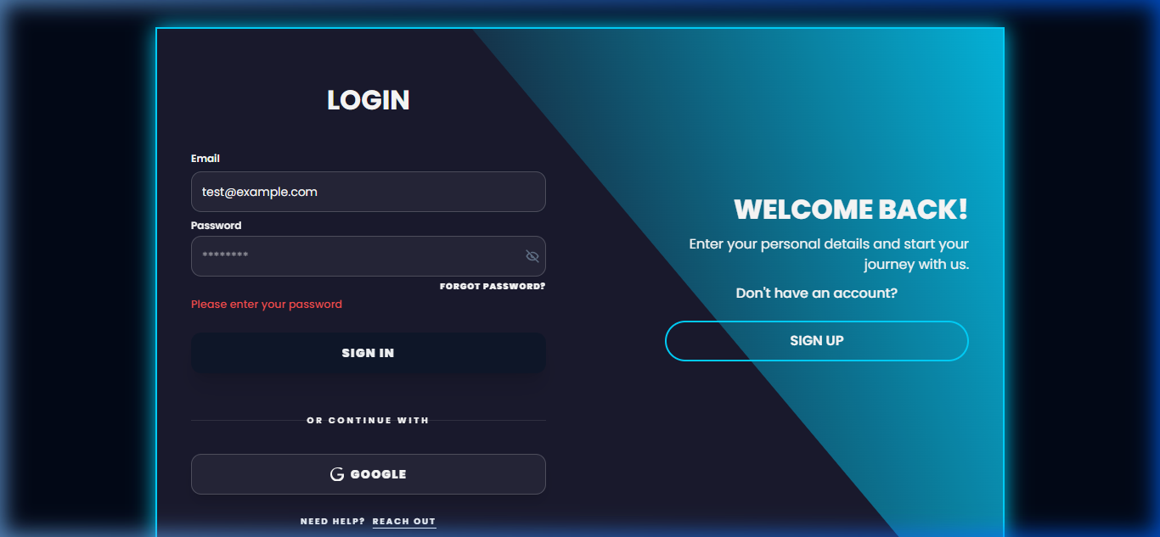
Login Screens
System Screenshot Interface

Slide 39
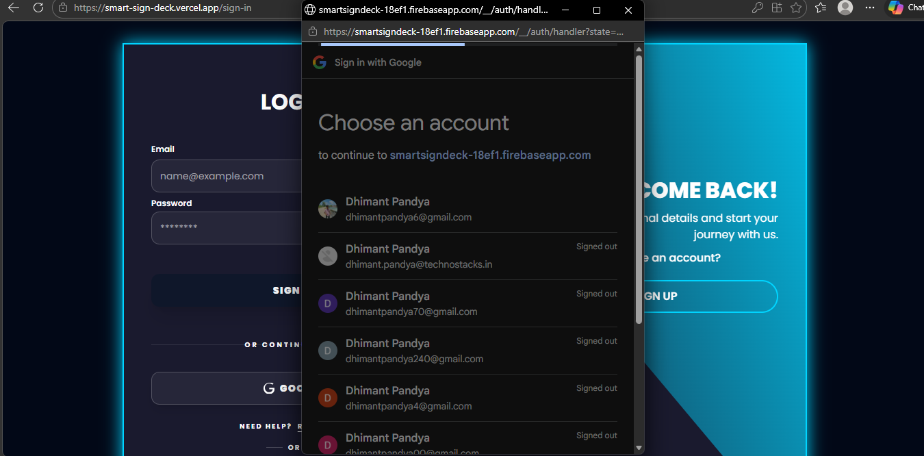
Login Screens
System Screenshot Interface

Slide 40
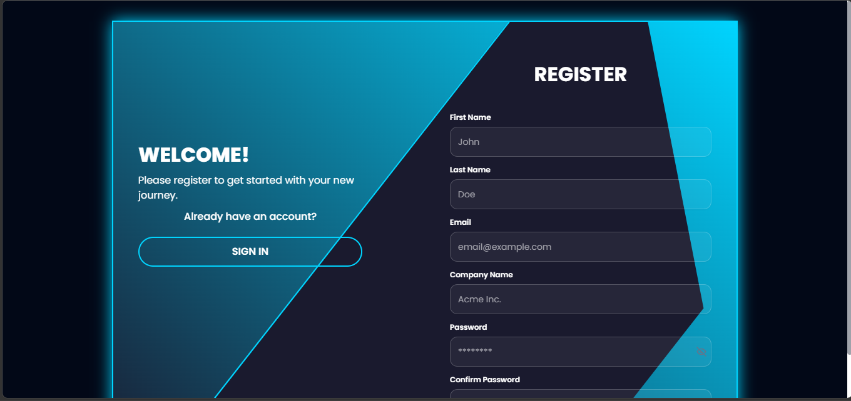
Registration Process
System Screenshot Interface

Slide 41
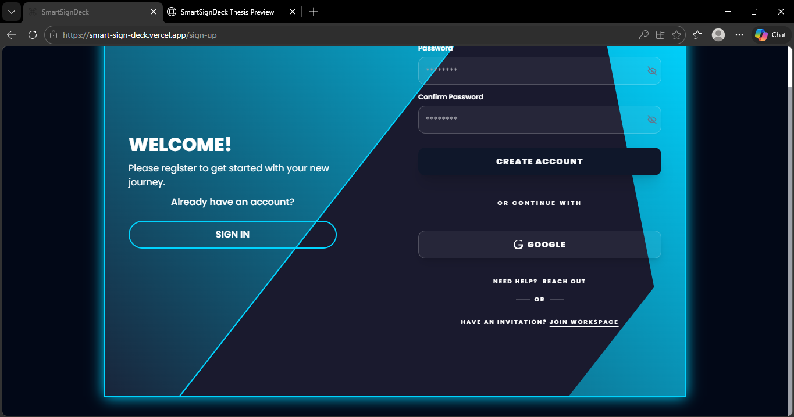
Registration Process
System Screenshot Interface

Slide 42
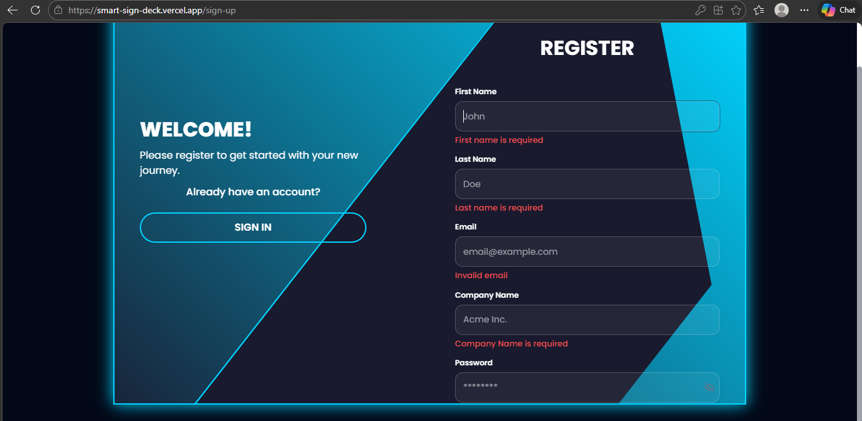
Registration Process
System Screenshot Interface

Slide 43
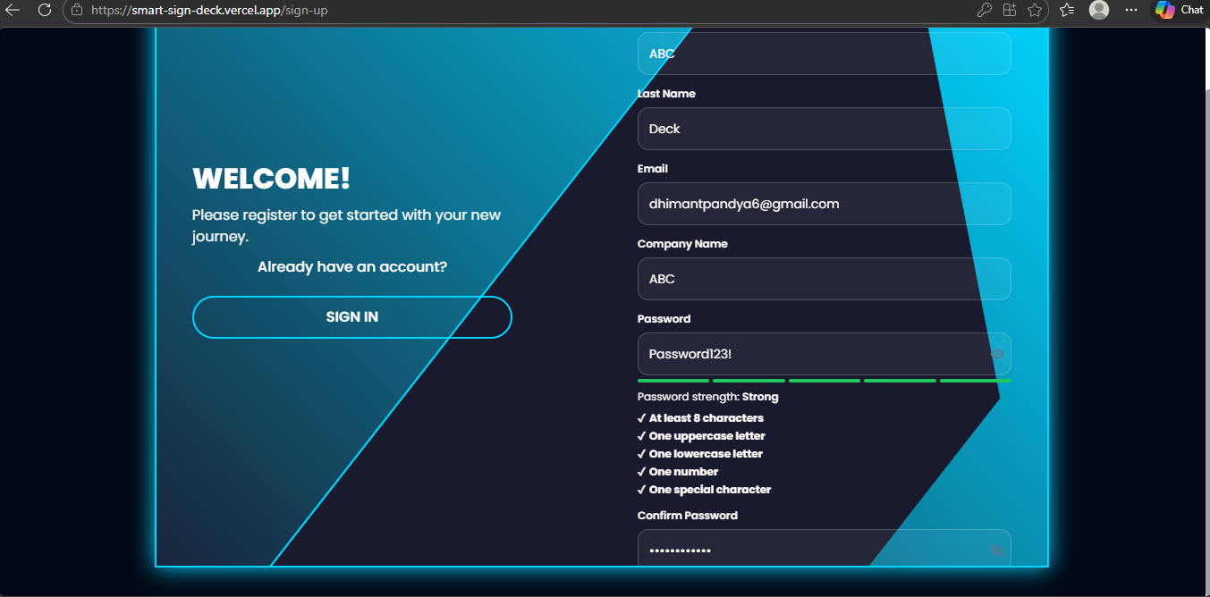
Registration Process
System Screenshot Interface

Slide 44
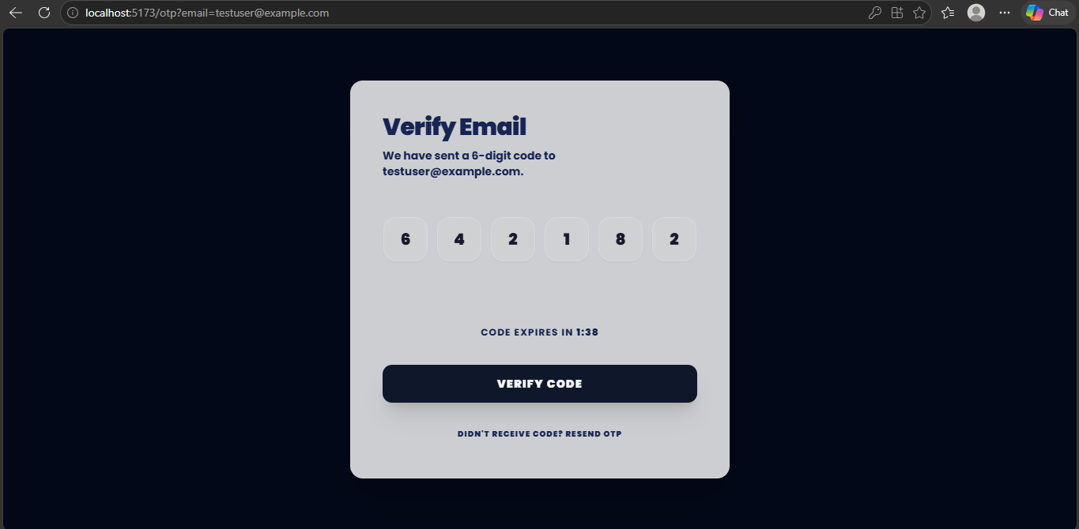
Registration Process
System Screenshot Interface

Slide 45
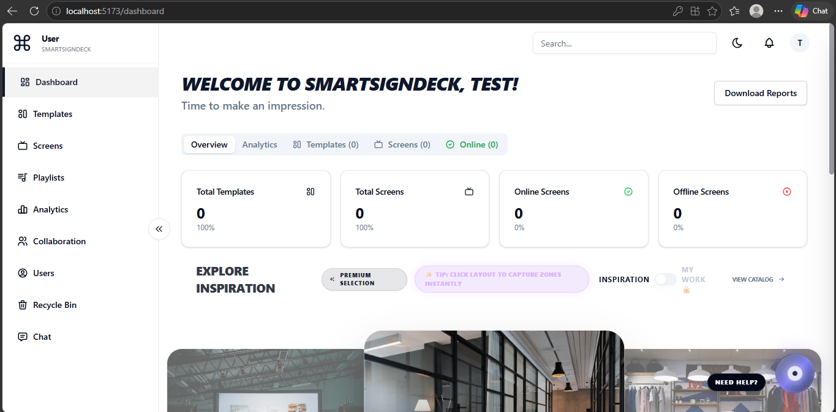
Registration Process
System Screenshot Interface

Slide 46
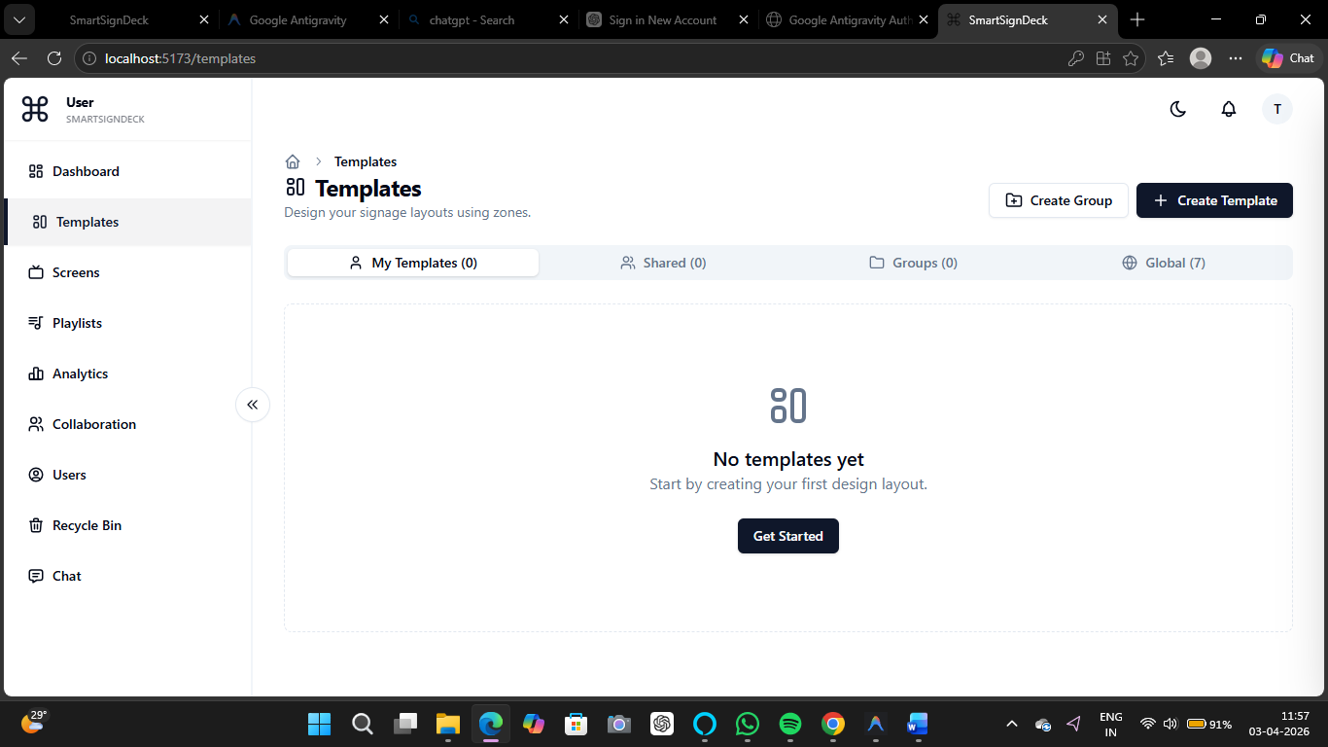
Template Builder
System Screenshot Interface

Slide 47
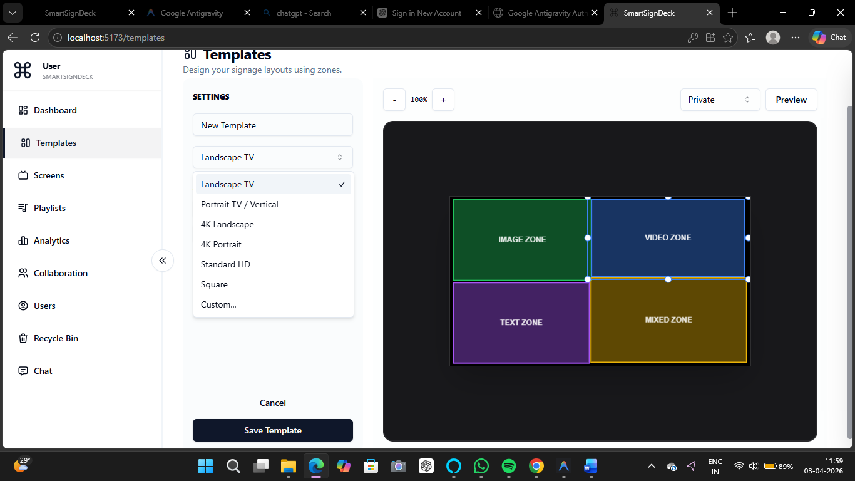
Template Builder
System Screenshot Interface

Slide 48
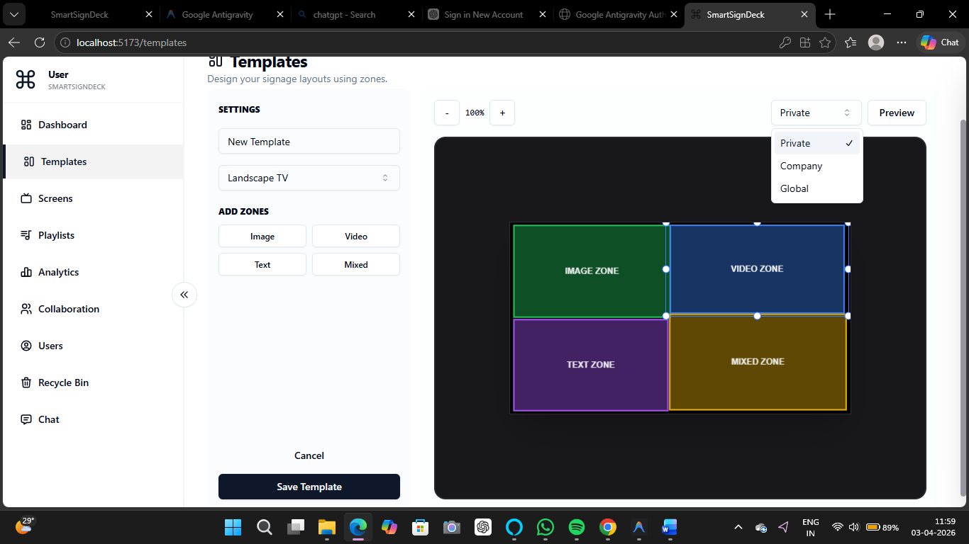
Template Builder
System Screenshot Interface

Slide 49
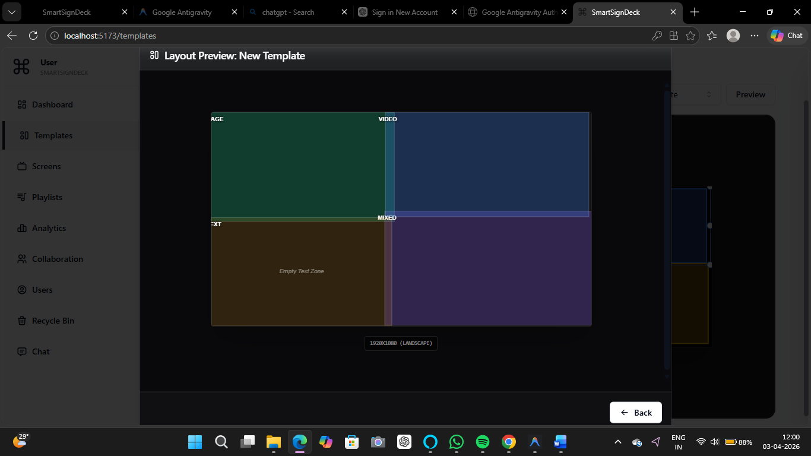
Template Builder
System Screenshot Interface

Slide 50
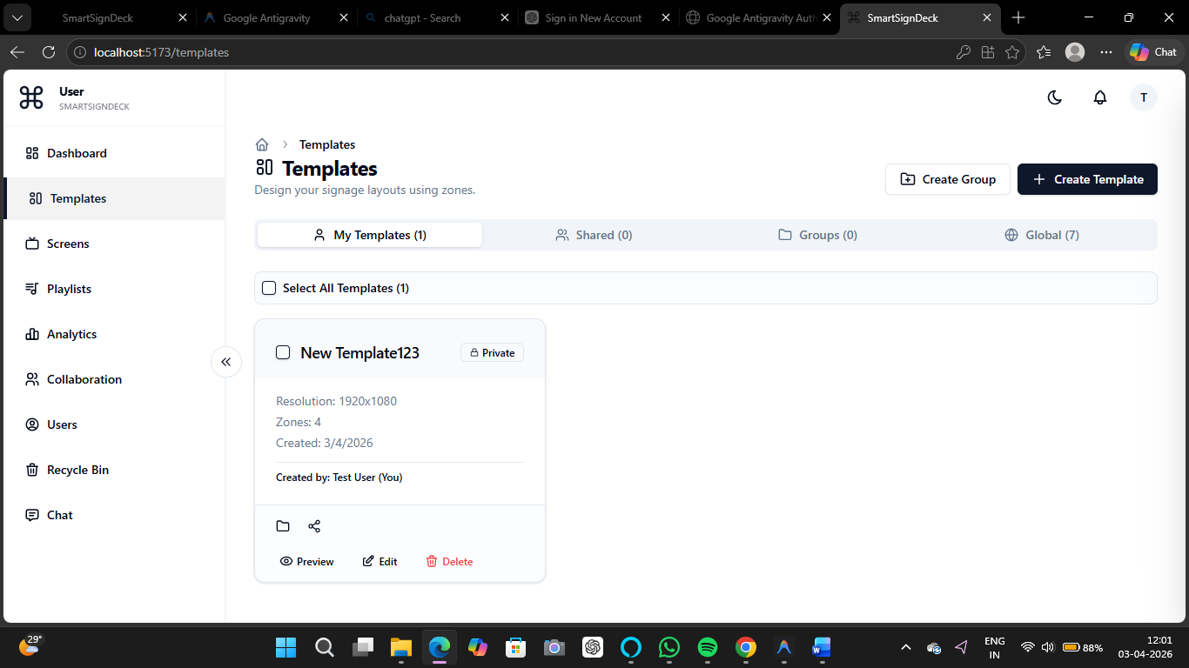
Template Builder
System Screenshot Interface

Slide 51
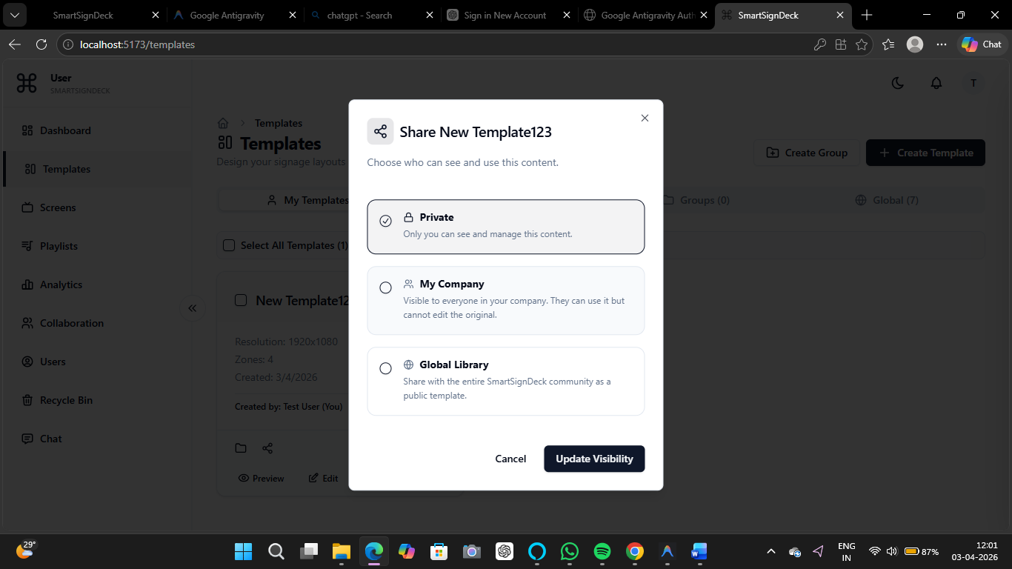
Template Builder
System Screenshot Interface

Slide 52
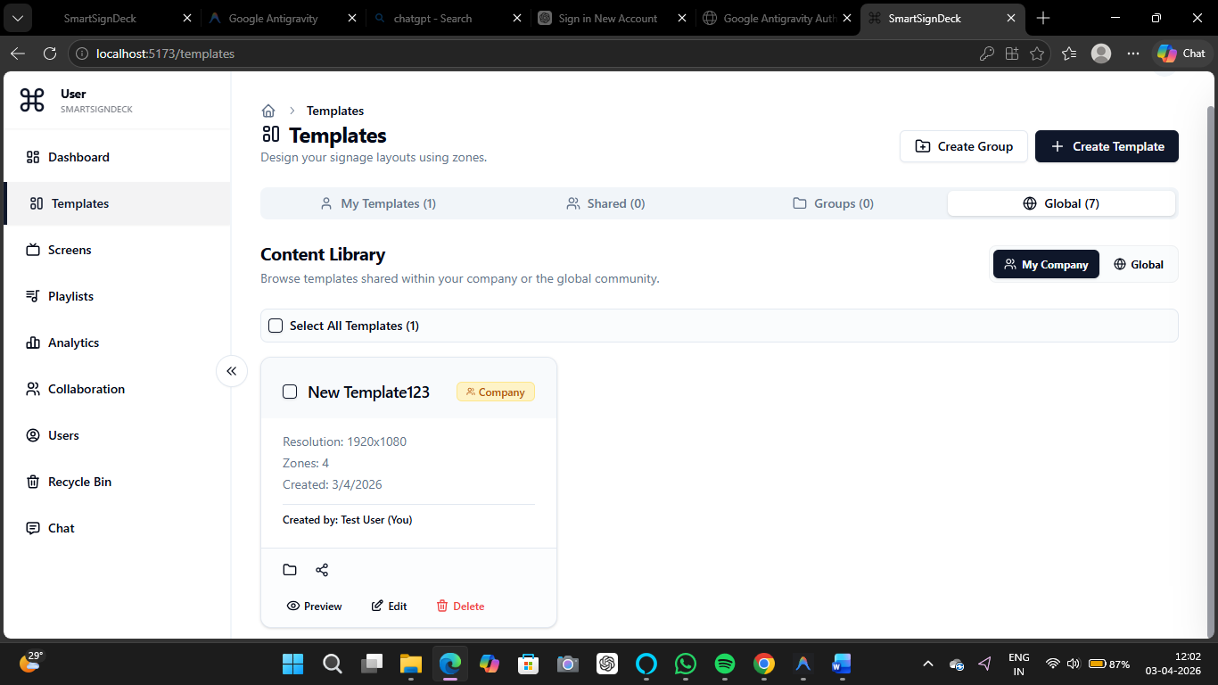
Template Builder
System Screenshot Interface

Slide 53
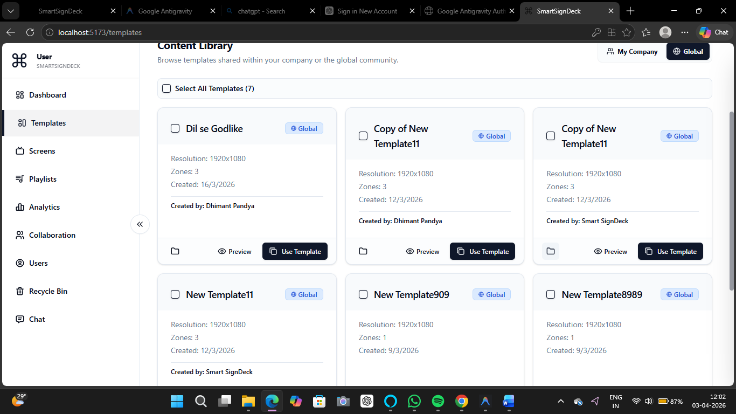
Template Builder
System Screenshot Interface

Slide 54

Template Builder
System Screenshot Interface

Slide 55
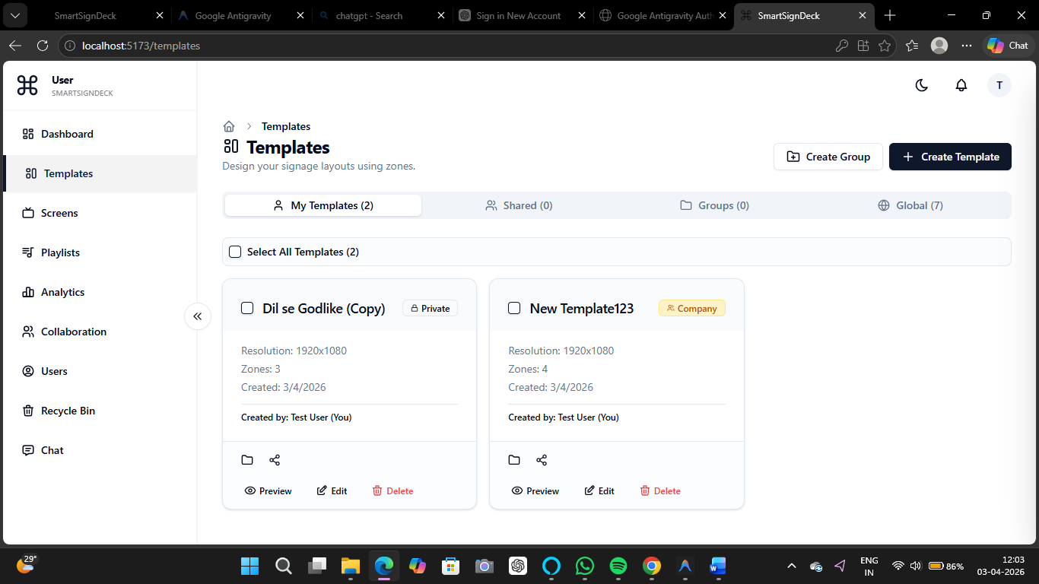
Template Builder
System Screenshot Interface

Slide 56
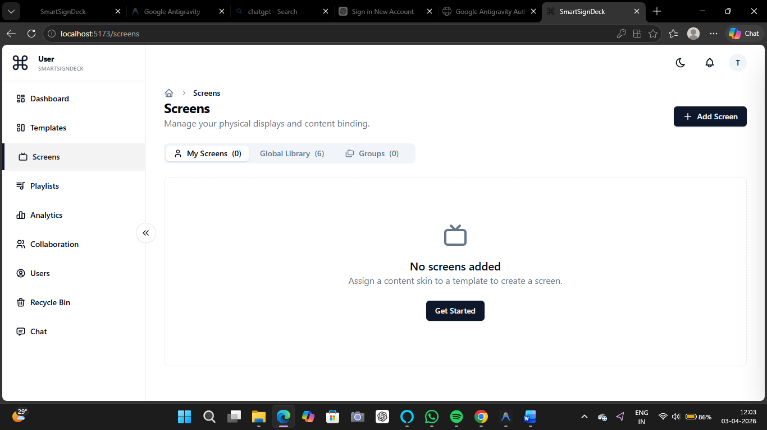
Screen Management
System Screenshot Interface

Slide 57
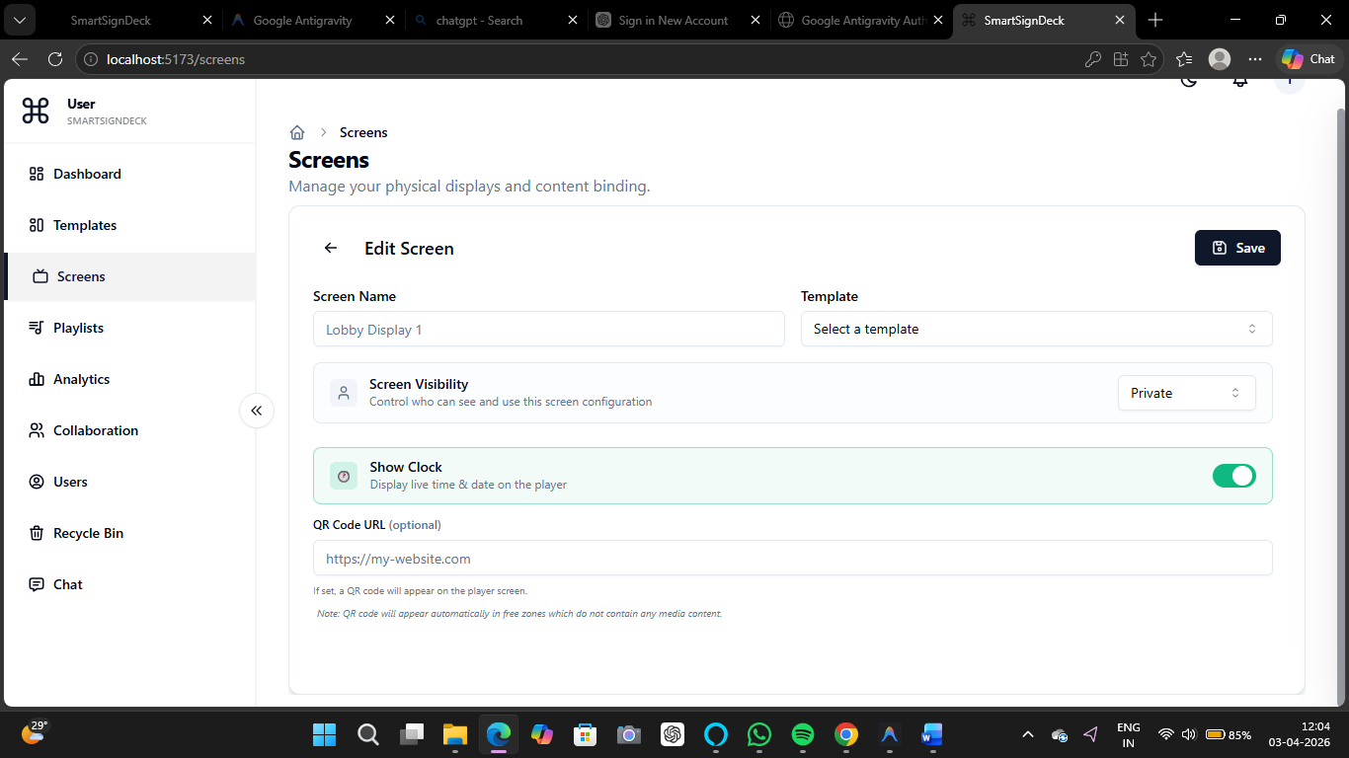
Screen Management
System Screenshot Interface

Slide 58
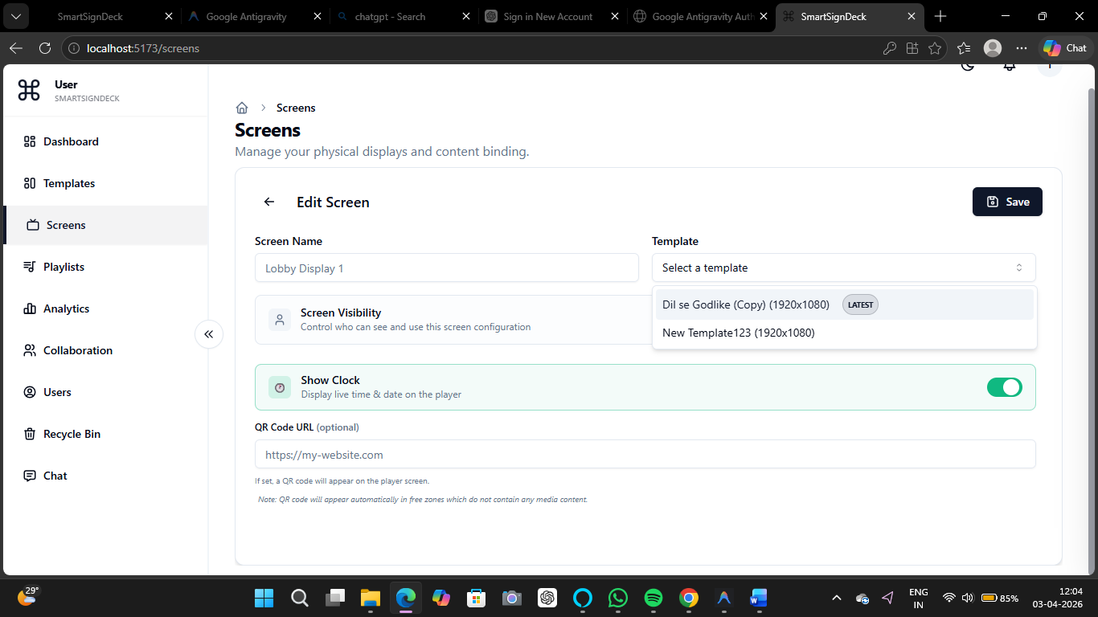
Screen Management
System Screenshot Interface

Slide 59
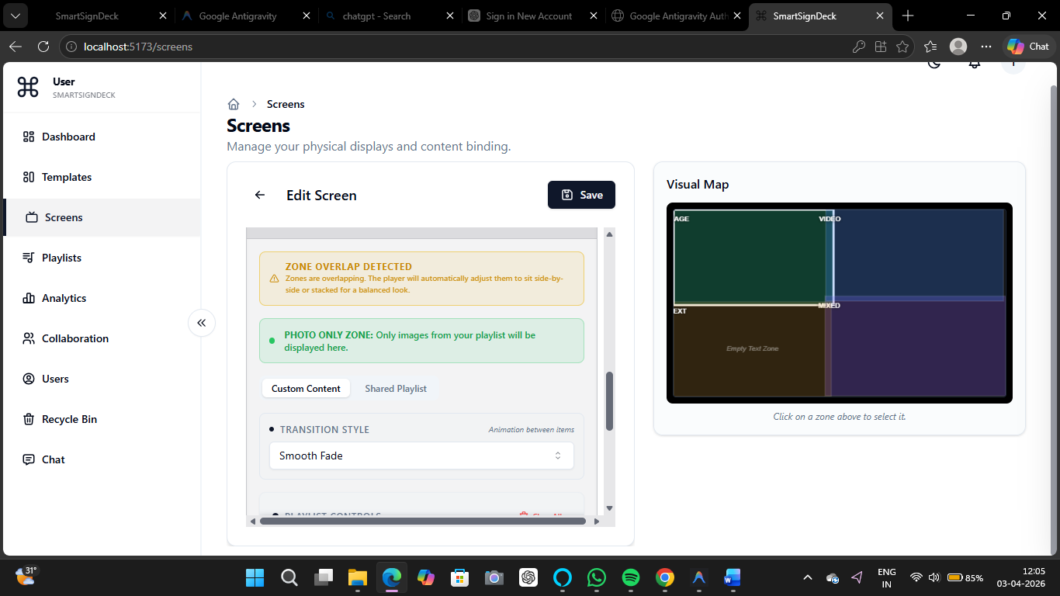
Screen Management
System Screenshot Interface

Slide 60
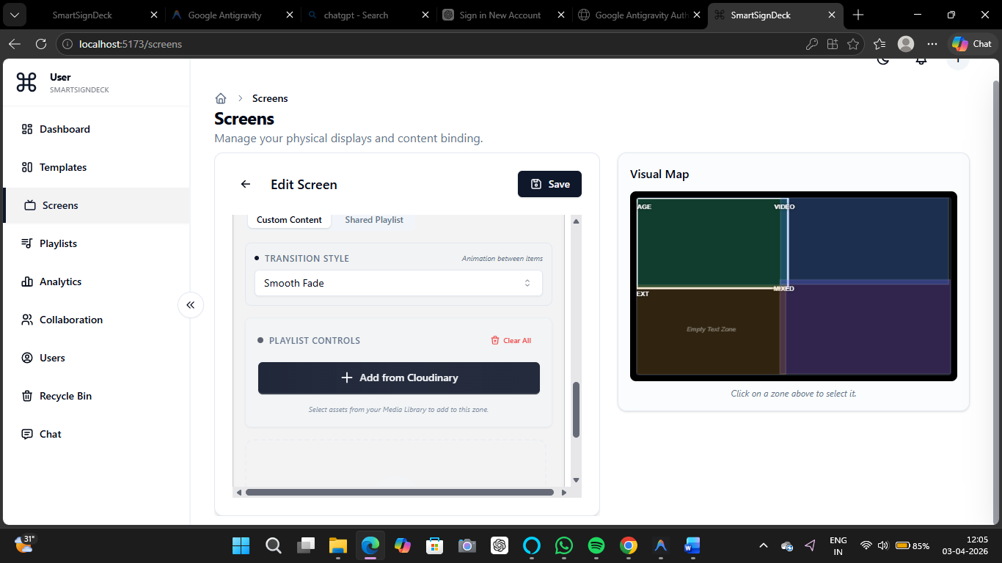
Screen Management
System Screenshot Interface

Slide 61
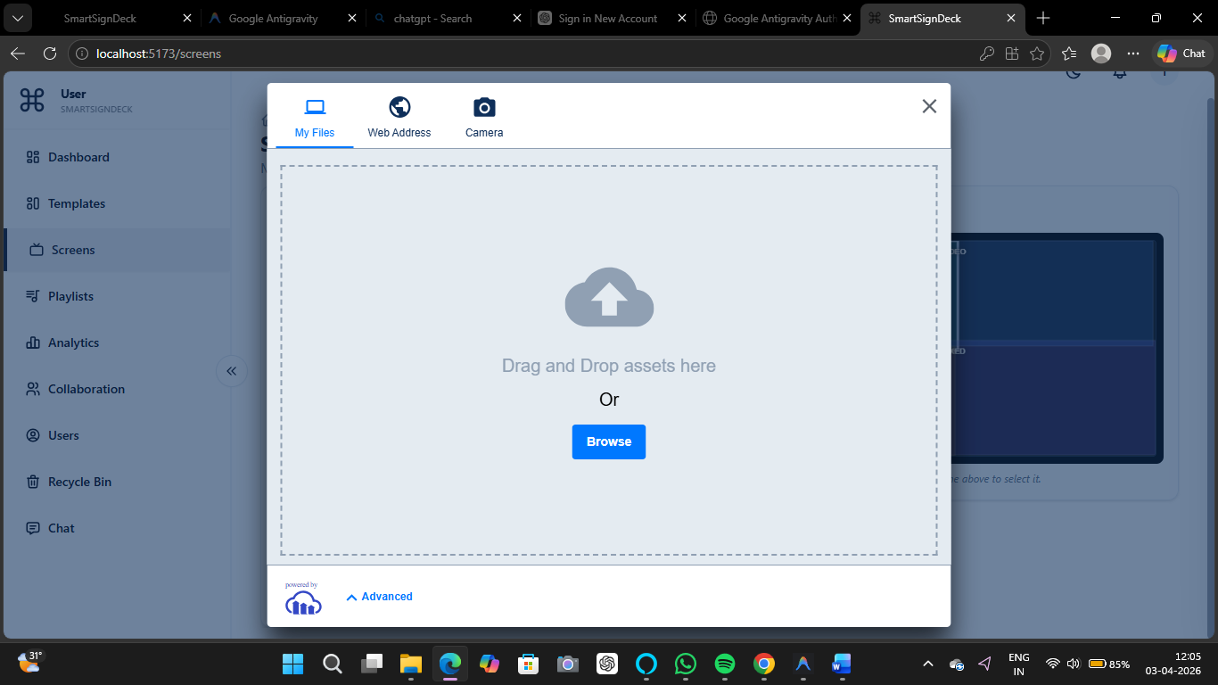
Screen Management
System Screenshot Interface

Slide 62
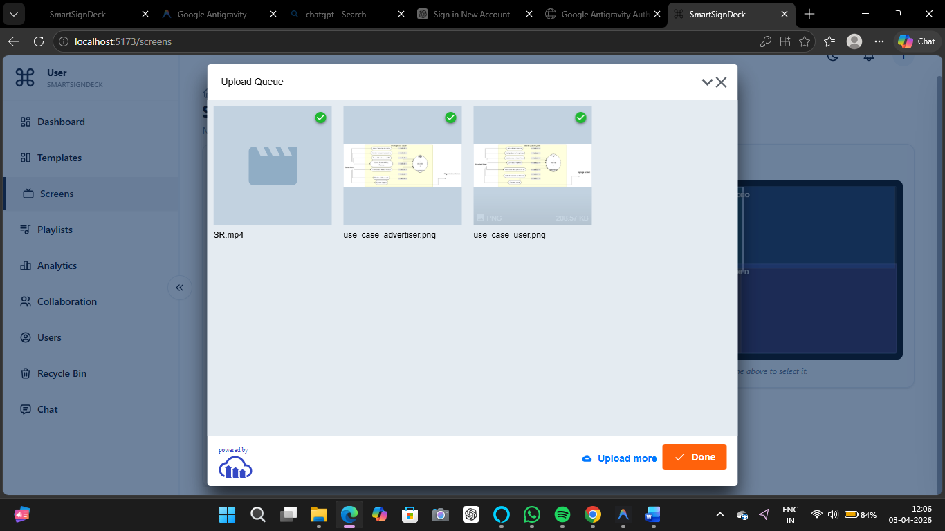
Screen Management
System Screenshot Interface

Slide 63
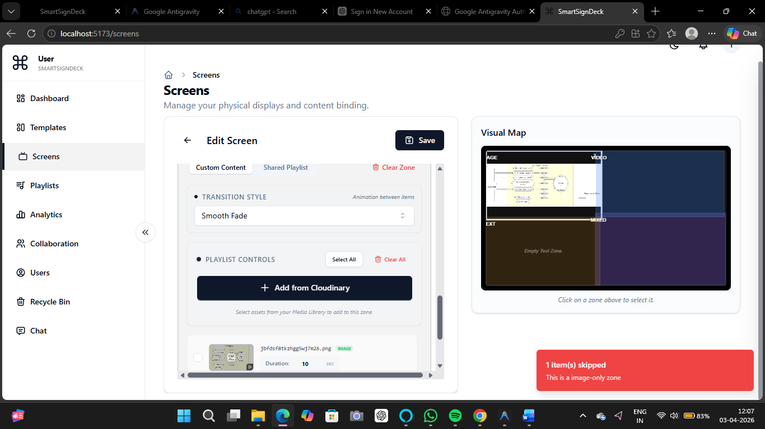
Screen Management
System Screenshot Interface

Slide 64
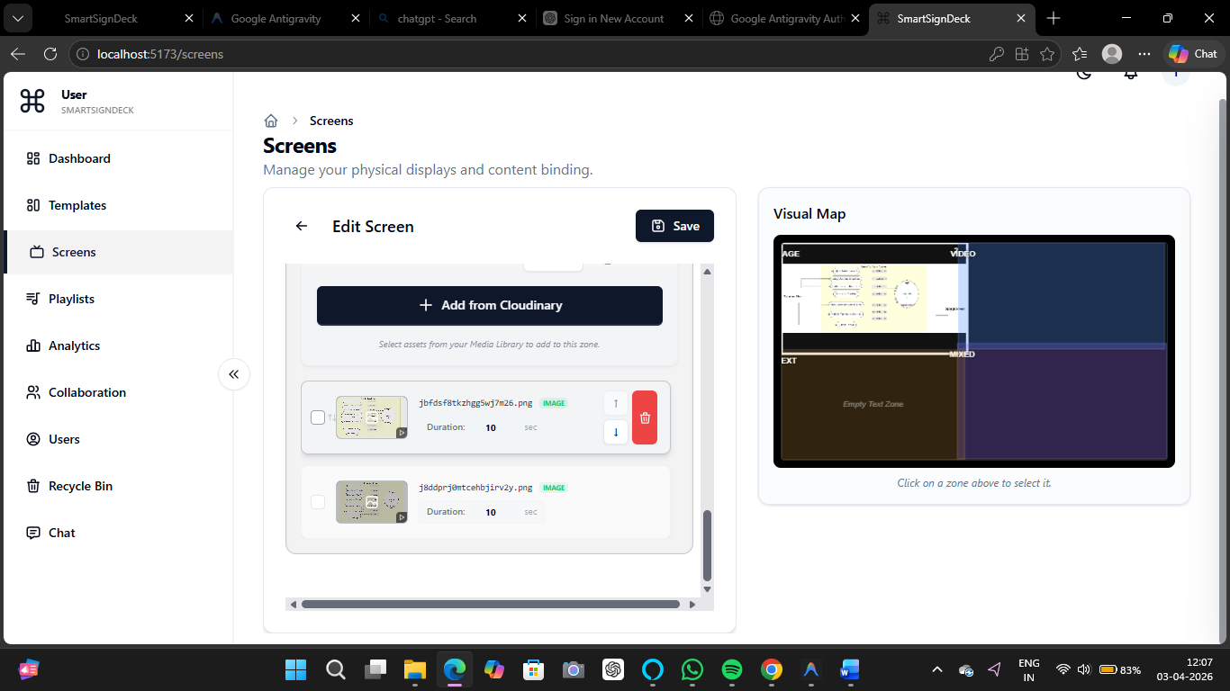
Screen Management
System Screenshot Interface

Slide 65

Screen Management
System Screenshot Interface

Slide 66

Screen Management
System Screenshot Interface

Slide 67

Screen Management
System Screenshot Interface

Slide 68

Screen Management
System Screenshot Interface

Slide 69

Screen Management
System Screenshot Interface

Slide 70

Screen Management
System Screenshot Interface

Slide 71

Screen Management
System Screenshot Interface

Slide 72

Screen Management
System Screenshot Interface

Slide 73

Screen Management
System Screenshot Interface

Slide 74

Screen Management
System Screenshot Interface

Slide 75

Playlist Management
System Screenshot Interface

Slide 76

Playlist Management
System Screenshot Interface

Slide 77

Playlist Management
System Screenshot Interface

Slide 78

Playlist Management
System Screenshot Interface

Slide 79

Playlist Management
System Screenshot Interface

Slide 80

Playlist Management
System Screenshot Interface

Slide 81

Super Admin Console
System Screenshot Interface

Slide 82

Super Admin Console
System Screenshot Interface

Slide 83

Super Admin Console
System Screenshot Interface

Slide 84

Super Admin Console
System Screenshot Interface

Slide 85

Super Admin Console
System Screenshot Interface

Slide 86

Super Admin Console
System Screenshot Interface

Slide 87

Super Admin Console
System Screenshot Interface

Slide 88

Super Admin Console
System Screenshot Interface

Slide 89

Real-time Analytics
System Screenshot Interface

Slide 90

Real-time Analytics
System Screenshot Interface

Slide 91

Real-time Analytics
System Screenshot Interface

Slide 92

Real-time Analytics
System Screenshot Interface

Slide 93
System Generated Reports

Slide 94

Generated Report
analytics-screenshot-2026-03-28-2026-04-04

Slide 95

Generated Report
smartsigndeck-dashboard-2026-04-03

Slide 96
Scope & Limitations
Scope:
• The system is capable of pushing dynamic visual changes to unlimited displays connected globally.
• Distinct access layers ensure users only control screens and media assigned to their workspace.
• Audit logging provides administrators with a complete history of all content changes over time.
Limitations:
• Strict dependency on reliable internet access. Screens cannot render completely new updates if the connection drops entirely.
• Timezone management is currently unified globally, lacking automatic local timezone logic for displays heavily relying on accurate local time.
• Pushing raw uncompressed 4K video assets may induce buffering latency on low-end WiFi networks.

Slide 97
Future Expansion
1. Implement Offline Player Architecture:
Develop electron-based or native mobile applications to heavily cache templates offline for 100% uninterrupted looping when internet drops.
2. AI-Powered Templating:
Integrate Generative AI tools (e.g. OpenAI) to automatically auto-design marketing graphics based entirely on prompt keywords.
3. Audience Analytics:
Embed camera modules at display zones to capture demographic engagement metrics and view-duration statistics anonymously.
4. Ad-Tech Payment Gateways:
Allow external third-party advertisers to bid and rent out your unused screen timeslots and pay digitally via Stripe.

Slide 98
Thank You
Any Questions?

