Slide 1
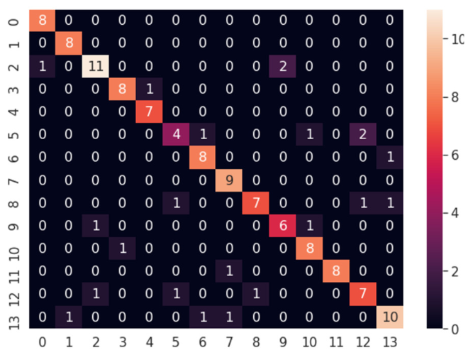

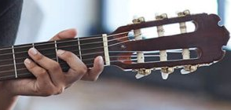



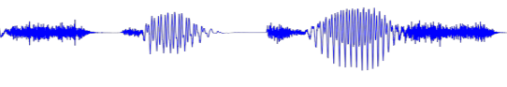
Fretboard Object
Fretboard Object Detection / Extraction
Fretboard Object Detection / Extraction
Chord Classification

Slide 2
