Slide 1


Outline of Funding opportunities for early career scientists by stage Workshop for Junior Investigators ISMB 2016
Lucia Peixoto, PhD
Assistant Professor
Department of Biomedical Sciences
Elson S. Floyd College of Medicine
Sleep and Performance Research Center
Notes:
The person who associated a work with this deed has dedicated the work to the public domain by waiving all of his or her rights to the work worldwide under copyright law, including all related and neighboring rights, to the extent allowed by law.
You can copy, modify, distribute and perform the work, even for commercial purposes, all without asking permission.

Slide 2
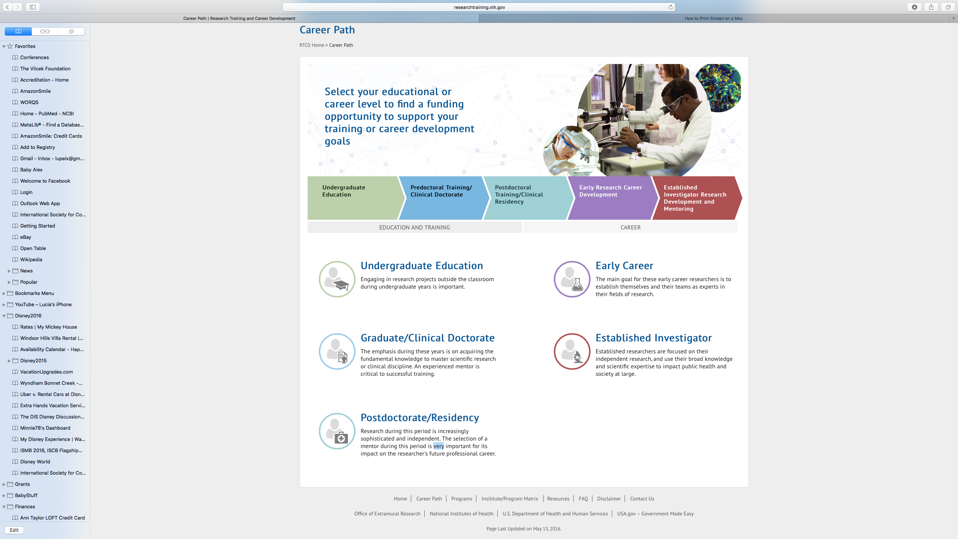
When should I start applying for funding?
Probably the right time to start
You have learned how to do science and communicate the results (write papers, give talks)
You likely do not depend on the funding-> you can afford to fail
If you succeed, you will have a stronger CV going forward
You probably should have started earlier
You have a limited time to obtain independent funding-> you cannot afford to fail too many times
Those that have will be more competitive in the job market
The earlier the better
Convincing people (in writing) to fund you and your research is an acquired skill that gets better with practice
At this career stage it is not expected, thus you should be careful it does not interfere with necessary training

Slide 3
Mentored/Career Development awards
You and your potential to be successful are as important as the research you propose
THE MAN – THE FAN –THE PLAN
Not going to talk about the research plan

Slide 4
What determines potential, part I
The man : YOU
YOUR CV -> actively build achievement
abstracts and peer reviewed publications
Success in merit-based applications: fellowships and grants
Performance relative to your peers: honors, awards
Learn how to write a compelling CV
Your vision: A clear connection between your research and a future career goal -> candidate statement, career background, CV.
Your strategy: A clear outline of how to achieve your goals and a long-term plan -> IDP/training plan, goals for training and career

Slide 5
About your training plan/IDP
It can carry as much weight on your application as your research plan
You likely know how to write about your research but may not know how to outline a training plan -> write your training plan first
You need to be specific as to which activities it will include and how they will help you develop conceptual, technical and professional growth -> avoid fluff

Slide 6
What determines potential, part II
The fan: Your mentors, references and your standing among peers
Think carefully about choosing an advisor. Look not only at their success at obtaining funding, but also at how successful they are at helping their trainees achieve their goals
Cultivate mentor and sponsor relationships outside your advisors-> assemble a mentoring committee
Network: invited lectures, involvement in research societies
Strong letters of recommendation and support.
Learn how to write a good reference letter about yourself

Slide 7
Strategies for grant and fellowship applications: predoctoral and early postdoc
It is good experience to help your PI write a grant. If funded it will likely support your research. But the result cannot be put in your CV. Limit how much of this you do.
Focus on writing individual fellowship applications, or any other form of merit-based application that you can list on your CV
Do not accept a postdoc position unless your PI can guarantee some protected time (2- 3years)

Slide 8
Examples of fellowship applications for the predoctoral and early postdoctoral stages
Country/ Area | Funding agency and grant type
United States | NIH: Fs (F31,F32) sometimes T32 NSF: Doctoral dissertation and Postdoctoral Research fellowships
Europe | EU contest for young scientists Doctoral dissertation awards
Private Foundations | Doctoral dissertation awards AAAS fellowships Damon Runyon

Slide 9
Strategies for writing grant and fellowship applications later in your career
Mind your timeline. A lot of young scientist awards have a limit of when you can apply relative to your PhD or start of your lab. You cannot be a posdoc for too long.
As a PI, take advantage of applications that honor early investigator status
Look for limited/targeted submissions that fit both your profile and your future plans
As a PI, help trainees obtain their own career development awards

Slide 10
Examples of fellowship applications for late postdoctoral and early PI stages
Country/ Area | Funding agency and grant type
United States | NIH: Ks (K01, K22, K99/R00 pathway to independence) NSF: Early Faculty Career development program
Europe | Marie Curie Individual Fellowships Junior grant in national grant scheme
Private Foundations | Alfred P Sloan Foundation, Simons foundation, Moore Foundation, Burroughs Welcome fund (CASI)

Slide 11
Some useful career Development resources
Fogarty International Center: a good summary of non-NIH US and International grant opportunities searchable by career stage https://www.fic.nih.gov/Funding/Pages/default.aspx
HHMI “ Making the right moves”. A practical Guide to Scientific Management for Postdocs and New Faculty http://www.hhmi.org/programs/resources-early-career-scientist-development/making-right-moves

Slide 12
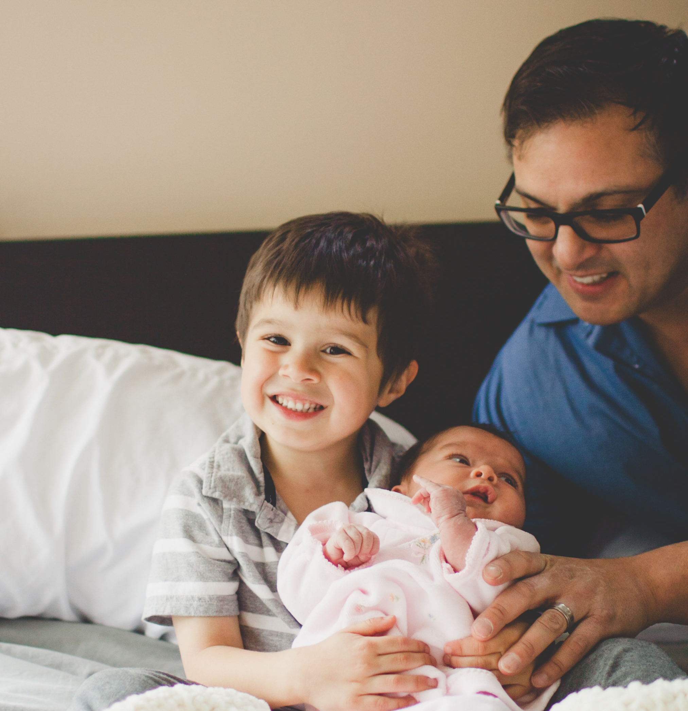
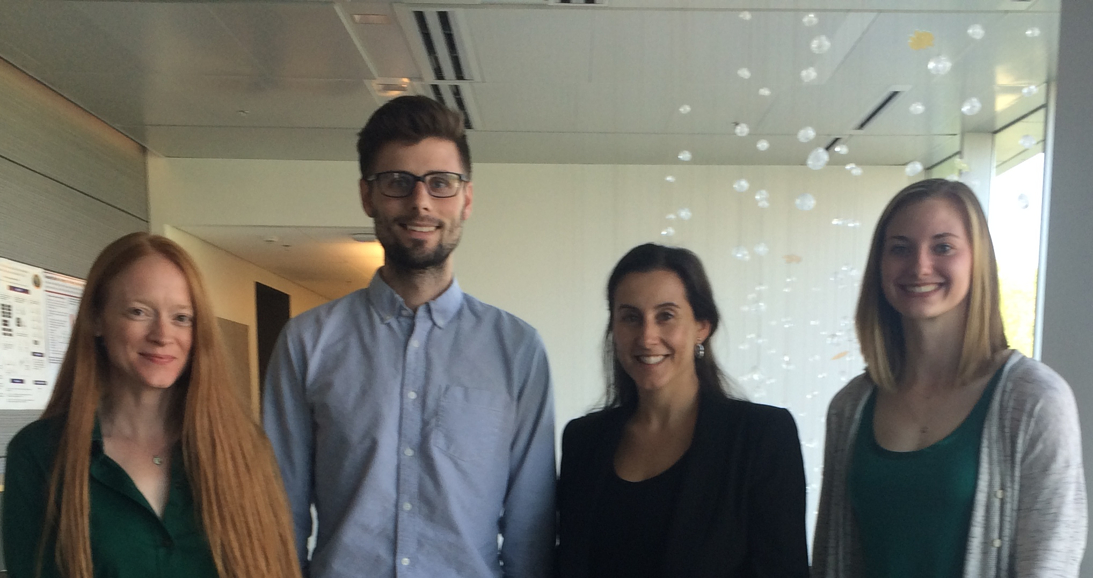
Thanks!
To my wonderful family!
My mentors
Official:
Ted Abel and David Roos, UPENN
Unofficial:
Mike Robinson, CHOP: Training program in Neurodevelopmental disabilities (NRSA T32NS007413 to Peixoto L., Robinson, M.B. PI)
NICHD and NINDS career development training
Nancy Zhang, Wharton School
Terry Speed, WEHI
Peixoto Lab members
Kristan Singletary
Taylor Wintler
John Koberstein

