Slide 1

Degree: Bachelor Of Computer Application(BCA)
Course: Mini Project
Course code: CAP300

Slide 2
HUMAN DETECTION AND COUNTING SYSTEM Review Batch No:02
Submitted By:
Dhinesh kumar M (223027020)
Harish k (223027028)
Prabaharan S (223027066)
Guided by:
Dr.N.Rajesh kumar
Mrs.D.Rubhitha devi

Slide 3
INTRODUCTION
Human detection and counting system is a computer vision technique that involves identifying and locating objects of interest in an image, video or real time video sequences with fast inference while maintaining a base level of accuracy.
This system provides an efficient and user friendly platform to detect and count the humans.
The purpose of human detection and counting systems is multifaceted and serves several important objectives such as Security and surveillance, crowd management, traffic management.

Slide 4
PROBLEM STATEMENT
Counting people in visual surveillance is hard and challenging problem.
In the current situation, a huge crowd could be especially dangerous where the virus is mainly spread in the air when people are close to each other.
Automatic counting surveillance of individuals publicly areas is vital for safety control.

Slide 5
OBJECTIVE
To develop an application that can easily detect and count the humans in the crowded area’s like airports, shopping malls , stadiums, transportation hubs in a video or image or data in real time.
It proposes an effective and efficient real-time human detection and counting solution specifically for the need of crowd management by producing a system with graphical user interface.

Slide 6
ADVANTAGES
The system can precisely identify and count individuals in real-time, minimizing errors and providing trustworthy data.
They reduce the need for manual counting and surveillance, freeing up resources and personnel for other tasks, and enabling cost savings.
These systems assist in traffic management and transportation planning

Slide 7
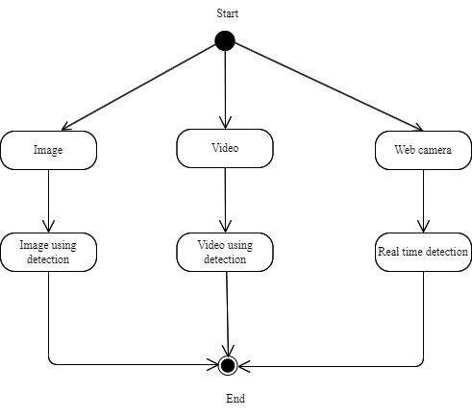
ARCHITECTURE DIAGRAM

Slide 8
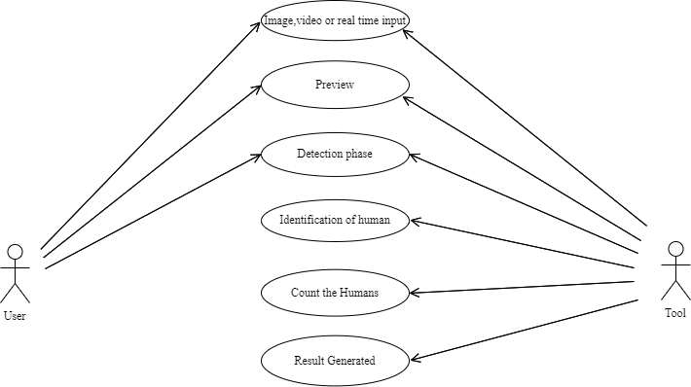
USE CASE DIAGRAM

Slide 9
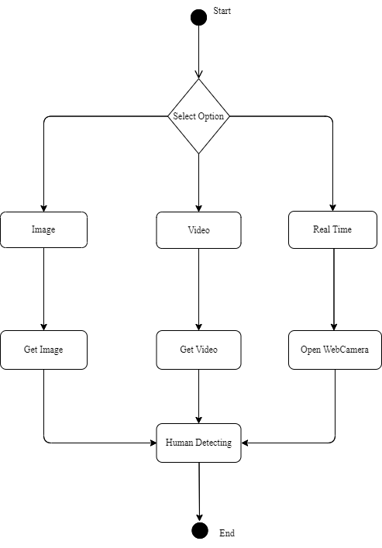
ACTIVITY DIAGRAM

Slide 10
TECHNOLOGY AND ALGORITHMS USED
Software Tools : Python (3.11), Open CV, Tkinter, Imutils, Argparse, Numpy.
Algorithms:
HOG Descriptor (Histogram of Oriented Gradient)
The histogram of oriented gradients (HOG) descriptor is a widely used feature descriptor in computer vision and image processing for object detection and recognition tasks. It is particularly effective for detecting and describing the shape and appearance of objects in images. It is a technique that counts events of gradient orientation in a specific portion of an image or region of interest.

Slide 11
Steps involved in HOG Descriptor:
HOG decomposes an image into small squared
Computes a histogram of oriented gradients in each cell
Normalizes the result using a block wise pattern
Return a descriptor for each cell

Slide 12
YOLO v4 (You Only Look Once)
YOLO (you only look once) is a real-time object detection algorithm that revolutionized the field of computer vision. YOLO is known for its speed and accuracy in detecting and localizing objects in images and videos. The key idea behind YOLO is to frame object detection as a regression problem rather than a traditional sliding window or region proposal-based approach. Instead of scanning the image multiple times at different scales and locations, YOLO divides the input image into a grid and predicts bounding boxes and class probabilities directly from this grid. This grid-based approach significantly reduces computational complexity and enables real-time object detection.

Slide 13
Steps involved in YOLO:
Pre-processing
Network initialization
Forward pass
Anchor box assignment
Bounding box prediction
Class prediction
Confidence filtering
Non-maximum suppression (NMS)
Post-processing
Output

Slide 14
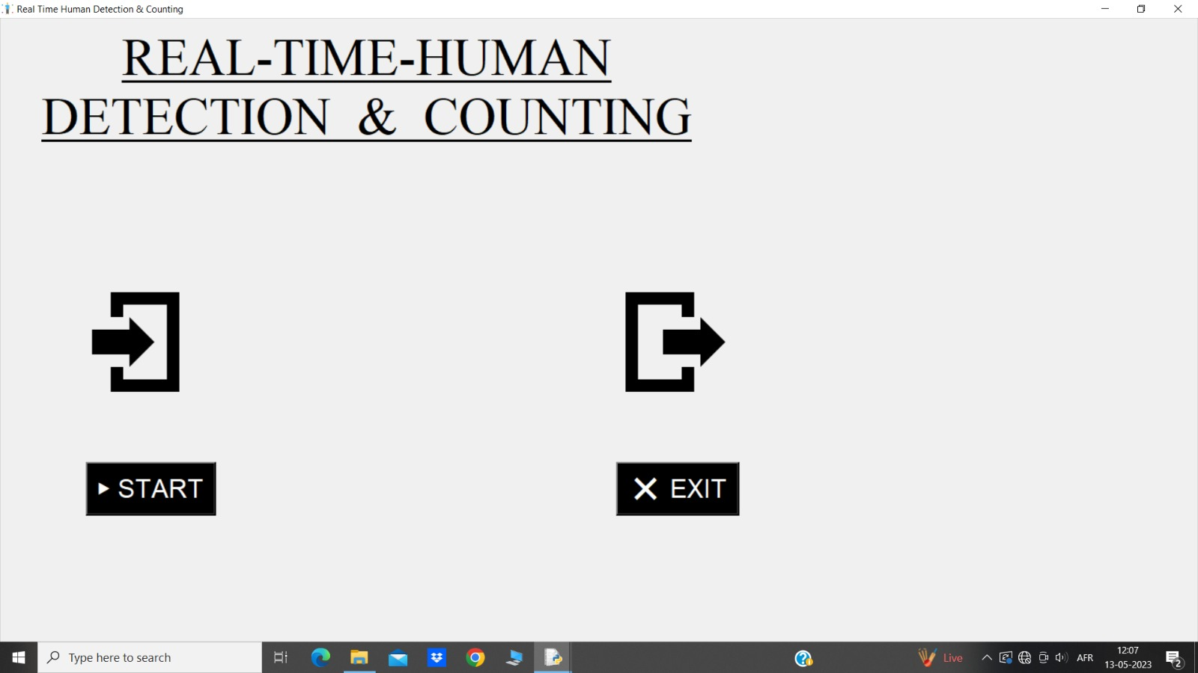
FRONTED AND OUTPUT DESIGN
Start Page

Slide 15
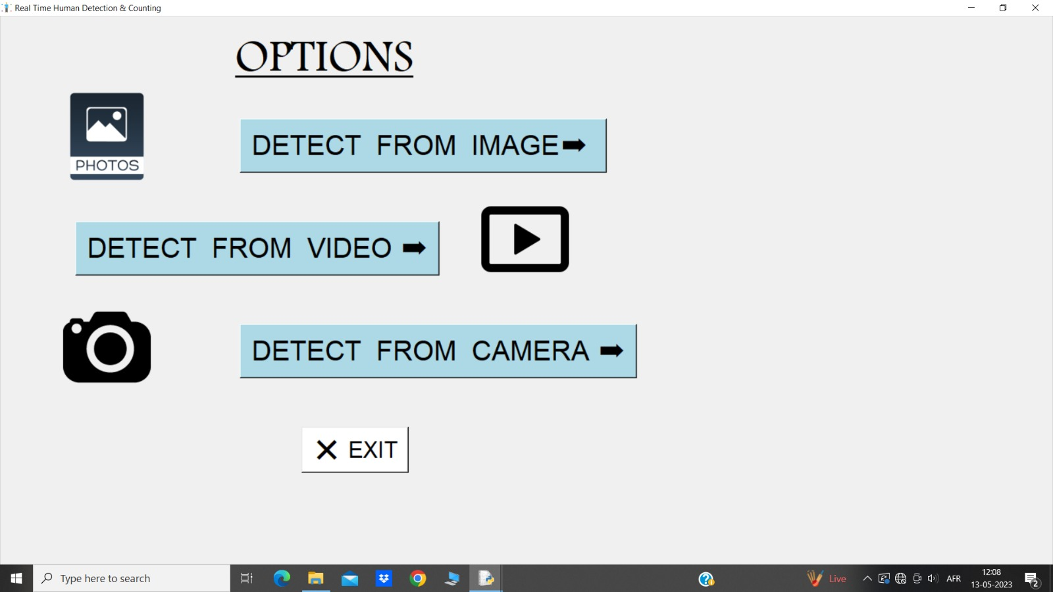
Option

Slide 16
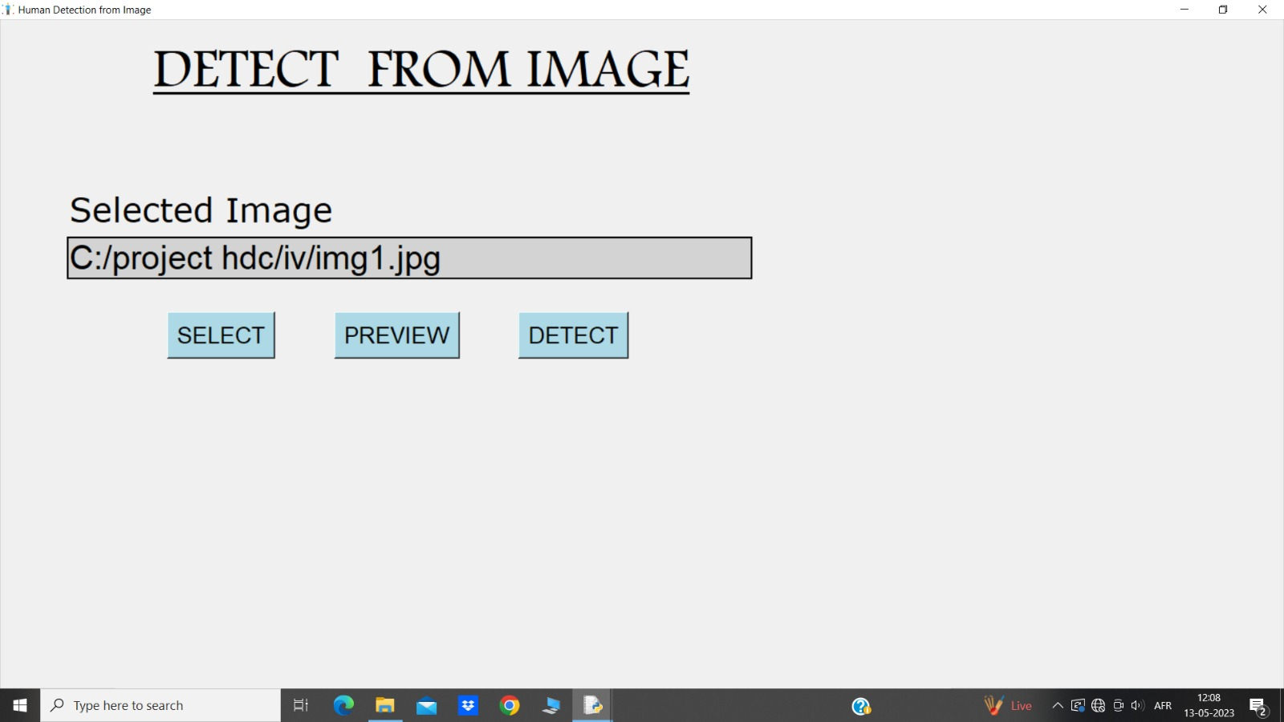
Image Selection

Slide 17
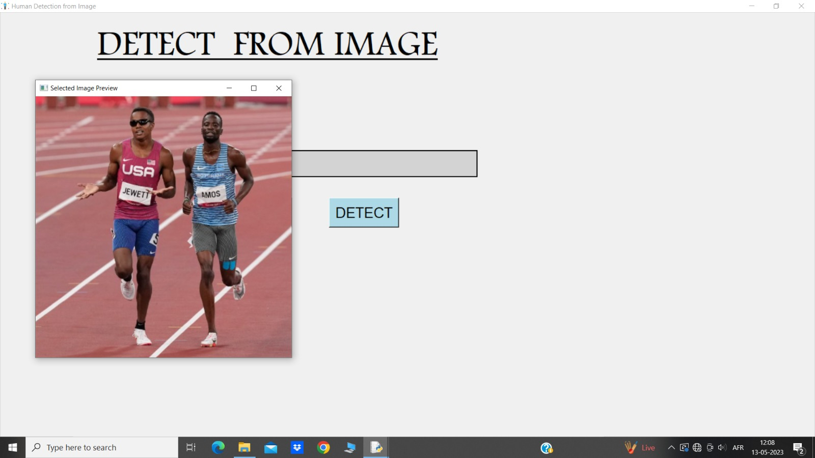
Preview

Slide 18
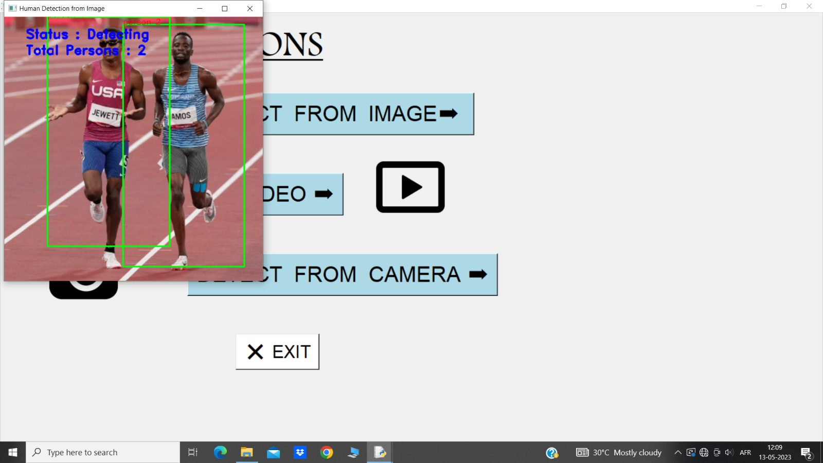
Detect the image

Slide 19

Video selection

Slide 20
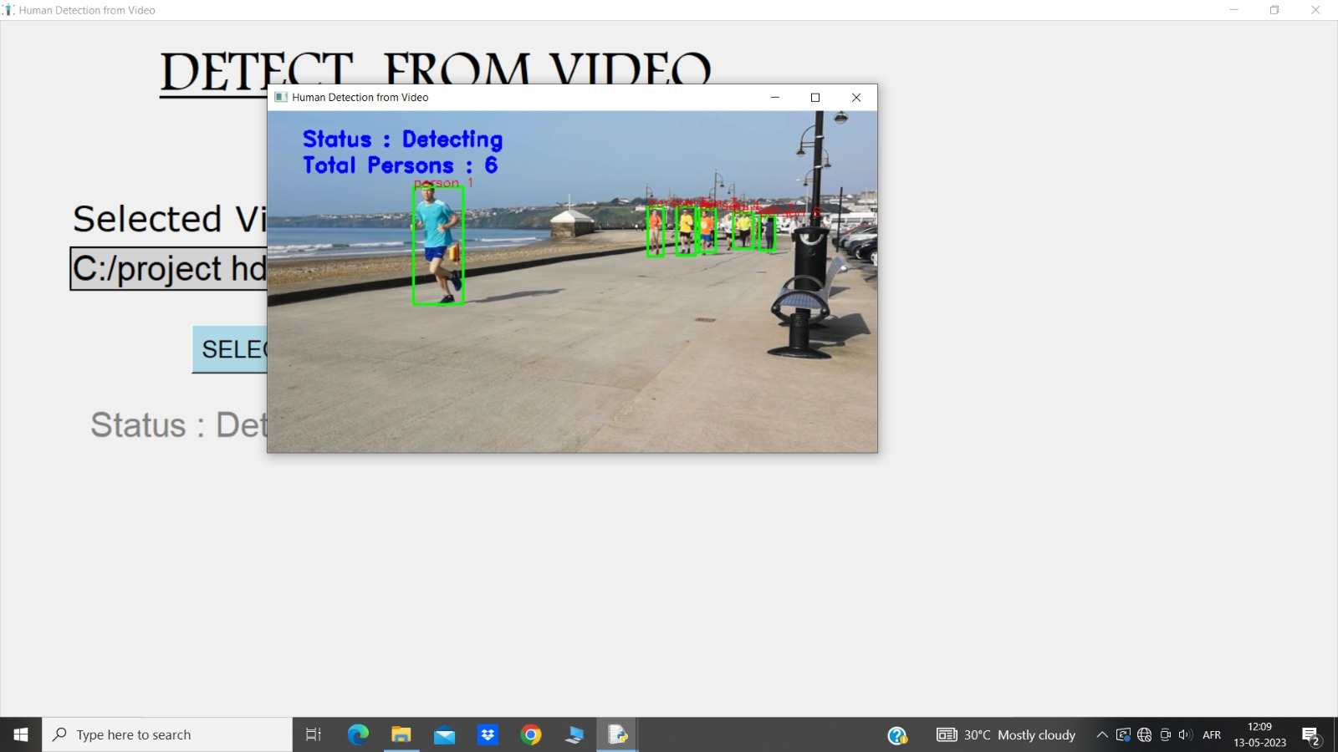
Detect the video

Slide 21
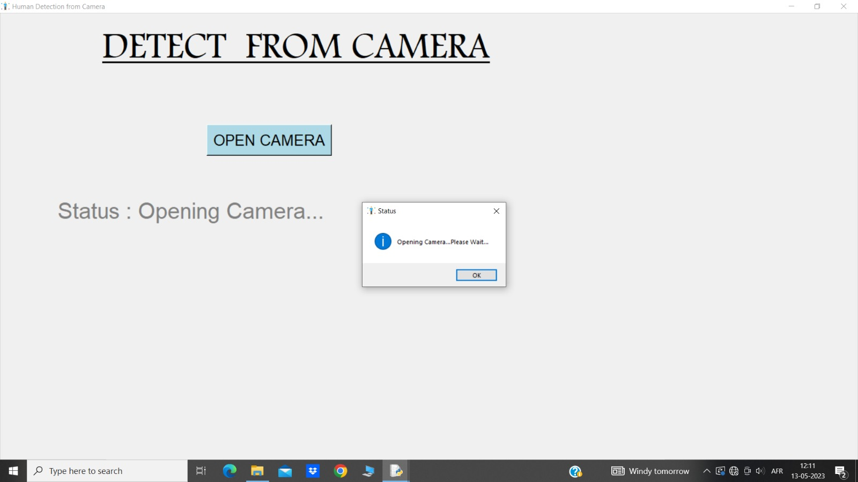
Open camera

Slide 22
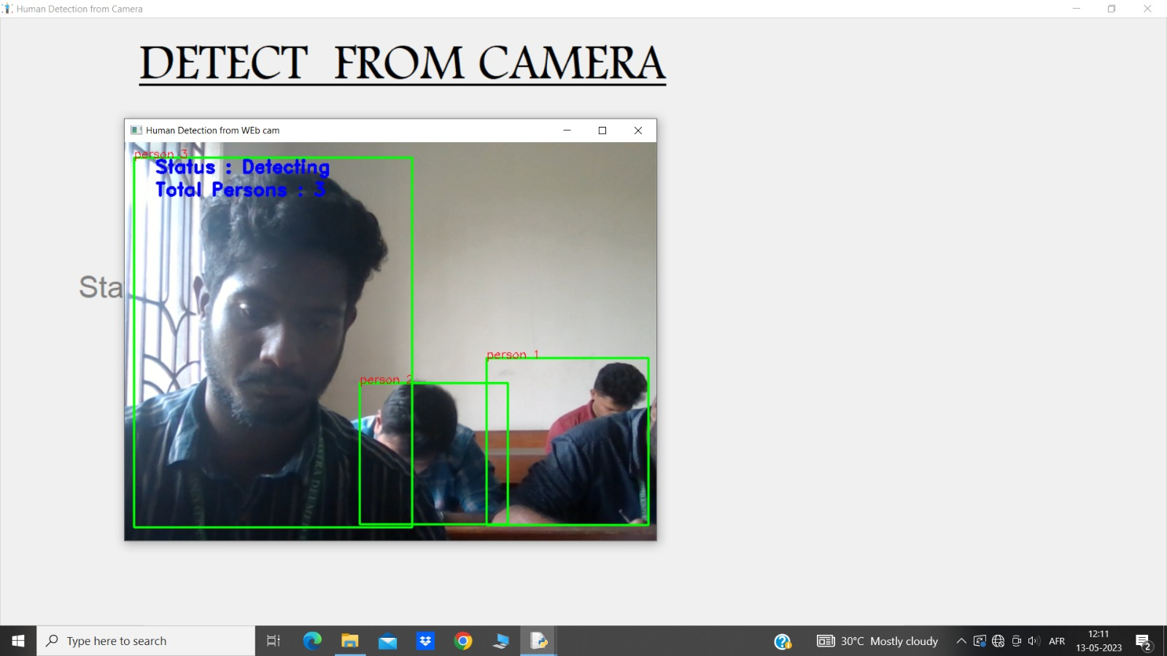
Detect the real time

Slide 23
Thank you…

