Slide 1




NEXT GEN EMPLOYABILITY PROGRAM
Creating a future-ready workforce
Team Members
College Name
Student Name :Dhinesh Kumar G
Register Number :422721104301
V.R.S College of Engineering and Technology

Slide 2
CAPSTONE PROJECT SHOWCASE
Project Title
Car Rentals Application with Django Framework
Abstract | Problem Statement | Project Overview | Proposed Solution | Technology Used | Modeling & Results | Conclusion

Slide 3
NEXT GEN EMPLOYABILITY PROGRAM
Abstract
Django Car Rental is a web application developed using the Django framework, designed to facilitate the rental and management of vehicles. The application provides a user-friendly interface for customers to browse available cars, make reservations, and manage their bookings. It also offers administrative functionalities for car owners or rental agencies to add, update, and remove vehicles, as well as manage reservations and customer data.

Slide 4
NEXT GEN EMPLOYABILITY PROGRAM
Problem Statement
Browse the various car categories (e.g., sedan, SUV, luxury). Examine comprehensive details about every vehicle, such as its characteristics, cost of rental, and availability. Make a car reservation by indicating the dates of the rental and entering the required personal data. Examine their past rentals and current bookings. Modify or cancel already made reservations. The program ought to enable administrators to do the following:
Add, modify, or remove vehicles from the inventory. Determine the availability and cost of each car's rental. Examine a list of all reservations, along with information about their status (confirmed, canceled, pending)

Slide 5
NEXT GEN EMPLOYABILITY PROGRAM
Project Overview
The Car Rental Application aims to provide a user-friendly platform for renting cars online. The application will allow users to browse through a variety of cars, view details, make reservations, and manage their bookings. Administrators will have access to an admin interface to manage cars, users, and reservations efficiently.

Slide 6
NEXT GEN EMPLOYABILITY PROGRAM
Proposed Solution
Project Structure: Create the "car_rentals" app and the "CarRentalSystem" Django project. Sort the project files into the appropriate media, static, and template files folders.Models: Create models of cars, customers, reservations, and managers.
The Car model should contain fields for the make, model, year, category, price, availability, and image. The client model should contain fields for name, email, phone number, and address. The reservation model should contain fields for the client, the vehicle that was rented, the dates of the rental, the status, and any further information. Email addresses, encrypted passwords, login, and permissions should all be included in the Administrator model.
Points of view:
Develop views to explore cars, examine information on cars, schedule appointments, and view rental

Slide 7
NEXT GEN EMPLOYABILITY PROGRAM
Key Components
1. Authentication & Authorization: Guarantee safe login for administrators and customers; limit access according to roles. 2. Car Management: Easily update inventory, track availability, and keep thorough records of your cars. 3. Reservation System: Make booking simple for clients and give administrators the resources they need to handle reservations effectively. 4. User Interface: Create user-friendly interfaces that make booking, browsing, and administrative chores easy.

Slide 8
NEXT GEN EMPLOYABILITY PROGRAM
5. Admin Dashboard: A central location where administrators may manage users, reservations, and automobile inventory. 6. Forms & Validation: Verify user input to ensure accuracy and preserve data integrity. 7. Security Measures: Guard against online dangers, encrypt confidential information, and guarantee safe correspondence. 8. Quality Control & Testing: Perform exhaustive testing to find and fix problems prior to launch.

Slide 9
NEXT GEN EMPLOYABILITY PROGRAM
Modelling & Results
We arranged the models we designed for our automobile rental application to effectively capture the most important data. The Car model ensures that buyers can browse and choose their desired vehicles with ease by encapsulating facts like car type, cost, and availability. Conversely, the Customer model streamlines communication and booking procedures by storing pertinent customer data such as names, emails, and phone numbers.
The Admin model gives administrators secure access to manage cars, bookings, and user accounts, while the Reservation model serves as the foundation of our booking system, monitoring reservations, including dates and statuses. With the help of these models, we can provide a simplified and easy-to-use interface for administrators and consumers alike. This includes secure logins, effortless booking procedures, simple automobile selection, and effective management features.

Slide 10
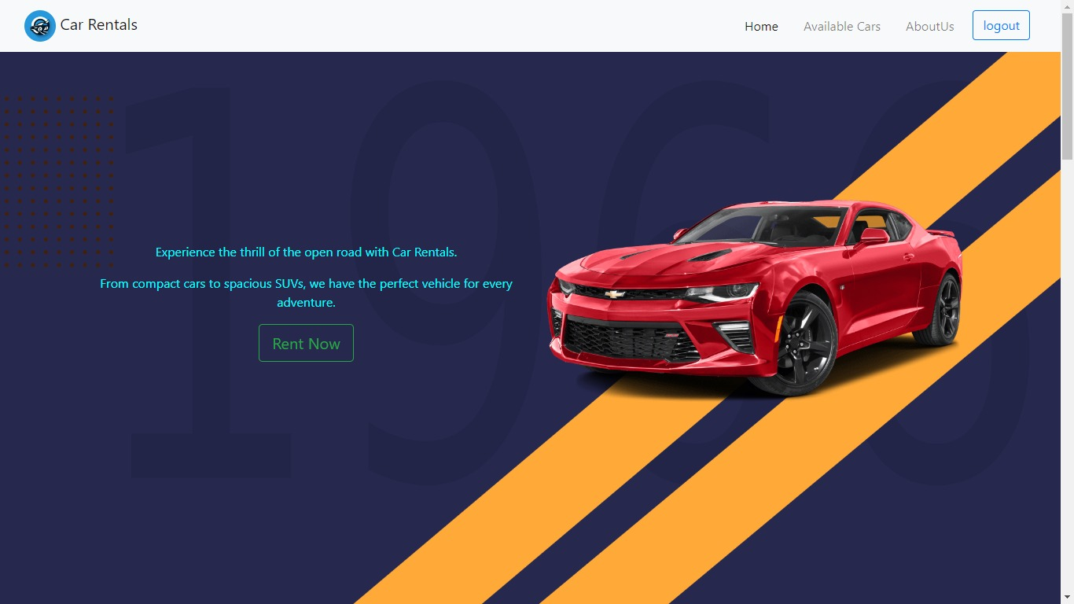
NEXT GEN EMPLOYABILITY PROGRAM
Homepage

Slide 11
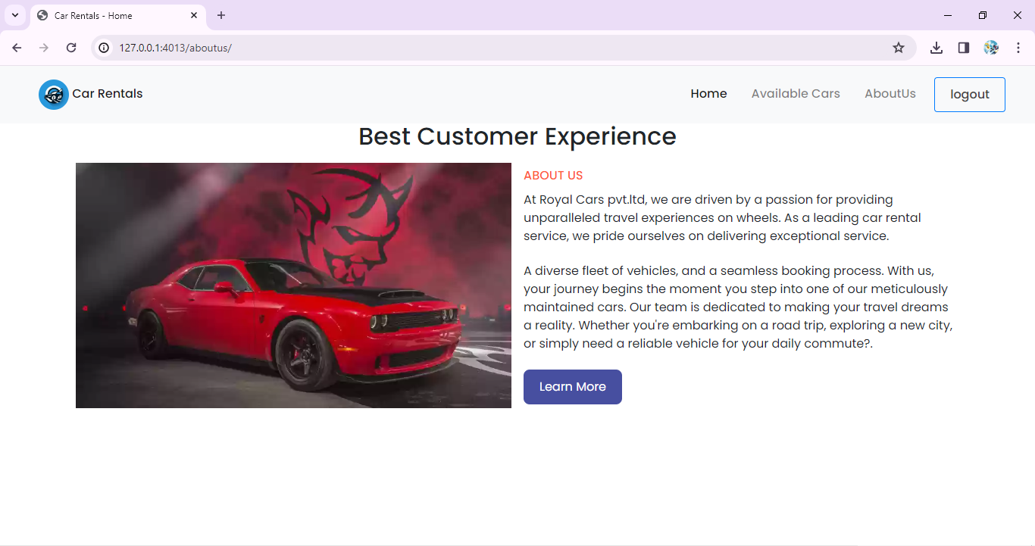
NEXT GEN EMPLOYABILITY PROGRAM
About-Us-Page

Slide 12
NEXT GEN EMPLOYABILITY PROGRAM
Future Enhancements:
With a few new projects in the works, we hope to improve our automobile rental application and provide our clients with an even better experience while also increasing operational efficiency. First, in order to make it easier for consumers to identify cars based on particular requirements like seating capacity or fuel efficiency, we want to implement enhanced search and filtering tools. Customers will find it more convenient to make safe online payments when payment gateway integration is implemented. We also want to put in place a rating and feedback system in order to collect insightful data and build community trust. Creating a mobile application will increase accessibility even more, and loyalty plans will encourage return reservations. The total rental experience will be enhanced by integrating with GPS and navigation systems, and dynamic pricing algorithms will maximize revenue. As we keep adding new car options, we're providing

Slide 13
NEXT GEN EMPLOYABILITY PROGRAM
Conclusion
In conclusion, developing a car rental application with the Django framework offers immense potential for providing users with a seamless and efficient rental experience. By leveraging Django's powerful features for model definition, views, and templates, you can create a robust system capable of managing rental transactions, user accounts, and inventory seamlessly. The application can be enhanced further by focusing on aspects such as user experience improvements, advanced search and filtering capabilities, dynamic pricing strategies, integration with payment gateways, and ongoing maintenance.

Slide 14
NEXT GEN EMPLOYABILITY PROGRAM
Thank You!

