Slide 1


CE – TAF – SEMINAR
Yield stress of the Wet Foam
Presented by,
Dhineshkumar Balasubramaniam (21971603)

Slide 2
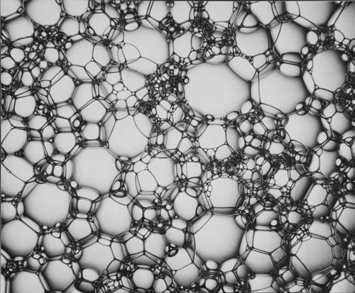

Slide 3
