Slide 1
Optimized Multigrid solver
Team Name : “ADG”
Presented by,
Aravind Raman
Dhineshkumar Balasubramaniam
Ganesh Rajaram

Slide 2
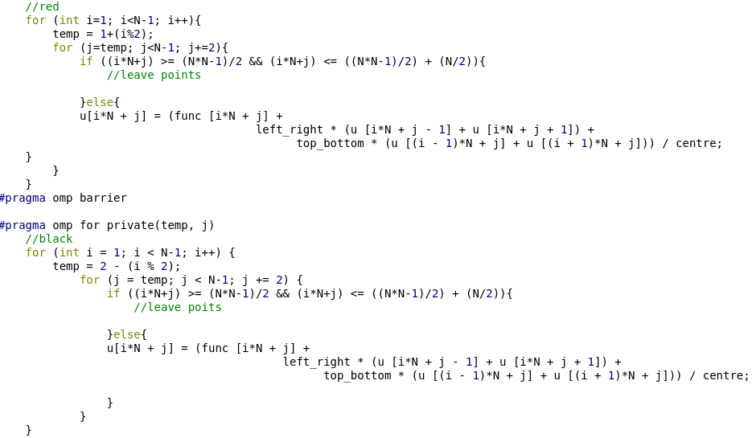
Optimization strategies
Optimization techniques :
Load / store in 1D vector
Effective RBGS algorithm

Slide 3
Parallelization
OpenMP
#pragma omp parallel
{
#pragma omp for private(variable)
}
#pragma omp barrier

Slide 4
Time to solution
For following case: (emmy cluster)
No. of Levels = 11
No. of V-cycles = 13
export SET_NUM_THREADS = 16
Time to solve the problem:
Without OpenMP : 1.9 s
With OpenMP : 0.54 s

Slide 5
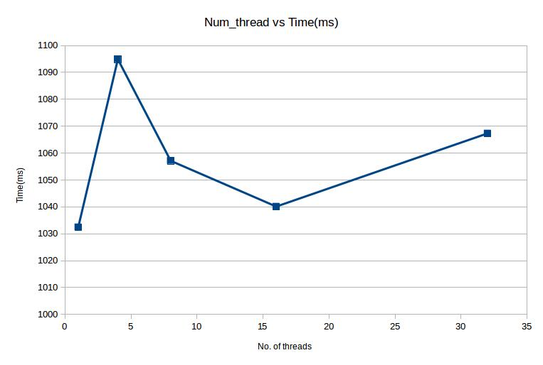
Num thread vs Time (ms)

Slide 6
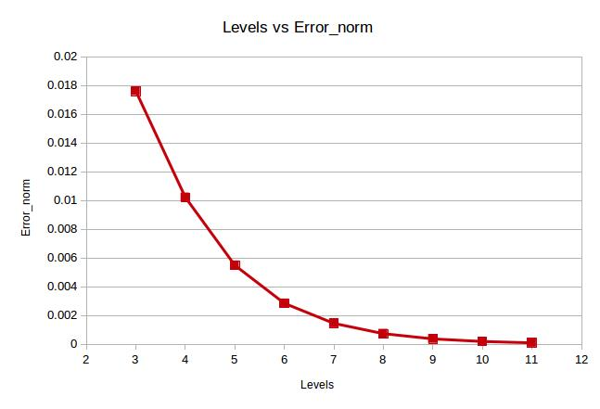
Levels vs Error norm

Slide 7
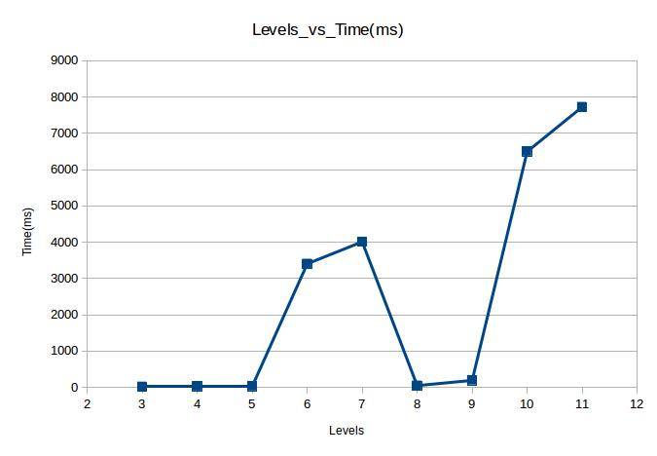
Levels vs Time (ms)

Slide 8
Conclusion
We have successfully implemented the MG solver for the given PDE.
We have found out the optimum performance of our solver with OpenMP.
          Thanks for your attention.

