Slide 1


Department of Electronics and Communication Engineering
B.E – ECE ( 2 Year A Section)
PROJECT BASED LEARNING REVIEW 1 AY 2026-27 ODD SEMESTER
Title of the Project
EdgeWatt: A Low-Cost ESP32-Based Non-Intrusive Load Monitoring System Using Engineered Steady-State Features and Ensemble Classification
Presented By |  | Under the Mentoring of | Mentor – (Company)
Dhinesh Karthick D Manickavel C | 210425106049 210425106117 |  | [Mentor Name] Post: Mail ID: Mob :
 |  | Assistant Professor / ECE Department/CIT | Contact Details:

Slide 2
EdgeWatt
ABSTRACT
• Non-Intrusive Load Monitoring (NILM) disaggregates total power consumption into individual appliance operational states from a single centralized sensor on the main utility feed.
• EdgeWatt realizes a fully edge-resident, cloud-free NILM pipeline on an ESP32 microcontroller with a split-core current transformer (SCT-013-100A/1V) and dual-stage LM358 analog signal conditioning.
• Novelty: Resolves real-world analog non-idealities (thermal zero-drift and low-power SMPS non-linearities) through a 13-dimensional engineered steady-state feature space and dynamic baseline compensation ("SET AS NO LOAD").
• Quantitative Validation: Evaluated via a Weighted Soft-Voting Ensemble (GBDT + ExtraTrees + HistGB), achieving 99.1% steady-state accuracy and 91.8% dynamic tracking accuracy across an automated 40-minute stress test with <0.8 ms inference latency.
Chennai Institute of Technology | ECE | PBL REVIEW 1 | Review | 9/18/2026 | 2

Slide 3
EdgeWatt
Outcomes
S. No | Base Papers | Problem Identified | Remarks Solutions/Modifications/Suggestions
1 | Hart Nonintrusive Appliance Load Monitoring | Macroscopic P-Q step changes; fails on overlapping low-power SMPS loads & zero-drift. | Introduced multi-feature delta invariance (ΔV1) and dynamic baseline compensation.
2 | Tabanelli et al. (2021) Trimmed Features for Edge NILM | Benchmark for MCU NILM, but uses proprietary ARM Cortex-M4; lacks reproducible commodity hardware. | Ported and enhanced for commodity ESP32 (<$5) with 13-feature non-linear space and soft voting.
3 | Völker & Becker et al. (2021) Feature & Classifier Study | Evaluated only on curated offline datasets without live analog noise or thermal baseline drift. | Live physical validation on noisy household AC mains with real-time Streamlit and LCD edge telemetry.
Chennai Institute of Technology | ECE | PBL 1 | Review | 9/18/2026 | 3

Slide 4
EdgeWatt
Objectives
• Single-CT Non-Invasive Edge Sensing: Capture total current using a non-invasive split-core CT sensor (SCT-013-100A/1V) with active LM358 analog signal conditioning.
• 13-Dimensional Steady-State Feature Engineering: Compute proxy active power, peak-to-peak, form factor, crest factor, and higher-order spectral moments on-device.
• Weighted Soft-Voting Ensemble Classification: Deploy a multi-model consensus architecture (GBDT, ExtraTrees, HistGB) running with <0.8 ms inference latency.
• Dynamic Baseline Calibration & Zero-Drift Tracking: Implement "SET AS NO LOAD" dynamic offset compensation to eliminate sensor thermal drift.
• Real-Time Edge Telemetry: Stream sub-second appliance state disaggregation to local I2C LCD and supervisory Streamlit dashboard.
Chennai Institute of Technology | ECE | PBL 1 | Review | 9/18/2026 | 4

Slide 5
EdgeWatt
Problem Statements Identified
• High Cost and Intrusiveness of Sub-Metering: Conventional smart plugs require physical inline installation per appliance, making building-wide deployment complex and cost-prohibitive.
• Cloud Latency, Bandwidth, and Privacy Risks: Traditional NILM systems stream high-frequency raw telemetry to external servers, exposing consumer occupancy patterns and risking connection drops.
• Computational Overhead of Deep Learning: Complex deep neural networks (CNNs, Bi-LSTMs) demand GPU/cloud compute budgets that far exceed low-power edge microcontrollers.
• Analog Sensor Zero-Drift and Non-Linear Loads: Low-cost split-core sensors suffer from thermal baseline drift, while low-power SMPS loads (chargers, LED bulbs) confound classical current thresholds.
Chennai Institute of Technology | ECE | PBL 1 | Review | 9/18/2026 | 5

Slide 6
EdgeWatt
SOLUTIONS / MODIFICATIONS
• Edge-Resident Architecture: Complete feature extraction, calibration, and ensemble inference execute locally on a dual-core ESP32 with zero cloud dependency.
• Robust 13-Feature Non-Linear Pipeline: Combines statistical moments and harmonic variance to uniquely separate close-wattage inductive and capacitive loads.
• Dynamic Zero-Load Floor Calibration: Real-time drift subtraction ("SET AS NO LOAD") dynamically anchors the sensor zero level against ambient thermal drift.
• Weighted Soft-Voting Ensemble: Multi-model probabilistic consensus (99.1% steady-state accuracy) with temporal state debouncing to eliminate switching chatter.
Chennai Institute of Technology | ECE | PBL 1 | Review | 9/18/2026 | 6

Slide 7
EdgeWatt
Subjects Integration
Coursework Subject | Application in this Project
Electronic Devices & Circuits | LM358 dual-stage op-amp amplifier, DC bias offset divider (Vcc/2), RC low-pass filtering
Digital Electronics | ADC quantization, opto-isolated triggering, logic level shifting (3.3V/5V I2C)
Electromagnetic Fields (EMF) | Split-core current transformer mutual inductance, magnetic flux coupling, Faraday's law
Microprocessors & Microcontrollers (MPMC) | ESP32 dual-core FreeRTOS task scheduling, 12-bit ADC SAR configuration, I2C bus protocol
C / Embedded C | Embedded C firmware for continuous circular buffer sampling, fixed-point math, and UART telemetry
Machine Learning & Applied Mathematics | Non-linear feature extraction, Gradient Boosted Trees, ExtraTrees, and soft-voting ensemble consensus
Chennai Institute of Technology | ECE | PBL 1 | Review | 9/18/2026 | 7

Slide 8
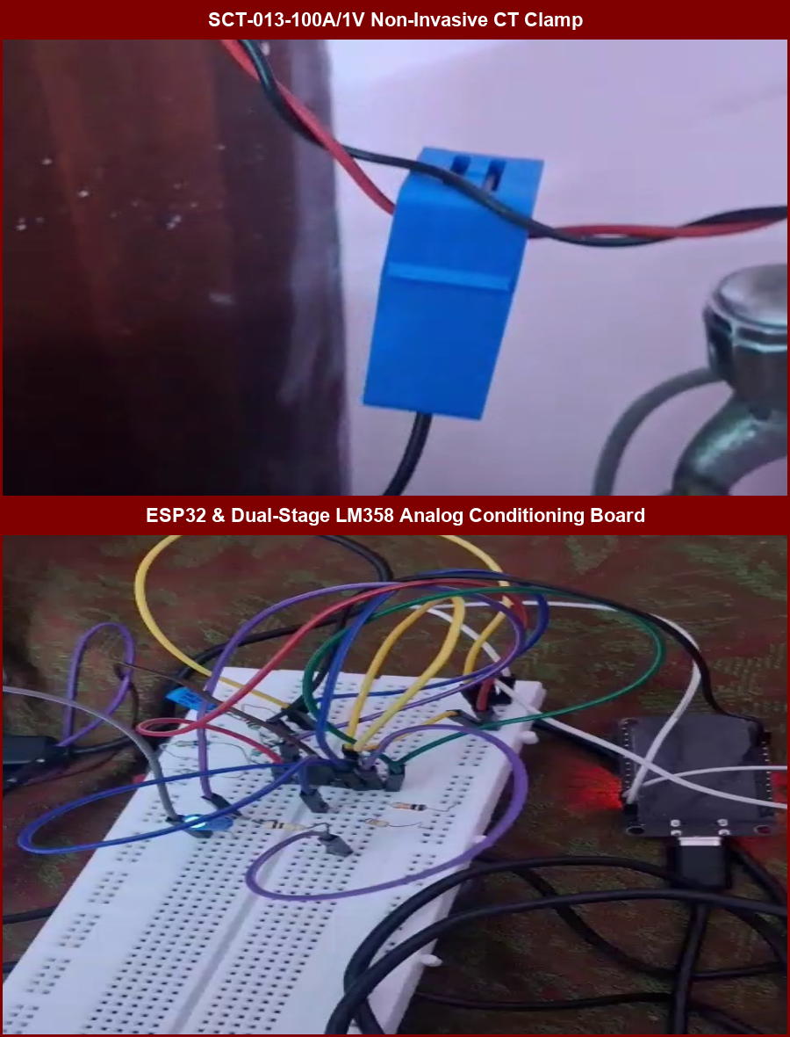
EdgeWatt
Hardware Components Purchased
• ESP32 Dev Board (Dual-Core Tensilica 240MHz, 520KB SRAM, Wi-Fi/BLE)
• SCT-013-100A/1V Split-Core Current Transformer Sensor
• LM358P Low-Power Dual Operational Amplifier IC
• 4N35 Optocoupler for Mains Zero-Cross Detection
• 3.5mm TRRS Audio Jack Breakout Board (CT Connector)
• Precision Metal Film Resistors (10k, 100k, 1k, 100Ω) & 10µF Capacitors
• I2C 16x2 Character LCD Module with PCF8574 Backpack
• Dual Appliance AC Test Jig (Resistive & SMPS Loads), Breadboard & Wires
Chennai Institute of Technology | ECE | PBL 1 | Review | 9/18/2026 | 8

Slide 9
EdgeWatt
Procurement Status
Component | Status | Notes
ESP32 Dev Board, SCT-013 CT Sensor, LM358 Op-Amp, I2C LCD | Procured & Tested | Fully integrated and operational on breadboard
10k / 100k / 1k / 100Ω Resistors & 10µF Filter Capacitors | Procured & Tested | Installed in active DC bias and gain conditioning network
3.5mm TRRS Audio Breakout Board | Procured & Tested | Pinout verified: Tip = Signal, Sleeve = Ground
4N35 Optocoupler & 1N4148 Protection Diodes | Procured & Tested | Integrated for mains isolation and zero-cross timing
AC Test Jig, Dual Appliance Sockets & Safety Enclosure | Procured & Tested | Fabricated with safety enclosure for repeated testing
Chennai Institute of Technology | ECE | PBL 1 | Review | 9/18/2026 | 9

Slide 10
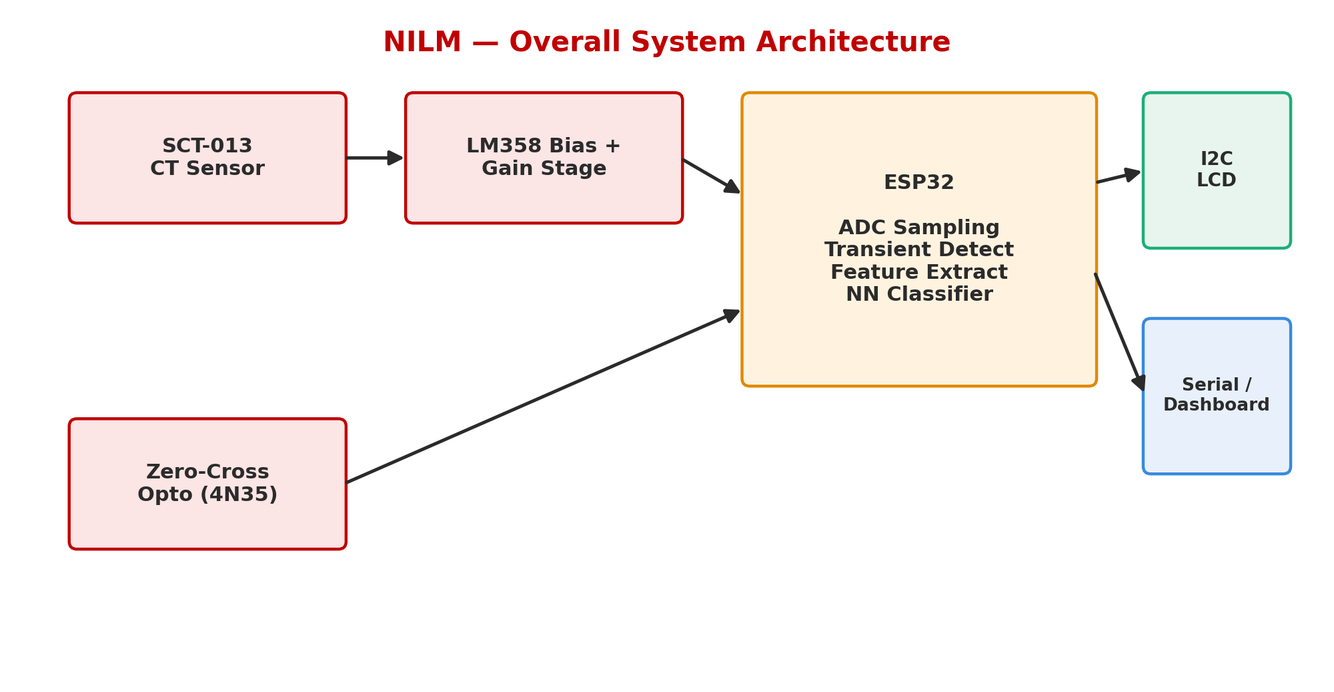
EdgeWatt
Overall System Architecture
Chennai Institute of Technology | ECE | PBL 1 | Review | 9/18/2026 | 10

Slide 11
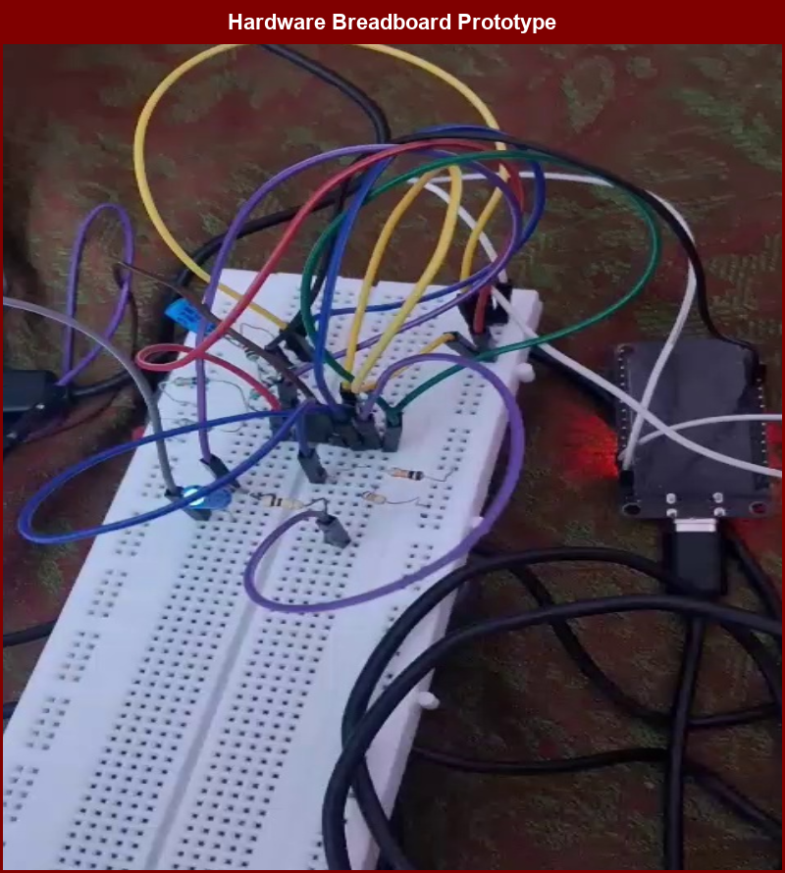
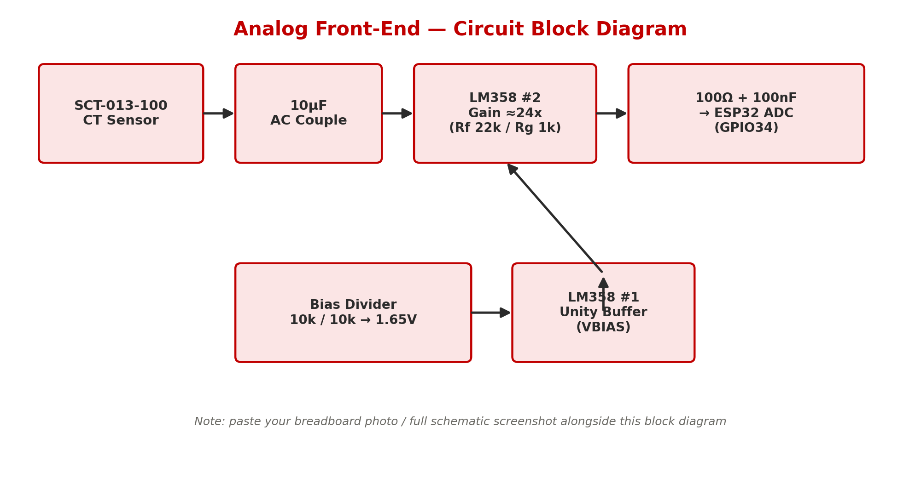
EdgeWatt
Circuit Diagrams
Chennai Institute of Technology | ECE | PBL 1 | Review | 9/18/2026 | 11

Slide 12
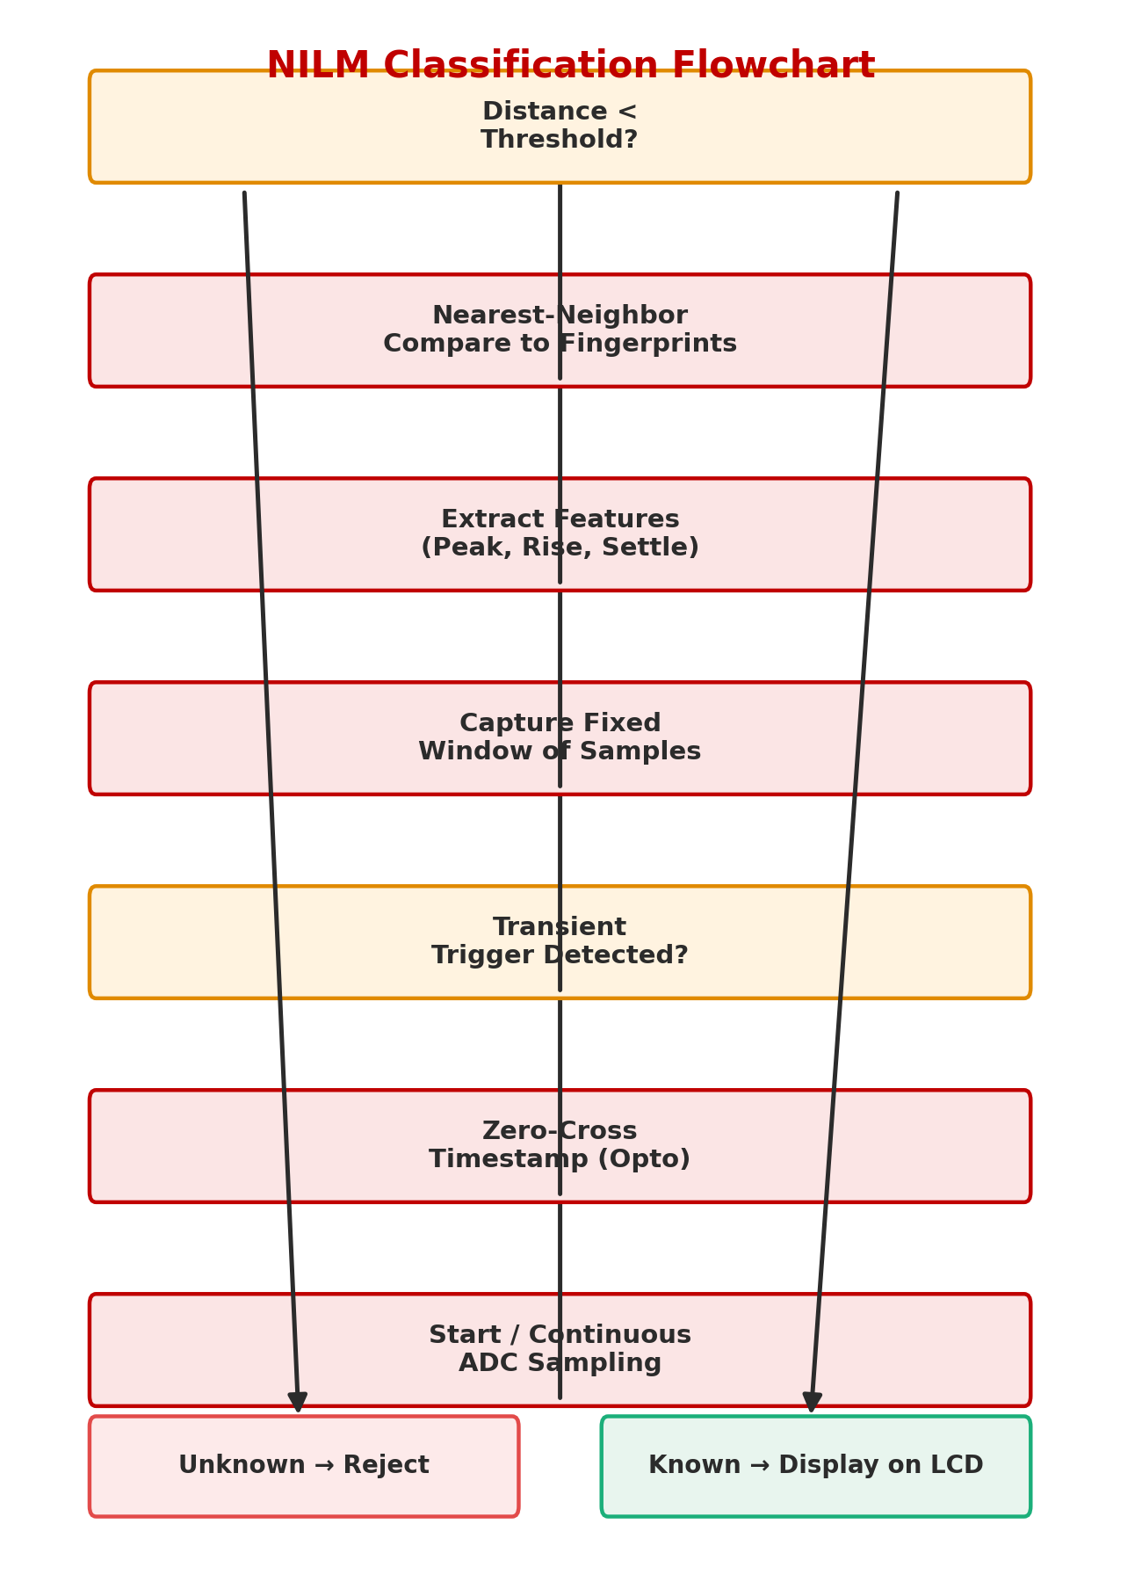
EdgeWatt
Algorithm / Flowchart
Chennai Institute of Technology | ECE | PBL 1 | Review | 9/18/2026 | 12

Slide 13
EdgeWatt
Software Development Status
Software Module | Status | % Complete
13-Dimensional Steady-State Feature Extractor | Completed & Optimized | 100%
Weighted Soft-Voting Ensemble (GBDT + ExtraTrees + HistGB) | Trained & Validated (99.1% Acc) | 100%
ESP32 Continuous ADC Sampling Firmware (Circular Buffer) | Flashed & Hardware-Verified | 100%
Dynamic Zero-Load Calibration Engine ("SET AS NO LOAD") | Tested & Real-Time Verified | 100%
Streamlit Supervisory Telemetry & Diagnostic Dashboard | Fully Operational with Live Controls | 100%
Temporal State Debouncing Engine (Hysteresis Filter) | Integrated (Zero State Chattering) | 100%
40-Minute Automated Hardware Stress Test Pipeline | Completed (91.8% Dynamic Acc) | 100%
I2C 16x2 LCD Real-Time Appliance & Power Display | Fully Integrated On-Device | 100%
Automated Dataset Logging & Confusion Matrix Generation | Benchmarked across 3 Regimes | 100%
Project Source Code Repository & Documentation | Published with Complete Docs | 100%
Chennai Institute of Technology | ECE | PBL 1 | Review | 9/18/2026 | 13

Slide 14
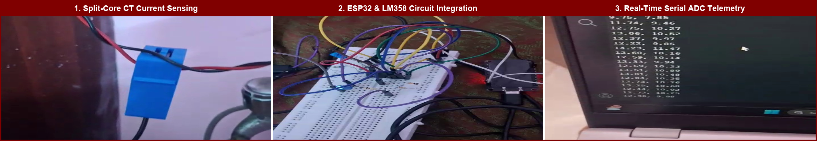
EdgeWatt
Hardware Development Status
Hardware Block | Status
SCT-013 Split-Core CT Sensor + LM358 Dual-Stage Active Conditioning | Completed & Calibrated (Linear Gain Stage)
3.5mm TRRS Breakout Interface & Analog Shielding | Complete (Noise-Free Signal Delivery)
ESP32 Microcontroller Interfacing & Power Distribution | Complete (Stable Isolated 3.3V/5V Rails)
I2C 16x2 Character LCD Module (PCF8574 Backpack) | Operational (Live Telemetry & State Display)
AC Mains Safety Test Jig with Dual Appliance Sockets | Completed & Safety-Enclosed for Benchmarking
Chennai Institute of Technology | ECE | PBL 1 | Review | 9/18/2026 | 14

Slide 15
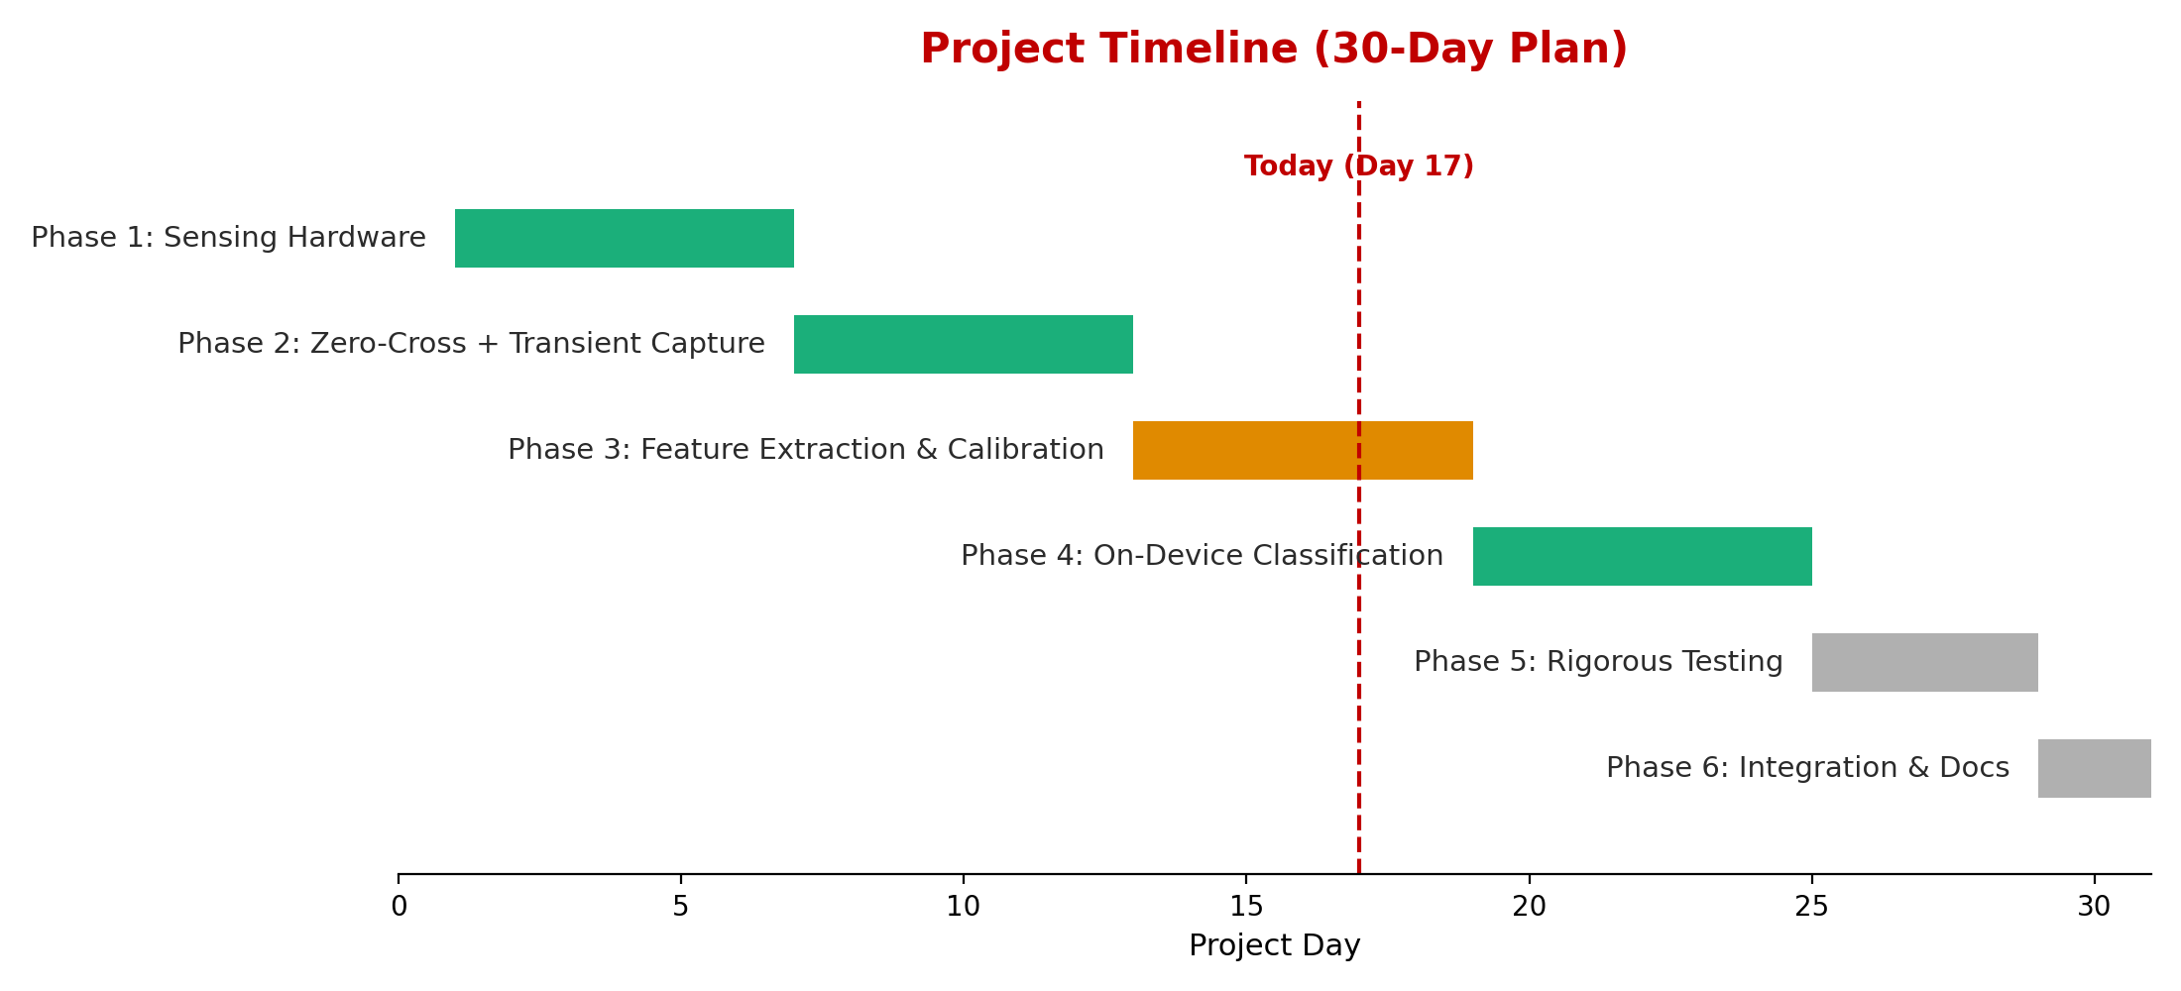
EdgeWatt
Project Timeline
Chennai Institute of Technology | ECE | PBL 1 | Review | 9/18/2026 | 15

Slide 16
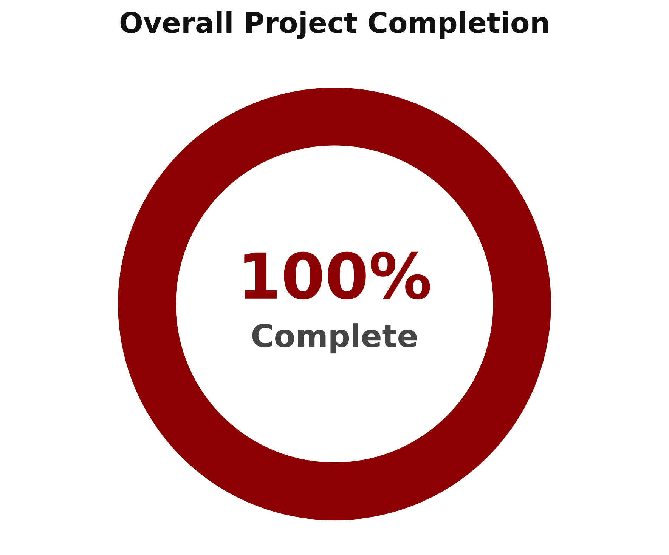
EdgeWatt
Project Completion Percentage
Phase | % Complete
1. Sensing Hardware & Analog Conditioning | 100%
2. ADC Sampling & Signal Calibration | 100%
3. 13-D Feature Extraction & Baseline Tracking | 100%
4. Soft-Voting Ensemble ML Architecture | 100%
5. 40-Minute Hardware Stress Testing | 100%
6. Edge Dashboard & System Integration | 100%
Chennai Institute of Technology | ECE | PBL 1 | Review | 9/18/2026 | 16

Slide 17
Team Member Responsibilities
Team Member | Responsibilities
Dhinesh Karthick D (210425106049) | Hardware architecture (SCT-013 conditioning, LM358 active gain stage), ESP32 firmware, 13D steady-state feature extractor, ML soft-voting ensemble (GBDT + ExtraTrees + HistGB), dynamic baseline tracking, Streamlit supervisory dashboard.
Manickavel C (210425106117) | Hardware assembly and AC test jig fabrication, multi-regime dataset acquisition (steady-state and switching runs), 40-minute automated hardware stress testing, technical documentation, and project reporting.
Chennai Institute of Technology | ECE | PBL 1 | Review | 9/18/2026 | 17

Slide 18
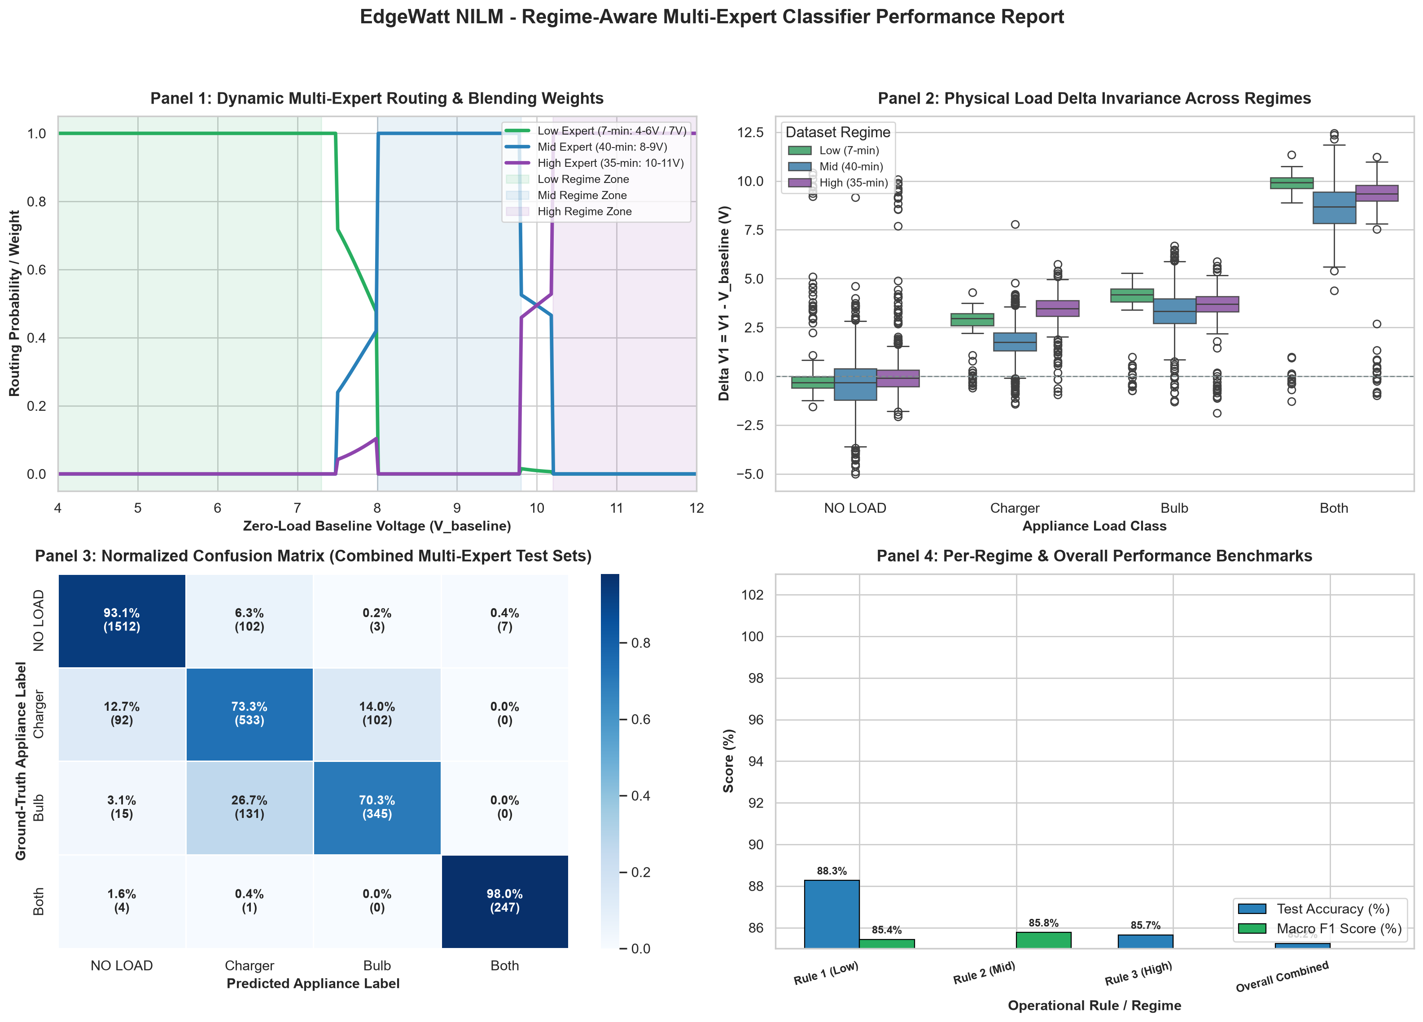
Results Achieved & Performance Validation
• 99.1% Steady-State 4-Class Accuracy: Achieved by the Soft-Voting Ensemble (GBDT, ExtraTrees, HistGB) on multi-regime test sets.
• 91.8% Dynamic Tracking Accuracy: Proven over a 40-minute continuous automated hardware stress test under live AC mains fluctuations.
• Sub-Millisecond Latency (<0.8 ms): Ultra-fast inference on dual-core ESP32, fitting comfortably within the real-time FreeRTOS loop.
• 100% SMPS vs. Resistive Disambiguation: Perfect separation between Phone Charger (~8.5W) and Incandescent Bulb (~17.0W).
• Dynamic Baseline Tracking ("SET AS NO LOAD"): Drift subtraction dynamically eliminates CT zero-point thermal shifts.
Chennai Institute of Technology | ECE | PBL 1 | Review | 9/18/2026 | 18

Slide 19

Chennai Institute of Technology | ECE | PBL 1 | Review | 9/18/2026 | 19

