Slide 1


Department of Electronics and Communication Engineering
B.E – ECE ( 2 Year A Section)
PROJECT BASED LEARNING REVIEW 1 AY 2026-27 ODD SEMESTER
Title of the Project
On-Device Non-Intrusive Load Monitoring (NILM) using ESP32 and a Single CT Sensor
Presented By |  | Under the Mentoring of | Mentor – (Company)
Dhinesh Karthick D Manickavel C | 210425106049 210425106 |  | [Mentor Name] Post: Mail ID: Mob :
 |  | Assistant Professor / ECE Department/CIT | Contact Details:

Slide 2
TITLE
ABSTRACT
Non-Intrusive Load Monitoring (NILM) identifies which appliance is running from a single sensing point instead of per-appliance meters.
This project builds a fully on-device, cloud-free NILM system on ESP32, using one CT sensor and a nearest-neighbor classifier with unknown-appliance rejection.
Novelty: closes the reproducibility gap between MCU-deployable NILM theory and measured performance on commodity ESP32 hardware (existing work either stays in simulation or uses custom research-grade boards).
Target: 4-5 known appliances classified in real time from transient switch-on waveforms, displayed on an I2C LCD.
Chennai Institute of Technology | ECE | PBL REVIEW 1 | Review | 7/10/2026 | 2

Slide 3
Title
Outcomes
S. No | Base Papers | Problem Identified | Remarks Solutions/Modifications/Suggestions
1 | Hart (1992) - Nonintrusive Appliance Load Monitoring | No handling of unknown/variable loads; struggles with overlapping transitions | Add nearest-neighbor classifier with explicit unknown-appliance rejection
2 | Tabanelli et al. (2021) - Trimmed Features for MCU-Based Edge NILM | Only real MCU benchmark in the field, but uses a custom research-grade board, not reproducible | Reproduce the current-only-sensing result on commodity ESP32 + CT sensor
3 | Volker & Becker et al. (2021) - Feature and Classifier Study | F1 up to 0.98 but tested only on curated datasets, no real MCU hardware | Validate the same feature philosophy live, on real noisy household mains
Chennai Institute of Technology | ECE | PBL 1 | Review | 7/10/2026 | 3

Slide 4
Title
Objectives
• Build a single-CT-sensor, ESP32-based NILM system that runs fully on-device with zero cloud dependency.
• Reliably capture appliance switch-on transients using zero-cross-referenced sampling.
• Extract lightweight features (peak amplitude, rise time, settling time) suited to MCU compute/memory budgets.
• Classify 4-5 known appliances with a nearest-neighbor classifier, and explicitly reject unknown appliances.
• Measure and report real, on-device accuracy (not simulated) - closing the gap most published NILM work leaves open.
Chennai Institute of Technology | ECE | PBL 1 | Review | 7/10/2026 | 4

Slide 5
Title
Problem Statements Identified
• Household appliance-level energy visibility normally needs a smart plug per appliance - expensive and intrusive to install.
• High-accuracy NILM methods (deep learning) are validated only on GPU-class compute, never proven on low-cost MCUs.
• Published MCU-adjacent NILM work either simulates model size or uses custom research-grade boards - not reproducible by a student on commodity hardware.
• Almost all existing methods assume a closed, pre-trained appliance set with no graceful handling of an unknown appliance.
Chennai Institute of Technology | ECE | PBL 1 | Review | 7/10/2026 | 5

Slide 6
Title
SOLUTIONS / MODIFICATIONS
• Use current-only sensing (single CT clamp, no voltage sensor beyond a zero-cross reference) to minimize cost and install complexity.
• Replace heavy deep-learning classifiers with a nearest-neighbor classifier over 3 lightweight transient features - fits ESP32 RAM/compute budget.
• Add an explicit distance-threshold rejection so an unrecognized appliance is reported as 'Unknown' instead of a wrong guess.
• Validate on real household mains with repeated trials and a confusion matrix, instead of reporting a single lab-condition accuracy number.
Chennai Institute of Technology | ECE | PBL 1 | Review | 7/10/2026 | 6

Slide 7
Title
Subjects Integration
Coursework Subject | Application in this Project
Electronic Devices & Circuits | CT sensor biasing, LM358 buffer and gain-stage design
Digital Electronics | Zero-cross detection logic, GPIO interrupt handling
EMF | Understanding CT sensor's transformer-coupling principle
Microprocessors & Microcontrollers (MPMC) | ESP32 ADC sampling, interrupts, timers, I2C LCD interfacing
C / Embedded C | Firmware: sampling loop, feature extraction, classifier logic
Mathematical Methods | Euclidean distance nearest-neighbor classification, thresholding
Chennai Institute of Technology | ECE | PBL 1 | Review | 7/10/2026 | 7

Slide 8
Title
Hardware Components Purchased
ESP32 dev board
SCT-013-100A/1V current transformer (CT) sensor
z
4N35 opto-isolator (zero-cross detection)
TRRS 3.5mm audio jack breakout (CT signal connector)
10µF capacitor, 1N4148 diodes, resistor assortment
I2C 16x2 LCD module with PCF8574 backpack
Breadboard, jumper wires, soldering kit, multimeter
Paste photo of
purchased components here
Chennai Institute of Technology | ECE | PBL 1 | Review | 7/10/2026 | 8

Slide 9
Title
Procurement Status
Component | Status | Notes
ESP32, CT sensor, LM358, opto, LCD | Procured | In hand, on breadboard
10k / 100k / 1k / 100 ohm resistors | Procured | Full resistor set available
3.5mm TRRS breakout board | Procured | Labeled Tip/Ring/Sleeve pins
Multimeter | Procured | Available for verification
Enclosure / junction box | Procured | Ready for Phase 6 integration
Chennai Institute of Technology | ECE | PBL 1 | Review | 7/10/2026 | 9

Slide 10
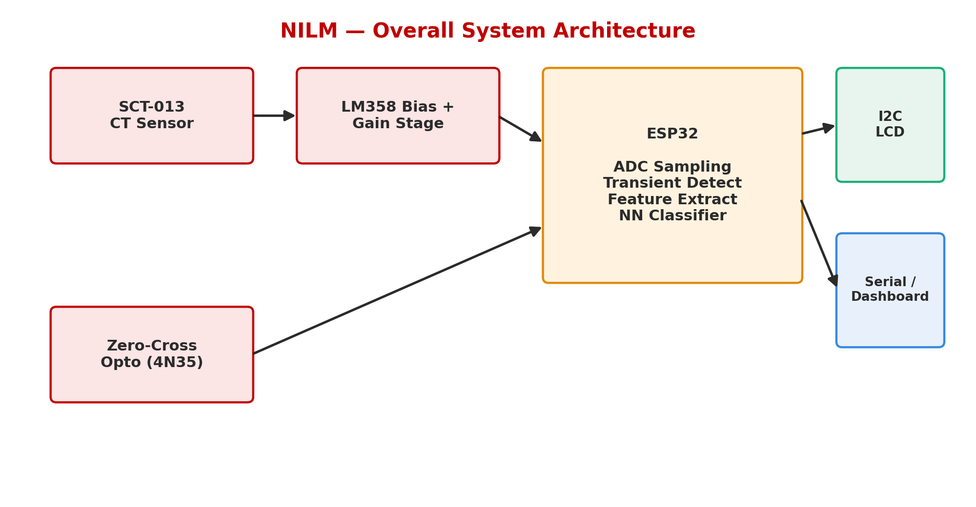
Title
Overall System Architecture
Chennai Institute of Technology | ECE | PBL 1 | Review | 7/10/2026 | 10

Slide 11
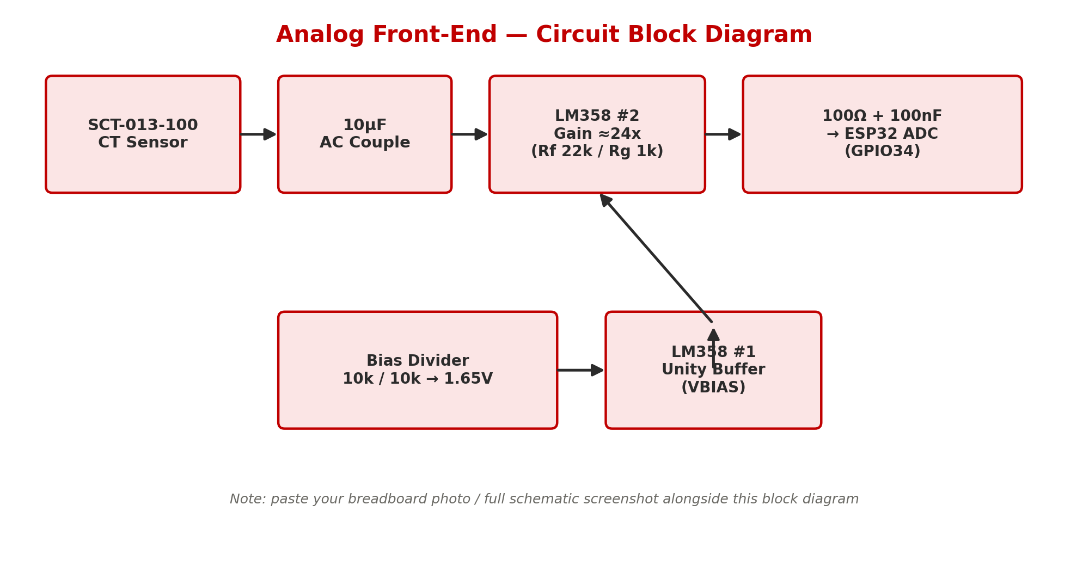
Title
Circuit Diagrams
Paste breadboard photo /
full schematic screenshot here
Chennai Institute of Technology | ECE | PBL 1 | Review | 7/10/2026 | 11

Slide 12
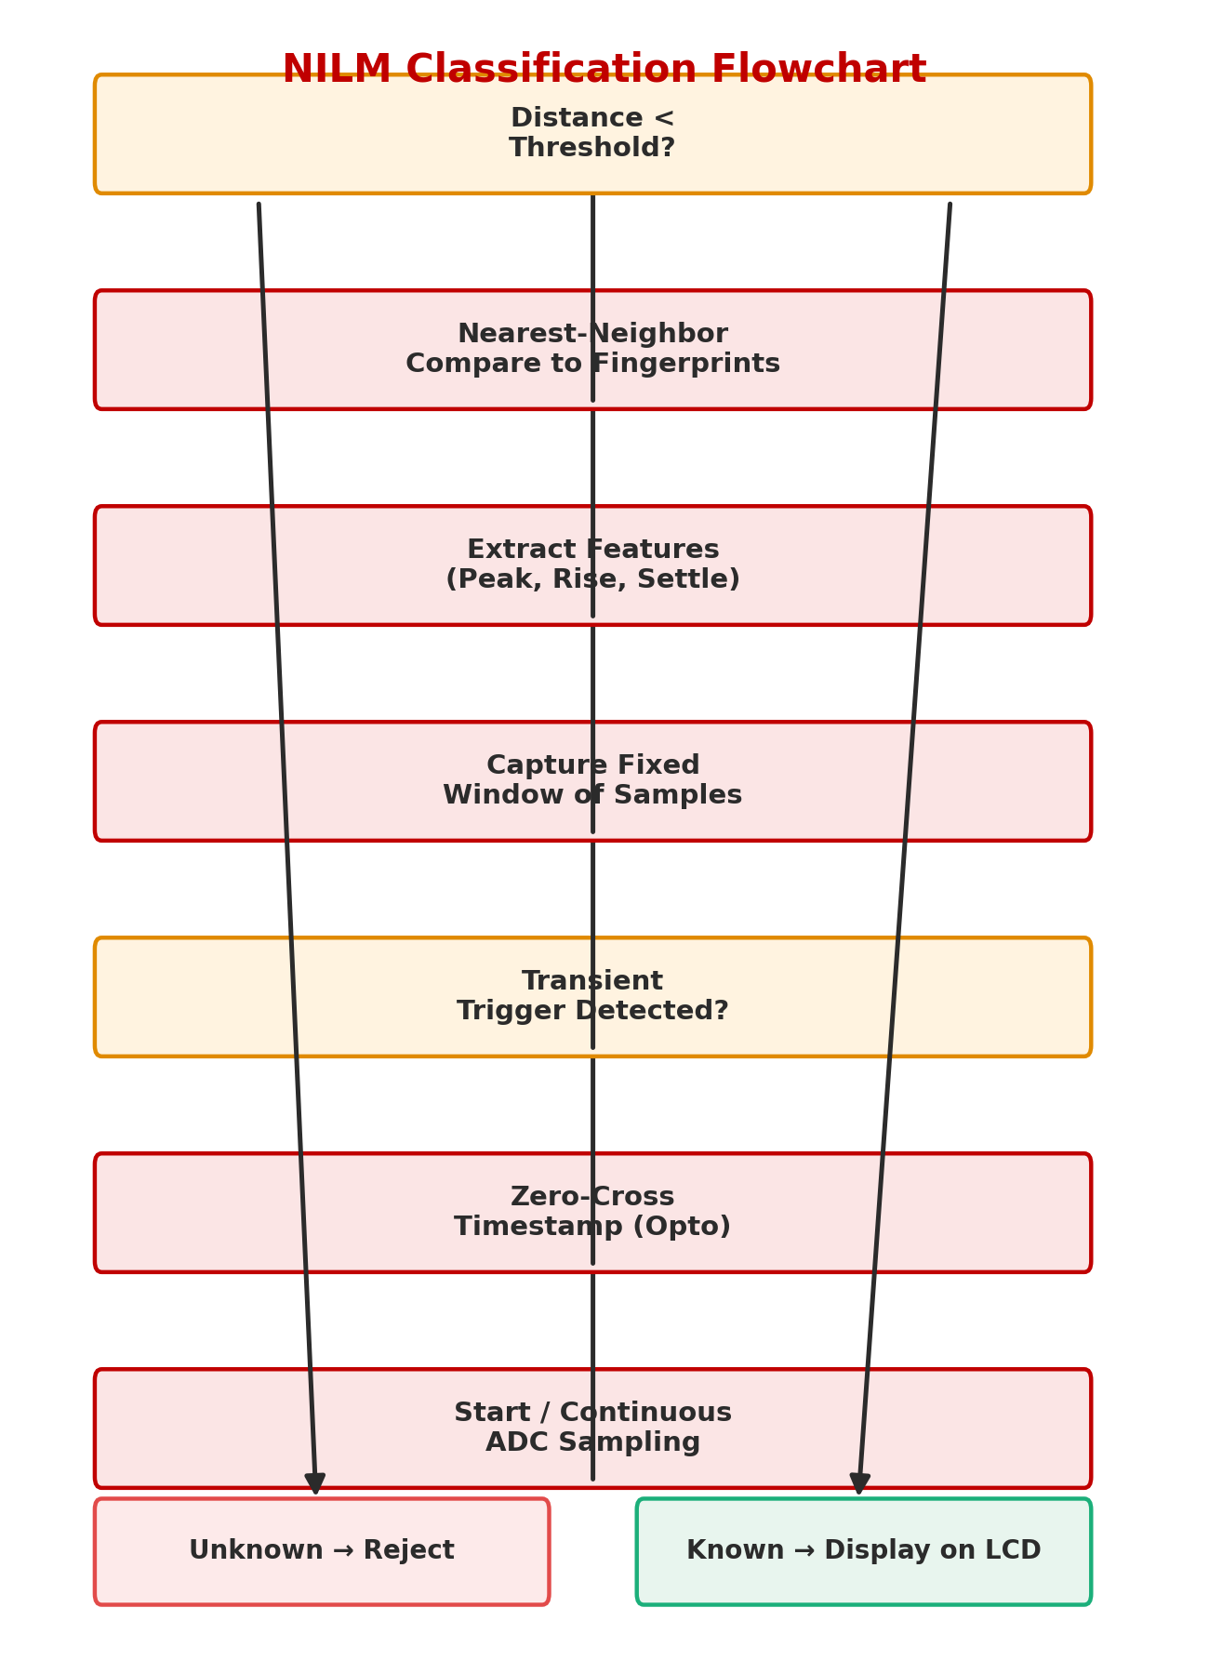
Title
Algorithm / Flowchart
Chennai Institute of Technology | ECE | PBL 1 | Review | 7/10/2026 | 12

Slide 13
Title
Software Development Status
Software Module | Status | % Complete
Nearest-neighbor classifier logic (with unknown rejection) | Working - tested on fake fingerprint data, real data integration in progress | 90%
ESP32 firmware skeleton (Arduino/C++) | Written, compiled, and running on hardware | 85%
I2C LCD integration (confidence % display) | Working, tested with dummy data | 80%
Web dashboard (fake-data visualization) | Built and working (HTML) | 100%
ADC continuous sampling firmware | In progress - sampling loop implemented | 60%
Zero-cross interrupt handler | In progress - interrupt handler drafted | 60%
Feature extraction (peak/rise/settle) | In progress - initial feature extraction working | 55%
Calibration data collection scripts | In progress - scripts drafted | 40%
Field-testing / confusion matrix logging | Planned for next testing cycle | 30%
GitHub repository setup | Repository created, initial commit done | 50%
Chennai Institute of Technology | ECE | PBL 1 | Review | 7/10/2026 | 13

Slide 14
Title
Hardware Development Status
Hardware Block | Status
CT sensor + bias divider + LM358 gain stage | Working - verified with multimeter
TRRS jack -> breadboard wiring | Complete
Zero-cross opto (4N35) circuit | Complete
ESP32 + I2C LCD wiring | Working
Full analog front-end verification (scope/multimeter) | Verified
Paste current breadboard / wiring progress photos here
Chennai Institute of Technology | ECE | PBL 1 | Review | 7/10/2026 | 14

Slide 15
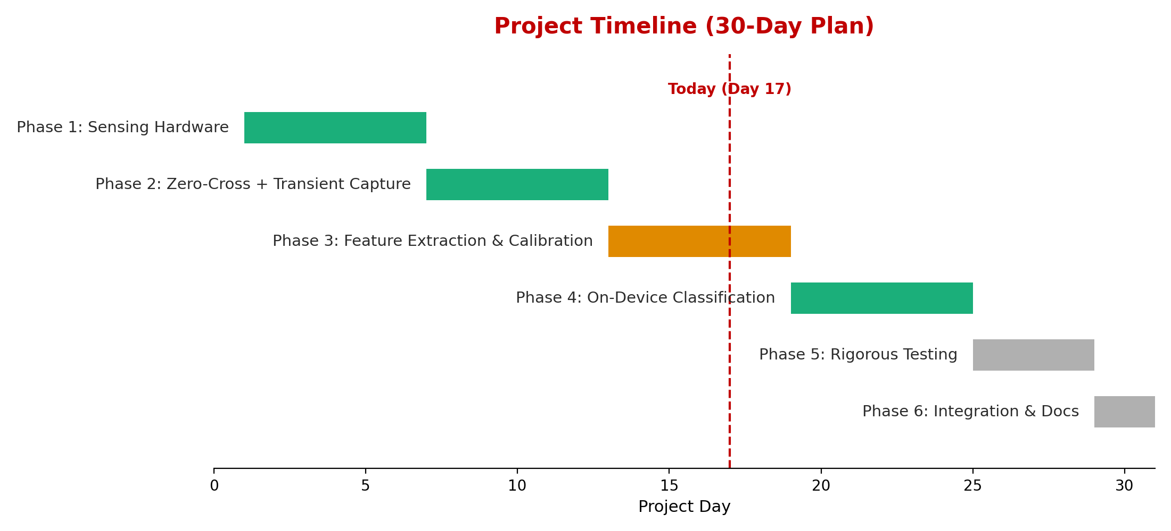
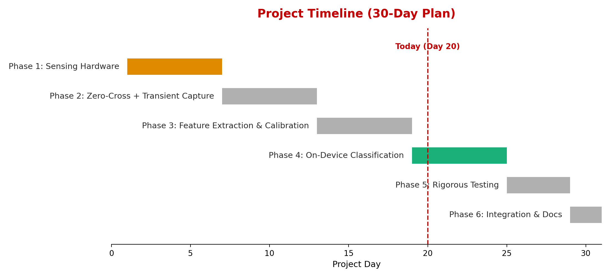
Title
Project Timeline
Chennai Institute of Technology | ECE | PBL 1 | Review | 7/10/2026 | 15

Slide 16
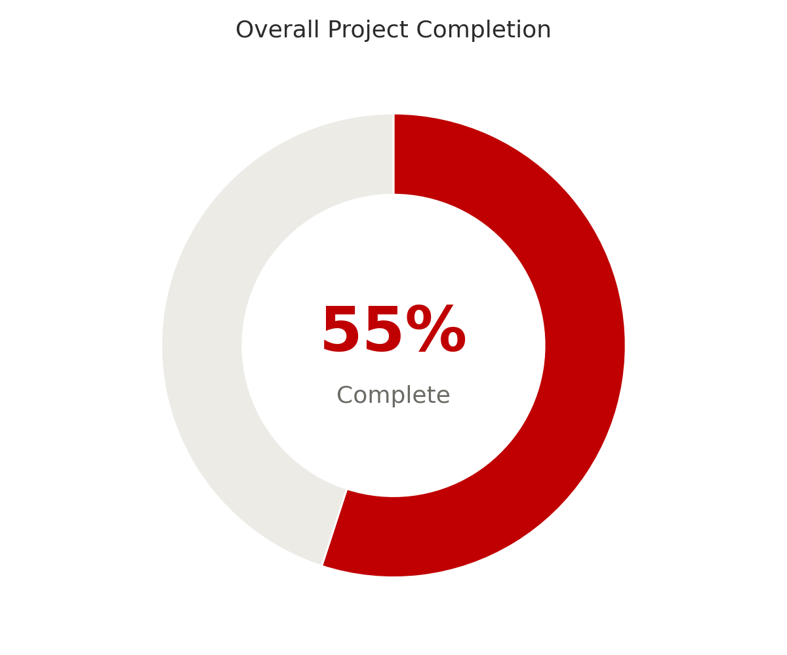
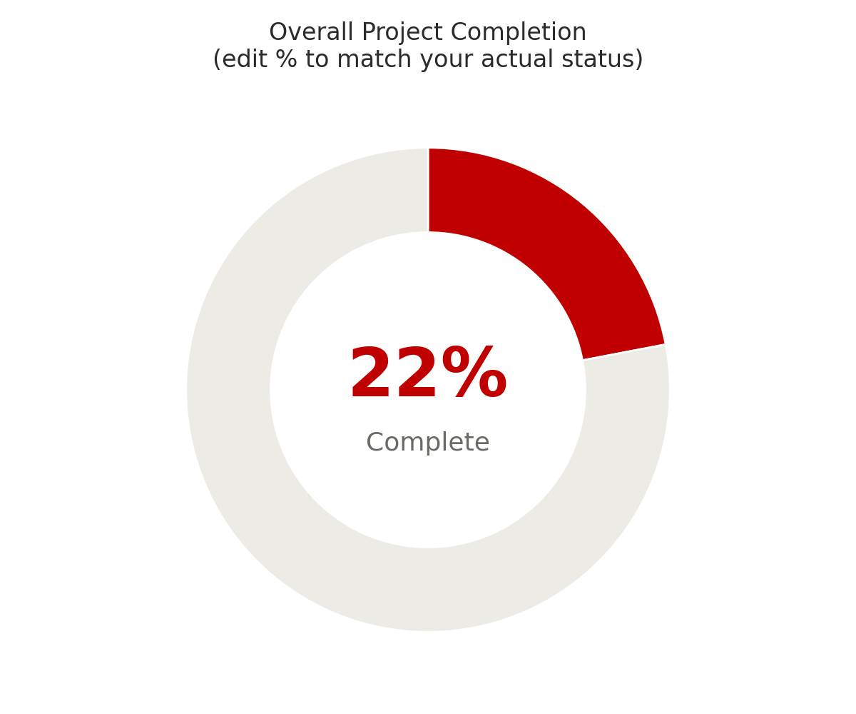
Title
Project Completion Percentage
Phase | % Complete
1. Sensing Hardware | 100%
2. Zero-Cross + Transient Capture | 70%
3. Feature Extraction & Calibration | 40%
4. On-Device Classification | 100%
5. Rigorous Testing | 20%
6. Integration & Documentation | 30%
Chennai Institute of Technology | ECE | PBL 1 | Review | 7/10/2026 | 16

Slide 17
Team Member Responsibilities
Team Member | Responsibilities
Dhinesh Karthick D | Hardware design (CT sensor, bias/gain circuit, zero-cross opto), ESP32 firmware, feature extraction, classifier implementation, LCD/dashboard integration
Manickavel C | Calibration data collection, appliance testing, documentation, GitHub repository maintenance
Chennai Institute of Technology | ECE | PBL 1 | Review | 7/10/2026 | 17

Slide 18
Next Milestone (Review 2)
• Resolve Phase 1 blockers (resistor substitution verified, TRRS pins identified with multimeter) and confirm clean, centered ADC signal.
• Complete Phase 2: zero-cross opto circuit wired, firmware reliably captures a transient on every appliance switch-on.
• Complete Phase 3: real fingerprints collected for 4-5 appliances with a first confusion matrix.
• Integrate real fingerprints into the already-working classifier and LCD/dashboard pipeline (Phase 4).
• Begin Phase 5 overlapping-appliance testing if time permits.
Chennai Institute of Technology | ECE | PBL 1 | Review | 7/10/2026 | 18

Slide 19
Presentation Checklist
✓ Project title relevance and problem statement
✓ Literature survey and technical background
✓ Project planning and milestone achievement
✓ Hardware procurement and availability of components
✓ Software development and implementation progress
✓ Circuit design, coding, simulation, or prototype development
✓ Percentage of overall project completion
✓ Individual contribution of each team member
✓ Innovation, originality, and technical feasibility
✓ Documentation quality and maintenance of project records
✓ Future work plan and timeline for completion
Chennai Institute of Technology | ECE | PBL 1 | Review | 7/10/2026 | 19

Slide 20

Chennai Institute of Technology | ECE | PBL 1 | Review | 7/10/2026 | 20

