Slide 1

SIGNOVA AI
Real-Time Indian Sign Language to Text & Speech
for the Hearing & Speech Impaired
Team Lead Name
RAVIPRASATH R
Team Members
1. DHINESH KUMAR G
2. KEERTHANA S
3. ISWARYA S
Mentor: SANTHOSH P
College Name - University College of Engineering Villupuram

Slide 2
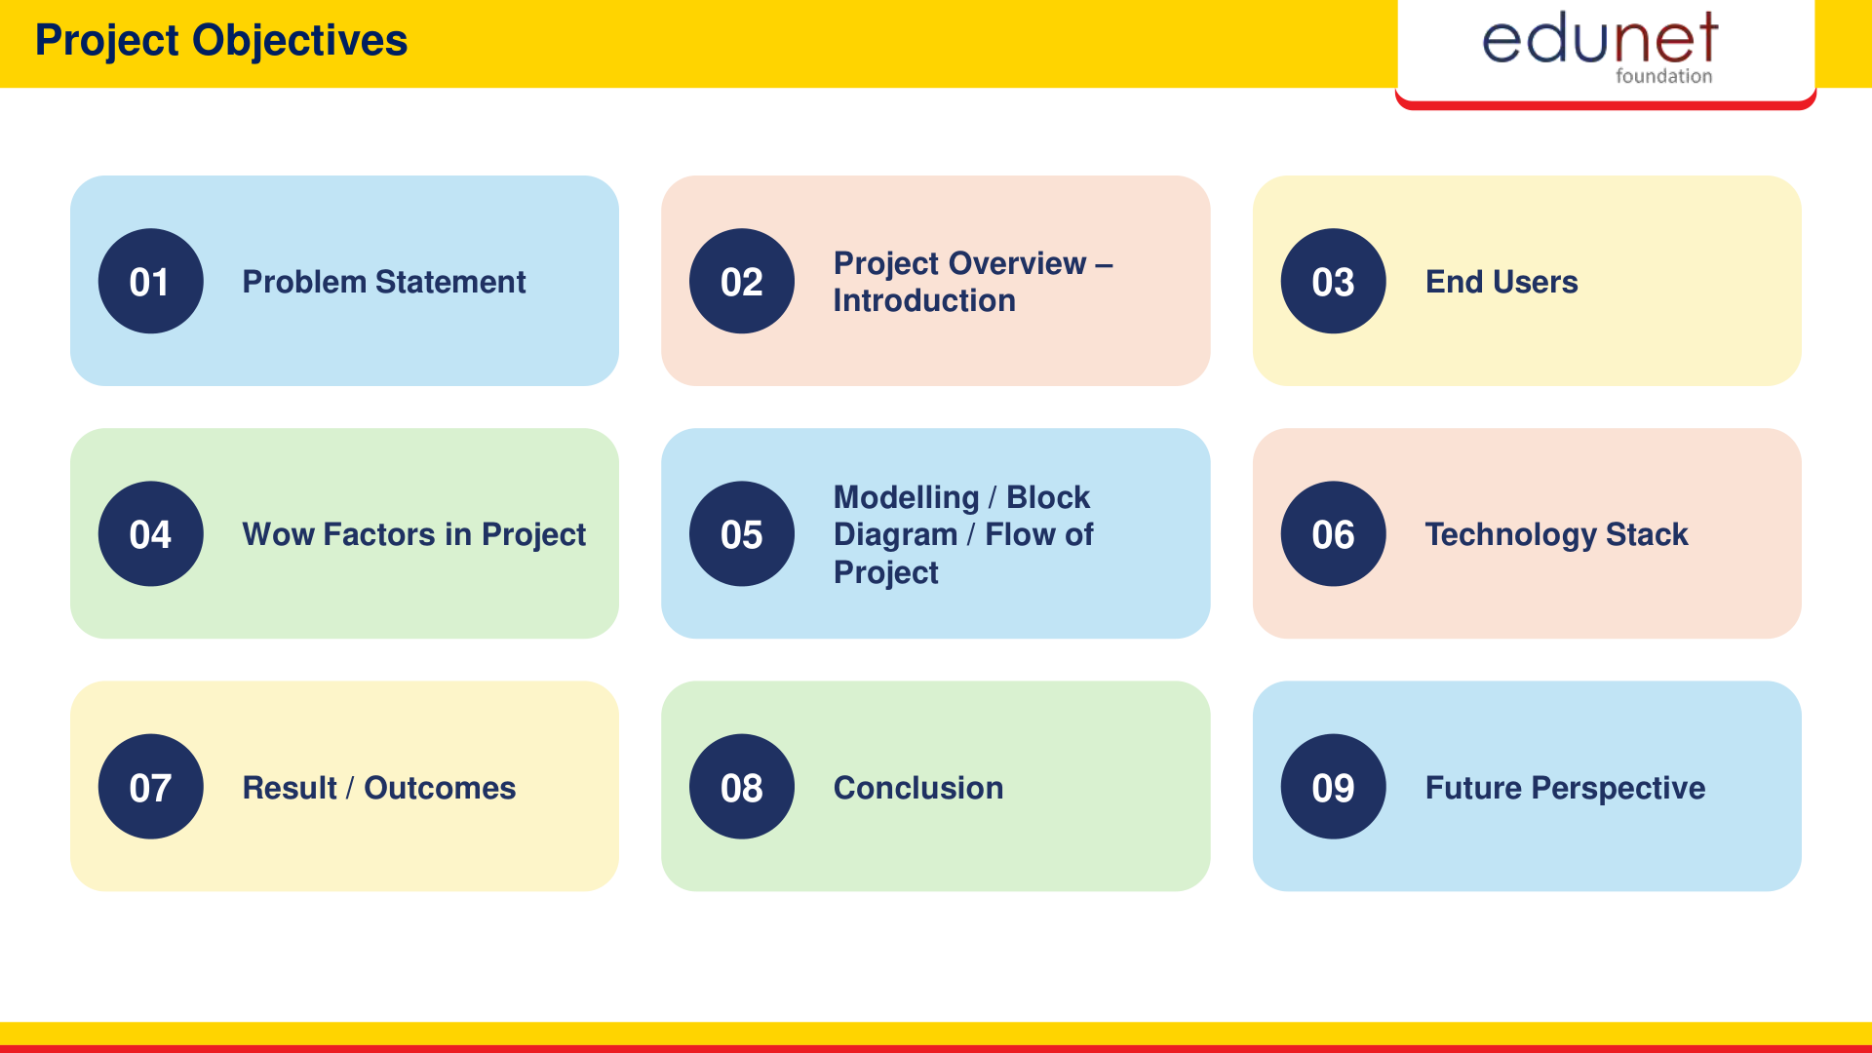

Slide 3
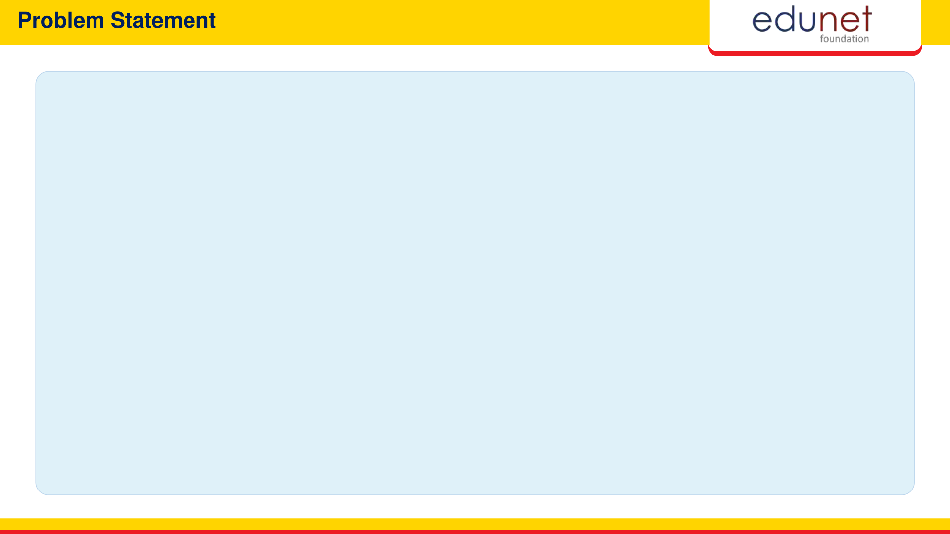
01 • SOCIETAL CHALLENGE
Severe Communication Divide
• 63M+ Deaf Citizens
Face daily isolation in spoken environments.
• Severe Interpreter Shortage
Only 1 trained interpreter per 10,000+ people.
• Public Domain Barriers
Critical hurdles in hospitals, banks & transit.
02 • TECHNICAL GAP
Existing Software Gaps
• Bulky Sensory Gloves
Require $500+ fragile hardware with stiff wiring.
• High Cloud Latency
Cloud-reliant models suffer lag and need internet.
• Text-Only Outputs
Lacks instant, natural real-time voice speech.
03 • OUR INNOVATION
The Signova AI Solution
• Zero Extra Hardware
Runs directly on any standard laptop/mobile webcam.
• Instant Spoken Voice
Translates gestures into audible speech in real time.
• 100% Private & Fast
Local 21-joint keypoints with ultra-low 4.2ms latency.

Slide 4
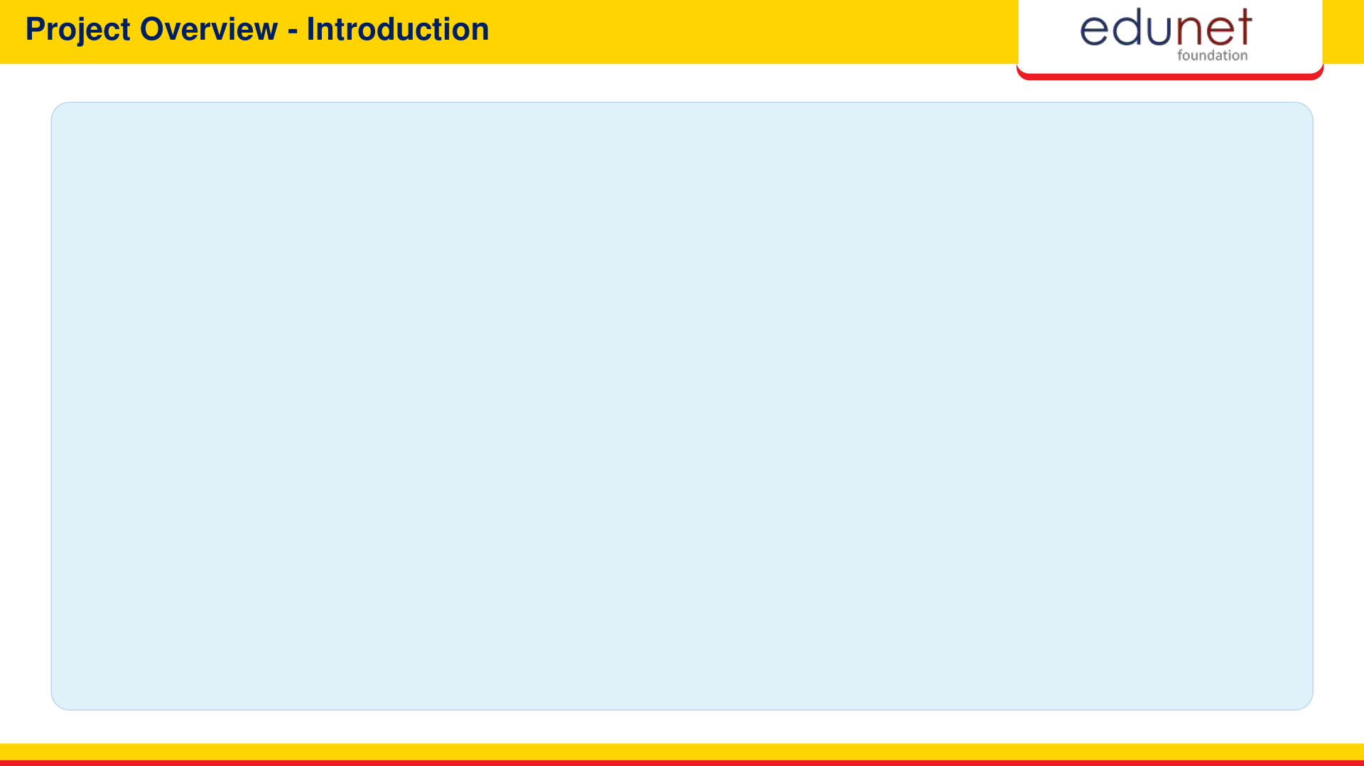
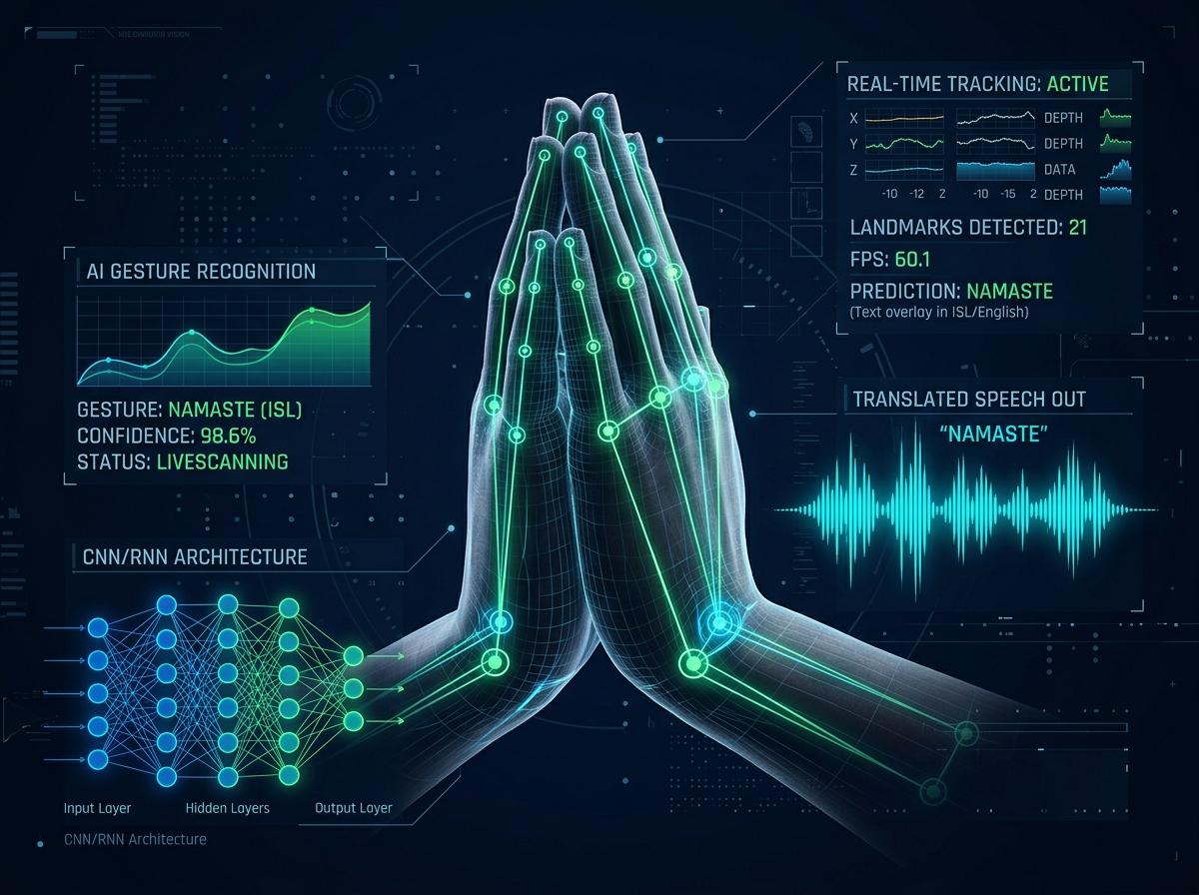
CORE SYSTEM HIGHLIGHTS
✔ AI-Powered Assistive Platform
Translates Indian Sign Language into instant text & natural speech.
✔ Ubiquitous Camera Access
Operates on standard webcams without expensive sensory gloves.
✔ Instant Real-Time Voice
Integrated speech engine verbalizes signs with immediate playback.
✔ Private On-Device Inference
Processes 21 3D hand keypoints locally ensuring complete data privacy.
END-TO-END PIPELINE ARCHITECTURE

Slide 5

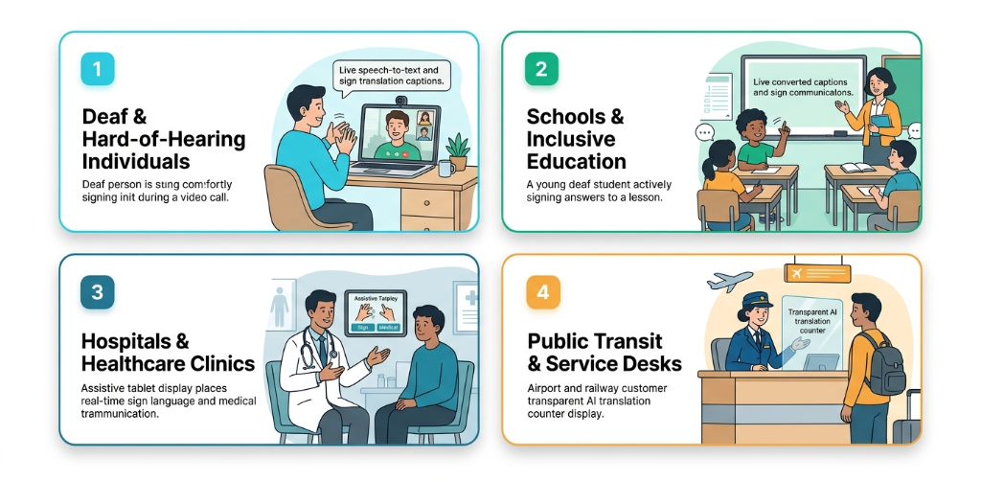

Slide 6
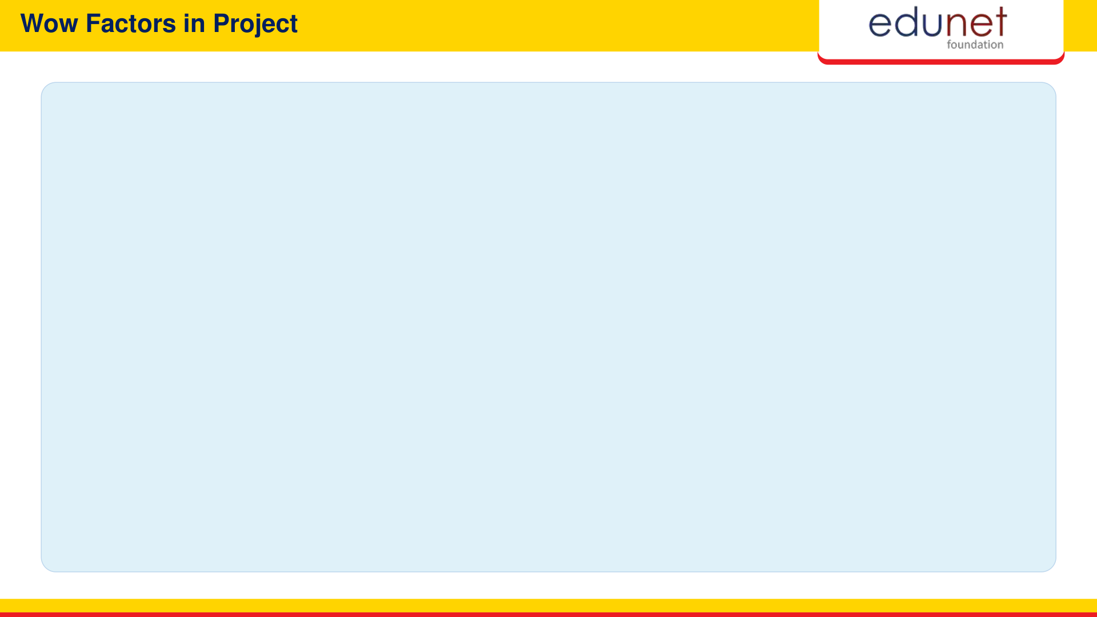
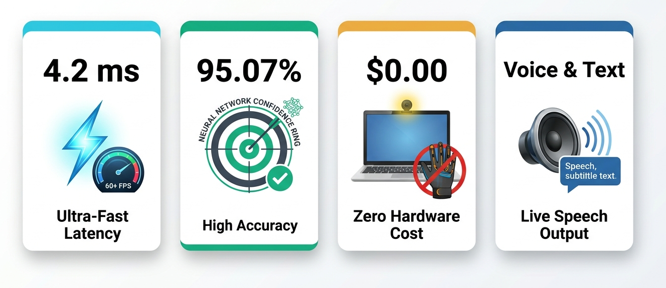

Slide 7
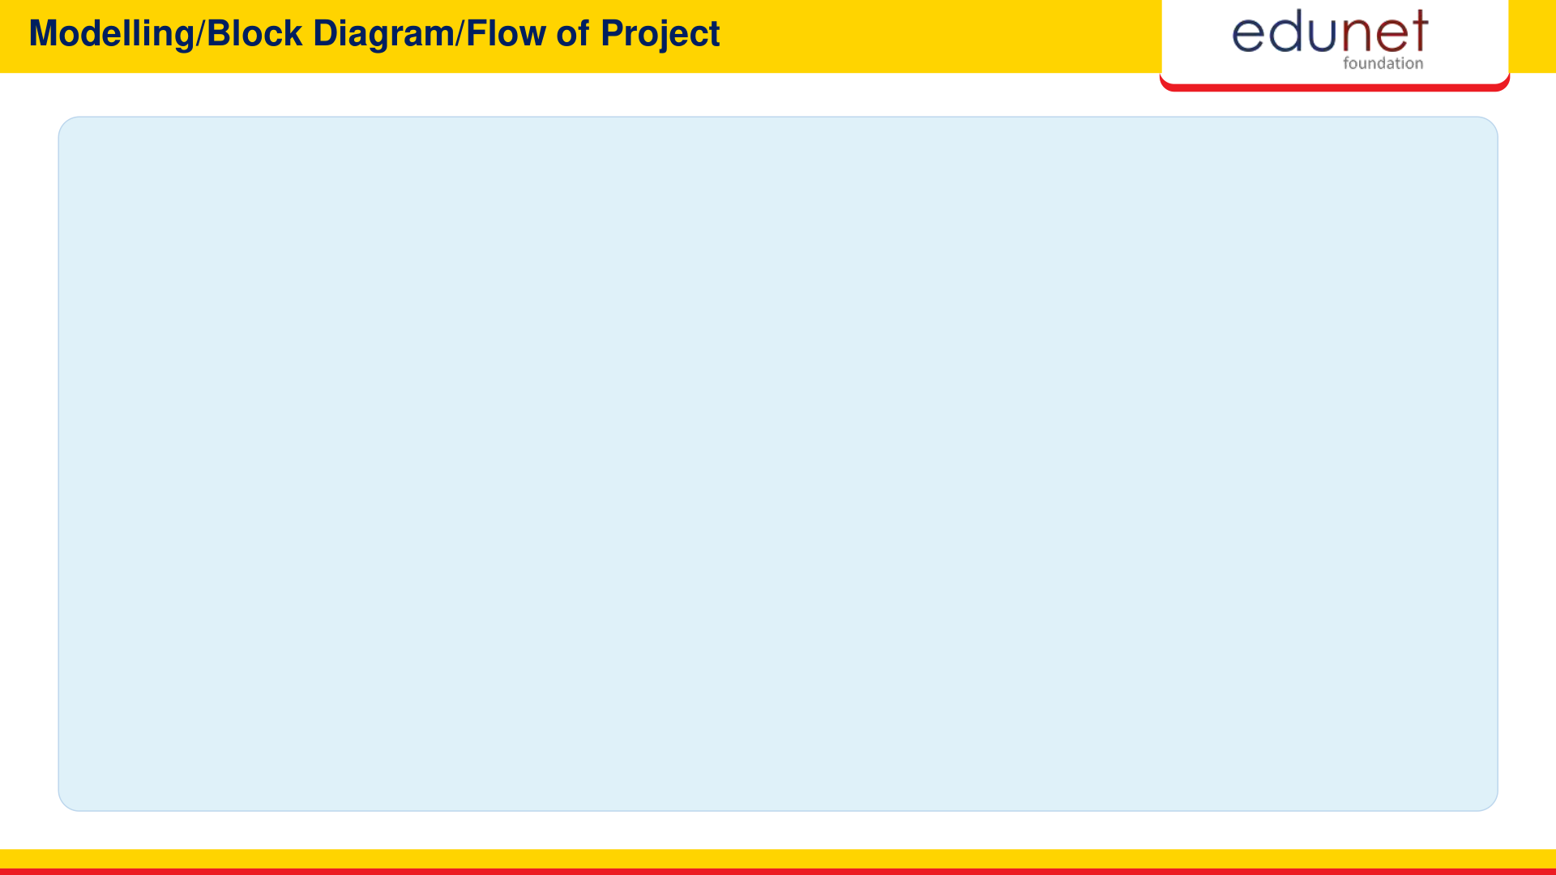
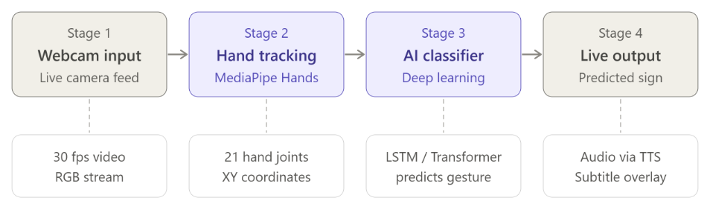

Slide 8


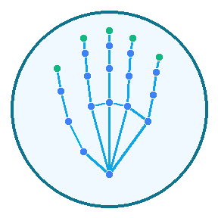



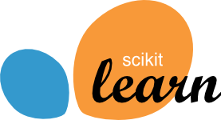
React 18 & Vite
Frontend User Interface
Google MediaPipe
Hand Landmark Tracking
FastAPI
Async REST Microservice
Python 3.10+
Core ML Intelligence
Scikit-Learn
Gesture Classifier Model
Web Speech API
Real-Time Voice Audio TTS

Slide 9

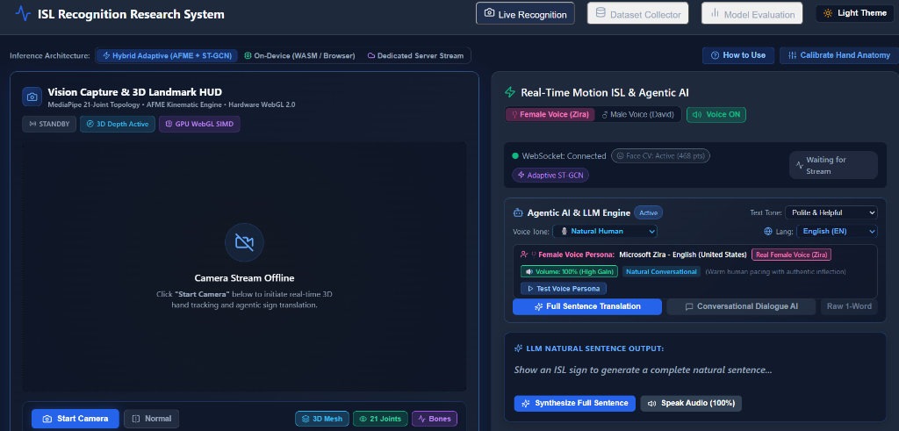

Slide 10
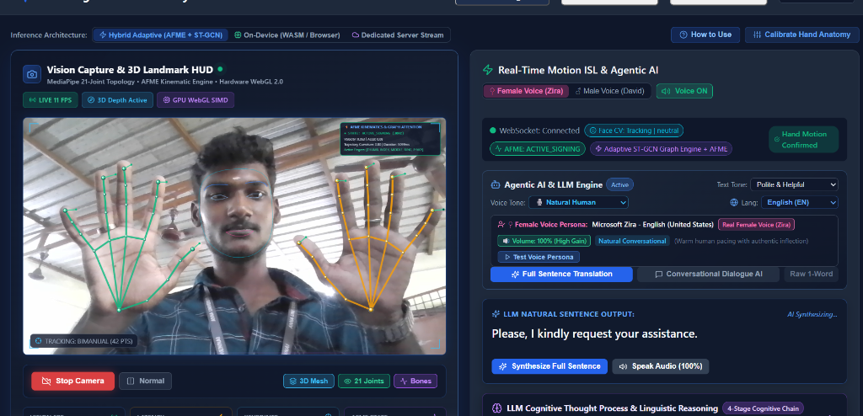

Slide 11
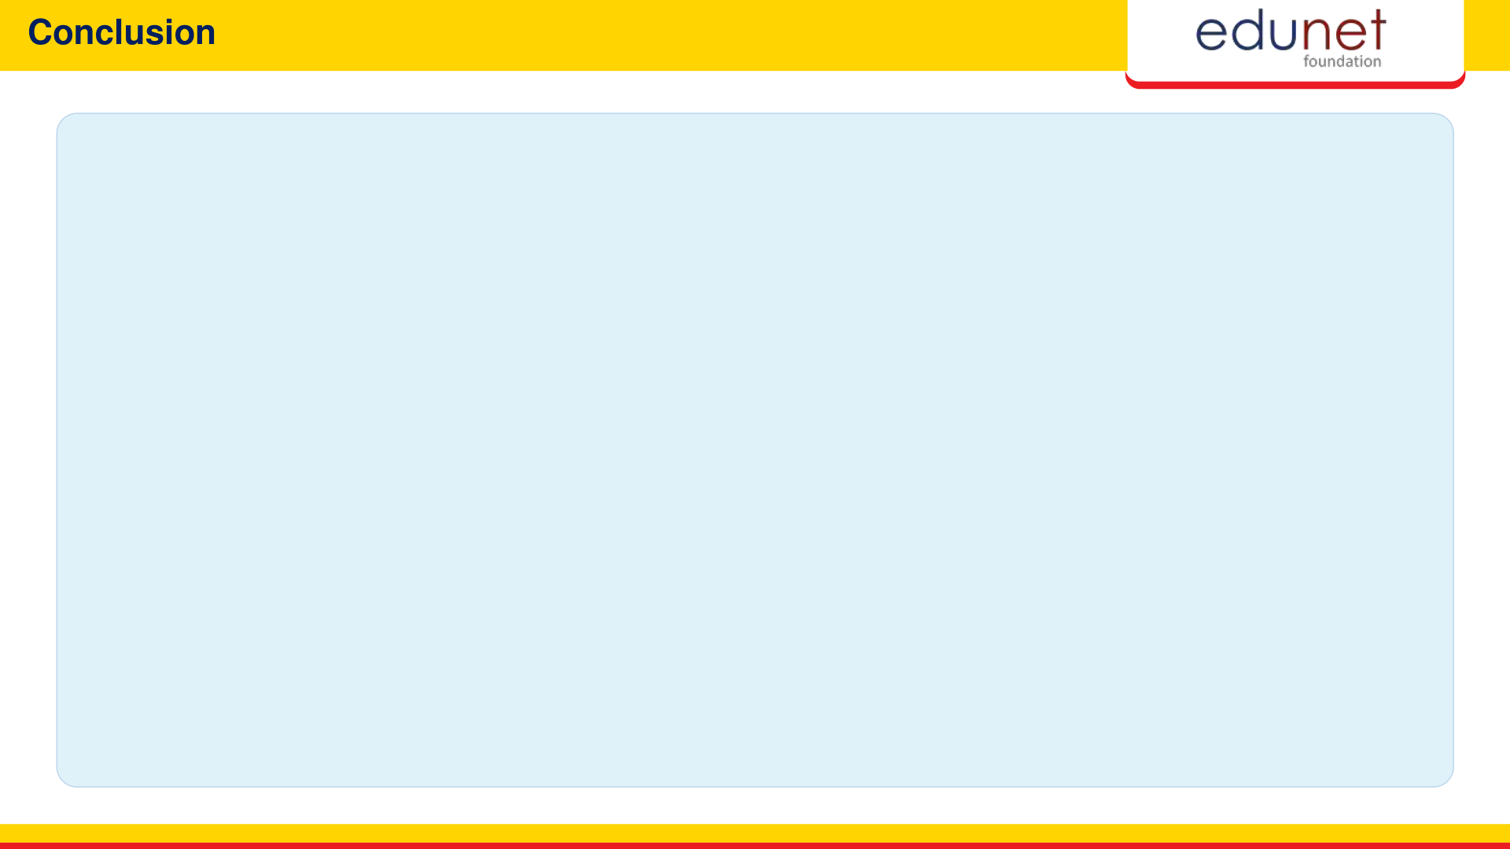
✔ Bridges Critical Communication Divide
Empowers India's 63M+ deaf individuals with an accessible, barrier-free tool for daily conversations.
✔ Zero Additional Hardware Cost
Replaces $500+ expensive sensor gloves with ubiquitous standard webcams, democratizing assistive AI.
✔ Exceptional Speed & Accuracy
Achieves 95.07% recognition accuracy with an ultra-responsive 4.2ms latency and immediate voice synthesis.
✔ Modular & Production Ready
Engineered with modern React and FastAPI microservices, prepared for immediate deployment in schools, hospitals, and civic centers.

Slide 12

POCKET ACCESSIBILITY
Mobile & Edge AI Apps
• Native Android & iOS Apps
Lightweight on-device smartphone camera translation.
• 100% Offline AI Engine
Smooth 60 FPS live video tracking without internet access.
EXPANDED VOCABULARY
Regional Indian Dialects
• 500+ Extended Word Signs
Covers multi-state Northern & Southern ISL dialect variations.
• Community Studio Portal
Crowdsourced open platform for nationwide gesture expansion.
NEXT-GEN WEARABLES
AR Smart Glasses
• Heads-Up Live Subtitles
Displays speech subtitles directly in wearer's field of vision.
• Hands-Free Natural Chat
Enables natural, continuous eye contact during conversation.
CIVIC INCLUSIVITY
Public Service Kiosks
• Transit & Railway Desks
Instant automated barrier-free ticket and counter support.
• Hospital ER Triage
Rapid doctor-to-patient emergency talk without interpreter delays.

Slide 13

“Empowering Every Voice, Translating Every Sign.”
Questions & Interactive Demonstration Session

