Slide 1


K.RAMAKRISHNAN COLLEGE OF TECHNOLOGY
(AUTONOMOUS), TRICHY.
DEPARTMENT OF
COMPUTER SCIENCE AND ENGINEERING
20CS5501 DESIGN PROJECT-1
Batch No : 14
Date : 05.12.2024

Slide 2
COLLEGE ADMISSION ENQUIRY CHATBOT
Guided by Team
Ms.G.RAJENDRA KANNAMMAL BALAJI P (811722104021)
Assistant Professor, CSE DHINESH KUMAR S(811722104033)
HARIVARMA M (811722104050)

Slide 3
OBJECTIVE OF THE PROJECT
To develop an intelligent interactive chatbot that is capable of interacting with the user and giving information about the various enquiries made by the user about the college.
To answering queries for the user, the chatbot should be able to make a talk with the user making the user feel as if conversing with a human.
To assign the user does not have to personally visit the college to enquire about the details and also can have a conversation about any topic if the user prefers.
To provide input for the Chatbots which can create a user friendly chatbot with the mindset of questions typically enquired by users.
To recommend a python based intelligent chatbot using Natural Language Processing libraries in Python so that the chatbot can interact with the user.

Slide 4
ABSTRACT
A College enquiry bot is very essential these days for providing information to non-college/college students about the college.
Many students do not have any information regarding the college and the information that is present online is very less and hence, less people know about the working of college and students become very uncertain whether to take admissions or not.
A college enquiry chatbot understands the user's message, what type of information is being enquired and then it answers the query accordingly.
The user can ask queries and the chatbot analyses the questions, interprets the meaning using a tag and intent and provides an answer.
The chatbot answers the questions as if it were answered by a human because the dataset it gets trained on contains many human-to-human conversations making it easier for the chatbot to understand the way humans converse.
This system helps the student to be updated about the college activities and the non- students to gain information about various details about the college and its working.

Slide 5
LITERATURE SURVEY
TITLE OF THE PAPER | AUTHOR (S) | PUBLISHER | PAPER GIST | TECHNOLOGY USED
College Enquiry Chatbot using Conversational AI | Dhruv Patel[may-2023 ] | IJRASET: International Journal & Research Paper Publisher | To address these issues, companies and businesses have started to adopt automated systems | The chatbot was built with Azure's LUIS and achieved a 95% accuracy rate, rendering it a highly dependable and efficient tool for college students, teachers, and other stakeholders looking for information.
An Interactive Chatbot for College Enquiry | Walaa Hassan[21 Jan 2023] | SCINITO | Chatbots are computer programmes that replicate human-to-human interaction, typically over the Internet | The chatbot searches quickly and efficiently for answers to their questions and provides them with relevant connections.
smart college chatbot using ml and python | Hrushikesh Koundinya K | International Conference on System, Computation, Automation and Networking (ICSCAN | Chatbots are now widely used in many applications, particularly in systems that give intelligent support to users | the responses given by the chatbot system more meaningful and 90% accurate

Slide 6
LITERATURE SURVEY
TITLE OF THE PAPER | AUTHOR (S) | PUBLISHER | PAPER GIST | TECHNOLOGY USED
Chatbot Utilizing a Knowledge in Database | Bayu Setiaji and Ferry Wahyu Wibowo | The journal is published by ACTA Press | The journal has a impact factor, which indicates its reputation and influence in the research community. | Modelling and Simulation, explores the concept of a chatbot that leverages a knowledge database to provide accurate and relevant responses.
Chatbot Based Enquiry System for College Admissions | S. S. Gupta and R. K. Singh | The journal is published by ACTA Press | The journal has a impact factor, which indicates its reputation and influence in the research community. | this research provides valuable insights into the design and development of a chatbot-based system for addressing admission-related queries.

Slide 7
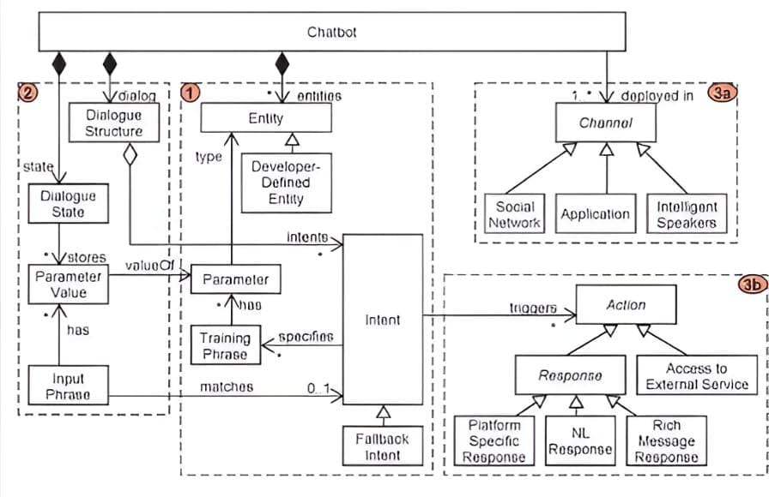
PROPOSED SYSTEM ARCHITECTURE

Slide 8
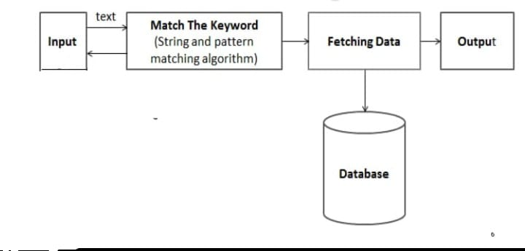
EXISTING SYSTEM ARCHITECTURE

Slide 9
SOFTWARE AND HARDWARE REQUIREMENTS
HARDWARE
SOFTWARE
A pc or Laptop with following specification:
32 bit version of Microsoft windows 7,8,10
3GB RAM minimum, 1.5 GB hard disk space + at least 1GB for caches
Python IDLE is an Integrated Development Environment (IDE) for Python that comes with the default Python distribution. It's a simple, yet powerful tool that provides features such as syntax highlighting, code completion, debugging, and testing

Slide 10
MODULES
Course enquiry module
Admission process module
Fees structure module
Faculty and department module
Location and infrastructure module

Slide 11
SUMMARY OF MODULE-1
Course enquiry module
Purpose:-
Provide information on courses offered by the college-
Help users find the right course based on their interests and qualifications
Answer frequent questions about courses
Benefits:
Informed Decision-Making: Students can make informed decisions about their course choices.

Slide 12
SUMMARY OF MODULE-2
Admission process module
Purpose:-
Provide information on courses offered by the college-
Help users find the right course based on their interests and qualifications-
Answer frequent questions about courses
Benefits:
. Improved Efficiency: Automates the admission process, reducing manual errors and saving time for both users and administrators.

Slide 13
SUMMARY OF MODULE-3
Fees structure module
Purpose:
Provide transparent and up-to-date information on course fees
Help users understand the financial aspects of their education
Enable informed decision-making about course selection
Benefits:
Improved User Experience: Enhances the overall user experience by providing a comprehensive fee structure module

Slide 14
SUMMARY OF MODULE-4
Faculty and department module
Purpose:
Showcase the institution's academic expertise and resources
Help users understand the faculty's teaching and research focus
Enable informed decision-making about course selection
Benefits:
Informed Decision-Making: Empowers users to make informed decisions about course selection based on faculty expertise.

Slide 15
SUMMARY OF MODULE-5
Location and infrastructure module
Purpose:
Provide information about the institution's location and accessibility
Showcase the institution's infrastructure and facilities
Help users understand the learning environment
Benefits:
Informed Decision-Making: Empowers users to make informed decisions about the institution based on location and infrastructure.

Slide 16
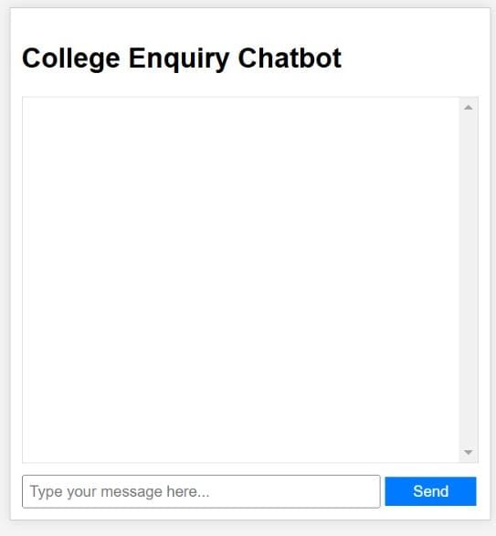
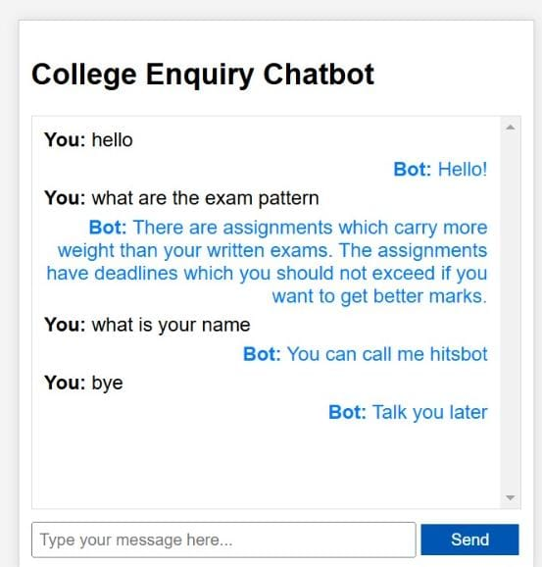
RESULTS AND DISCUSSION

Slide 17
CONCLUSION
In this project we made a college specific chatbot system that can be custom fitted to education domain chatbot, the addition of this chatbot system in the college website will make the webpage more user interactive as it responds to the user queries very accurately as it is a domain specific chatbot system, and furthermore we had investigated our college chatbot system design stages and a few different techniques by which the precision of the chatbot system can be made much better. To make the responses given by the chatbot system more meaningful and accurate the administrator has to train the chatbot system with more information regarding to college and increase the scope of knowledge base.

Slide 18
THANK YOU

