Slide 1
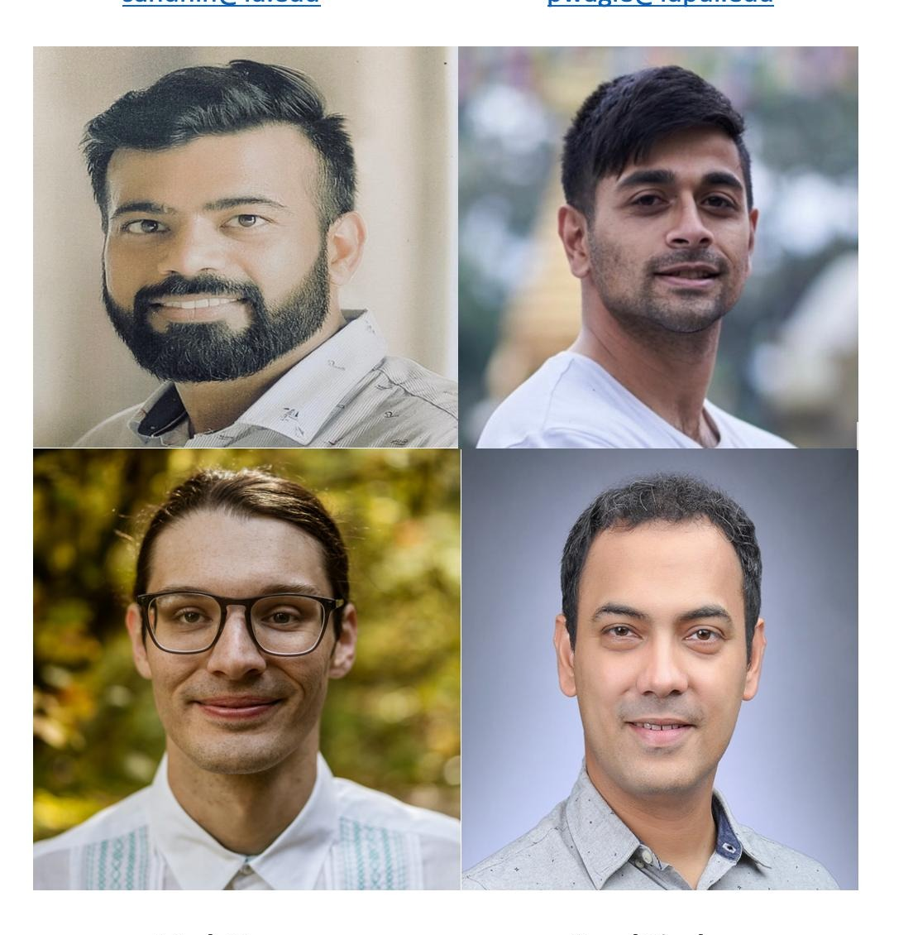
Group Number 10
Sahil Dhingra: sahdhin@iu.edu
Pragat Wagle: pwagle@iupui.edu
Mark Green: margree@iu.edu
Kunal Singh: singhku@iu.edu
HOME CREDIT DEFAULT RISK PREDICTION

Slide 2
PROJECT DESCRIPTION
Many PEOPLE NEED TO GET LOANS FOR MANY Different RESONS, To OPEN THEIR OWN BUSINESS OR BUY A HOUSE
HOME CREDIT DEFAULT RISK SET UP A COMPETITION to UTLIZE EXISTING DATA TO BUILD A MODEL TO HELP PREDICT, BASED ON THE FEATURES PROVIDED IN THE DATASET, who is likely to pay back that LOAN.
This project consisted of USING DIFFERENT Approaches TO TRANSFORM THE DATA AND TRAIN A modEL BASED on the data to Improve the predictive Ability of that model.

Slide 3
Example OF VISUAL EDA and Feature Engineering
Below is an example of A Histogram of a normal, root, and Log Transformed COLUMn That was used to determine if we should Leave as is or root Transform or Log Transform.
The Criteria was: if it improves the central distribution or the SCAle was extremely large compared to their values And For some the Skewness was calculated and the Transformation or Non-Transformation that returned the lowest abs value was kept

Slide 4
Feature Engineering
This class reduces features by measuring collinearity between the input variables and target.
Works on numerical features based on the correlations between each variable pair.
Of the variable pairs with absolute correlations above the threshold value......the variables with the lowest target variable correlation are dropped from the input X.
The process is repeated until there are no more colinear pairs with absolute correlations above the threshold.
The figure in the right shows the EDA and Feature Engineering for The POS Cash Balance Table.
Features Were Engineered and some log transformed based on distribution

Slide 5
OVERVIEW OF THE MODELING PIPELINES: one Example
THE Main PIPELINE CONSISTED OF A CATEGORICAL and NUMERICAL pipeline
They were both combined into one pipeline and Grid Search Was performed on those PIPElines
Using Eg. Logistic Regression The Model was tuned using hyperParameters C, Solver, and penalty.
The best Hyper Parameters were found to be:

Slide 6
Results and Discussion of the Results
The Kaggle Results:
Results From phase one Demonstrated A Model with the Test AUC to BE between .735-.745
Results From phase TWO AFTER EDA improved our accuracy as we rolled up data and aggregated them by ["min", "max", "count", "sum", "median", "mean", “var”] Demonstrated AN TEST AUC AT .7709
In Phase 3 With additional feature engineering and log transformations from phase 2, The model Demonstrated a Test AUC of .7734, a recall of 0.9194 and Balanced Accuracy of 0.5113 using Logistic Regression
XgbOost gave a Test Auc of 0.7574, a Recall of 0.9182, and a Balanced Accuracy of 0.5319
PHASE 3
Losgistic Regression
Xgboost

Slide 7
Conclusion from Phase 3 and Next Steps
The Majority of phase 3 was dedicated to Feature engineering and log transformations
Our overall accuracy on OUR dataSet with the model predicted about the same but Our AUC is improve slightly by .34.
In Phase 1 the Baseline Features Returned 0.7478, 0.7472, 0.7434 for Train AUC, Valid AUC, and Test AUC Respectively.
In Phase 2 After Aggregation and further EDA The AUC measures were 0.7724, 0.7585, 0.7623 for Train AUC, Valid AUC, and Test AUC Respectively.
In phase 3 after further specific feature engineering .7750, .7698, and .7734 for Train AUC, Valid AUC, and Test AUC.
The importance of feature Engineering and EDA has been highlighted in the three phase.
At this point further feature engineering could help improve our model and a multilayer PerCeptron.

Slide 8
THE FOUR P’s: Past, Present, Next Phase Plan, and Problems
PAST PHASE Tasks
In The previous phases we completed data description, model building, data merging, and model testing. This was improved by EDA and Data Aggregations which were used to improve the model and predictive ability.
PHASE 3 Tasks
In phase 3 HyperParameters and feature engineering was done to improve the overall model’s predicability. A collinearity reducer was introduced for feature selection which improved performance dramatically but underperformed in Test AUC. Overall we were able to improve our AUC by .3-.4.
NEXT PHASE tasks
The Plan for the next phase will be to build a multiLayer perceptron to build a model along with any more feature Engineering.
Problems
hyper-parAmeter tuning model took a substantial time.
Model training on 100% of the data was raised challenges due to hardware limitations.

