Slide 1

PRESENTATION ON
ONLINE VOTING SYSTEM
BY:
RHYTHM DHINGRA
MCA 3rd Sem (2200290140123)

Slide 2
CONTENTS:
INTRODUCTION TO ONLINE VOTING SYSTEM
Requirement Elicitation of Online Voting System
Software Requirements
MODULE DESCRIPTION
CONTROL FLOW DIAGRAM
E-R Diagram
Test Cases
VOTER REGISTRATION PAGE
VOTER LOGIN PAGE
CASTING VOTE PAGE

Slide 3
INTRODUCTION TO ONLINE VOTING SYSTEM:
In this system people who have citizenship of India and whose age is above 18 years of age and any gender can give his\her vote online without going to any physical polling station.
There is a database which is maintained in which all the names of voters with complete information is stored.
He\She has to be registered first for him/her to vote.
Registration is mainly done by the system administrator for
security reasons.
The system Administrator registers the voters on a special site of the system visited by him only by simply filling a registration form to register voter.
After registration, the voter is assigned a secret Voter ID with which he/she can use to log into the system and enjoy services provided by the system such as voting.

Slide 4
If invalid/wrong details are submitted, then the citizen is not registered to vote.
Online voting system (ovs) will require being very precise or cost cutting to produce an effective election management system. Therefore crucial points that this (ovs) emphasizes on are listed below. Require less number of staff during the election.
This system is a lot easier to independently moderate the elections and
SUBSEQUENTLY REINFORCE ITS TRANSPARENCY AND FAIRNESS.
Less capital, less effort, and less labor intensive, as the primary cost and effort will focus primarily on creating, managing, and running a secure online portal.
Increased number of voters as individual will find it easier and more convenient to vote, especially those abroad.

Slide 5
Requirement Elicitation of Online Voting System
Requirement elicitation for an online voting system involves gathering information about what the system should achieve and how it should function. Here are some key steps and considerations for eliciting requirements for an online voting system:
Stakeholder Identification:
Identify all stakeholders involved in the voting process, such as voters, election administrators, candidates, and observers.
User Stories and Use Cases:
Create user stories or use cases to describe the interactions between different users and the system. For example:
As a voter, I want to be able to log in securely to cast my vote.
As an administrator, I want to be able to add and manage election candidates.
Functional Requirements:
Specify the functional features that the system must provide, including:
User registration and authentication.
Candidate registration and management.
Secure and verifiable electronic voting.
Results tabulation and reporting.
Accessibility features for voters with disabilities.
.

Slide 6
Non-Functional Requirements:
Define non-functional requirements such as:
Security measures to protect against fraud and tampering.
Performance requirements to handle a certain number of simultaneous users.
Usability and accessibility standards.
Compliance with election laws and regulations.
Security and Authentication:
Specify security measures to ensure the integrity of the voting process:
Secure login and authentication methods.
Encryption of transmitted data.
Protection against unauthorized access and manipulation of votes.
Voter Privacy:
Define mechanisms to ensure voter privacy:
Anonymous voting.
Protection against vote coercion.
Confidentiality of voter information
Legal and Compliance Requirements:
Identify legal and regulatory requirements that the system must comply with:
Election laws.
Data protection and privacy regulations.

Slide 7
SOFTWARE REQUIREMENTS
MYSQL DBMS: It allows combination, extraction, manipulation and organization of data in the voters’ database. It is platform independent and therefore can be implemented and used across several such as Windows, Linux server and is compatible with various hardware mainframes.
ii. PHP Coding is used for implementing the software.
Testing- It is done via XAMPP SERVER.
Web browsers: Mozilla Firefox, Google chrome, Opera and Internet Explorer.

Slide 8
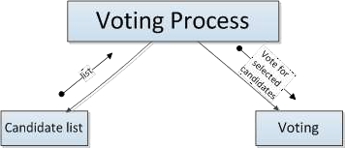
CONTROL FLOW DIAGRAM:
CONTROL FLOW OF TRANSFORM MODULE

Slide 9
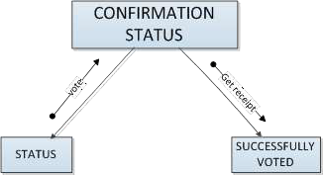
CONTROL FLOW DIAGRAM:
CONTROL FLOW OF OUTPUT MODULE

Slide 10
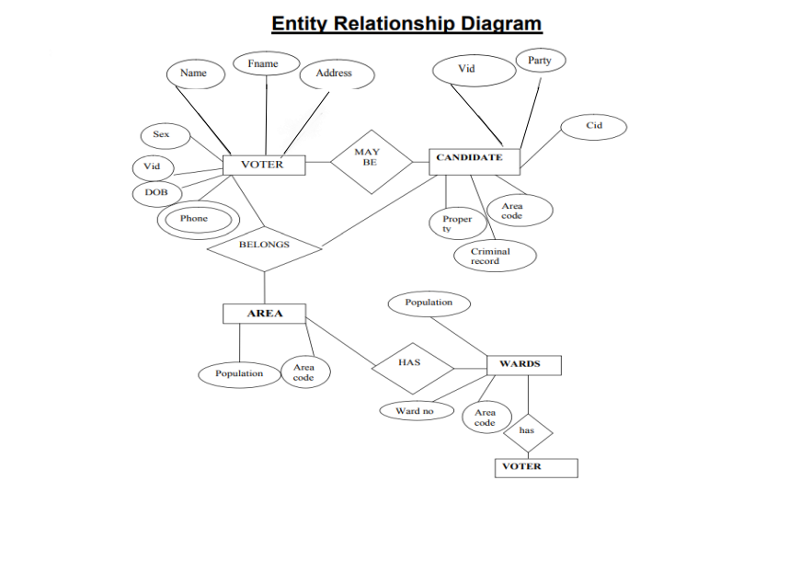
E-R Diagram

Slide 11
Test Cases:
1. Test Case: User Registration
Objective: Verify that users can successfully register on the system.
2. Login Functionality
Objective: Ensure that users can log in securely.
3. Authentication Failure
Objective: Verify that the system prevents unauthorized access.
4. Display of Candidates
Objective: Verify that the system displays the correct list of candidates for a specific election.
5. Casting a Vote
Objective: Ensure that users can cast their votes successfully.
6. Preventing Duplicate Votes
Objective: Confirm that a user cannot vote more than once for the same election.

Slide 12
7. Encryption of Data
Objective: Verify that sensitive data, such as user credentials and vote information, is encrypted.
8. User Interface
Objective: Ensure that the user interface is intuitive and user-friendly.
9. Accessibility
Objective: Verify that the system is accessible to users.
10. Results Reporting
Objective: Verify that the system accurately displays election results.

Slide 13
Deployment Methodologies:
Deploying an online voting system involves careful planning, testing, and execution to ensure the system is reliable, secure, and meets the requirements of the users and stakeholders. Here are common deployment methodologies for online voting systems:
Phased Deployment:
Description: Release the online voting system in phases, starting with a limited set of features or a specific group of users. Gradually expand the deployment to additional features or user groups.
Advantages:
Allows for thorough testing in a controlled environment.
Reduces the impact of potential issues by addressing them in smaller segments.
Considerations:
Requires effective communication to inform users about the phased rollout plan.

Slide 14
Parallel Deployment:
Description: Run the new online voting system alongside the existing system for a certain period. Users can choose between the old and new systems during this parallel phase.
Advantages:
Allows for a smooth transition as users can switch back to the old system if needed.
Enables comparison and validation of results between the old and new systems.
Considerations:
Requires synchronization of data between the old and new systems.
Increases operational complexity during the parallel phase.

Slide 15
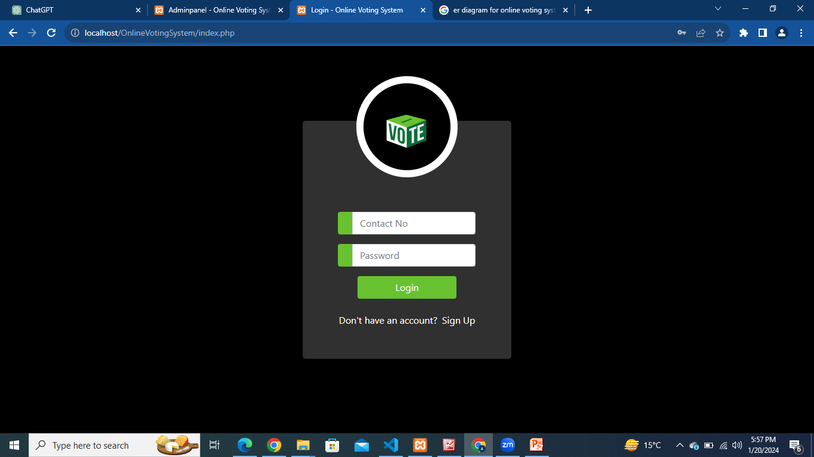
Voter Login Page

Slide 16
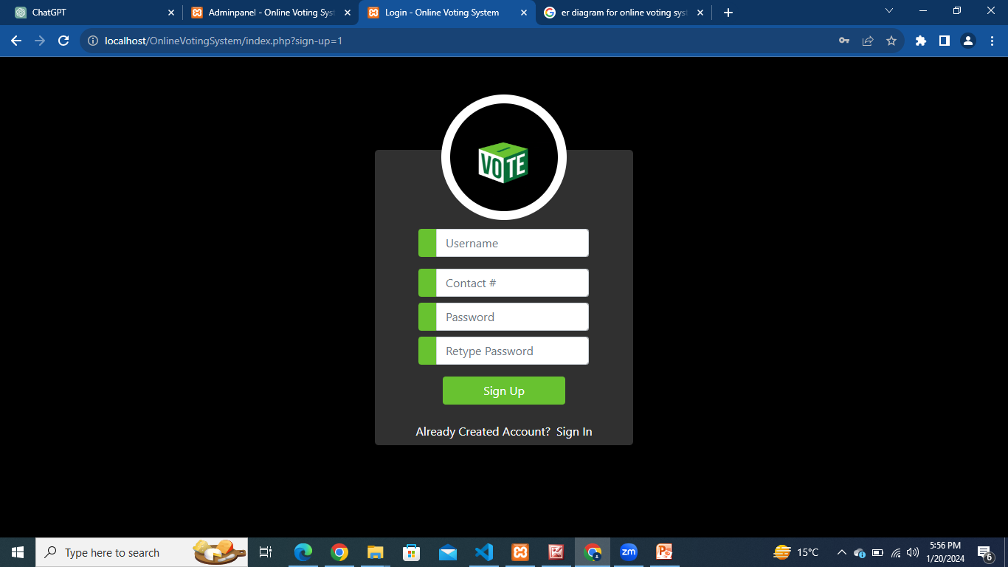
VOTER REGISTRATION PAGE:

Slide 17
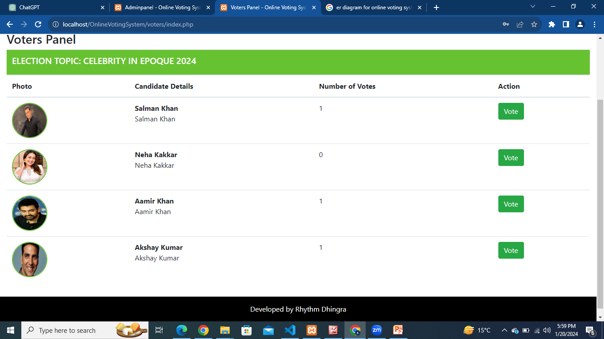
Casting vote Page:

Slide 18


