Slide 1
ProcuraAI
Autonomous Procurement Intelligence
ROCKATHON'26 — Problem Statement 01: Autonomous Commerce Engineering
Team
College
Members
Dhinith Pragalyan M-CSE(III Yr)
Nibshan Jovin Joseph-CSE(III Yr)
TwinThink
Panimalar Engineering College
"From buying intent to authorized action — autonomously, transparently, and responsibly."
Notes:
1

Slide 2

Procurement Is Still a Human Bottleneck
The traditional procurement workflow remains fragmented, opaque, and slow — even for routine purchases.
01
Business Requirement Defined
01
Budget & Authorization Checks
Stakeholder articulates need in natural language or informal brief.
Manual policy lookups with no enforcement layer; easy to bypass.
02
Manual Vendor Discovery
02
Approval Bottlenecks & Delays
Cross-source search with no systematic aggregation or normalization.
Sequential sign-offs add days of latency to routine decisions.
03
Time-Consuming Quote Comparison
03
Order Placement & Documentation
Manual side-by-side evaluation with no structured scoring model.
Manual data entry into systems with fragmented record-keeping.
04
Constraint Validation & Conflicts
04
Fragmented Decision Traceability
Budget, spec, and delivery conflicts resolved informally — if at all.
No unified audit trail; decisions driven by availability, not optimization.
RESULT · Days to weeks for routine purchases • no clear audit trail • decisions driven by availability, not optimization.

Slide 3
The Real Problem Isn't Finding a Product
It is making the right purchasing decision under constraints.
Traditional System Asks
ProcuraAI Asks
"Which products match the specs?"
Product discovery only. No constraint enforcement, no risk assessment, no policy layer, no justification.
"Which purchase best satisfies requirements, minimizes risk, stays within authorization, and can be justified?"
Decision intelligence across all dimensions — simultaneously and autonomously.
Example Brief: "Buy 10 laptops under ₹45,000 each, with ≥16GB RAM, ≥512GB SSD and delivery within 7 days." — This single sentence encodes hard constraints, soft preferences, and budget policy simultaneously.
UNDERSTAND
REASON
Extract intent and constraints from natural language
Evaluate alternatives using multi-dimensional criteria
CONTROL
EXPLAIN
Enforce authorization boundaries and policy
Justify every decision with evidence
Notes:
3

Slide 4
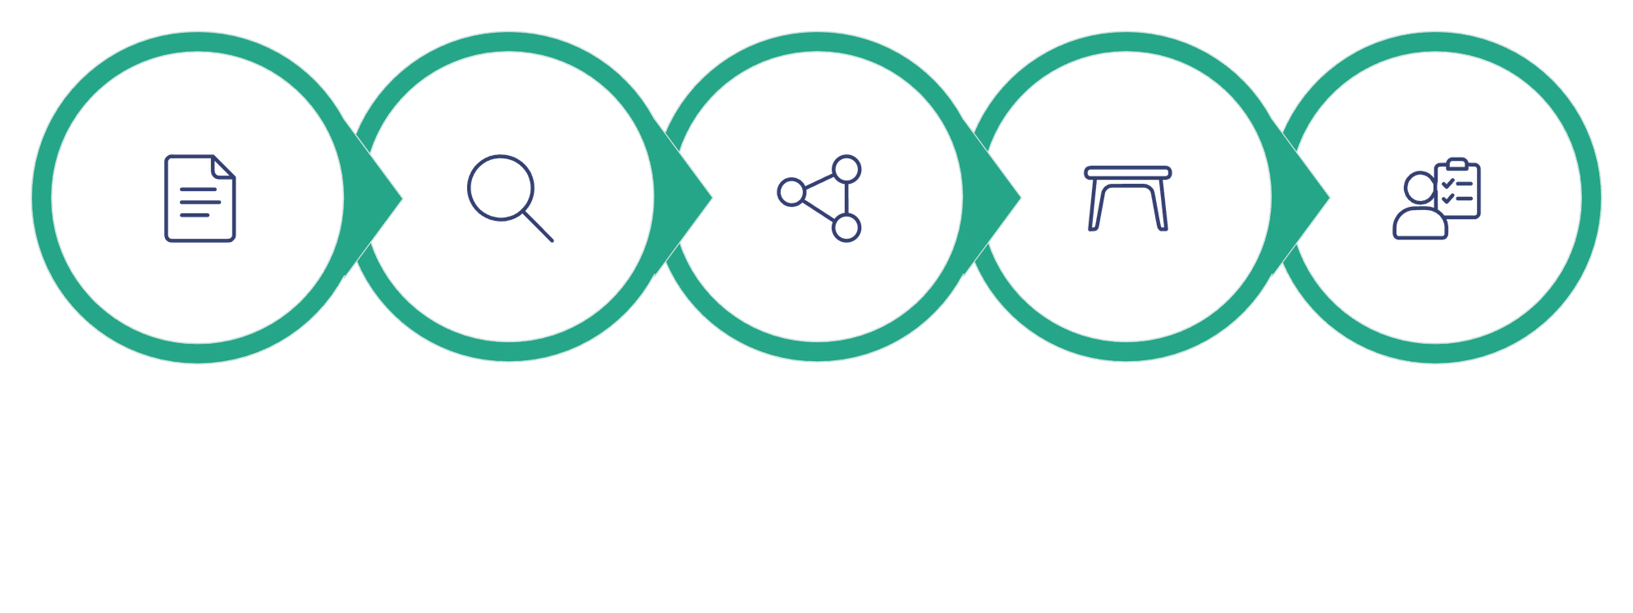
Meet ProcuraAI
An autonomous, policy-aware procurement agent that converts natural-language buying requirements into structured procurement decisions and executes them within defined boundaries.
Brief
Extract
Discover
Normalize
Analyze
ProcuraAI does not merely search for products — it executes a complete decision lifecycle, ensuring every purchase is constraint-compliant, policy-authorized, and fully explainable.
Core Principle
Autonomy within boundaries. The agent acts decisively on routine purchases, escalates intelligently when authorization is required, and never exceeds defined policy limits.
Notes:
4

Slide 5
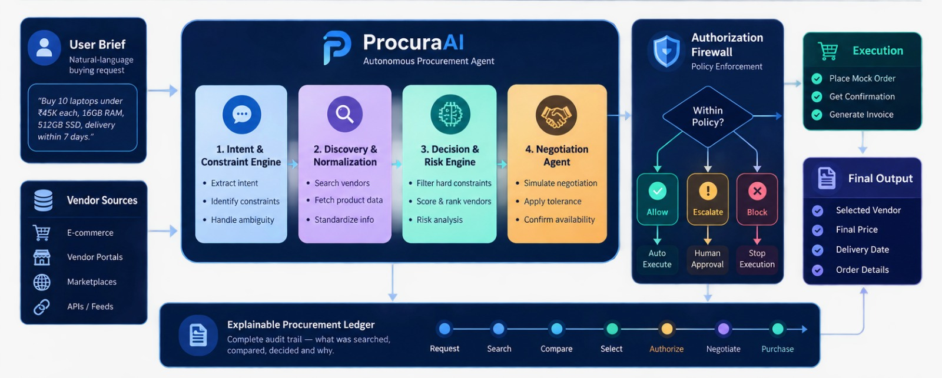
ProcuraAI System Architecture
A complete autonomous procurement workflow with policy-controlled execution.

Slide 6
Constraint Intelligence Engine
The first innovation pillar: converting natural language into machine-checkable constraints — the foundation of every downstream decision.
Example Buying Brief: "Buy 10 laptops under ₹45,000 each, with 16GB RAM, 512GB SSD and delivery within 7 days."
Hard Constraints
Soft Preferences
Ambiguous / Unclear
Quantity = 10
Budget ≤ ₹45,000 per unit
RAM ≥ 16GB
SSD ≥ 512GB
Delivery ≤ 7 days
Brand preference
Warranty coverage
Return policy quality
"Good performance" → Requires clarification
"Affordable" → Budget threshold undefined
Influence the ranking score. A vendor without preferred brand is not eliminated but ranked lower.
Agent proactively asks: "What is your maximum budget per laptop?" before proceeding.
Non-negotiable. Any vendor failing a hard constraint is automatically eliminated.
Ambiguity Handling
Constraint Relaxation
When input is underspecified, the agent does not guess. It identifies the ambiguous field, pauses decision execution, and requests targeted clarification from the requester before continuing.
When no vendor satisfies all hard constraints simultaneously, the engine performs a relaxation analysis — showing the user exactly which constraint could be softened, and the downstream consequence of each relaxation option.
Notes:
5

Slide 7

Risk-Aware Decision Engine
Cheapest ≠ Best. Hard constraints are applied first to eliminate non-compliant vendors. Remaining options are ranked using a multi-objective scoring model that captures total procurement outcome — not just unit price.
Vendor
Price / Unit
Delivery
Reliability
Risk Level
Score
Vendor A
₹42,000
5 days
94%
Low
91.4
Vendor B
₹39,000
7 days
63%
High
71.8
Vendor C
₹44,000
4 days
91%
Low
89.7
Decision Factors
Outcome: Vendor A Selected
Constraint satisfaction
Vendor A meets all hard constraints, achieves the highest reliability score (94%), carries the lowest procurement risk, and delivers the best overall outcome — despite not being the cheapest option. Vendor B's low reliability (63%) and high risk profile disqualify it from serious consideration regardless of price advantage.
Hard constraint pass/fail gate applied before scoring
Value & delivery speed
Price and timeline jointly optimized
Reliability & risk
Vendor track record and procurement risk band
Notes:
6

Slide 8
One Request. One Intelligent Procurement Journey.
From a natural-language buying brief to an explainable, policy-compliant purchase.
PROCESS
1
User submits a buying brief
DECISION HIGHLIGHT
“Buy 10 laptops under ₹45K each, 16GB RAM, 512GB SSD, delivery within 7 days.”
2
Intent & constraints extracted
Budget, quantity, specifications, delivery timeline, and ambiguity checks.
ProcuraAI’s Final Decision
3
Vendor discovery
Example procurement outcome
12 vendors discovered across multiple procurement sources.
4
Constraint filtering
LOW RISK
7 vendors eliminated immediately for violating hard constraints.
SELECTED VENDOR
TOTAL COST
5
Risk-aware ranking
Vendor A
₹4.2L
Remaining vendors scored using price, reliability, delivery, and procurement risk.
CONTROL
DELIVERY
RELIABILITY
6
Authorization check
Decision passes through the Authorization Firewall.
5 Days
94%
7
Negotiation
Bulk pricing confirmed within negotiation tolerance.
DECISION RATIONALE
EXECUTE
8
Mock purchase executed
Vendor A is selected because it satisfies all hard constraints, remains within policy, delivers in 5 days, and achieves the highest overall procurement score.
Purchase confirmation and order details generated.
9
Explainable audit ledger
Every comparison, rejection, approval, and action is permanently recorded.

Slide 9
The Agent Can Act — But Never Beyond Its Authority
A hard policy enforcement layer validates every procurement decision before execution.
AI DECISION
AUTHORIZATION FIREWALL
WITHIN POLICY?
Proposed procurement action
Independent policy engine
ALLOW
ESCALATE
BLOCK
Execute automatically
Human approval required
Policy violation
CONFIGURABLE POLICY
Budget
Reliability
EXAMPLE · LAPTOP PROCUREMENT
Auto ≤ ₹4.25L
Minimum 85%
₹4.2L • 94% • ALLOW
Category
Quantity
Within budget, reliability exceeds threshold, and every hard constraint is satisfied.
Allowed product types
Bulk purchase validation
₹4.8L + 82% reliability → ESCALATE · budget exception + reliability threshold require review
Negotiation
Within predefined tolerance

Slide 10
Decision-Centric Human Oversight
Do not ask humans to approve every routine action. Escalate only when it matters. Human attention is a scarce resource — the agent preserves it for genuinely consequential decisions.
Escalation Triggers
Decision Packet Delivered to Approver
Authorization Exception
Proposed Purchase
Escalation Context
Total cost exceeds autonomous execution limit
Vendor, quantity, unit price, total cost, authorized amount, and variance
Reason for escalation, risk level, delivery implications
Critical Ambiguity
Requirements too underspecified to proceed safely
Alternatives with Trade-offs
Agent Recommendation
High-Risk Decision
Best available vendor has low reliability score
All compliant alternatives with ranked comparison
Preferred action with full justification
Low Confidence
Human Actions Available
Multiple equally-ranked options with no clear winner
APPROVE
REJECT
Constraint Conflict
Accept recommendation
Decline, request alternatives
No fully compliant option exists across all hard constraints
MODIFY
Adjust constraints, recalculate
Notes:
9

Slide 11
Why-Not Engine
Every decision has two sides: what was chosen and why alternatives were rejected. The Why-Not Engine generates structured rejection rationale for every eliminated vendor — making the agent's logic fully auditable.
✓ SELECTED — Vendor A
✕ REJECTED — Vendor B
Meets all mandatory hard constraints
Within budget: ₹42K ≤ ₹45K limit
On time: 5 days ≤ 7-day requirement
High reliability: 94%
Low procurement risk classification
Reliability critically low: 63% (far below acceptable threshold)
High-risk procurement classification
Delivery at maximum boundary with insufficient reliability buffer
✕ REJECTED — Vendor C
✕ REJECTED — Vendor D
Total order cost: ₹44K × 10 = ₹4.4L
Exceeds authorization limit at policy boundary
Requires escalation — not auto-executable
Reliability 78% — below minimum policy threshold of 85%
Policy violation: mandatory reliability floor not met
Core Principle
The agent explains both its choice and its rejections. A decision that cannot be justified should not be executed. The Why-Not Engine is what separates a procurement intelligence system from a recommendation engine.
Notes:
7

Slide 12
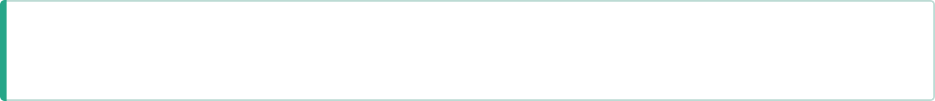
Negotiation + Failure Recovery
Autonomy doesn't stop when the first answer fails. The agent handles exceptions gracefully — not with error states. Failure recovery and negotiation are first-class capabilities, not afterthoughts.
Scenario 1
Vendor Unavailable
Scenario 2
No Exact Match
Scenario 3
Negotiation Simulation
Top-ranked vendor reports unavailability
Agent re-checks next compliant alternative automatically
Recalculates risk and delivery impact for new selection
Proceeds without human interruption if within policy
No vendor satisfies all hard constraints simultaneously
Agent performs constraint relaxation analysis
Presents ranked trade-off options per relaxation path
Asks human: which constraint may be relaxed?
Vendor quote received after initial selection
Agent applies pre-defined negotiation policy and tolerance thresholds
Within tolerance → accept automatically
Outside tolerance → escalate for human decision
Design Philosophy
Every failure path has a defined recovery strategy. The agent never reaches a dead end — it either resolves the exception autonomously, or escalates with a structured decision packet. Graceful recovery and escalation, not error states.
Notes:
10

Slide 13
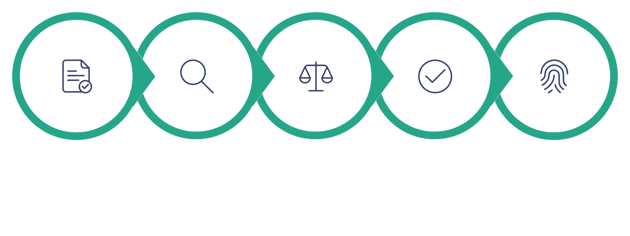
Explainable Procurement Ledger
Every action leaves evidence. Complete, immutable audit trail from request to execution — answering every question a stakeholder, auditor, or judge might ask.
Request
Search
Compare
Decide
Authorize
The Ledger Answers Three Questions
Five Innovation Pillars
"Why this?"
"Why not that?"
01
Why was the selected vendor chosen? Full scoring rationale, constraint satisfaction matrix, and comparative ranking evidence.
Why were other vendors rejected? Specific failure reason per vendor — hard constraint violation, policy threshold breach, or risk classification.
Constraint Intelligence Engine
Natural language → machine-checkable constraints
02
"What happened?"
Risk-Aware Decision Engine
What actions did the agent perform? Complete step-by-step execution log from natural language input to purchase confirmation.
Multi-objective scoring beyond price
03
Why-Not Engine
Structured rejection rationale for every alternative
04
Authorization Firewall
Architecturally separated policy enforcement
05
Explainable Procurement Ledger
Full audit trail: request → execution
Notes:
11

Slide 14
Technology Stack
Enterprise-ready technologies powering ProcuraAI’s autonomous procurement workflow.
CORE TECHNOLOGIES
R
React.js
F
FastAPI
L
LangGraph
O
OpenRouter
User Dashboard & Procurement Portal
Backend APIs & Business Logic
Multi-Agent Workflow Orchestration
Reasoning & Natural Language Understanding
P
PostgreSQL
C
ChromaDB
V
Vendor APIs
J
JWT + RBAC
Structured Procurement Data
Vendor Knowledge & Semantic Search
Product & Price Discovery
Authentication & Authorization
HOW EACH TECHNOLOGY FITS PROCURA AI
React Dashboard
FastAPI
LangGraph
Vendor APIs
PostgreSQL
Audit Ledger
Requests
Routing
Agent workflow
Discovery
Storage
Traceability
ONE CONTROLLED PROCUREMENT STACK
Dashboard → Agent reasoning → Policy → Execution → Audit
INTEGRATION PATH
React → FastAPI → LangGraph → Vendor APIs → PostgreSQL → Audit Ledger
PROCURA AI · ROCKATHON'26

