Slide 1


Personal Productivity Using The
Pomodoro Technique
Presented by:
Daniel Hinojosa
This presentation was created using the Pomodoro Technique. (21 pomodoros)

Slide 2
About the Pomodoro
Technique
Pomodoro = Tomato
http://www.pomodorotechnique.com
Highly Focused
Any Task
Tasks you don't like

Slide 3
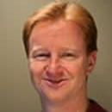
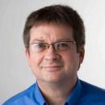
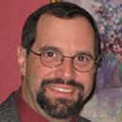

Who uses it at NFJS/Uberconf?

Slide 4
The Discipline
  Turn off Phone(s)
  Turn off IMs or DND
  No non-task related browsing
  No bathroom breaks*
  No conversations
  No meetings
  No eating
  No preening

Slide 5
The Essentials
  25 minutes all focused, timed, exact!
  Indivisible
  Use either
    a kitchen timer
    a tomato timer
    a software timer
  Adhere to the discipline
  THE BELL HAS TO RING
  Do not use it for free time
  Surprisingly not very easy

Slide 6
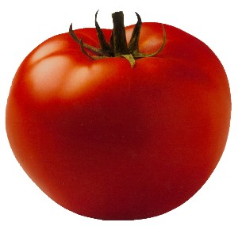
Daily Planning

Slide 7

To Do Today
To do today: 07/14/2011
Daniel Hinojosa, Über Conf, Denver
Introduce Pomodoro Technique
Discuss Pomodoro Recording and Analysis
Discuss Experience, Integration with Agile, Questions, Concerns

Slide 8
Start the Clock

Slide 9
25 Minutes Later

Slide 10
To Do Today
To do today: 7/14/2011
Daniel Hinojosa, Über Conf, Denver
Introduce Pomodoro Technique
Discuss Pomodoro Recording and Analysis
Discuss Experience, Integration with Agile, Questions, Concerns

Slide 11
It's about focus

Slide 12
Break!

Slide 13
Taking Breaks
  3-5 minutes
  Don't think about work.
  Let your right brain review your left brain
  Ease up on your back
  Get water, coffee
  (Water preferred)
  After 4 pomodoros take longer break

Slide 14


Taking Breaks
  3-5 minutes
  Don't think about work.
  Let your right brain review your left brain
  Ease up on your back
  Get water, coffee
  (Water preferred)
  After 4 pomodoros take longer break.

Slide 15

Taking Breaks
  3-5 minutes
  Don't think about work
  Let your right brain review your left brain
  Ease up on your back
  Get water, coffee (Water preferred)
  After 4 pomodoros take longer break, but why?

Slide 16
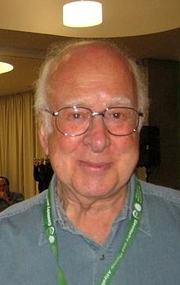
Taking Breaks

Slide 17
Taking Breaks
Peter Higgs, Emeritus Professor University of Scotland

Slide 18
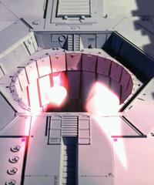
Taking Breaks

Slide 19
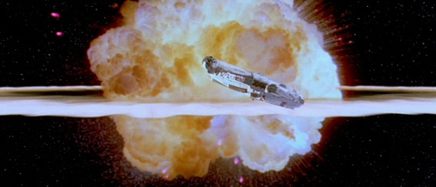
Taking Breaks

Slide 20
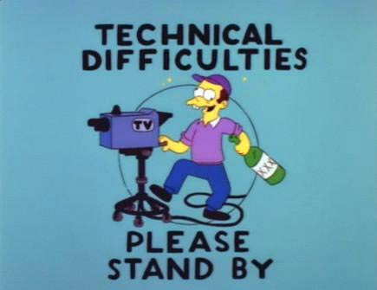
Taking Breaks

Slide 21
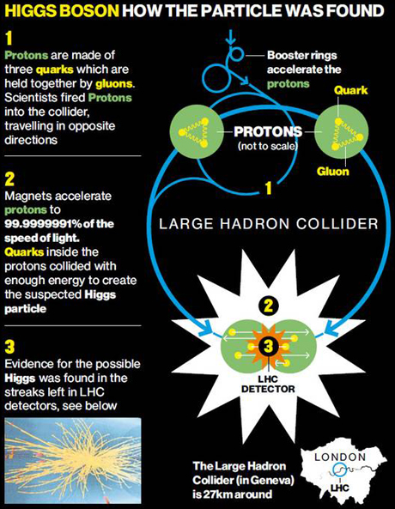
Taking Breaks
Source: http://www.belfasttelegraph.co.uk/news/world-news/cern-announces-discovery-of-higgs-boson-god-particle-16181215.html

Slide 22
Taking Breaks
His “eureka” moment reportedly came in a flash of inspiration while on a walking trip to the Cairngorms (a Scottish National Park). When one of his initial papers was rejected, he insisted the journal had clearly not understood him.
By Nick Collins, Science Correspondent, Telegraph UK 6:05PM BST 04 Jul 2012

Slide 23

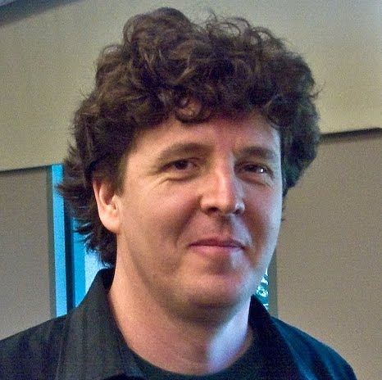
Taking Breaks
“Step away from the Computer” or
“Hammock Driven Development”
http://blip.tv/clojure/hammock-driven-development-4475586

Slide 24
Coming back from break.

Slide 25
To Do Today
To do today: 7/14/2011
Daniel Hinojosa, Über Conf, Denver
Introduce Pomodoro Technique
Discuss Pomodoro Recording and Analysis
Discuss Experience, Integration with Agile, Questions, Concerns

Slide 26

To Do Today
To do today: 7/14/2011
Daniel Hinojosa, Über Conf, Denver
Introduce Pomodoro Technique
Discuss Pomodoro Recording and Analysis
Discuss Experience, Integration with Agile, Questions, Concerns

Slide 27

To Do Today
To do today: 7/14/2011
Daniel Hinojosa, Über Conf, Denver
Introduce Pomodoro Technique
Discuss Pomodoro Recording and Analysis
Discuss Experience, Integration with Agile, Questions, Concerns

Slide 28
Starting the clock again

Slide 29
25 Uninterrupted Minutes

Slide 30
But I am done before 25 minutes are up?

Slide 31
Overlearning
  Review or repeat what you’ve done
  Make small improvements
  Note down what you’ve learned

Slide 32
Break!

Slide 33
To Do Today
To do today: 7/14/2011
Daniel Hinojosa, Über Conf, Denver
Introduce Pomodoro Technique
Discuss Pomodoro Recording and Analysis
Discuss Experience, Integration with Agile, Questions, Concerns

Slide 34
Starting the clock

Slide 35
Work 25 Uninterrupted Minutes

Slide 36
Break!

Slide 37
But I didn't finish!

Slide 38
To Do Today
To do today: 7/14/2011
Daniel Hinojosa, Über Conf, Denver
Introduce Pomodoro Technique
Discuss Pomodoro Recording and Analysis
Discuss Experience, Integration with Agile, Questions, Concerns

Slide 39
To Do Today
To do today: 7/14/2011
Daniel Hinojosa, Über Conf, Denver
Introduce Pomodoro Technique
Discuss Pomodoro Recording and Analysis
Discuss Experience, Integration with Agile, Questions, Concerns

Slide 40

To Do Today
To do today: 7/14/2011
Daniel Hinojosa, Über Conf, Denver
Introduce Pomodoro Technique
Discuss Pomodoro Recording and Analysis
Discuss Experience, Integration with Agile, Questions, Concerns

Slide 41
Starting the Clock Again

Slide 42
Another 25 Uninterrupted Minutes

Slide 43
Break!

Slide 44
To Do Today
To do today: 7/14/2011
Daniel Hinojosa, Über Conf, Denver
Introduce Pomodoro Technique
Discuss Pomodoro Recording and Analysis
Discuss Experience, Integration with Agile, Questions, Concerns

Slide 45
To Do Today
To do today: 7/14/2011
Daniel Hinojosa, Über Conf, Denver
Introduce Pomodoro Technique
Discuss Pomodoro Recording and Analysis
Discuss Experience, Integration with Agile, Questions, Concerns

Slide 46
Other Scenarios

Slide 47
Finishing Early

Slide 48
To Do Today
To do today: 7/14/2011
Daniel Hinojosa, Über Conf, Denver
Deliver update to customer

Slide 49
25 Uninterrupted Minutes Later...

Slide 50
To Do Today
To do today: 7/14/2011
Daniel Hinojosa, Über Conf, Denver
Deliver update to customer

Slide 51
Another 25 Uninterrupted Minutes Later...

Slide 52
Done!

Slide 53
To Do Today
To do today: 7/14/2011
Daniel Hinojosa, Über Conf, Denver
Deliver update to customer

Slide 54
To Do Today
To do today: 7/14/2011
Daniel Hinojosa, Über Conf, Denver
Deliver update to customer

Slide 55
Next Scenario: Really bad at estimating

Slide 56
To Do Today
To do today: 7/14/2011
Daniel Hinojosa, Über Conf, Denver
Solve Rubik's Cube

Slide 57
25 Uninterrupted Minutes Later..

Slide 58
To Do Today
To do today: 7/14/2011
Daniel Hinojosa, Über Conf, Denver
Solve Rubik's Cube

Slide 59
Another 25 Uninterrupted Minutes Later...

Slide 60
To Do Today
To do today: 7/14/2011
Daniel Hinojosa, Über Conf, Denver
Solve Rubik's Cube

Slide 61
Another 25 Uninterrupted Minutes Later...

Slide 62
To Do Today
To do today: 7/14/2011
Daniel Hinojosa, Über Conf, Denver
Solve Rubik's Cube

Slide 63
Fail!

Slide 64
To Do Today
To do today: 7/14/2011
Daniel Hinojosa, Über Conf, Denver
Solve Rubik's Cube

Slide 65
One Pomodoro Later...

Slide 66
To Do Today
To do today: 7/14/2011
Daniel Hinojosa, Über Conf, Denver
Solve Rubik's Cube

Slide 67
Another Pomodoro Later..

Slide 68
To Do Today
To do today: 7/14/2011
Daniel Hinojosa, Über Conf, Denver
Solve Rubik's Cube

Slide 69
Fail!

Slide 70

To Do Today
To do today: 7/14/2011
Daniel Hinojosa, Über Conf, Denver
Solve Rubik's Cube

Slide 71
Another Fail!

Slide 72
To Do Today
To do today: 7/14/2011
Daniel Hinojosa, Über Conf, Denver
Solve Rubik's Cube

Slide 73
When extreme failure happens
Accept that it couldn't be done today.
Note the time it took
Another Strategy?
  Break up Pomodoros?
  Call for Backup?
  Research Some More?
  Need Rest?
  Need A Doctor?
Do not cross out the task.

Slide 74
Interruptions

Slide 75
Internal Interruptions

Slide 76
To Do Today
To do today: 7/14/2011
Daniel Hinojosa, Über Conf, Denver
Fix Tests on Classes

Slide 77
Internal Interruption: I need to call customer about another issue

Slide 78
To do today: 7/14/2011
Daniel Hinojosa, Über Conf, Denver
To Do Today
'
Fix Tests on Classes
Unplanned and Urgent
Call customer on issue

Slide 79
Continue 25 Uninterrupted Minutes

Slide 80
Internal Interruption: Need to write email to QA

Slide 81
To Do Today
To do today: 7/14/2011
Daniel Hinojosa, Über Conf, Denver
'
'
Fix Tests on Classes
Unplanned and Urgent
Call customer on issue
Need to write email to QA

Slide 82
Continue 25 Uninterrupted Minutes

Slide 83
Pomodoro Done!

Slide 84
To Do Today
To do today: 7/14/2011
Daniel Hinojosa, Über Conf, Denver
'
'
Fix Tests on Classes
Unplanned and Urgent
Call customer on issue
Need to write email to QA

Slide 85
To Do Today
To do today: 7/14/2011
Daniel Hinojosa, Über Conf, Denver
'
'
Fix Tests on Classes
Unplanned and Urgent
Call customer on issue
Need to write email to QA

Slide 86
External Interruptions

Slide 87
To Do Today
To do today: 7/14/2011
Daniel Hinojosa, Über Conf, Denver
Remove Unused Methods

Slide 88
External Interruption: Skull asks about meeting highlights!

Slide 89
To Do Today
To do today: 7/14/2011
Daniel Hinojosa, Über Conf, Denver
-
Remove Unused Methods
Unplanned and Urgent
Give Skull meeting highlights

Slide 90
To Do Today
To do today: 7/14/2011
Daniel Hinojosa, Über Conf, Denver
-
Remove Unused Methods
Unplanned and Urgent
Give Skull meeting highlights

Slide 91
To Do Today
To do today: 7/14/2011
Daniel Hinojosa, Über Conf, Denver
-
Remove Unused Methods
Unplanned and Urgent
[3:00PM] Give Skull meeting highlights

Slide 92
To Do Today
To do today: 7/14/2011
Daniel Hinojosa, Über Conf, Denver
-
Remove Unused Methods
Unplanned and Urgent
[3:00PM] Give Skull meeting highlights

Slide 93
Skull Can't Wait

Slide 94
Pomodoro Dead

Slide 95
Skull can wait until tomorrow

Slide 96
To Do Today
To do today: 7/14/2011
Daniel Hinojosa, Über Conf, Denver
-
Remove Unused Methods

Slide 97
Skull can wait! Activity Inventory!

Slide 98
Activity Inventory
Activity Inventory
Daniel Hinojosa
Task
Estimate
Give Skull Meeting Highlights

Slide 99
Activity Inventory
Activity Inventory
Daniel Hinojosa
Task
Estimate
[Jul 31] Give Skull Meeting Highlights

Slide 100
Continue 25 Uninterrupted Minutes

Slide 101
Pomodoro Done

Slide 102
You know your interruptions

Slide 103
Activity Inventory

Slide 104
Fast forward to July 31st

Slide 105
Future Tasks
Activity Inventory
Daniel Hinojosa
Task
Estimate
[Jul 31] Give Skull Meeting Highlights
Order Pomodoro Timers for friends
Add some acceptance testing
Make some calls for the party

Slide 106
Smaller Tasks
Activity Inventory
Daniel Hinojosa
Task
Estimate
[Jul 31] Give Skull Meeting Highlights
1
Order Pomodoro Timers for friends
1
Add some acceptance testing
7
Make some calls for the party
0.5
No such thing as a fractional pomodoro!

Slide 107
Merging Tasks
Activity Inventory
Daniel Hinojosa
Task
Estimate
[Jul 31] Give Skull Meeting Highlights
1
Order Pomodoro Timers for friends + Make some calls for the party in February
1
Add some acceptance testing
7

Slide 108
From Inventory to To Do Today
To do today: 7/31/2011
Daniel Hinojosa, Über Conf, Denver
Give Skull Meeting Highlights
Order Pomodoro Timers for friends + Make some calls for the party in February
Add some acceptance testing

Slide 109
Go about July 31st

Slide 110
We are done with July 31st

Slide 111
Recording
your work
Record Sheet
Daniel Hinojosa
Date
Task
Est.
Real
Diff
7-31-11
Give Skull Meeting Highlights
1
1
0
7-31-11
Order Pomodoro Timers for friends + Make some calls for the party.
1
2
-1
7-31-11
Add some acceptance testing
7
2
+5

Slide 112
Other
Information
Record Sheet
Daniel Hinojosa
Date
Task
Est.
Real
Diff
Diff II
7-23-11
Give Skull Meeting Highlights
1
1
0
0
7-23-11
Order Pomodoro Timers for friends + Make some calls for Party
1+1
2
-1
0
7-23-11
Add some acceptance testing
7+2
8
-1
1
Time Started
Time finished
Importance,
Types
Tags
Interrupters
Cost
Price

Slide 113
Does it fit
into Agile?
Record Sheet
Daniel Hinojosa
Date
Task
Est.
Real
Diff
Diff II
7-23-11
Give Skull Meeting Highlights
1
1
0
0
7-23-11
Order Pomodoro Timers for friends + Make some calls for Party
1+1
2
-1
0
7-23-11
Add some acceptance testing
7+2
8
-1
1
Is this a fairly regular estimate?

Slide 114
Caveats & Lessons
Respect your spouse or partner.
You're on a roll, what now?
Forgot to start timer?
Bill your breaks, your walks, your thoughts!
Too interrupted?

Slide 115
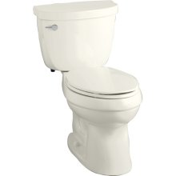
Sorry

Slide 116
Additional Notes and Ideas
  Great for students
  Tobata Protocol in exercise (http://bit.ly/4kix8)
    20-second full-speed Sprints
    Rest periods of 10 seconds.
  Turn off Windows, IM notifications, popups, ads, registrations.
  Don't lose browsing control

Slide 117
Worth Discovering
Getting
Agile
Pomodoros
Done

Slide 118
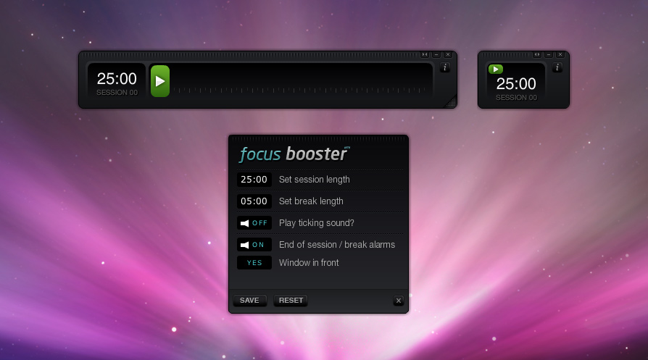
Focus Booster
http://www.focusboosterapp.com/

Slide 119

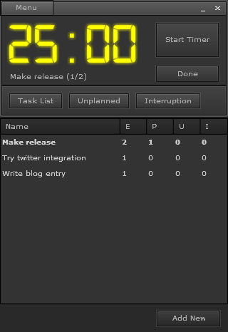
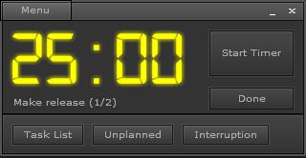
Pomodairo
http://code.google.com/p/pomodairo/

Slide 120
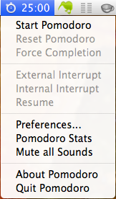
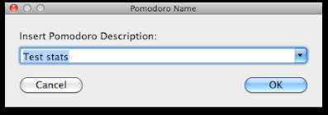
Pomodoro
(Mac Only)
http://pomodoro.ugolandini.com/

Slide 121
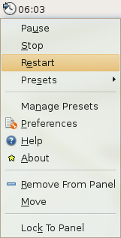
Linux Gnome
Timer-Applet
(Linux Only)
%apt-get install timer-applet

Slide 122
Questions?

Slide 123
Thank You.
Email: dhinojosa@evolutionnext.com
Twitter: @dhinojosa
Google Plus: gplus.to/dhinojosa
Linked In: www.linkedin.com/in/dhevolutionnext

Slide 124
Questions?

