Slide 1
Seam

Slide 2
About Seam
Integrates the best of JavaEE technologies
  Java Server Faces (JSF)
  Enterprise Java Beans (EJB)
  Java Persistence Architecture (JPA)
Full Dependency Injection Framework

Slide 3
About Seam Class
Different ways to skin the cat.
Things omitted in the class.
  @DataModel – DataModel doesn't expose URLs and is not RestFUL
  Home – Bloated object, not flexible, hurts > helps
Class focuses on building the best application.

Slide 4
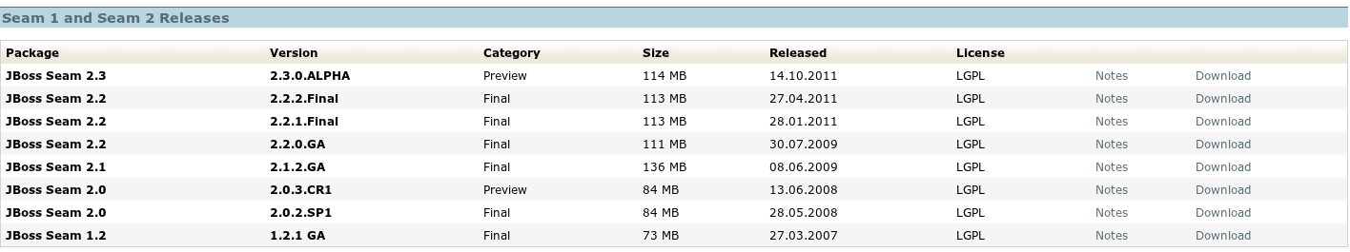
Download Seam
Download from http://seamframework.org/Seam2/Downloads

Slide 5
Setup
Extract zip file to any directory, (e.g. ~/java)
Map %SEAM_HOME% to directory location (e.g. C:\Users\Bob\Java\jboss-seam-2.2.2.Final) (Windows)
Or Map $SEAM_HOME to latest to directory location (e.g. ~/java/jboss-seam-2.2.2.Final) (Linux)
Add %SEAM_HOME%\bin to PATH
Add $SEAM_HOME\bin to PATH

Slide 6
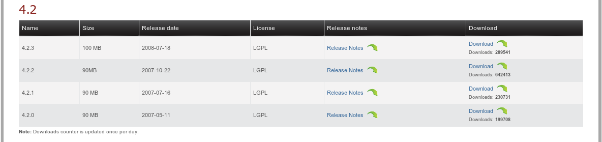
Download JBoss (Optional)
Download from http://www.jboss.org/jbossas/downloads/

Slide 7
Setup with JBoss
Extract zip file to any directory, (e.g. ~/java)
Map %JBOSS_HOME% to directory location (e.g. C:\Users\Bob\Java\jboss-4.2.3.GA) (Windows)
Or Map $JBOSS_HOME to latest to directory location (e.g. ~/java/jboss-4.2.3.GA) (Linux)
Add %JBOSS_HOME%\bin to PATH
Add $JBOSS_HOME\bin to PATH

Slide 8
Starting Seam Setup
%seam setup
setup:
[echo] Welcome to seam-gen 2.2.2.Final :-)
[echo] Answer each question or hit ENTER to accept the default (in brackets)
[echo]
[input] Enter the directory where you want the project to be created (should not contain spaces) [/home/danno/development] [/home/danno/development]

Slide 9
App Server Setup
[input] Enter your JBoss AS home directory [/home/danno/java/jboss-4.2.3.GA [/home/danno/java/jboss-4.2.3.GA]
[input] Enter your JBoss AS domain [default] [default]
[input] Enter your GlassFish V2 or V3 home directory (Ignore if you aren't deploying to GlassFish) [C:/Program Files/glassfish-v2.1] [C:/Program Files/glassfish-v2.1]
[input] Enter your GlassFish domain (Ignore if you aren't deploying to GlassFish) [domain1] [domain1]

Slide 10
Project Setup
[input] Enter the project name [default] [default]
seam2-study
[echo] Accepted project name as: seam2_study
[input] Do you want to use ICEfaces instead of RichFaces? [n] (y, [n])
[input] skipping input as property icefaces.home.new has already been set.
[input] Select a RichFaces skin [glassX] (blueSky, classic, darkX, deepMarine, DEFAULT, emeraldTown, [glassX], japanCherry, laguna, ruby, wine)

Slide 11
Ear or War
[input] Is this project deployed as an EAR (with EJB components) or a WAR (with no EJB support)? [ear] ([ear], war)
War uses JBOSS Embedded project
The upside? You can deploy a war file
The downside? JBoss embedded has been deprecated.

Slide 12
Packages
[input] Enter the base package name for your Java classes [com.mydomain.seam2_study] [com.mydomain.seam2_study]
com.evolutionnext
[input] Enter the Java package name for your session beans [com.ipipeline.ref] [com.ipipeline.ref]
com.evolutionnext
[input] Enter the Java package name for your entity beans [com.ipipeline.ref] [com.ipipeline.ref]
com.evolutionnext
[input] Enter the Java package name for your test cases [com.ipipeline.ref] [com.ipipeline.ref]
com.evolutionnext

Slide 13
Databases
[input] What kind of database are you using? [hsql] ([hsql], mysql, derby, oracle, postgres, mssql, db2, sybase, enterprisedb, h2)
[input] Enter the filesystem path to the JDBC driver jar [/home/danno/java/jboss-seam-2.2.2.Final/lib/hsqldb.jar] [/home/danno/java/jboss-seam-2.2.2.Final/lib/hsqldb.jar]
[input] skipping input as property driver.license.jar.new has already been set.
[input] Enter the Hibernate dialect for your database [org.hibernate.dialect.HSQLDialect] [org.hibernate.dialect.HSQLDialect]
[input] Enter the JDBC driver class for your database [org.hsqldb.jdbcDriver] [org.hsqldb.jdbcDriver]
[input] Enter the JDBC DataSource class for your database [org.hsqldb.jdbc.jdbcDataSource] [org.hsqldb.jdbc.jdbcDataSource]
[input] Enter the JDBC URL for your database [jdbc:hsqldb:.] [jdbc:hsqldb:.]

Slide 14
Databases Credentials
[input] Enter the database username [sa] [sa]
[input] Enter the database password [] []
[input] Enter the database schema name (Enter '-' to clear previous value) [] []
[input] Enter the database catalog name (Enter '-' to clear previous value) [] []
[input] Are you working with tables that already exist in the database? [n] (y, [n])
[input] Do you want to recreate the database tables and execute import.sql each time you deploy? [n] (y, [n])

Slide 15
Apply the changes
%seam create-project

Slide 16
Seam Setup Done
Project found in development directory and project name. (~/development/seam2-study)
Project pre-configured

