Slide 1
A Deep Learning Method Approach for Sleep Stage Classification with EEG Spectrogram
Li et al. (2022)

Slide 2
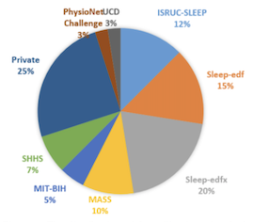
The paper addresses the challenge of accurate sleep stage classification using electroencephalogram (EEG) signals

Slide 3
While Convolutional Neural Networks (CNNs) are commonly used for feature extraction from EEG data, they may overlook the temporal transition relationships between different sleep stages

Slide 4
To address this, the paper proposes a novel deep learning-based model called EEGSNet for automatic sleep stage classification

Slide 5
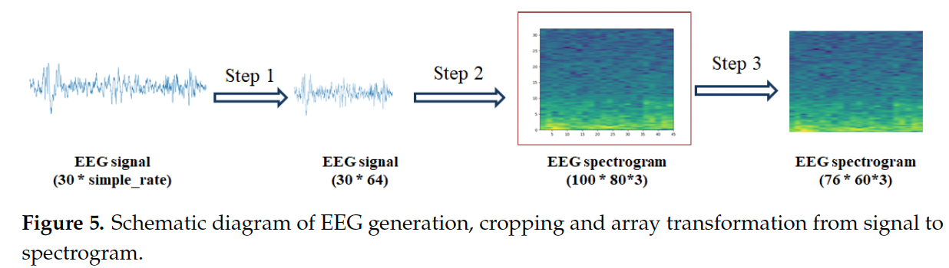
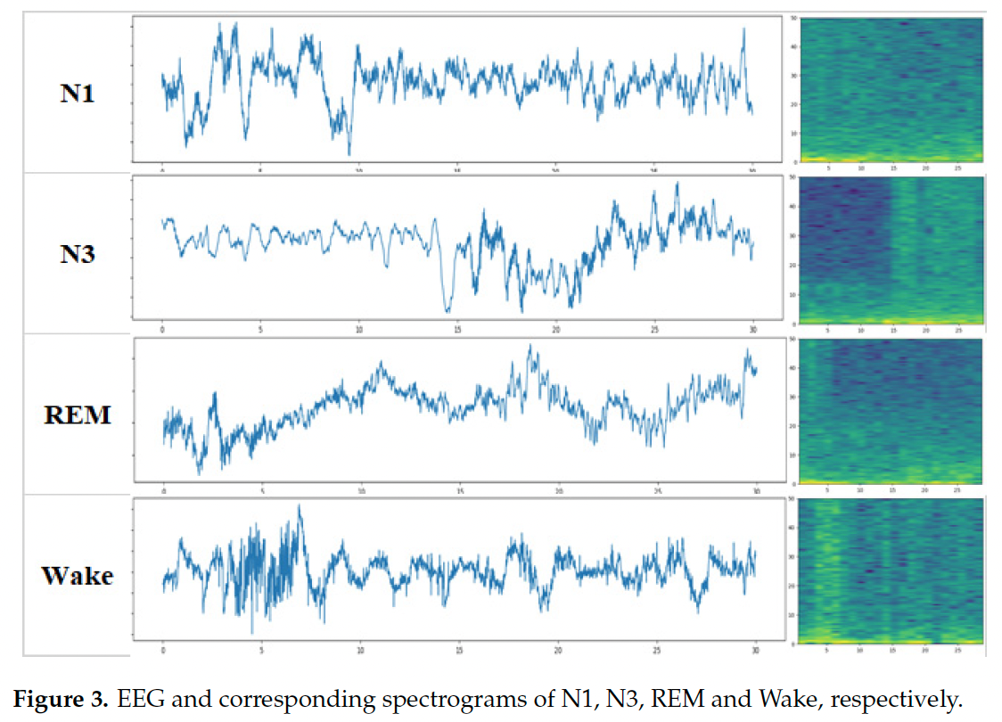
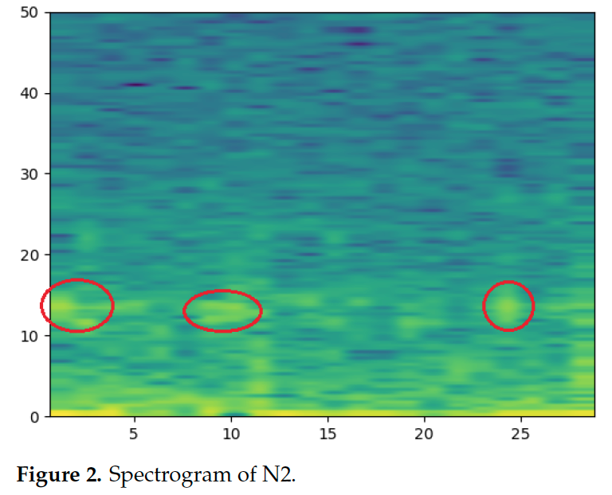
EEGSNet utilizes EEG spectrograms as input for the model
A spectrogram visually represents the frequency content of the EEG signal over time

Slide 6
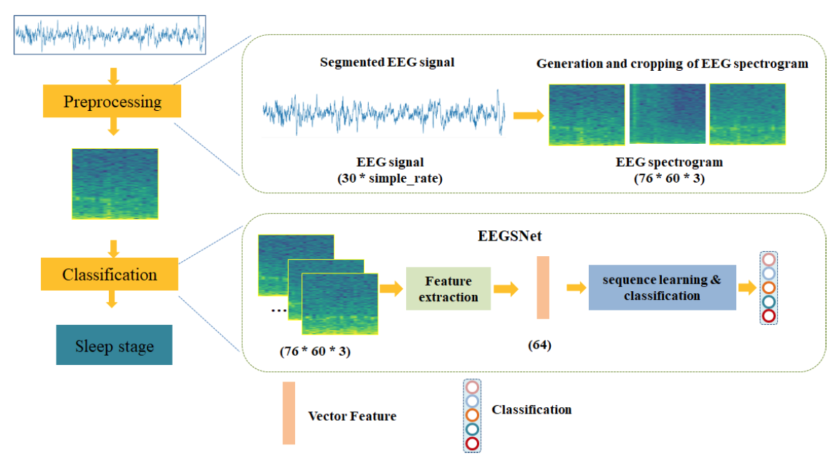
The EEGSNet model consists of two primary modules
◦ A feature extraction module that employs a CNN network with multi-layer convolution kernels. This module is designed to extract local features such as color, position, and contour information from the EEG spectrograms
◦ A sequence learning module that uses Bidirectional Long Short-Term Memory (Bi-LSTM) networks. This module aims to learn and model the transition relationships between adjacent sleep stages to improve classification performance

Slide 7
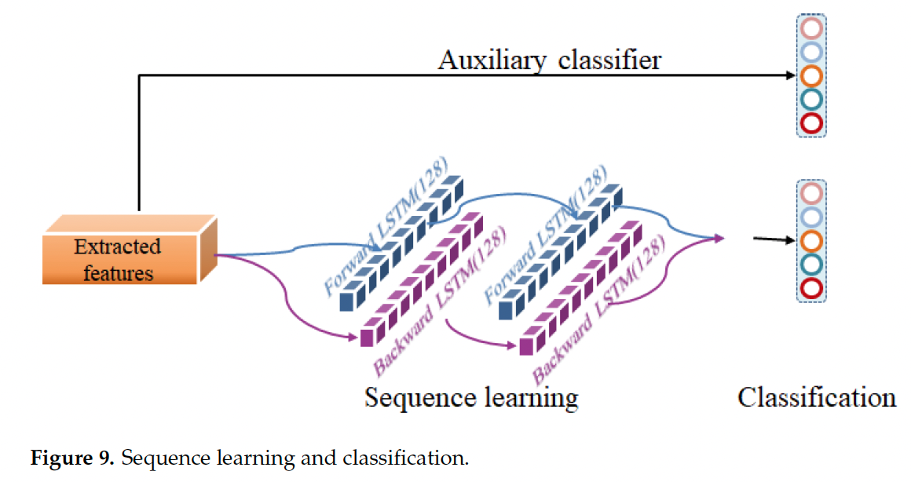
The model incorporates an auxiliary classifier after the feature extraction module. This is intended to prevent the loss of feature details during the subsequent sequence learning process

Slide 8
A key aim of the EEGSNet model is to improve the classification accuracy of the N1 sleep stage and the overall sleep stage classification performance. The authors note that N1 can be easily misclassified as REM sleep.

Slide 9
The data used to evaluate the EEGSNet model included datasets from the Sleep Heart Health Study and PhysioNet.

Slide 10
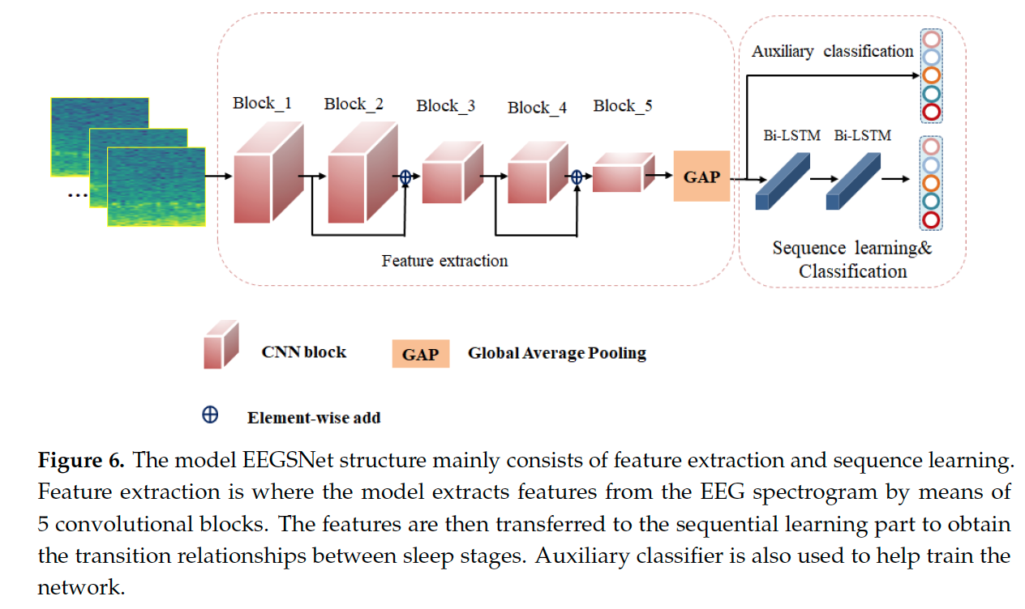
Main contributions of the paper
The use of EEG spectrograms as input and the combination of CNNs for feature extraction with Bi-LSTM for sequence learning to capture the temporal dependencies in sleep stage transitions

Slide 11
Research limitations
The recognition accuracy for the N1 sleep stage remained lower compared to other stages, with many N1 instances being misclassified as N2.
The inclusion of Bi-LSTM increases the complexity of the model.

