Slide 1
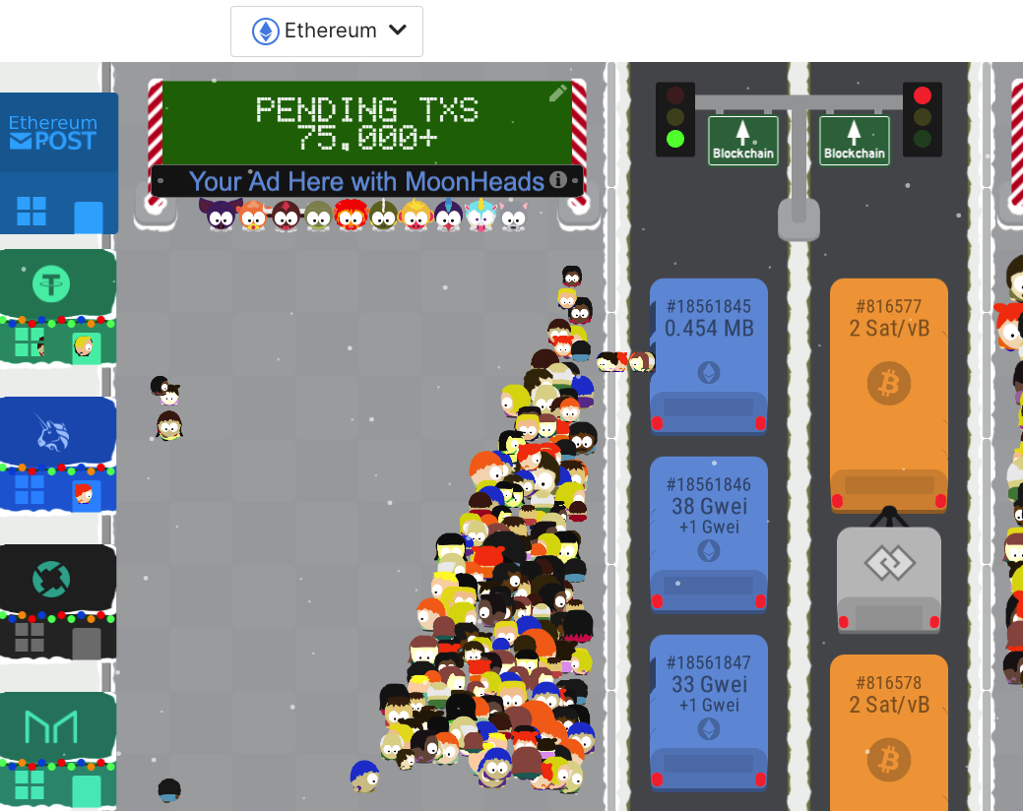
TxStreet
https://txstreet.com/v/eth-btc
Currently unique 2k daily users
A blockchain explorer/visualisation tool
Helps news Decentralised Applications (dApps) onboard users
Educate new users to dApps and Blockchains
Gives bird’s view of blockchain transactions (mempool)

Slide 2
What is txstreet?
Txstreet is a blockchain explorer and visualizer that can help users see real-time blockchain transaction from execution to finality
It allows for dApps to rent houses and market their product to users
Also onboard new users to crypto

Slide 3
Problem Statement 1 – A million dollar business
Explorer is a huge business, the most popular explorer currently etherscan.com has a monopoly and charges $1 to $2 USD million to every blockchain and L2
Explorers are more blocks and transaction focused and not dApp focused

Slide 4
Problem Statement 2 – dApp marketing coverage
New dApps on blockchain struggle in onboarding users and create awareness about their dApps due to few dApps having control and presence in the entire market
As per dAppRadar.com and DefiLama.com there are
Nearly 3k defi dApp applications with only top 100 dApps having transaction volume over 100k USD while (Total Value Locked)TVL is over $1 billion USD for only first 15 dApps
The situation with Gaming dApps is more worst as there are only top 10 dApps with more than 50k transaction volume out of 2500 dApps aprox.

Slide 5
Problem Statement 3 – User experience
If you are yet to comprehend working on blockchain technology after reading tons of articles and watching hundreds of videos then don’t worry you are not alone.
Blockchain technologies major issue have been User experience and the complexity of the technology that has failed to bring masses to crypto world.
As per nasdaq.com article that blockchain ecosystem needs to prioritize User Experience to make mass adoption possible

Slide 6
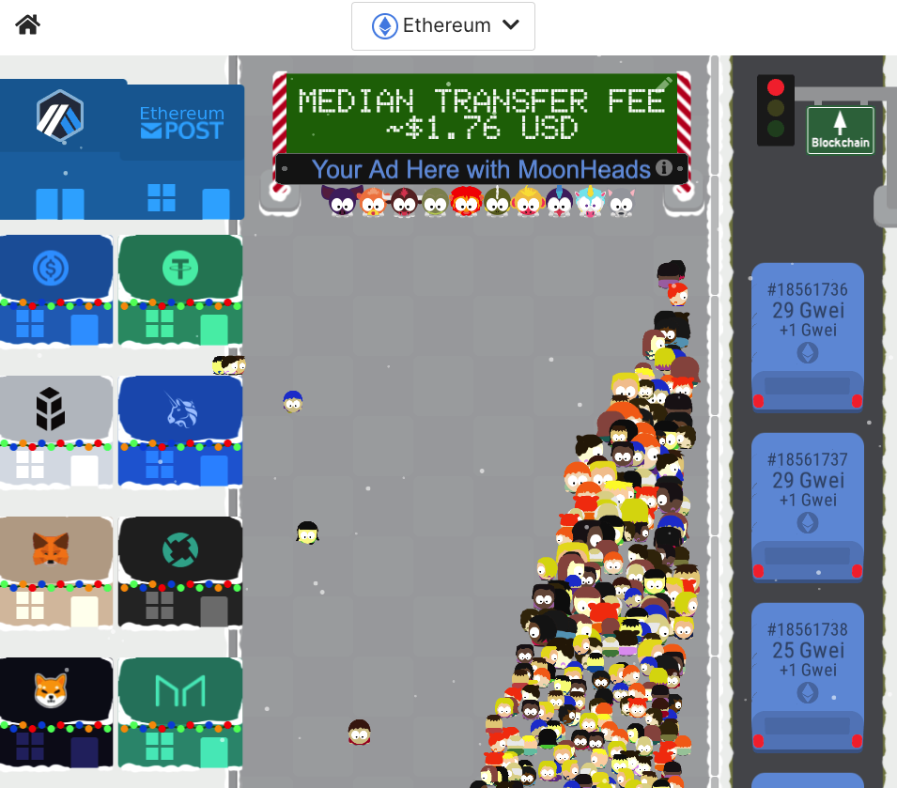
Solution – Take a % of explorer busines
As mentioned, explorers are charging $1 million USD per L2 on an average, we could charge fraction of that and still be largely profitable in the current market
We provide an explorer that is more dApp focused.
User can filter out transactions specific to dApps and even visualize bridge transactions

Slide 7
Solution – Space in metaverse
We at https://txstreet.com/ allow dApps to rent houses on the street.
Currently we have around 2k daily unique active users, so the dApp will get an instant exposure to 60k users in a month

Slide 8
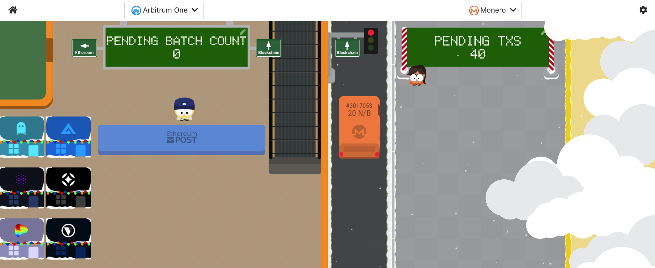
Solution – onboard more blockchains
Add Multiple L2s and Zero knowledge chains to showcase users how they work.
Potentially add some dynamic features to allow users to interact and use the dApp on chain

Slide 9
Milestone 1 – 45 days (started at 1st Dec)
Target for Milestone 1: Allow dApps to rent houses
Steps to Complete
Add form for dApps for request to rent house on txstreet
Showcase rented dApps on txstreet
Add dynamic feature for the dApps
Cloud | Cost
Digital Ocean cloud | 600-700 USD

Slide 10
Milestone 2 – 45 days (started at 15th Jan)
Target for Milestone 2: Add other L2s such and showcase their transactions to in txstreet as explorer
Steps to Complete
Create a wallet dApp on txstreet
Allow users to execute tranxs
Show transactions in real-time from execution to finality
Cloud | Cost
Digital Ocean cloud | 600-700 USD

Slide 11
Milestone 3 – 45 days (started at 15th Feb)
Target for Milestone 2: Add Wallet to allow users to perform transactions
Steps to Complete
Create a wallet dApp on txstreet
Allow users to execute tranxs
Show transactions in real-time from execution to finality
Cloud | Cost
Cloud cost | 600-700 USD

Slide 12
Expected Revenue: First month post launch
$250 per dApp per week on single chain
Target : 4 dApps to be given on rent per week
Expected revenue 4000 USD per month
((4 dApps*250 USD charged)*4 weeks = 4000)
Lowest Expected revenue is 500 USD with only 2 deploys
Highest Expected revenue for 4 chains 16,000 USD
Note: All the above estimates are in approximation

Slide 13
Expected Revenue: Second month with post second milestone
$1 per user to visualize tranx real-time
As currently we have 2k unique users daily
Target : 100 users daily
Expected revenue 3,000 USD per month
Lowest Expected revenue is 300 USD with only 10 users daily with
Highest Expected revenue with 200 to 300 daily subscribe to tranx visualization will be 10,000 USD per month
Note: All the above estimates are in approximation

