Slide 1
Local Coding LLMs:
7B → 14B
Qwen2.5-Coder 7B
DeepSeek-Coder 6.7B
Qwen2.5-Coder 14B
Faster small models, measured head-to-head
Claude Opus (frontier ref)
Qwen2.5-Coder 7B / 14B · DeepSeek-Coder 6.7B · Claude Opus reference
const r = await
eval('twoSum([2,7,11,15],9)');
Measured on an RTX 4070 Ti Super (16 GB) · 47 GB RAM · Ollama · Windows 11
Notes:
• This deck focuses on the FAST, self-hostable small models — Qwen2.5-Coder 7B and 14B, and DeepSeek-Coder 6.7B — the ones that fit a 16 GB GPU and answer in seconds. • Claude Opus appears as a frontier reference point for correctness, not as the subject. • Everything measured on one consumer machine: an RTX 4070 Ti Super, 16 GB VRAM. • Two workloads: 10 LeetCode problems (38 test cases) and a full Scheduler app (26 behavioural tests). • Larger 32B/33B models were also run earlier; we reference them but don't re-run them — they need a 24 GB+ GPU to be fast.

Slide 2
EXECUTIVE SUMMARY
3 Key Takeaways
01
02
03
7B is fast — but flaky on whole-app code
DeepSeek 6.7B is the steady all-rounder
14B buys reliability, not peak score
Qwen 7B answers in ~2 s and nails 34/38 LeetCode every run, but its Scheduler swings 5/26 ↔ 26/26 across runs — a hallucinated import crashes 2 of 3 attempts.
Fits 16 GB VRAM, ~5 s/problem, 26/26 Scheduler every single run. LeetCode wobbles 33–37/38 (one intermittent miss). The most reliable small model here.
Qwen 14B (~9 GB, still fits) holds 26/26 Scheduler and 34/38 LeetCode — steadier than 7B at ~5.6 s. The mid-size sweet spot before you need a bigger GPU.
Notes:
• Three takeaways up front. • 1) Qwen 7B is the speed champion and is perfectly stable on algorithms, but unreliable when generating a whole class — note the bimodal 5↔26 scheduler. • 2) DeepSeek 6.7B is the steady pick: scheduler 26/26 on every run, fits VRAM, ~5 s. • 3) Stepping up to 14B trades a little speed for steadier whole-app generation — the sweet spot before you need a 24 GB GPU for 32B. • The rest of the deck backs each of these with measured data.

Slide 3
MODELS UNDER REVIEW
The Local Line-up (+ a Frontier Yardstick)
Hardware: RTX 4070 Ti Super (16 GB) · 47 GB RAM · Ollama · Windows 11
Qwen2.5-Coder 7B
DeepSeek-Coder 6.7B
qwen2.5-coder:7b-instruct-q4_K_M
deepseek-coder:6.7b-instruct-q4_K_M
Footprint: ~5 GB · fits GPU
Footprint: ~4.5 GB · fits GPU
License: Apache 2.0
License: DeepSeek License
Qwen2.5-Coder 14B
Claude Opus 4.8
qwen2.5-coder:14b-instruct-q4_K_M
frontier API · reference only
Footprint: ~9 GB · fits GPU
Footprint: no GPU · cloud
License: Apache 2.0
License: Anthropic ToS
All three local models fit a 16 GB GPU and run fully on-device at $0 / token. (32B/33B were also measured but need 24 GB+ to run at speed.)
Notes:
• The contenders: three local models that all fit 16 GB VRAM, plus Claude Opus as a correctness yardstick. • Qwen 7B (~5 GB) and DeepSeek 6.7B (~4.5 GB) are the fast small models; Qwen 14B (~9 GB) is the mid-size. • All are Q4-quantised, served by Ollama, $0 per token. • Licensing: Qwen is Apache 2.0, DeepSeek under its own commercial-friendly license; Claude is API-only. • 32B/33B exist in our earlier data but aren't the focus — they offload to RAM on 16 GB and are slow.

Slide 4
EVALUATION METHODOLOGY
What We Tested & How It's Scored
LeetCode Problem Suite
Scheduler / Reminder App
10 problems · Easy→Hard · 38 test cases · TypeScript
26 behavioural tests · full class generation
Easy
Two Sum, Valid Parens, Merge Lists, Reverse LL
✓ create() — id, defaults, uniqueness
✓ getById() — found vs. undefined
Medium
Longest Substring, Max Subarray, Num Islands
✓ listPending() / listOverdue() — time filters
✓ complete() / delete() — with error cases
Hard
Trapping Rain, Min Window, Median Stream
✓ getDueWithin(n) — window filter
✓ reschedule() — updates dueAt
✓ Integration — full create→complete→overdue (×5)
Model writes TS → we transpile, sandbox-execute in a worker (killed at 5 s), and assert exact outputs.
Notes:
• Two workloads, identical harness for every model. • LeetCode: 10 problems, 38 test cases, sandboxed execution with a 5 s infinite-loop guard. • Scheduler: the model generates a whole ReminderService class from a spec; 26 behavioural checks drive CRUD, time-window filters, and a 5-part integration scenario. • LeetCode measures algorithmic correctness; the Scheduler measures real-world, multi-method code generation. • Exact prompts for every test are on the final two slides.

Slide 5
LEETCODE BENCHMARK RESULTS
Measured Pass Rate (38 test cases)
Reading the numbers
Small models cluster at 34/38
Qwen 7B & 14B: 34/38; DeepSeek 6.7B: 33–37/38 across runs.
One universal miss: LC#295
MedianFinder is class-based; the driver can't instantiate it, so EVERY model scores 0/1 — a harness limit, not a model error.
Claude tops out at 37/38
The frontier ceiling on this suite — only 3 points above the small local models.
Notes:
• Measured LeetCode pass rate. The small local models land at 89% (34/38); DeepSeek varies 33–37 across sessions. • Claude Opus reaches 97% (37/38) — the frontier ceiling here is only ~3 points above the 7B/14B models. • Everyone misses LC#295 — the class-based MedianFinder the harness can't instantiate. It's a driver limitation, identical for every model. • Headline: on well-specified algorithm problems, a 7B model is already within a few points of the frontier.

Slide 6
SCHEDULER APP RESULTS
ReminderService — 26 Behavioural Tests
26/26
26/26
26/26
tests pass
tests pass
tests pass
Qwen 7B (best run)
DeepSeek 6.7B
Qwen 14B
but 5/26 on 2 of 3 runs
26/26 every run
26/26 every run
The catch — reliability, not peak score: Qwen 7B can hit a perfect 26/26, but only on a good run. On 2 of 3 runs it crashed to 5/26 because it hallucinated `import { v4 } from 'crypto'` (crypto has no v4). DeepSeek 6.7B and Qwen 14B used a valid id generator and passed 26/26 on every run. See the next slide.
Notes:
• Scheduler = whole-class generation, where the models diverge. • All three CAN hit 26/26 — the doughnuts show best-case. • But Qwen 7B only got there on 1 of 3 runs; the other two crashed to 5/26 on a hallucinated `crypto.v4` import. • DeepSeek 6.7B and Qwen 14B passed 26/26 on every run — they generated a valid id scheme. • So the real differentiator at this size is run-to-run reliability, not the best-case number. The consistency slide quantifies it.

Slide 7
RUN-TO-RUN CONSISTENCY
Same Prompt, 3 Runs — Who Is Stable?
Each model run 3× with identical prompts (temperature 0.05). LeetCode = /38, Scheduler = /26.
Model | Run 1 | Run 2 | Run 3 | Verdict
Qwen 7B — LeetCode | 34/38 | 34/38 | 34/38 | rock-solid
Qwen 7B — Scheduler | 5/26 | 26/26 | 5/26 | BIMODAL
DeepSeek 6.7B — LeetCode | 33/38 | 33/38 | 33/38 | stable
DeepSeek 6.7B — Scheduler | 26/26 | 26/26 | 26/26 | rock-solid
Qwen 14B — LeetCode | 34/38 | — | — | (1 run)
Qwen 14B — Scheduler | 26/26 | — | — | (1 run)
Why it matters: a single run hides instability. Qwen 7B's Scheduler looks perfect (26/26) one run and broken (5/26) the next — a hallucinated import that compiles differently each sample. If you ship a 7B for app-generation, you must validate every output. DeepSeek 6.7B and 14B were deterministic across runs.
Notes:
• The slide a single-run benchmark can't give you: run-to-run variance. • Qwen 7B LeetCode is identical all 3 runs (34/38) — algorithms are stable. But its Scheduler is bimodal: 5, 26, 5 — it either works or crashes, nothing in between. • DeepSeek 6.7B is the opposite of flaky: 33/38 and 26/26 on all three runs, byte-stable. • 14B shown for one run (26/26, 34/38) — matched the stable pattern. • Practical lesson: at 7B, validate every generated file; reliability is a first-class metric, not an afterthought.

Slide 8
CODE STYLE — SYNTAX, NAMING & CONVENTIONS
How Each Model Writes the Same Code
Trait | Qwen 7B | DeepSeek 6.7B | Qwen 14B | Claude Opus
Hash map idiom | Map<> | plain {} obj | Map<> (typed) | Map<>
Local typing | inferred | untyped | explicit | explicit
Inline comments | none | heavy | none | none
UUID generation | crypto.v4 ✗ | uuid pkg | uuid pkg | crypto.randomUUID ✓
External deps | none | uuid | uuid | none (stdlib)
Indent | 4-space | 4-space | 4-space | 2-space
Conventions reveal capability. Claude & Qwen 32B reach for Node's built-in crypto.randomUUID() (zero deps, portable). DeepSeek and Qwen 14B assume the external `uuid` npm package. Qwen 7B hallucinated `v4` from `crypto` — a non-existent export that crashes at load. DeepSeek over-comments and uses a plain object as a map; the larger/frontier models write tighter, explicitly-typed TypeScript.
Notes:
• Same task, different house styles — and the differences predict reliability. • Hash maps: 7B/14B/Claude use a real Map<>; DeepSeek 6.7B uses a plain {} object (works, less idiomatic). • Typing: 14B and Claude annotate explicitly; 7B infers; DeepSeek leaves locals untyped. • UUID is the tell: Claude and Qwen 32B use the built-in crypto.randomUUID (no deps); DeepSeek/14B pull in the `uuid` package; Qwen 7B invented `crypto.v4`, which doesn't exist and crashes — the root cause of its flaky scheduler. • Comments: DeepSeek comments heavily; the others keep it clean. • Takeaway: dependency discipline and valid stdlib use track with model quality.

Slide 9
PERFORMANCE — LATENCY & TOKENS
Speed Is the Small-Model Advantage
Measured avg latency per LeetCode problem (seconds, local)
Tokens & throughput
Metric | 7B | 6.7B | 14B
Tokens/problem | 341 | 627 | 409
Avg latency | 2.3s | 4.7s | 5.6s
Sched gen | ~7s | ~9s | ~12s
Fits 16 GB | yes | yes | yes
Cost/token | $0 | $0 | $0
The point of small models: 7B/6.7B/14B all answer in 2–6 s on a 16 GB GPU. The 32B (shown grey) jumps to ~76 s because a 19 GB model spills into system RAM. Stay ≤14B and everything fits and flies.
Notes:
• Speed is why you'd pick a small model. • 7B ~2.3 s, 6.7B ~4.7 s, 14B ~5.6 s — all interactive on a 16 GB GPU. • The grey 32B bar (~76 s) shows the cliff: a 19 GB model can't fit 16 GB and offloads ~30% to CPU/RAM. • Token counts are modest (~400–600/problem), so latency is compute-bound, not verbosity. • Everything is $0 per token locally. Stay at or below 14B and you keep both speed and zero cost.

Slide 10
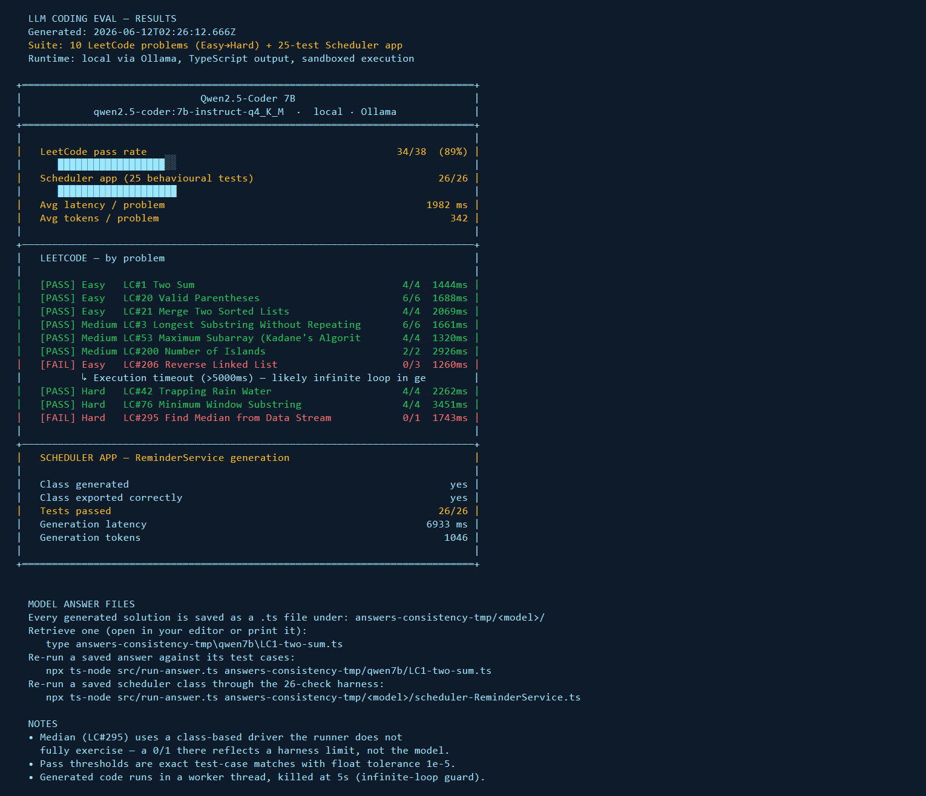
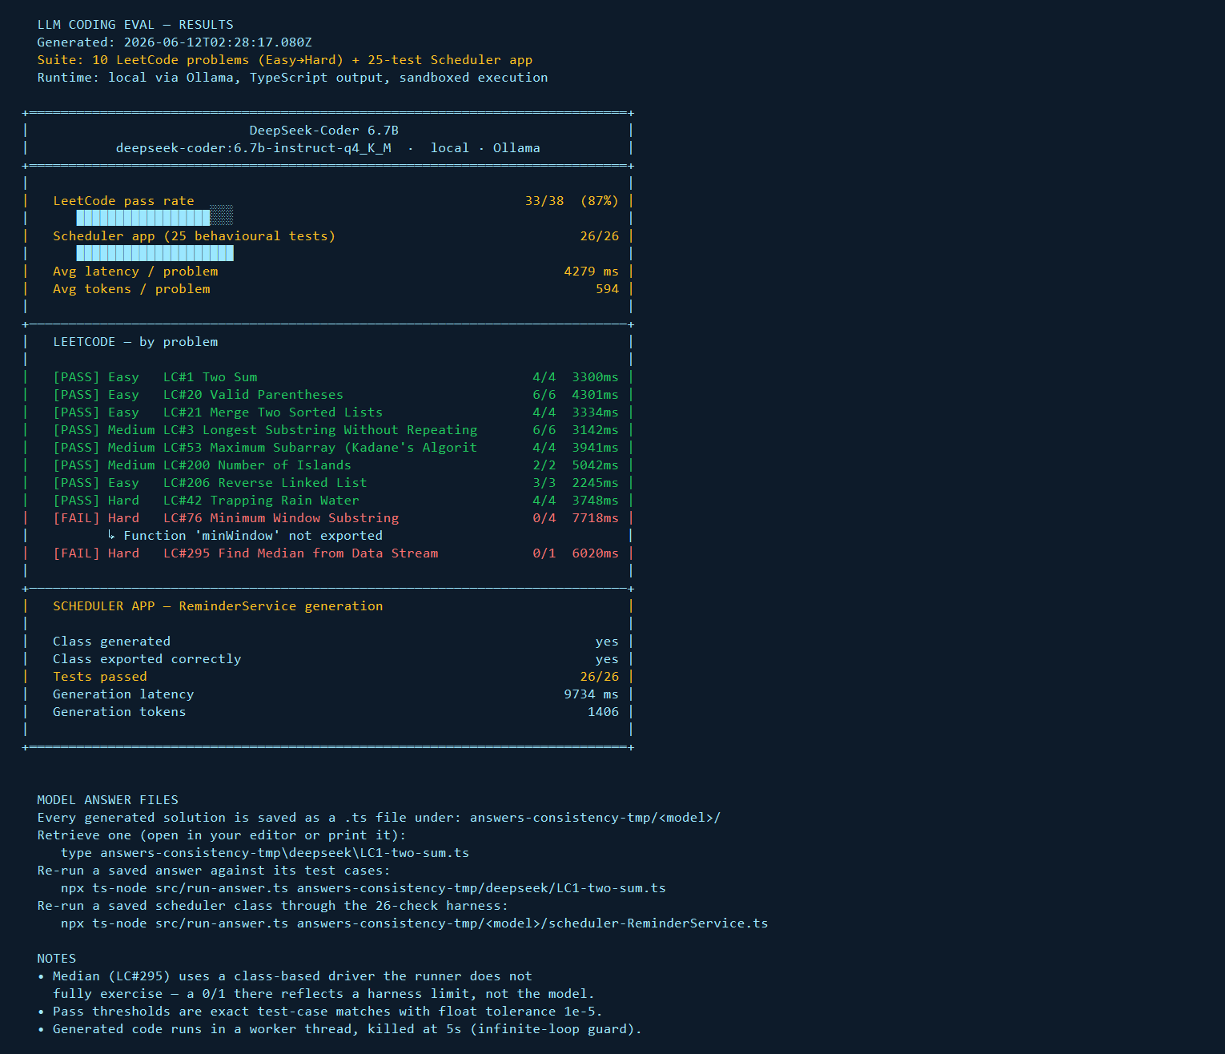
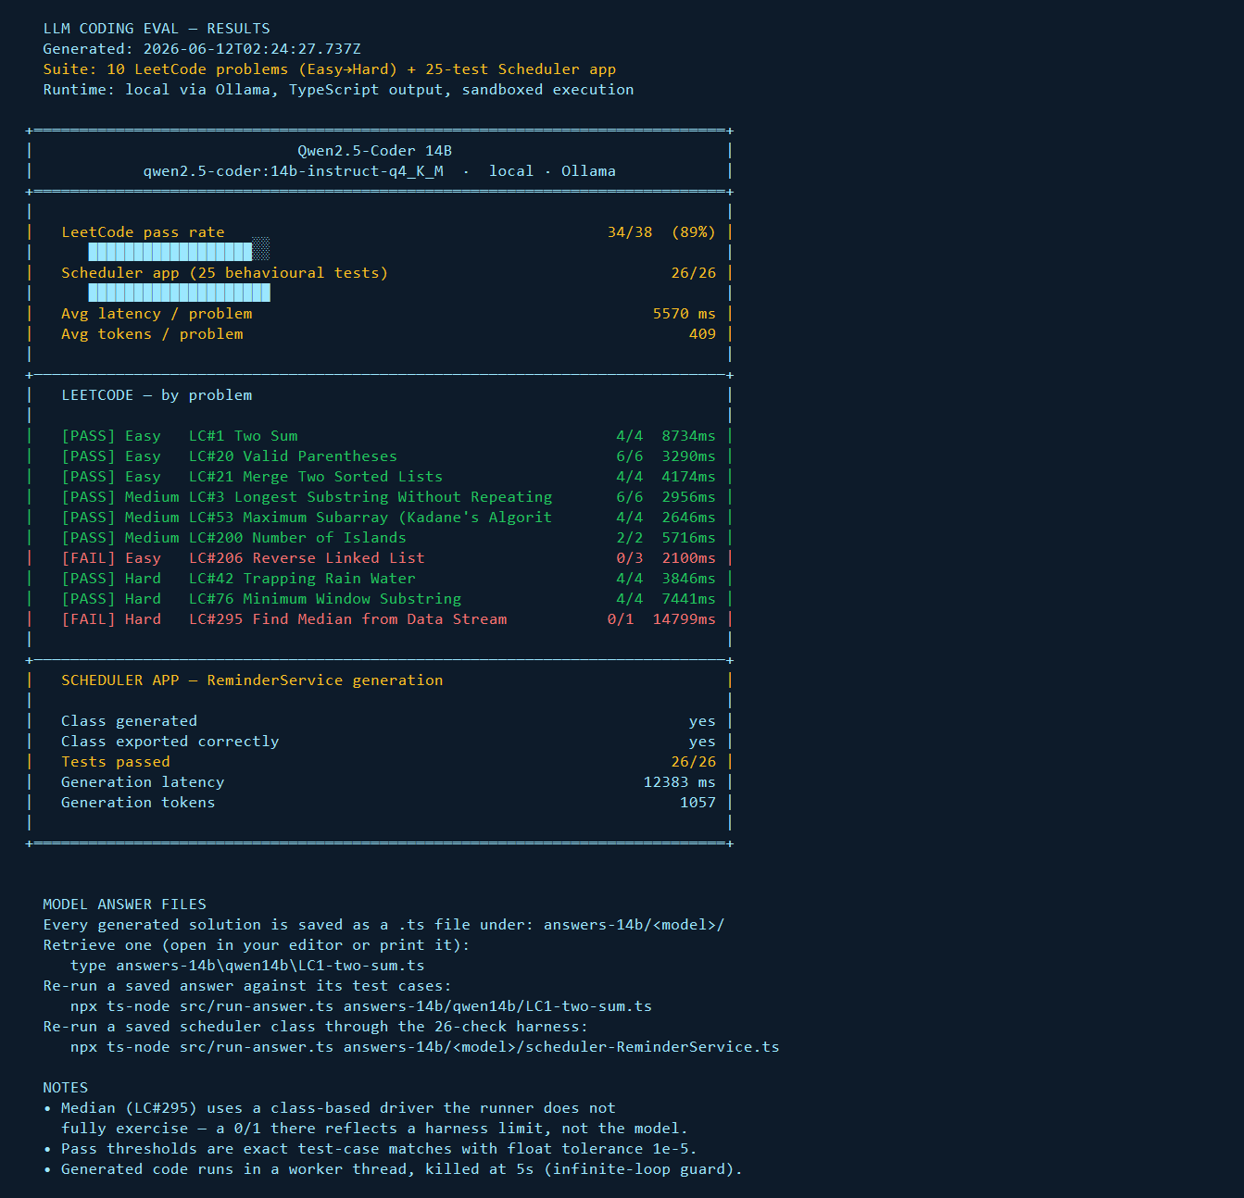
REPRODUCE IT — RUN & READ THE RESULTS
How to Run + the Result Cards
npm install && npm run build # one-time
$env:ONLY_MODELS="qwen7b"; $env:OUT="results-7b.json"; node dist/run-eval.js # run a model
node dist/render-cards.js results-7b.json results-7b.txt # render the card below
Qwen 7B
DeepSeek 6.7B
Qwen 14B
Each run writes a colour-coded result card (PASS green / FAIL red) — these three are pasted straight from results-*.txt.
Notes:
• Everything here is reproducible in three commands: install/build, run a model, render its card. • The three images are real screenshots of the result cards the harness prints (results-*.txt), colour-coded PASS/FAIL. • Qwen 7B card shows the LC#206 infinite-loop timeout; 14B shows its own misses; DeepSeek shows the clean run. • Point out you can re-run any single saved answer with `node dist/run-answer.js <file>`. • Full-resolution cards live in deck-assets/ and the raw text in results-*.txt.

Slide 11
SERVE THEM — NODE.JS + TYPESCRIPT API
Expose Every Model Behind One API
src/api-server.ts (Express) — OpenAI-compatible + per-model routes. Full docs in API.md.
Endpoints
// start it
npm run server:start // :3456
// call any model from Node/TS
const res = await fetch(
'http://localhost:3456/models/' +
'qwen2.5-coder-14b/chat', {
method: 'POST',
headers: {'Content-Type':'application/json'},
body: JSON.stringify({ messages: [
{ role: 'user',
content: 'Write twoSum in TS' }],
max_tokens: 512 }),
});
const { choices } = await res.json();
console.log(choices[0].message.content);
GET /health
liveness + model list
GET /v1/models
discover ids + tier
POST /v1/chat/completions
OpenAI-compatible (route by model)
POST /models/:id/chat
per-model REST
Model ids: qwen2.5-coder-7b · -14b · -32b · deepseek-coder-6.7b · -33b · claude-opus · codex
Notes:
• A single Express service (src/api-server.ts) puts every model — local and frontier — behind one HTTP API. • Two surfaces: an OpenAI-compatible /v1/chat/completions (point any OpenAI client at it) and a per-model /models/:id/chat REST route. • Local models route to Ollama by tag; claude-opus and codex route to the Anthropic/OpenAI SDKs via keys in .env. • The code sample is a plain fetch — no SDK needed. Swap the model id in the URL to switch models. • Full request/response shapes, curl, and the OpenAI-SDK pattern are in API.md.

Slide 12
TEST A SCHEDULER BY HAND
Run the Class Itself — No Test Suite
src/try-scheduler.ts loads any saved ReminderService and lets you call its methods directly.
# narrated demo of every method
node dist/try-scheduler.js \
answers-7b/qwen7b/\
scheduler-ReminderService.ts
# OR a live REPL — call methods
# yourself with a real `svc`
node dist/try-scheduler.js \
<answer.ts> --repl
scheduler> svc.create({ title:'X',
dueAt: FUTURE(5) })
scheduler> svc.listPending()
What you get
Demo mode
instantiates the class and calls create / getById / listPending / listOverdue / complete / delete / getDueWithin / reschedule, printing each result.
REPL mode (--repl)
drops you into a Node prompt with a live `svc` instance plus FUTURE(min) / PAST(min) helpers — poke at the class however you like.
No harness
runs the generated class on its own — not the 26-test suite — so you can explore behaviour, not just pass/fail.
Notes:
• For when you want to poke at a generated scheduler yourself, not run the 26-test grader. • try-scheduler.js loads any saved ReminderService answer, instantiates it, and either runs a narrated demo of every method or drops you into a REPL. • In REPL mode you get a live `svc` plus FUTURE()/PAST() helpers — call create(), listPending(), complete(), etc. by hand and see real return values. • This is the manual counterpart to run-answer.js (which runs the formal suite). • Great for understanding WHY a model's class behaves the way it does.

Slide 13
DECISION GUIDE & LICENSING
Which Small Model Should You Use?
Use case / property | Qwen 7B | DeepSeek 6.7B | Qwen 14B
Fastest responses | ★★★ | ★★ | ★★
Reliable whole-app generation | ★ | ★★★ | ★★★
Algorithmic correctness | ★★★ | ★★★ | ★★★
Fits 16 GB GPU | ★★★ | ★★★ | ★★★
Zero per-token cost | ★★★ | ★★★ | ★★★
Commercial license | Apache 2.0 | DeepSeek | Apache 2.0
Recommendation: Default to DeepSeek-Coder 6.7B — it fits, it's fast (~5 s), and it's the only small model that was 26/26 on the app every run. Reach for Qwen 7B when raw speed matters and you validate each output; step to Qwen 14B for steadier generation with a little more headroom. All three are $0/token and ship-ready.
Notes:
• Decision guide + licensing in one view, all three local models commercial-friendly. • Qwen 7B wins on speed; loses on whole-app reliability. • DeepSeek 6.7B and Qwen 14B win on reliable generation; all three tie on algorithms, VRAM fit, and $0 cost. • Recommendation: default to DeepSeek 6.7B (fast + the only small model 26/26 every run); use Qwen 7B for speed with per-output validation; 14B for steadier generation. • Licenses: Qwen Apache 2.0, DeepSeek's own commercial-friendly license — both shippable.

Slide 14
APPENDIX — EXACT PROMPTS (VERBATIM)
Prompts Sent to Every Model — LeetCode
System prompt (every LeetCode call)
LC#42 Trapping Rain Water (Hard)
You are an expert TypeScript engineer. When asked to solve a coding problem:
1. Write clean, correct TypeScript code.
2. Wrap your solution in a single ```typescript code block.
3. Use module.exports = { functionName } at the end.
4. Do NOT include any explanation outside the code block.
5. Ensure your solution handles all edge cases.
Given n non-negative integers representing an elevation map where the width of each bar is 1, compute how much water it can trap after raining.
Constraints:
- n == height.length
- 1 <= n <= 2 * 10^4
- 0 <= height[i] <= 10^5
Write an O(n) time, O(1) space solution.
Write a TypeScript function: function trap(height: number[]): number
Export it as: module.exports = { trap }
LC#206 Reverse Linked List (Easy)
Given the head of a singly linked list (represented as an array), reverse the list, and return the reversed list.
Write a TypeScript function: function reverseList(head: number[]): number[]
Export it as: module.exports = { reverseList }
Representative prompts shown verbatim — all 10 LeetCode prompts live in src/leetcode/problems.ts.
Notes:
• The exact text every model received — nothing paraphrased. • Top-left: the fixed system prompt for all LeetCode calls (identical for all models, temperature 0.05). • Two representative user prompts shown verbatim — Two Sum (Easy) and Trapping Rain Water (Hard). • Note the explicit module.exports contract and worked examples — same scaffolding for every model, so differences are the model, not the prompt. • All 10 prompts are in src/leetcode/problems.ts; the Scheduler prompt is on the next slide.

Slide 15
APPENDIX — EXACT PROMPTS (VERBATIM)
Prompt Sent to Every Model — Scheduler App
ReminderService — full prompt (task + interface + 7 requirements + output format), read top-to-bottom, left column then right
You are an expert TypeScript/Node.js engineer.
Build a complete, production-quality Reminder/Scheduler app in TypeScript.
## Requirements
Implement the following TypeScript class and export it:
```typescript
type RepeatInterval = "once" | "daily" | "weekly" | "monthly";
interface Reminder {
id: string; // UUID v4
title: string;
description?: string;
dueAt: Date;
repeat: RepeatInterval;
tags: string[];
completed: boolean;
createdAt: Date;
}
interface CreateReminderInput {
title: string;
description?: string;
dueAt: Date;
repeat?: RepeatInterval; // default: "once"
tags?: string[]; // default: []
}
class ReminderService {
create(input: CreateReminderInput): Reminder;
getById(id: string): Reminder | undefined;
listAll(): Reminder[];
listPending(): Reminder[]; // not completed, dueAt >= now
listOverdue(): Reminder[]; // not completed, dueAt < now
complete(id: string): Reminder; // throws if not found
delete(id: string): boolean;
getDueWithin(minutes: number): Reminder[]; // pending reminders due within N minutes
reschedule(id: string, newDueAt: Date): Reminder; // throws if not found
}
```
## Implementation requirements
1. Use `crypto.randomUUID()` or a simple counter-based ID generator for IDs.
2. Store reminders in an in-memory Map<string, Reminder>.
3. `listPending()` returns reminders where completed === false AND dueAt >= now.
4. `listOverdue()` returns reminders where completed === false AND dueAt < now.
5. `getDueWithin(minutes)` returns pending reminders where dueAt is between now and now+minutes.
6. All methods that take an id throw `new Error(`Reminder ${id} not found`)` if not found.
7. `complete()` and `reschedule()` mutate in-place and return the updated reminder.
## Output format
Respond with ONLY a ```typescript code block containing the implementation.
End with: module.exports = { ReminderService };
Notes:
• The full Scheduler prompt, verbatim — the whole-app generation task. • It gives the TypeScript interface (Reminder, CreateReminderInput, ReminderService) and 7 explicit implementation requirements: UUID ids, in-memory Map, pending/overdue semantics, throw-on-missing, and the strict output format. • The 26 behavioural tests assert exactly these requirements. • This is the prompt where Qwen 7B's hallucinated crypto.v4 import shows up — the spec says 'crypto.randomUUID() or a simple counter', and 7B mangled it. • Closing: small local models are fast and capable; pick by reliability, and validate generated code.

