Slide 1
Setting baseline results:
This document describes how to to get LB=0.82 using a simple "Cnn_Trad_Pool2_Net" from paper [1]. Implementation is in pytorch.
[References]
[1] "Convolutional Neural Networks for Small-footprint Keyword Spotting" - Tara N. Sainath, Carolina Parada, INTERSPEECH 2015
[2] https://research.googleblog.com/2017/08/launching-speech-commands-dataset.html
[3] https://github.com/castorini/honk

Slide 2
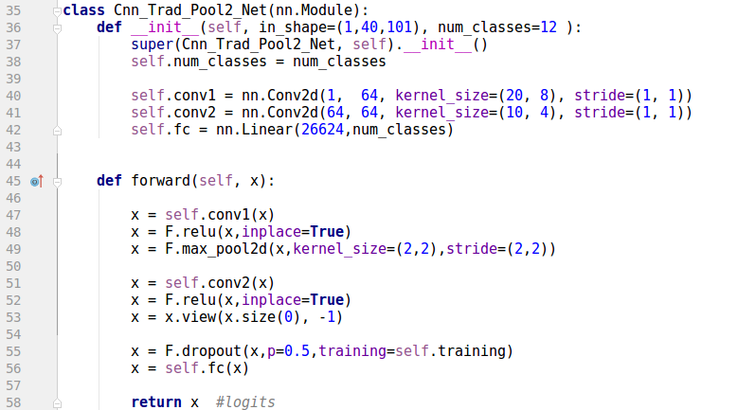
1. Network structure

Slide 3
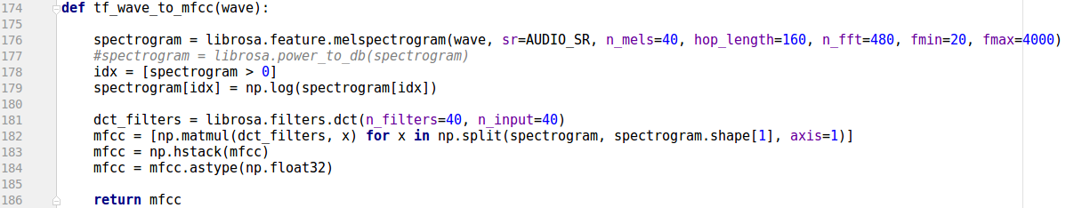
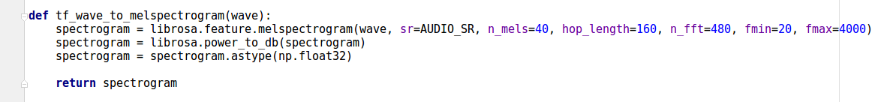
2. Input (melspectrogram/MFCC)

Slide 4
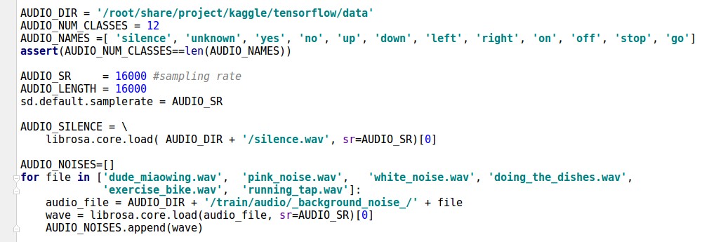
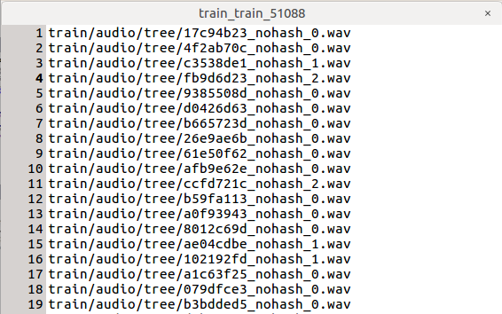
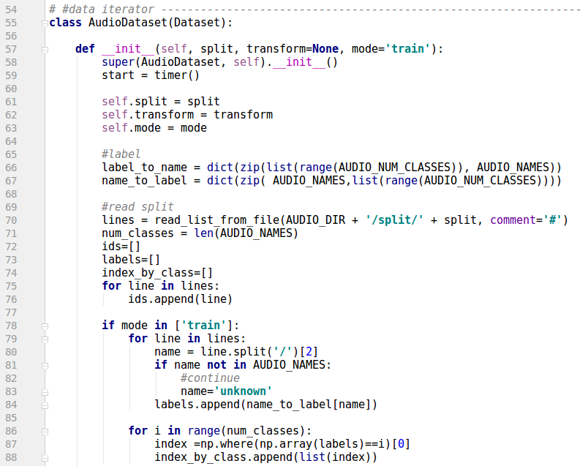
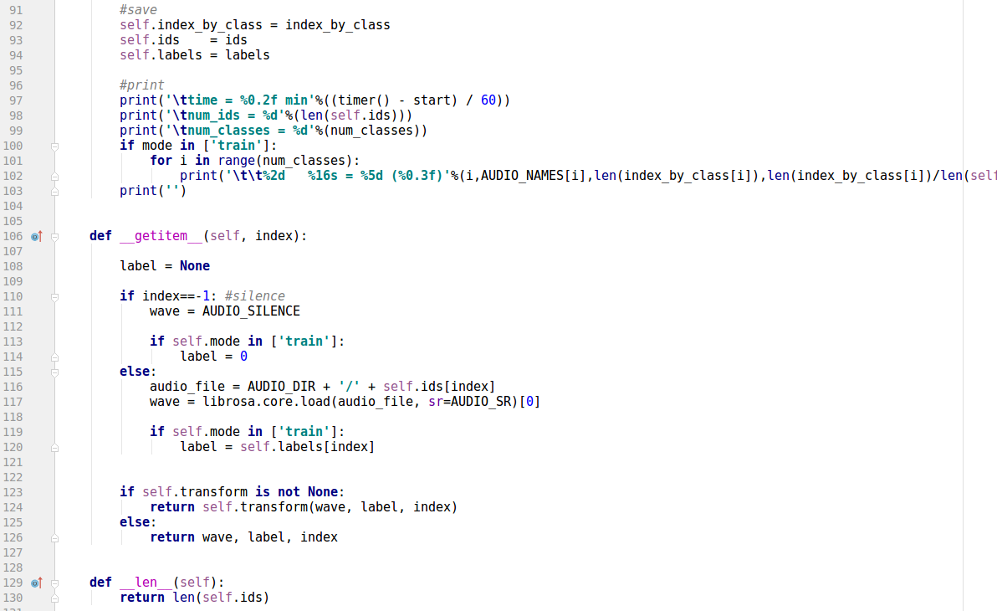
2. Dataset
# split is a list of file paths, e.g.
# this is a "zero array" audio file
#divide sample index by class

Slide 5
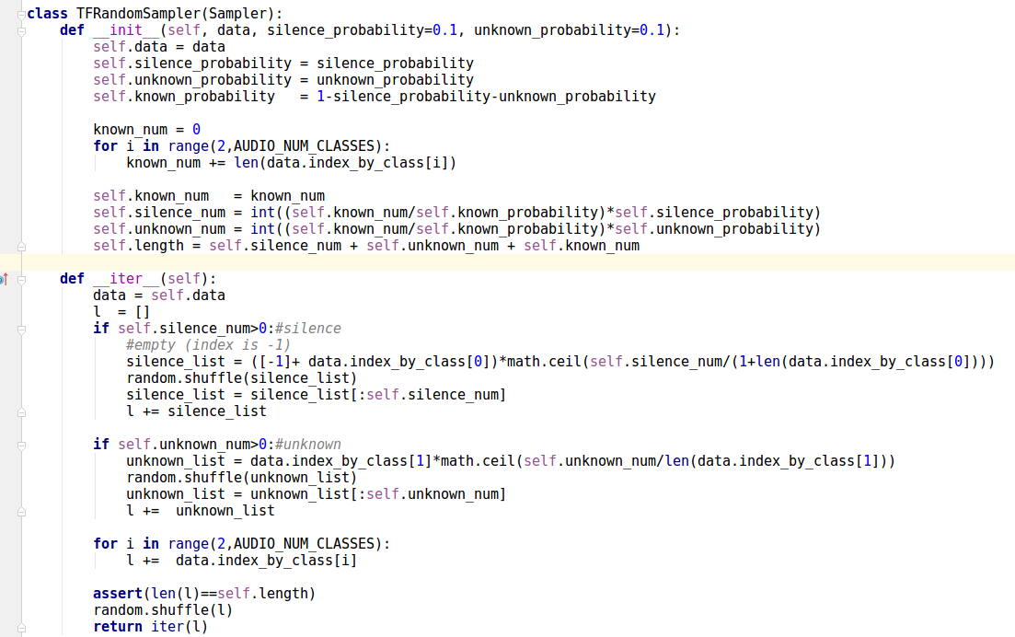
# sampler for given silence and unknow samples
# epoch epoches uses different silence and unknow samples

Slide 6
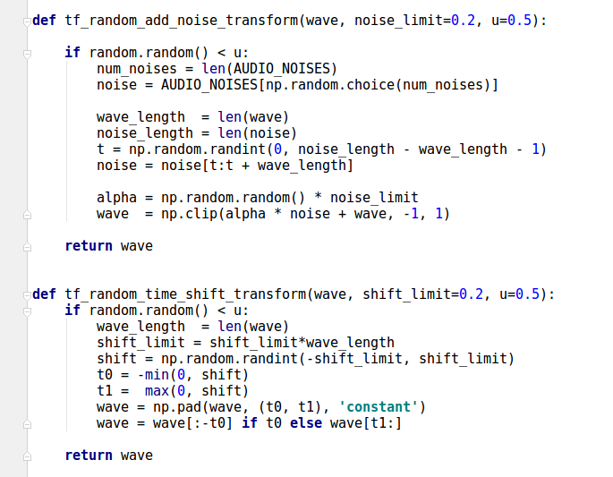
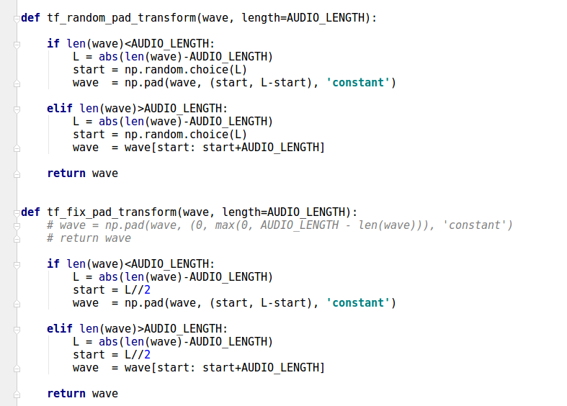
# augmentation

Slide 7
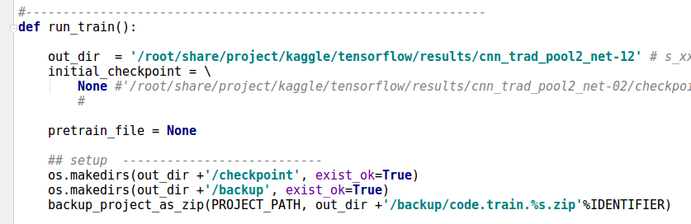
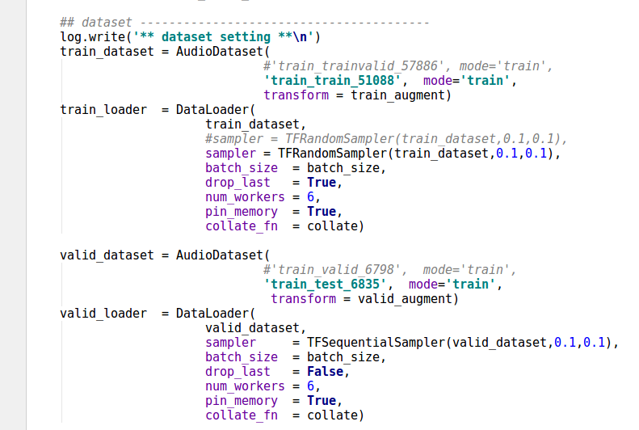
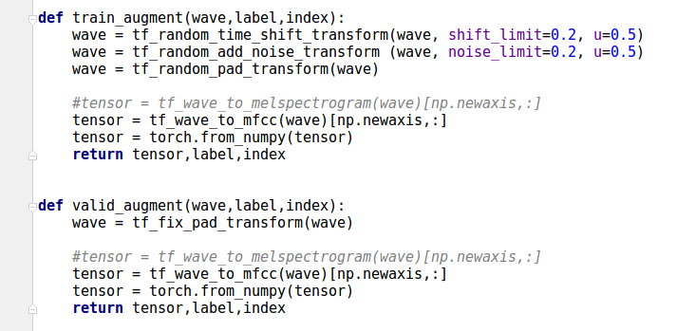
3. Training (SGD)
...
# train/valid augmentation
random sampling with given silence and unknown probabilities
fix sampling with given silence and unknown probabilities

Slide 8

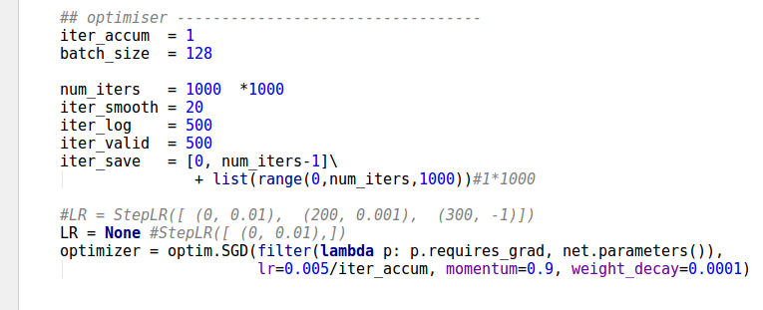
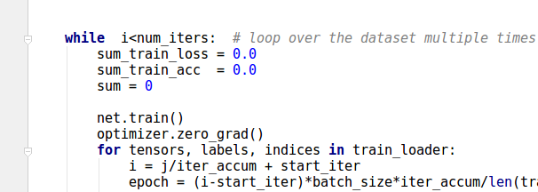
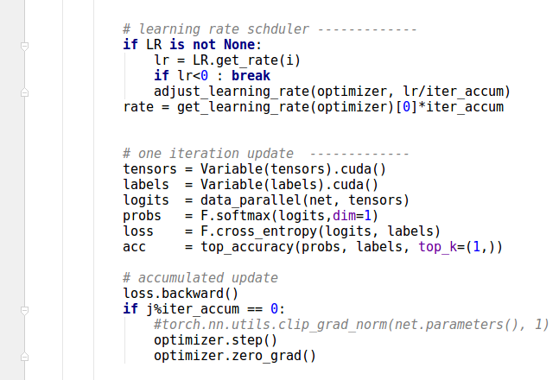
# optimizer
...
...

Slide 9
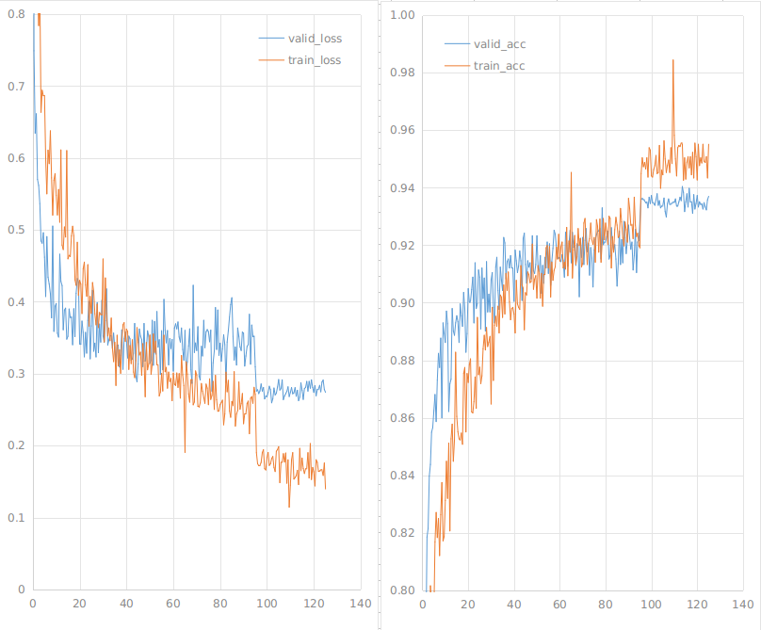

4. Example Results
/root/share/project/kaggle/tensorflow/results/cnn_trad_pool2_net-02a
curve are "spiky" becuase the silence and unknown samples are changed per epoch
rate 0.005
# public LB score
rate 0.0005
'1000 iters
'1000 iters

Slide 10
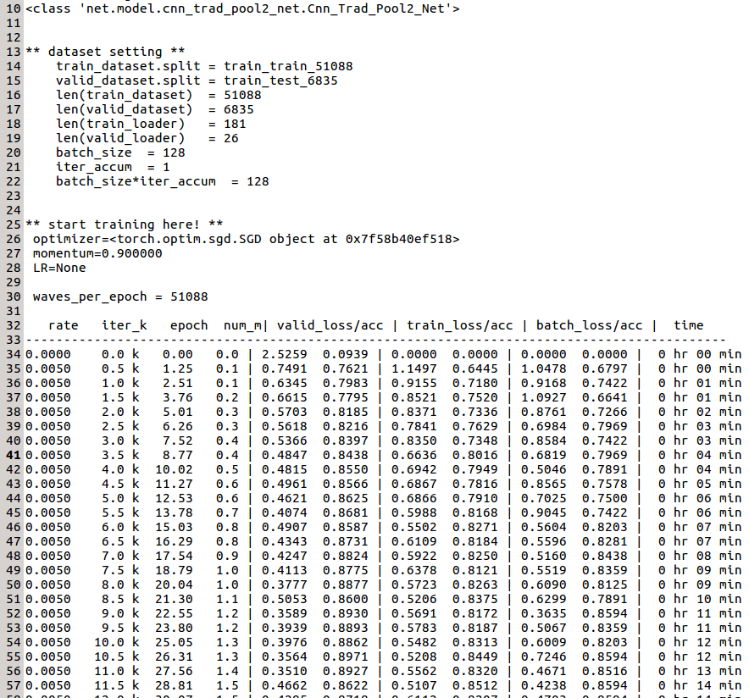
example log file

