Slide 1
S
Sentinel
Agentic GenAI for Payment Integrity
An LLM reasoning layer on top of unsupervised anomaly detection for Treatment, Payment, and Operations claims.
Dhiraj Salunkhe
LIVE DEMO
University of Pennsylvania
sentinel-payment-integrity.streamlit.app
Cotiviti Intern Assessment · June 2026
github.com/dhirajS1012/sentinel-payment-integrity

Slide 2
S
The problem
Cotiviti Intern Assessment
Payment integrity is the bottleneck in healthcare claims processing.
Rule engines catch the obvious. The expensive losses live in the long tail.
$300B+
~15%
hours -> days
Annual U.S. improper payments across payers
Of claims need integrity review after auto-adjudication
Typical analyst handle time for a complex flagged claim
Where rule engines fall short
Static rules miss provider-specific billing patterns that emerge over time.
Flag-and-forward queues bury analysts in cases without explanation.
Adversarial fraud (AI-assisted upcoding, synthetic documentation) outpaces rule updates.
Provider abrasion grows when denials lack a clear, policy-grounded rationale.
Sentinel · Agentic Payment Integrity
Dhiraj Salunkhe · University of Pennsylvania · 2 / 8

Slide 3
S
Why now
Cotiviti Intern Assessment
Payers are moving agentic AI from experiment to core strategy.
Three independent signals from 2026 point at the same shift.
80%
98%
Core strategy
of healthcare executives expect agentic and generative AI to deliver moderate-to-significant value in 2026.
of those executives expect at least 10% cost savings from agentic AI deployment.
Gartner 2026 projects U.S. payers move agentic AI out of experimentation under cost and regulatory pressure.
Deloitte 2026 US Health Care Outlook
Deloitte 2026 US Health Care Outlook
Gartner 2026 (via Cohere Health)
The pattern Cotiviti's own materials describe: AI as a tool that supports expert reviewers, not a replacement for clinical judgment.
Sentinel · Agentic Payment Integrity
Dhiraj Salunkhe · University of Pennsylvania · 3 / 8

Slide 4
S
Architecture
Cotiviti Intern Assessment
Sentinel: a two-stage pipeline.
Classical ML scores every claim. The agent reasons only about the flagged tail.
Synthetic claims
IsolationForest
Gemini reasoning agent
Structured decision
510 rows 10 planted anomalies
7 features 300 estimators contamination 0.04
JSON output policy grounding rate-paced
clear investigate escalate
LIVE
sentinel-payment-integrity.streamlit.app
Public Streamlit Cloud deployment. Synthetic data only. Reviewer can click Run Agent to trigger Gemini reasoning end-to-end.
Sentinel · Agentic Payment Integrity
Dhiraj Salunkhe · University of Pennsylvania · 4 / 8

Slide 5
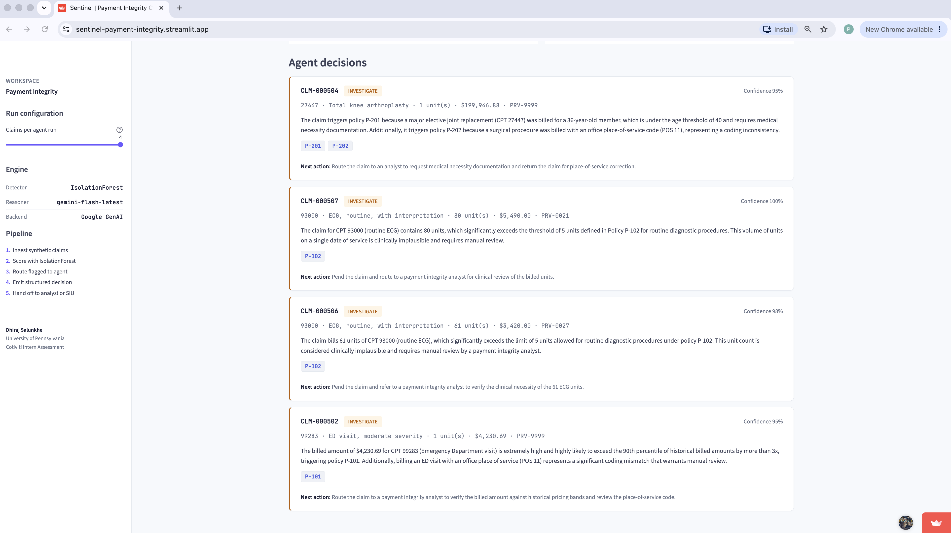
S
POC in action
Cotiviti Intern Assessment
One claim, two policy violations, structured decision.
A real Gemini decision from the live deployment.
CLM-000504
INVESTIGATE
Confidence 95%
27447 · Total knee arthroplasty · 1 unit · $199,946.88 · PRV-9999
The claim triggers policy P-201 because a major elective joint replacement (CPT 27447) was billed for a 36-year-old member, which is under the age threshold of 40 and requires medical necessity documentation. It also triggers policy P-202 because a surgical procedure was billed with an office place-of-service code (POS 11), representing a coding inconsistency.
P-201
P-202
Next action:
Refer to a payment integrity analyst to request medical necessity documentation and return the claim for place-of-service correction.
Agent decisions feed in the Sentinel console
Sentinel · Agentic Payment Integrity
Dhiraj Salunkhe · University of Pennsylvania · 5 / 8

Slide 6
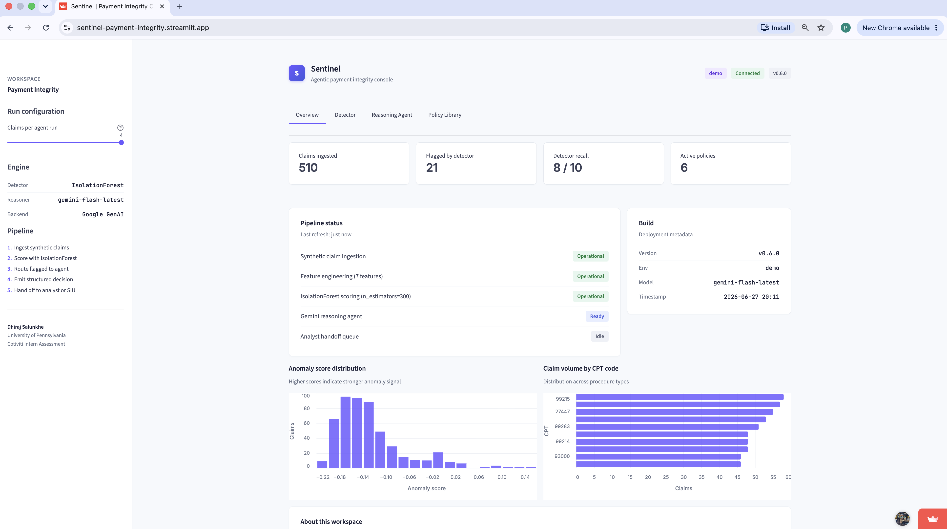
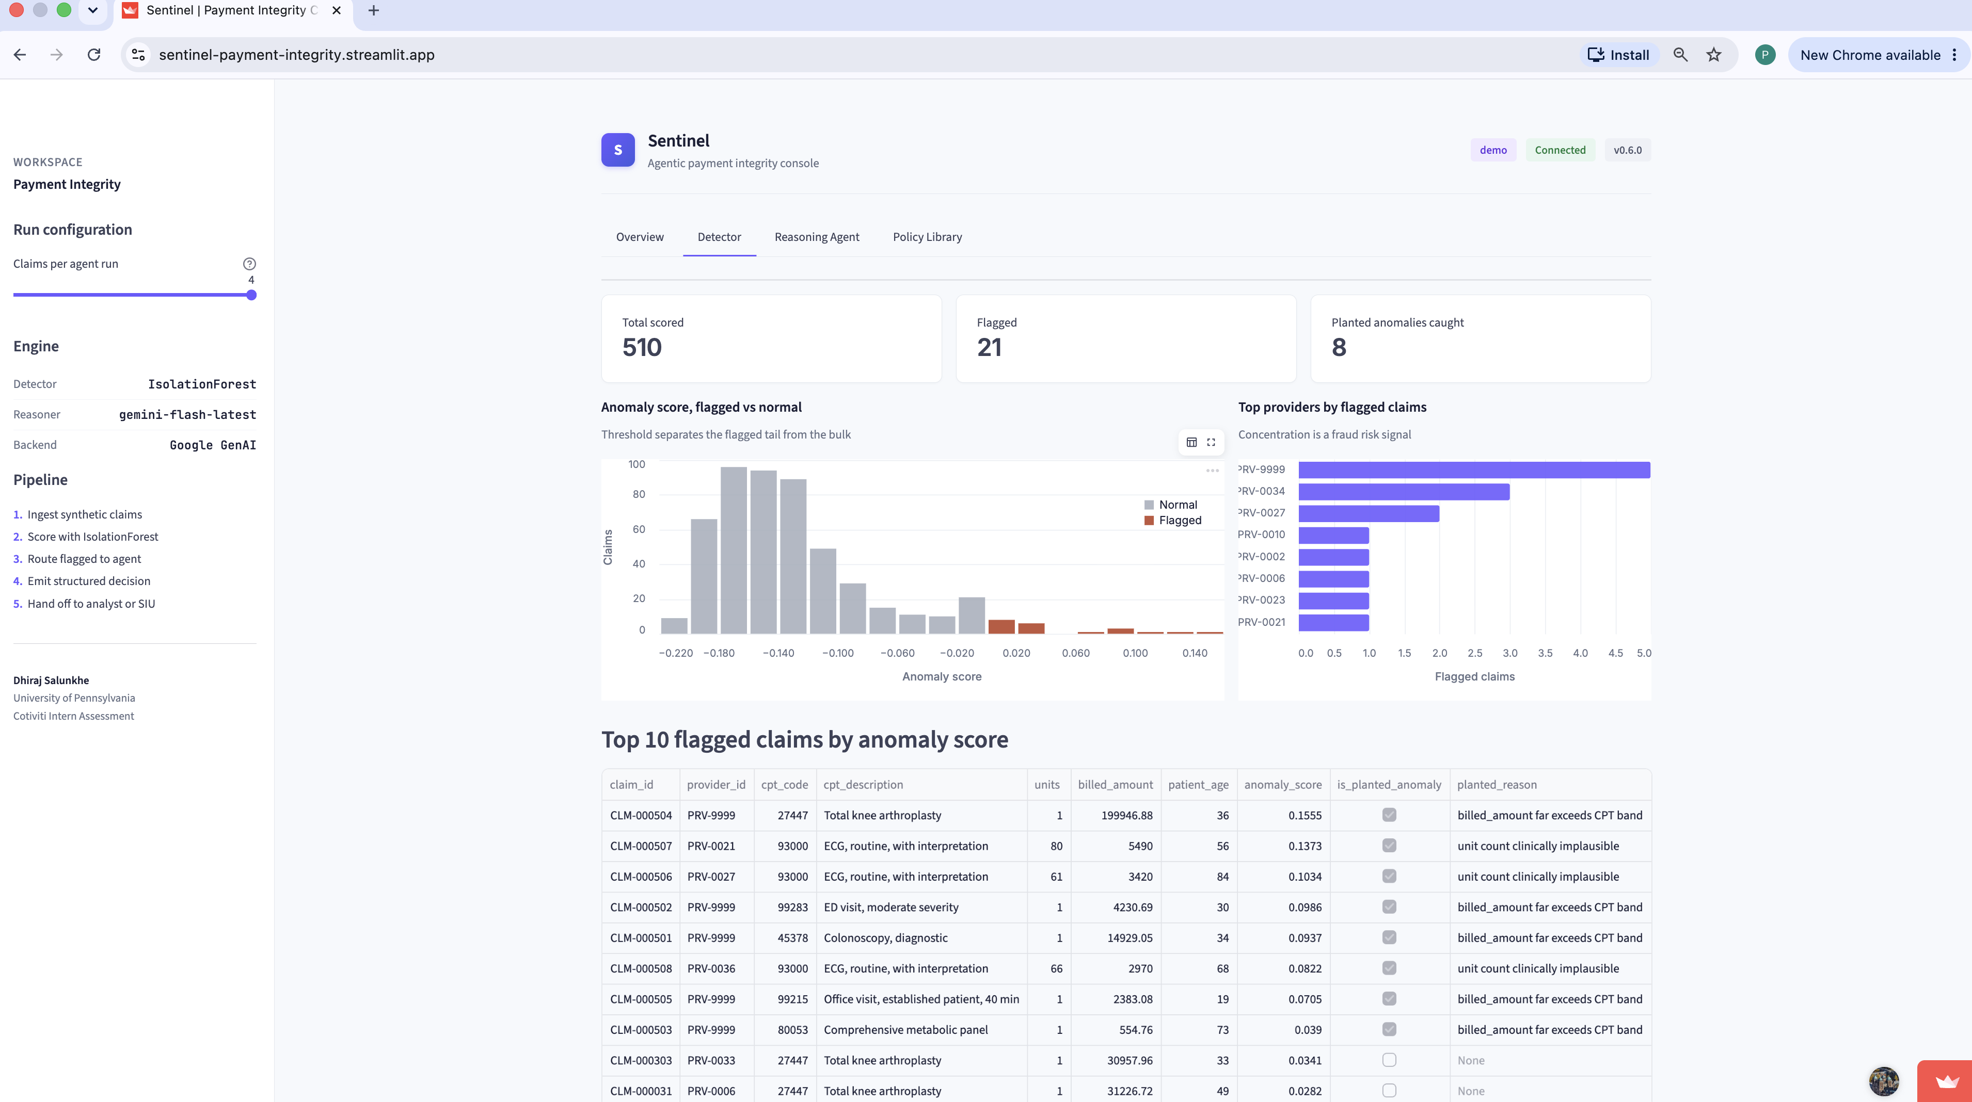
S
Console
Cotiviti Intern Assessment
Operator surface, not a Jupyter notebook.
Four workspaces: Overview, Detector, Reasoning Agent, Policy Library.
Overview: pipeline health, scoring distribution, CPT volume
Detector: flagged vs normal, top providers by flagged count
Sentinel · Agentic Payment Integrity
Dhiraj Salunkhe · University of Pennsylvania · 6 / 8

Slide 7
S
Strategic options for Cotiviti
Cotiviti Intern Assessment
Two product paths that compound Cotiviti's existing advantage.
Both keep humans in the loop, both are buildable on existing data assets, both are defensible to regulators.
Option 1
Option 2
Embed an agentic reasoning layer on top of existing payment integrity products.
Launch an "Agentic FWA Sentinel" service.
Wrap Data Mining, Clinical Chart Validation, and Coding Validation flags with the Gemini-style reasoner.
Combine provider-level time-series anomaly detection with the LLM reasoning layer.
Each flag arrives at a reviewer as a decision-ready package with policy citations.
Position as a forward-deployed capability against AI-assisted fraud and synthetic documentation.
Compress analyst handle time without removing human adjudication.
Reinforces Cotiviti's "AI as tool, expert as decider" stance in the market.
Sentinel · Agentic Payment Integrity
Dhiraj Salunkhe · University of Pennsylvania · 7 / 8

Slide 8
S
Stack and references
Cotiviti Intern Assessment
Built with restraint. One model, one framework, one host.
Stack
References
Language
Python 3.10
Deloitte. 2026 US Health Care Outlook.
Detector
scikit-learn IsolationForest
Cohere Health. Agentic AI for health plans (Gartner 2026 summary).
Data
pandas, NumPy
Charta Health. Payer audit risk and AI, May 2026.
UI
Streamlit + Altair
Cotiviti. Future-proofing payment integrity, 2026.
LLM
Google Generative AI SDK
Cotiviti. The practical landscape of AI in payment integrity and VBP.
Model
gemini-flash-latest
Hosting
Streamlit Community Cloud
Frontiers in CS & AI. AI-driven payment integrity modeling, March 2026.
Repo
github.com/dhirajS1012/sentinel-payment-integrity
ITIJ. AI deepfake detection for synthetic claims fraud, March 2026.
Thank you · Dhiraj Salunkhe · dhirajsalunkhe349@gmail.com
Sentinel · Agentic Payment Integrity
Dhiraj Salunkhe · University of Pennsylvania · 8 / 8

