Slide 1
Breast Cancer: Tumor Detection in Mammogram Images Using Modified AlexNet Deep Convolution Neural Network
Authors:
Micheal David
Dept. of Telecommunication Engineering Federal University of Technology Minna Niger State, Nigeria
Emmanuel Lawrence Omonigho
Dept. of Telecommunication Engineering Federal University of Technology Minna Niger State, Nigeria
Saliyu Aliyu
Dept. of Telecommunication Engineering Federal University of Technology Minna Niger State, Nigeria
Achonu Adejo
Dept. of Telecommunication Engineering Federal University of Technology Minna Niger State, Nigeria
Dhiraj Bandi
Data Science and Artificial Intelligence University of Central Missouri 700760856
Lee’s Summit dxb08560@ucmo.edu

Slide 2
Motivation
Importance of Early Detection: Early detection of breast cancer significantly increases the chances of successful treatment and survival.
Challenges in Diagnosis: Radiologists face difficulties in accurately identifying tumors in mammographic images due to noise, varying resolutions, and contrasting intensities.
Advancements in Technology: Leveraging deep learning and neural networks can enhance diagnostic accuracy and aid radiologists in making more informed decisions.
Aim: To improve the classification accuracy of mammogram images by utilizing a modified AlexNet Deep Convolution Neural Network (DCNN) and data augmentation techniques.

Slide 3
Problem Statement
Current Issues: Traditional machine learning and image processing methods often struggle with the accurate detection and classification of tumors in mammographic images, leading to lower diagnostic accuracy.
Data Limitation: Small dataset sizes can restrict the training efficacy of deep learning models, resulting in overfitting or underfitting, and hindering generalization to new data.
Technical Challenges: Mammogram images typically contain noise, varying resolutions, and contrasting intensities, making it difficult to accurately locate and classify tumor tissues.
Objective: To address these limitations by employing a modified AlexNet Deep Convolutional Neural Network (DCNN) model tailored for binary classification (benign vs. malignant tumors), enhanced by extensive data augmentation techniques to expand the dataset size and improve model robustness and accuracy.
Notes:
Traditional ML models less accurate
Data limitation
Mammograms contain noise varying resolution/intensities

Slide 4
Objectives
Enhance the accuracy of tumor detection and classification in digital mammographic images.
Implement data augmentation techniques to increase the training dataset size and diversity.
Modify the AlexNet architecture for improved suitability in binary classification tasks (benign vs. malignant tumors).
Optimize the CNN model using appropriate pre-processing and training techniques to handle mammographic image noise and resolution issues.

Slide 5
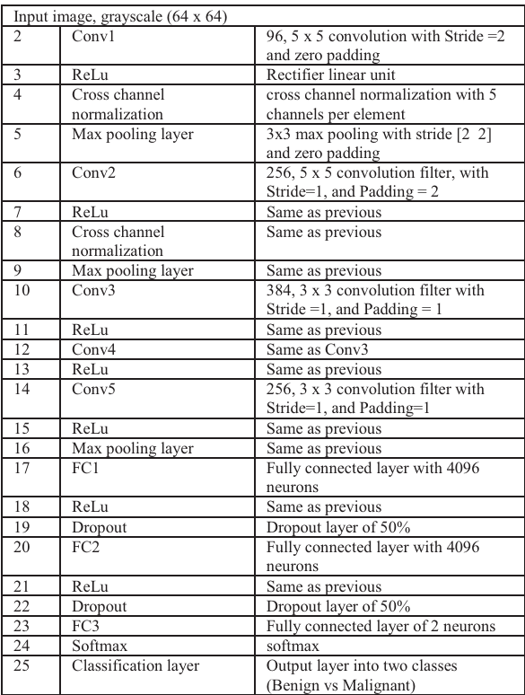
Contributions
Novel Approach: Developed a customized version of AlexNet DCNN, specifically adapted for mammogram image analysis.
Data Augmentation: Employed innovative data augmentation methods, including image reflection and rotation, significantly enhancing the training dataset.
Improved Accuracy: Achieved a high classification accuracy of 95.70%, demonstrating substantial improvement over traditional methods.
Practical Implementation: Provided a detailed methodology for the pre-processing, augmentation, and training processes using the MIAS database, offering a replicable framework for future research.
ARCHITECTURE OF THE MODIFIED ALEXNET
Notes:
Removed last 3 dense layers of the Alexnet and added Fully connected layers
Cross channel normalization, to better generalize the features

Slide 6
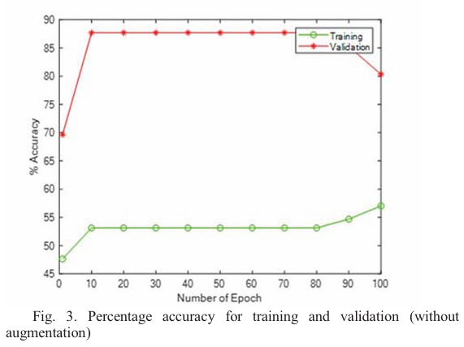
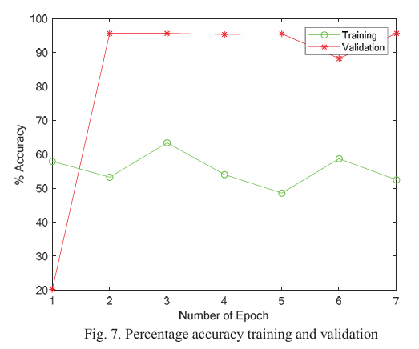
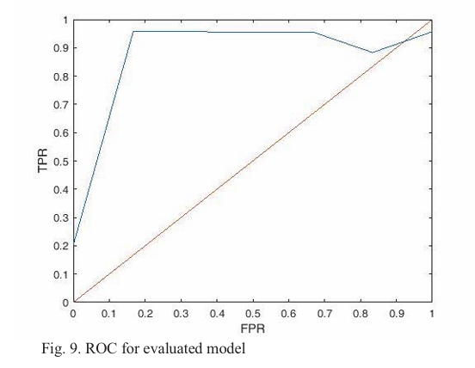
Results
Accuracy: Achieved an overall system accuracy of 95.70% in classifying mammogram images.
ROC Curve: The Area Under the Curve (AUC) of the ROC curve was 0.957, indicating high sensitivity and specificity.
We have demonstrated improved performance with data augmentation compared to using the original dataset without augmentation.
We have seen some example mammogram images before and after augmentation, and the corresponding classification results.

Slide 7
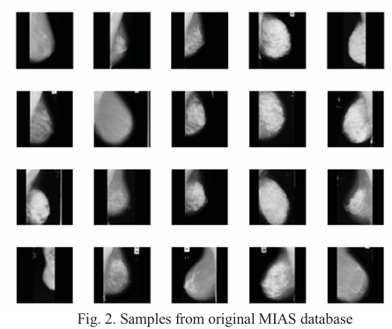
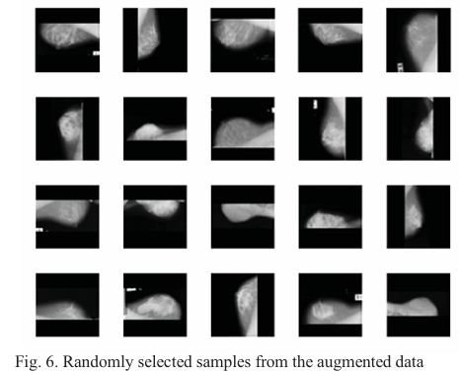
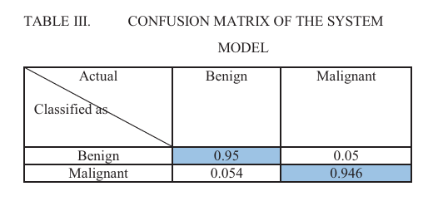
Precision = 0.95
Recall/sensitivity = 0.946
F1 score = 2.PxR/P+R = 0.947
Notes:
Precision propotion of correct positives among total positives
Sensitivity: proportion of actual positives correctly identified by the model
F1 score: combined measure of both recall and precision
Importance of sensitivity/ FN

Slide 8
Critical Analysis
Strengths:
High Accuracy: Significant improvement in classification accuracy through the use of a modified AlexNet architecture and data augmentation.
By using data augmentation the approach has effectively increased the dataset size, enhancing the model’s robustness and generalizability.
Practical Implementation: Utilized practical and efficient methods for pre-processing and training, making the approach viable for real-world applications.
Areas for Improvement:
Additional Metrics: Incorporating other evaluation metrics like precision, recall, and F1-score to provide a more comprehensive performance analysis.
Dataset Diversity: Testing the model on a more diverse set of mammogram images from different sources to ensure its robustness.
Further Optimization: Exploring different hyperparameters and training algorithms to potentially improve performance even further.
Notes:
Great base but need more work by increasing datasets, etc
Limitation of data augmentation
Extra: further optimi include learning rate, batch size, epochs(using gridsearch), advanced augmentation

Slide 9
References
Primary Source
E. L. Omonigho, M. David, A. Adejo and S. Aliyu, "Breast Cancer:Tumor Detection in Mammogram Images Using Modified AlexNet Deep Convolution Neural Network," 2020 International Conference in Mathematics, Computer Engineering and Computer Science (ICMCECS), Ayobo, Nigeria, 2020, pp. 1-6, doi: 10.1109/ICMCECS47690.2020.240870.
Supplementary Sources:
M. A. Al-masni et al., "Detection and classification of the breast abnormalities in digital mammograms via regional Convolutional Neural Network," 2017 39th Annual International Conference of the IEEE Engineering in Medicine and Biology Society (EMBC), Jeju, Korea (South), 2017, pp. 1230-1233, doi: 10.1109/EMBC.2017.8037053.
Bozek, J., Mustra, M., Delac, K., Grgic, M. (2009). A Survey of Image Processing Algorithms in Digital Mammography. In: Grgic, M., Delac, K., Ghanbari, M. (eds) Recent Advances in Multimedia Signal Processing and Communications. Studies in Computational Intelligence, vol 231. Springer, Berlin, Heidelberg. https://doi.org/10.1007/978-3-642-02900-4_24

