Slide 1
Resume preparation

Slide 2
Resume Preparation
Let’s check out a sample resume and highlight some key factors!

Slide 3
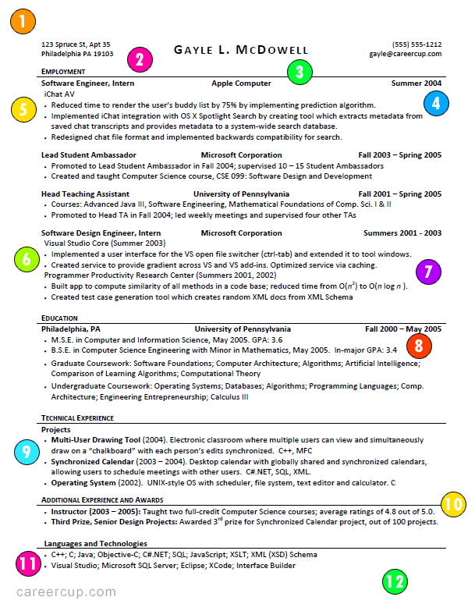
Address
Your Name
Phone Number
Email
1.) One Page Resume: Recruiters do not read your resume; they do a 15 - 30 second "spot check" of your resume. When your resume is too long, it just takes your best stuff - the stuff that would have made the "one page cut" - and dilutes it with more mediocre content. Lengthy resumes do not make you more impressive. A good rule of thumb is to keep your resume to one page if you have less than 10 years of experience or at most two pages if you have more than 10 years of experience.

Slide 4
Address
Your Name
Phone Number
Email
2.) No Objectives: All an objective does is state, in a wordy way, what position you're interested in. The company already knows that because you applied for a particular position. At best, it'll just waste space. At worst, it'll limit you since it'll exclude other positions that might have been interesting to you.

Slide 5
Address
Your Name
Phone Number
Email
3.) Use a Resume Template with Columns: Unless you're great with design, you probably shouldn't be creating your own resume template. It'll most likely look sloppy. Use a template, and make sure it has multiple columns. Using three columns, for example, will allow you to put the company name, position, and date all on one line. This makes it easier to read and saves space.

Slide 6
Address
Your Name
Phone Number
Email
4.) Use Tables: If you're using Microsoft Word to create your resume (which you probably should), use Microsoft Word's "tables." Just make sure to hide the borders afterwards.

Slide 7
Address
Your Name
Phone Number
Email
5.) Short Bullets: Because resume screeners only spend 15 - 30 seconds on your resume, length bullets - anything that feels like a paragraph - just won't get read. Keep your bullets to one to two lines (with one line being better than two).

Slide 8
Address
Your Name
Phone Number
Email
6.) Accomplishment Oriented: Your bullets should focus on your accomplishments - that is, the impact you had - rather than your responsibilities. What did you build, create, design, optimize, lead, etc?

Slide 9
Address
Your Name
Phone Number
Email
7.) Quantify: Whenever possible, you should quantify your accomplishments. If you optimized something, by how much? If you won an award, out of how many people?

Slide 10
Address
Your Name
Phone Number
Email
8.) Resume: The general rule of thumb is to list your GPA if it's at least 3.0 or higher, but there are two important rules to know here: (1) You may choose to list your in-major GPA if it's higher than your overall GPA, but you need to specify that it's your in-major GPA. (2) If your school uses a different scale (such as a 10-point scale), you may want to convert your GPA to a 4.0-scale which will be more widely understood.

Slide 11
Address
Your Name
Phone Number
Email
9.) Projects: Most candidates should pick their top 3 - 5 projects to list on their resume. These can be academic required project or independent projects. They do not need to be completed or launched either. As long as you've done a "meaty" amount of work on them, that's good enough!

Slide 12
Address
Your Name
Phone Number
Email
10.) Additional Experience: You can put additional experience, like leadership activities or awards, in a section like this (changing the name of the section depending on what you list). Be careful here to focus on what really matters. If you're applying for a coding role, your role as an eagle scout in high school is probably not very important!

Slide 13
Address
Your Name
Phone Number
Email
11.) Languages and Technologies: It's a good idea to list your languages and technologies, but remember that anything you list here is "fair game" for the interviewer to test. If you want to list a language but you happen to be a bit rusty in it, consider listing it as something like: "C++ (Proficient), C# (Prior Experience), ..."

Slide 14
Address
Your Name
Phone Number
Email
12.) What did you NOT include?: Is there anything impressive / interesting that you've done that you left out? About 50% of candidates leave out an important project or other component of their experience because it wasn't finished / "official" / etc. If you've done it, and it's impressive enough to "make the cut" (you shouldn't just list everything you've ever done), then it belongs on your resume!

Slide 15
Up next…
Resume Builder Websites!

