Slide 1


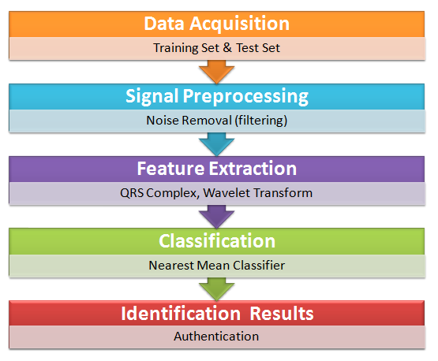

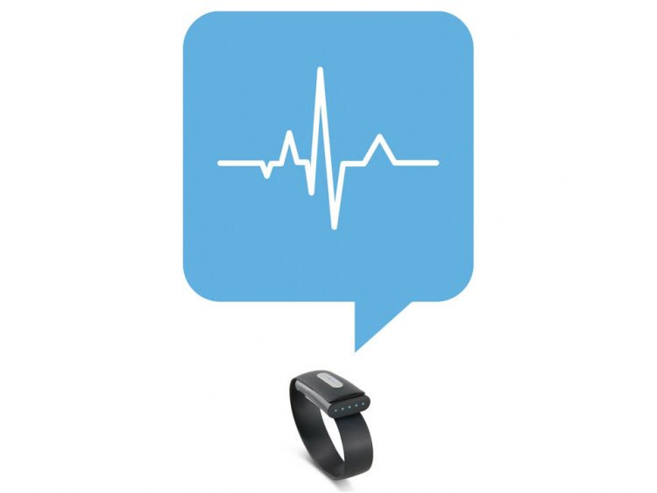
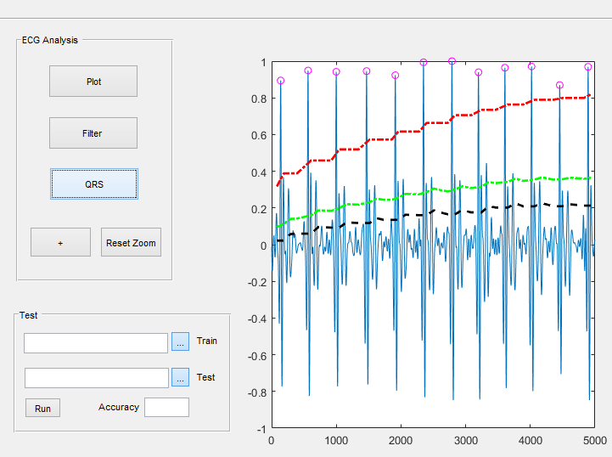
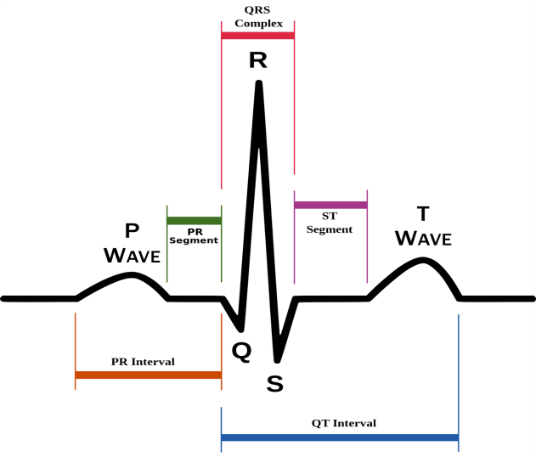



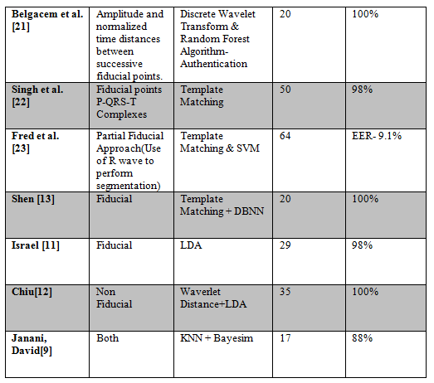
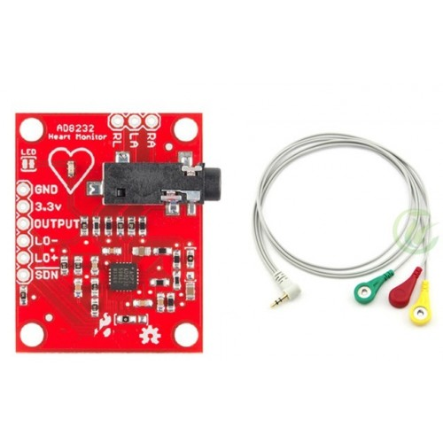

ECG based Human Authentication
G. H. Patel College of Engineering and Technology
Department of Computer Engineering
Dhiraj Ramnani| Shail Patil | Darpen Patel
.
Introduction
Description
Flow Chart
The electrocardiogram (ECG) is an emerging novel biometric approach for human identification.
The ECG, being a record of electrical currents generated by the heart, is potentially a distinct human characteristic, since ECG waveforms and other properties of the electrocardiogram depend on the anatomic features of the human heart and body.
Rather than using 'knowledge-based' passwords and PINs, my research analyzes the potential of the ECG to be used for authentication and security.
The ECG is unique to an individual, with benefits such as resilience to replay attacks and spoofing.
Firstly, signals are captured using ECG sensors.
Preprocessing is performed which includes band-pass filters to reduce noise.
Feature Vector is formed for further classification, by extracting QRS Complex.
Classification methods are used for pattern recognition. (Nearest Mean Classifier and Euclidean Distance).
ECG Basics
Future Work
ECG is a method to measure and record different electrical potentials of the heart. The ECG may roughly be divided into the phases of depolarization and repolarization of the muscle fibers making up the heart.
The depolarization phases correspond to the P-wave (atrial depolarization) and QRS-wave (ventricular depolarization).
The repolarization phases correspond to the T-wave.(ventricular repolarization).
We intend to develop a wearable device to perform real time ECG based authentication.
State of the art
Currently, We have developed a folder Locker which acquires real time ECG Signals to unlock any folder.
A
B
Application
Immediate applications of our technology include scenarios of low security and low user throughput, such as recognition in mobile phones, laptop computers, cable TV interfaces, and user-tuned in-game experience.
If combined with other modalities, there are several use cases where the ECG stands as an important add-on.
Figure 1
Figure 2
Figure 3
Technologies and Hardware
.
Literature Review
Guided By
Prof. Hetal Gaudani
Department of Computer Engineering
(+91 7567227626)
AD8232 Sensor

